Slide 1


{{SLIDE_TITLE}}
{{CONTENT}}
{{TEACHER_NAME}}

Slide 2
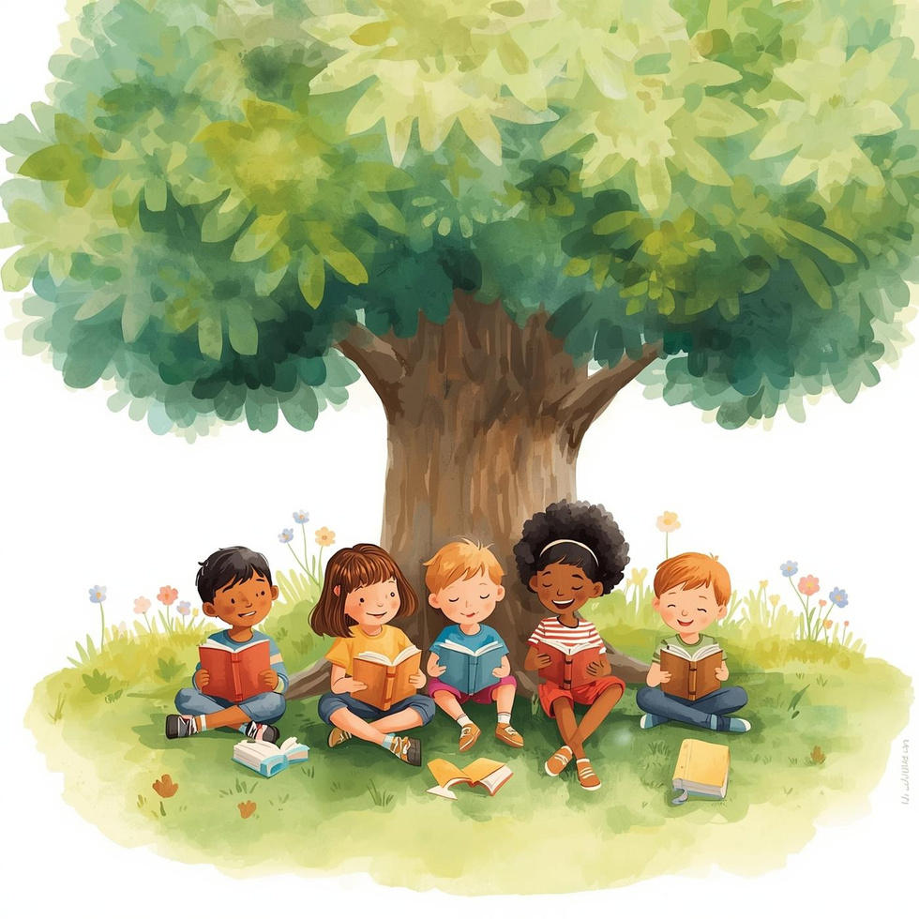
{{SLIDE_TITLE}}
{{CONTENT}}

Slide 3
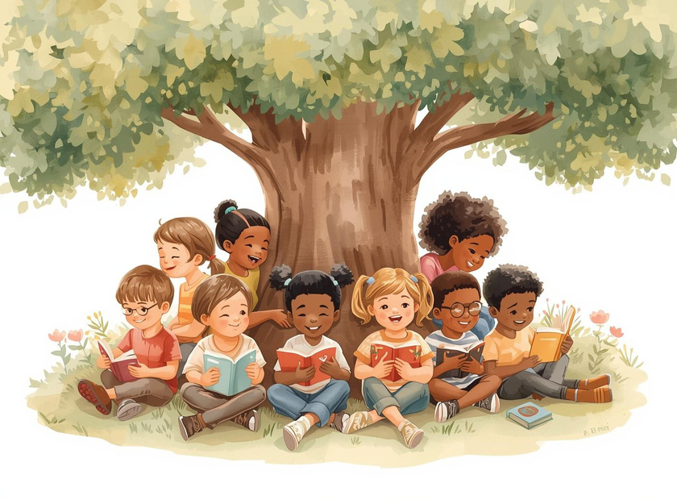


{{SLIDE_TITLE}}
Discover Reading
{{CONTENT}}
Share with Friends
{{CONTENT}}

Slide 4

{{SLIDE_TITLE}}
Alphabet
Phonics
Flashcards
{{CONTENT}}
{{CONTENT}}
{{CONTENT}}

Slide 5
{{SLIDE_TITLE}}
'A' for Apple
'B' for Ball
'C' for Cat
{{CONTENT}}
{{CONTENT}}
{{CONTENT}}

Slide 6
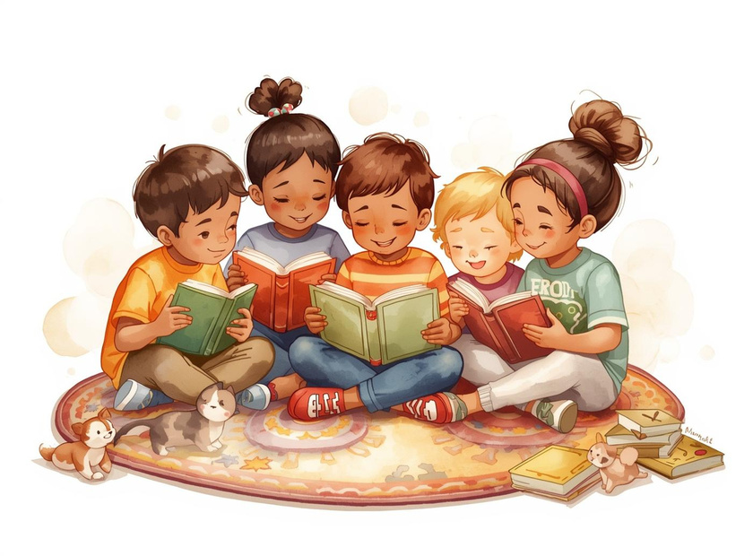
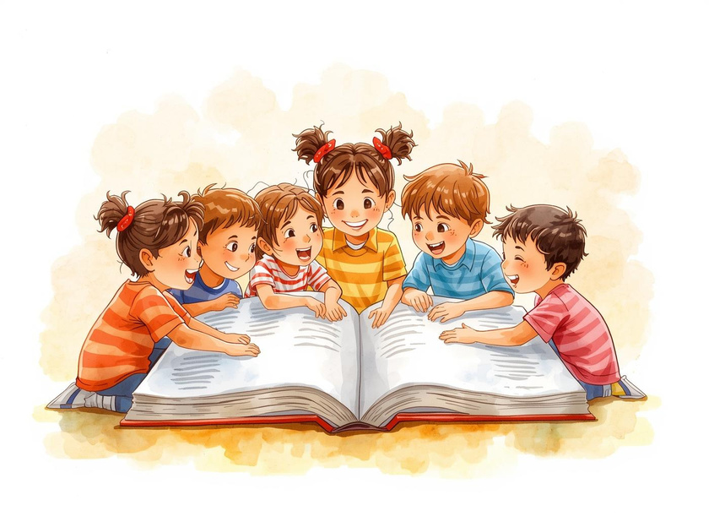
{{SLIDE_TITLE}}
Combining Letters
{{CONTENT}}
Forming Words
{{CONTENT}}

Slide 7
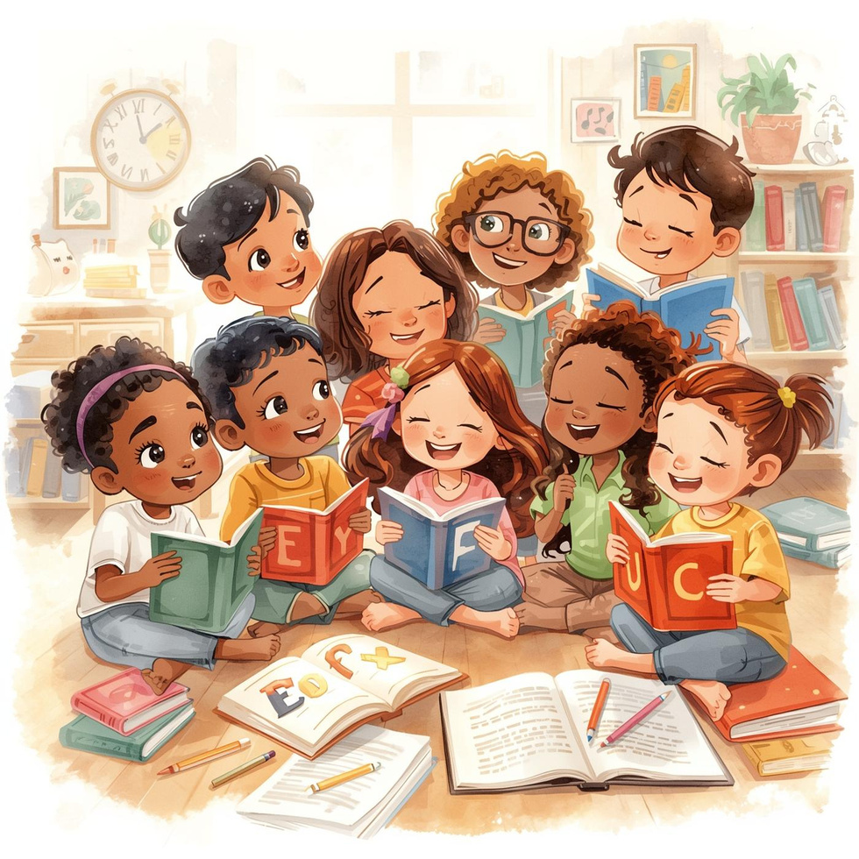
Mastering the Alphabet Together
Learning the alphabet is the first step to reading. By practicing sounds and letters, we become confident readers and explore new worlds through stories!

Slide 8
Reading Simple Words
Ibu
Ayah
Rumah
Ibu means mother. She loves to read stories to her children every night.
Ayah means father. He enjoys reading the newspaper while having breakfast with the family.
Rumah means home. It's where families come together to read and share stories happily.

