Slide 1
Intro to Release Automation
Joe Houghes
@jhoughes
1 / 15

Slide 2
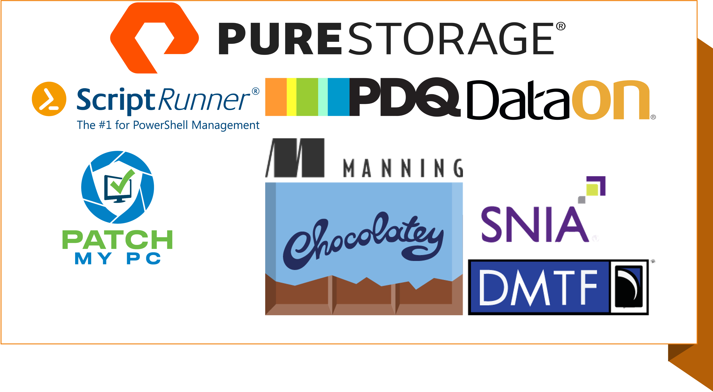

Slide 3




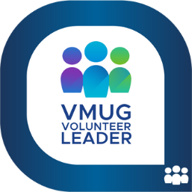

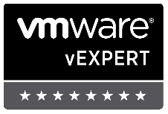



Who am I?
Consulting Field Solutions Architect @ Pure Storage
Co-leader – Denver PowerShell & VMware User Groups
Serial collector of Communities, now an International speaker (huzzah!)
Find me: Green Orange Colored hat, big grin & the loud "Howdy Y'all."
I have little (no) shame, and try to share my learnings with others
Push yourself, Learn more, Don’t fear sharing
Share YOUR knowledge (Perspective is important)
Teach whatever you can (Be The Master – Don Jones)
Job vs Career
Don’t let any of this scare you!
Even I’ll screw this up, and we’ll all survive…

Slide 4
DevOps
You can’t buy it, but I can sell it to you. - Matty Stratton
Notes:
We’ll start here to understand what we’re getting into, especially for vSphere admins
Let’s level set some explanations, this is going to be basic concepts and discussing some things from a new perspective, so hopefully we will understand better
Will this session make anyone an expert… absolutely not, but it should help you to think about things a bit differently and see some basics in action, and will give you another step in your learning journey

Slide 5
So… how do I “do DevOps”??
This is an IT management philosophy.
For us, it’s a methodology of full-stack engineering,
just for the infrastructure half of the stack.
Notes:
We’ll start here to understand what we’re getting into, especially for vSphere admins
Let’s level set some explanations, this is going to be basic concepts and discussing some things from a new perspective, so hopefully we will understand better
Will this session make anyone an expert… absolutely not, but it should help you to think about things a bit differently and see some basics in action, and will give you another step in your learning journey

Slide 6
DevOps in my organization
What if we don’t do software development?
What do we get?
Does everyone need to do DevOps now?
What’s the point?
Notes:
This is still applicable if you’re not working in a software development shop and shipping your own code; we’re not taking Ops out of the loop here, we’re just making it more automated
DevOps works to create certain, specific outcomes, and it’s only useful when you want those outcomes
Nope, if you don’t like what DevOps will bring, then don’t “do Devops”
Really think about how you make changes to your environment, test those changes to your environment, and being able to “undo’ change to your environment
This is all about enabling the rapid deployment of software. When that software breaks, DevOps is meant to equally support a rapid deployment of a replacement version, or of the last-known-good version
Even if you’re not going to fully automate software and infrastructure deployment pipelines, you should be aware of what the capabilities are when it comes to automating your environments

Slide 7




Define Success at the beginning
Define a Goal - Tasks & measurable results
Speed & performance = advantage, not benefit
Standardization, validation, efficiencies
Small, incremental changes = can be verified (MVP)
Notes:
Head’s up, here’s my usual speech to user groups, since it’s not just relevant for code:
This is the same whether you are using the GUI or CLI. Plan for success, ALWAYS.
Expect difficulties or failures, and be prepared to adjust your plan, but still plan for success. As part of your plan, define it well and be explicit with facts, assumptions and minimum requirements.
Speed and performance are great, but they are an advantage to the org, not the true benefit of automation.
Think about the real benefit to the business, which is accuracy & repeatability. It’s not about impressing someone with your code. It’s not just about doing it fast but doing it correctly and being certain that it stays that way.
The goal of these efforts isn’t just about getting your operations into code, it is the benefits that you can gain from it: standardization, granular control, validation of configs, and testing for success.
We need to build & maintain tools in this fashion, and now our tools are mirroring our internal environment and operations.
This makes it easier to improve or even re-write even as we change platforms or technologies, which is what really matters to them in the long-term.
Try to be specific about steps/components and have an expectation before you start.
Don’t do more than is necessary to make minor changes, so that you can track those changes and results.
Then, make additional changes as necessary, but test and verify them along the way.
If we understand these concepts and work with our organizations to help them operate in this fashion, it enables us to be more valuable to the organization as enablers of the business, and they can more easily trust our capabilities.
Don't fear the changes as your company's needs grow, and we can have the ability to continue to provide value to the business, which leads to great things in your career.

Slide 8

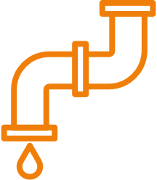

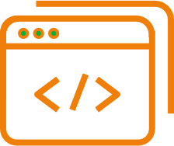
Don’t forget the PowerShell basics
Get-Help is your friend; make your life easier
PowerShell — Built for pipeline; embrace & use it
Stack cmdlets & results like Lego (Buy a set if you are outdated on the concept)
Forget what your teachers told you… Cheat/look up the answer whenever possible
Notes:
Follow the PowerShell way, even when building your own tool:
Remember what we learned about the PowerShell basics, look at the help files.
If you are still stuck or need more help, check out the examples and online documentation.
Other people are also normally glad to save you some pain in your journey.
The pipeline concept is simple: first, get an object, then work with it.
Once you learn how to leverage the pipeline to connect cmdlets together, you will see how quickly you can achieve massive results with PowerShell.
Seriously, get some Legos to practice.
The new sets can be a complex final product with many distinct steps to get you to that final product.
This is why you should have an expected result at the start, then specific steps to achieve that result.
Believe it or not, you can even cheat from yourself.
If you are trying to learn the code or find a specific setting, create or change it in the GUI and then pull it up in PowerShell to find how it was done.
The path to get there doesn’t matter to the business as long as you achieve success.
At the same time, you have to be careful with relying too much on searching, since searching is not the same as learning.
You can teach this to yourself if you just put in the effort, and you can always ask for help if you get stuck. Focus on the result, it is only important that you attain the goal or desired result.

Slide 9
CI/CD & Automation What are we doing

Slide 10
What is CI/CD?
Continuous Integration
Continuous Delivery/Deployment
The Only Way to Deploy
Tools
Fail Fast
Testing
Key Components
Notes:
Continuous integration, delivery, and deployment, is all known together as CI/CD.
It's really an integral part of modern development, and it's meant to reduce errors (once you get through all of them in every deployment) during your integration and deployment process, while still improving the speed of your projects.
CI/CD is a both philosophy and set of practices that are assisted by tools that focus on automated testing at each stage of the software pipeline.
When you incorporate these ideas into your regular process, you can reduce the time required to integrate changes for a release and thoroughly test each change before moving it into production.
CI/CD has lots of potential benefits, but doing it successfully requires a good deal of consideration. Deciding exactly how to use the tools and what changes you might need in your processes can be challenging without a LOT of trial and error. Still, there are significant best practices that many organizationa have learned and shared that can help a company avoid common problems and improve faster.
- Continuous Integration
There could be scenarios when developers in a team, work in isolation for an extended period and only merge their changes to the master branch once their work is completed.
This not only makes the merging of code very difficult, prone to conflicts, and time-consuming but also results in bugs accumulating for a long time which are only identified in later stages of development. These factors make it harder to deliver updates to customers quickly.
With Continuous Integration, developers frequently commit to a shared common repository using a version control system such as Git. A continuous integration pipeline can automatically run builds, store the artifacts, run unit tests, and even conduct code reviews using tools like Sonar. We can configure the CI pipeline to be triggered every time there is a commit/merge in the codebase.
- Continuous Delivery
Continuous delivery helps developers test their code in a production-similar environment, in an effort to avoid any last-moment or post-production surprises. This might be UI testing, load testing, integration testing, etc. It helps developers discover and resolve bugs preemptively.
By automating the software release process, this can give you low-risk releases, lower costs, better software quality, improved productivity levels, and most importantly, it helps us deliver updates faster and more frequently. If Continuous Delivery is implemented properly, you will always have a deployment-ready code that has passed through a standardized test process.
CD is carried out after Continuous Integration to make sure that we can release new changes to our customers quickly in an error-free way. This includes running integration and regression tests in the staging area (similar to the production environment) so that the final release is not broken in production. It ensures automation of the release process so that we have a release-ready product at all times and we can deploy our application at any point in time.
Continuous Delivery automates the entire software release process. The final decision to deploy to a live production environment can be triggered by the developer/project lead as required. Some popular CD tools are AWS CodeDeploy, Jenkins, and GitLab.
CI/CD typically means end to end automation
Make the CI/CD Pipeline the Only Way to Deploy to Production
Part of what makes it possible for CI/CD to improve your development practices and code quality is that tooling often helps enforce best practices for testing and deployment.
Promoting code through your CI/CD pipelines requires each change to demonstrate that it adheres to your organization’s codified standards and procedures.
Failures in a CI/CD pipeline are immediately visible and halt the advancement of the affected release to later stages of the cycle. This is a gatekeeping mechanism that safeguards the more important environments from untrusted code.
To realize these advantages, however, you need to ensure that every change to your production environment goes through your pipeline. The CI/CD pipeline should be the only mechanism by which code enters the production environment. This can happen automatically at the end of successfully testing with continuous deployment practices, or through a manual promotion of tested changes approved and made available by your CI/CD system.
Frequently, teams start using their pipelines for deployment, but begin making exceptions when problems occur and there is pressure to resolve them quickly. While downtime and other issues should be mitigated as soon as possible, it is important to understand that the CI/CD system is a good tool to ensure that your changes are not introducing other bugs or further breaking the system.
Putting your fix through the pipeline (or just using the CI/CD system to rollback) will also prevent the next deployment from erasing an ad hoc hotfix that was applied directly to production. The pipeline protects the validity of your deployments regardless of whether this was a regular, planned release, or a fast fix to resolve an ongoing issue. This use of the CI/CD system is yet another reason to work to keep your pipeline fast.
Tools – Jenkins, Gitlab, Travis CI, Github Actions, Azure DevOps

Slide 11
Process How are we doing this

Slide 12
Process
Code
Test
Log
Version
Publish
Iterate
Repeat
Notes:
Sandbox-based code testing
Version control for software programming teams
Dashboard analytics
Versioning
Release scheduling
Artifact management

Slide 13
Terminology Knowing what we’re working with
Notes:
GitHub Actions is a continuous integration and continuous delivery (CI/CD) platform that allows you to automate your build, test, and deployment pipeline. You can create workflows that build and test every pull request to your repository, or deploy merged pull requests to production.
GitHub Actions goes beyond just DevOps and lets you run workflows when other events happen in your repository. For example, you can run a workflow to automatically add the appropriate labels whenever someone creates a new issue in your repository.
GitHub provides Linux, Windows, and macOS virtual machines to run your workflows, or you can host your own self-hosted runners in your own data center or cloud infrastructure. You can configure a GitHub Actions workflow to be triggered when an event occurs in your repository, such as a pull request being opened or an issue being created. Your workflow contains one or more jobs which can run in sequential order or in parallel. Each job will run inside its own virtual machine runner, or inside a container, and has one or more steps that either run a script that you define or run an action, which is a reusable extension that can simplify your workflow.

Slide 14
GitHub Actions
Repository
Workflow
Workflow File
Event (Trigger)
Job
Actions
Runners
Notes:
A workflow is a configurable automated process that will run one or more jobs. Workflows are defined by a YAML file checked in to your repository and will run when triggered by an event in your repository, or they can be triggered manually, or at a defined schedule.
Workflows are defined in the .github/workflows directory in a repository, and a repository can have multiple workflows, each of which can perform a different set of tasks. For example, you can have one workflow to build and test pull requests, another workflow to deploy your application every time a release is created, and still another workflow that adds a label every time someone opens a new issue.
An event is a specific activity in a repository that triggers a workflow run. For example, activity can originate from GitHub when someone creates a pull request, opens an issue, or pushes a commit to a repository. You can also trigger a workflow to run on a schedule, by posting to a REST API, or manually.
A job is a set of steps in a workflow that is executed on the same runner. Each step is either a shell script that will be executed, or an action that will be run. Steps are executed in order and are dependent on each other. Since each step is executed on the same runner, you can share data from one step to another. For example, you can have a step that builds your application followed by a step that tests the application that was built.
An action is a custom application for the GitHub Actions platform that performs a complex but frequently repeated task. Use an action to help reduce the amount of repetitive code that you write in your workflow files. An action can pull your git repository from GitHub, set up the correct toolchain for your build environment, or set up the authentication to your cloud provider.
A runner is a server that runs your workflows when they're triggered. Each runner can run a single job at a time. GitHub provides Ubuntu Linux, Microsoft Windows, and macOS runners to run your workflows; each workflow run executes in a fresh, newly-provisioned virtual machine.

Slide 15
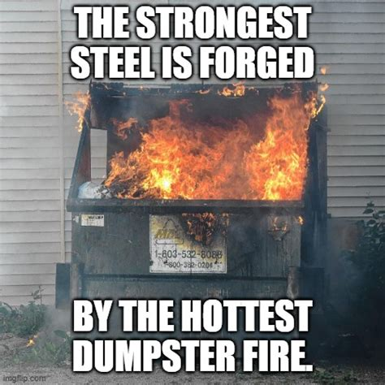
Demos & Code
Pray to the Demo Gods

Slide 16

Thanks for Listening
Make a Connection, Do Things, Share Them @jhoughes
joe@fullstackgeek.net
vCommunity.io

Slide 17

THANK YOU
Please review this session

