Slide 1
Building Mobile Phone Applications in the Cloud
Name
Title
Organization

Slide 2
Agenda
This session is focused on building device applications with Windows Azure
We’ll talk about storage, identity, communications, platform services, and tools
Several demos
Notes:
How many phone devs?
How many used Windows Azure?

Slide 3
BabelCam
demo
Windows Phone application leveraging Windows Azure
Notes:
Start 10:02
End 10:06
Install Certificate
Reset Storage

Slide 4
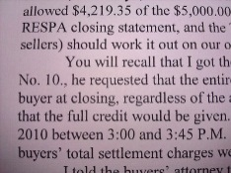
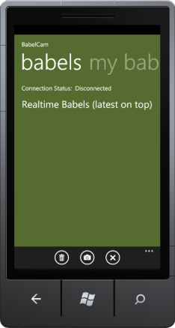
User Authentication
Store Image in Windows Azure Blob Storage
Process Image
Send Notification
Any pictures?
Process Image
SAS
Windows Azure
WAZ Storage
Send Image
Authenticate
Translated Text
Access Token
Access Token
Shared Access Signature
Translated Text
Translated Text
Microsoft Push Notification Service
Hawaii OCR & Bing Translator

Slide 5
Features in Action
Storage
Identity
Communications
Platform Services

Slide 6

Three Reasons for Device + Cloud
1
Allows new application scenarios
The cloud levels the playing field
The cloud provides a way to reach across device platforms and a larger pool of resources from which to pull
2
3

Slide 7
Why Windows Azure?
PaaS: you built it, Windows Azure runs it
Automatic O/S patching
Elasticity and scale
Utility billing
Higher-level services
ACS, Caching, CDN, Traffic Manager

Slide 8
Storage

Slide 9
Storage: What are our options?
Windows Azure Tables
Benefits:
Non-relational structured storage
Massive scale-out
Windows Azure Blobs
Benefits:
Big files
Windows Azure Queues
Benefits:
Persistent Async Messaging
Enqueue, Dequeue
Windows Azure SQL Database
Benefits:
Relational database
Highly available
Managed for you as a service

Slide 10
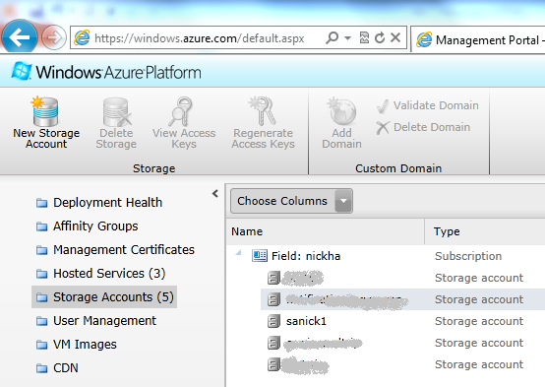
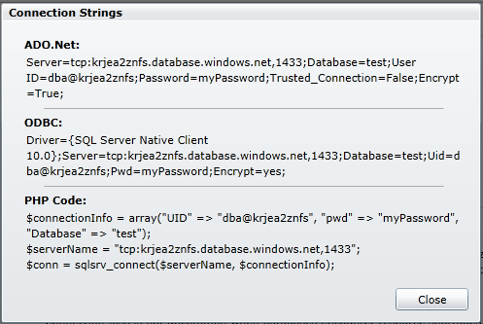
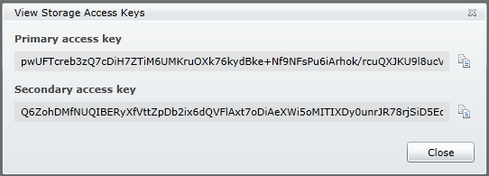
Storage: Secrets
Windows Azure
Storage name
Storage key
Windows Azure
SQL Database
Username
Password
Once you share your secret, it’s no longer secret

Slide 11
Storage: How do we keep secrets secret?
Proxy the requests
Client sends data to web role
Web role sends data to storage
(2)
Web Role
(1)

Slide 12
Storage: Using Shared Access Signatures
Client makes request of Web Role for SAS
Web Role sends client SAS
Client makes request
Client gets response
(3)
(2)
(4)
Web Role
(1)

Slide 13
Storage: Windows Azure SQL Database
Client sends request to proxy
Proxy makes SQL call against SQL Database
SQL Database returns a response
Proxy returns response to device
(2)
(3)
(4)
Web Role
(1)

Slide 14
Storage: Offloading work through queues
Client writes a message to a queue
Worker role is polling the queue
Worker role finds the message
(3)
Worker Role
(2)
(1)

Slide 15
Windows Azure Toolkits for Devices
demo
Notes:
Start 10:23
End 10:30

Slide 16
Identity

Slide 17
Identity: What are the options?
Create your own
Username + password, token, etc.
ASP.NET Membership Providers
Use a single existing identity system
Live Id, Facebook, etc.
Develop directly against IdP protocol
Outsource identity management
Access Control Service
Notes:
Think about the user
Contrast Babelcam login verse Registration

Slide 18
Using ACS from Windows Phone using NuGet
demo
Notes:
Optional iOS + Android using the Windows Azure Toolkit from iOS and Windows Azure Toolkit for Android

Slide 19
Communications

Slide 20

Communications
Two forms of communication with devices
Device-initiated
Cloud-initiated

Slide 21
Communications: Device-initiated
OData 8.5kb
REST-XML 1.2kb
Device-initiated options
HTTP-based, request/response
Framework choices (WCF, OData, WebRequest, etc.)
Wire format choices (SOAP, JSON, POX, etc.)
<?xml version="1.0" encoding="utf-8" standalone="yes" ?> - <feed xml:base="http://localhost:33779/WcfDataService1.svc/" xmlns:d="http://schemas.microsoft.com/ado/2007/08/dataservices" xmlns:m="http://schemas.microsoft.com/ado/2007/08/dataservices/metadata" xmlns="http://www.w3.org/2005/Atom"> <title type="text">Drivers</title> <id>http://localhost:33779/WcfDataService1.svc/Drivers</id> <updated>2010-05-24T22:12:38Z</updated> <link rel="self" title="Drivers" href="Drivers" /> - <entry> <id>http://localhost:33779/WcfDataService1.svc/Drivers(1)</id> <title type="text" /> <updated>2010-05-24T22:12:38Z</updated> - <author> <name /> </author> <link rel="edit" title="Driver" href="Drivers(1)" /> <link rel="http://schemas.microsoft.com/ado/2007/08/dataservices/related/DistributionCenter" type="application/atom+xml;type=entry" title="DistributionCenter" href="Drivers(1)/DistributionCenter" /> <link rel="http://schemas.microsoft.com/ado/2007/08/dataservices/related/Todays" type="application/atom+xml;type=feed" title="Todays" href="Drivers(1)/Todays" /> <category term="ContosoBottlingModel.Driver" scheme="http://schemas.microsoft.com/ado/2007/08/dataservices/scheme" /> - <content type="application/xml"> - <m:properties> <d:DriverId m:type="Edm.Int32">1</d:DriverId> <d:DistributionCenterId m:type="Edm.Int32">1</d:DistributionCenterId> <d:FirstName>Rob</d:FirstName> <d:LastName>Tiffany</d:LastName> </m:properties> </content> </entry> - <entry> <id>http://localhost:33779/WcfDataService1.svc/Drivers(2)</id> <title type="text" /> <updated>2010-05-24T22:12:38Z</updated> - <author> <name /> </author> <link rel="edit" title="Driver" href="Drivers(2)" /> <link rel="http://schemas.microsoft.com/ado/2007/08/dataservices/related/DistributionCenter" type="application/atom+xml;type=entry" title="DistributionCenter" href="Drivers(2)/DistributionCenter" /> <link rel="http://schemas.microsoft.com/ado/2007/08/dataservices/related/Todays" type="application/atom+xml;type=feed" title="Todays" href="Drivers(2)/Todays" /> <category term="ContosoBottlingModel.Driver" scheme="http://schemas.microsoft.com/ado/2007/08/dataservices/scheme" /> - <content type="application/xml"> - <m:properties> <d:DriverId m:type="Edm.Int32">2</d:DriverId> <d:DistributionCenterId m:type="Edm.Int32">1</d:DistributionCenterId> <d:FirstName>Loke Uei</d:FirstName> <d:LastName>Tan</d:LastName> </m:properties> </content> </entry> - <entry> <id>http://localhost:33779/WcfDataService1.svc/Drivers(3)</id> <title type="text" /> <updated>2010-05-24T22:12:38Z</updated> - <author> <name /> </author> <link rel="edit" title="Driver" href="Drivers(3)" /> <link rel="http://schemas.microsoft.com/ado/2007/08/dataservices/related/DistributionCenter" type="application/atom+xml;type=entry" title="DistributionCenter" href="Drivers(3)/DistributionCenter" /> <link rel="http://schemas.microsoft.com/ado/2007/08/dataservices/related/Todays" type="application/atom+xml;type=feed" title="Todays" href="Drivers(3)/Todays" /> <category term="ContosoBottlingModel.Driver" scheme="http://schemas.microsoft.com/ado/2007/08/dataservices/scheme" /> - <content type="application/xml"> - <m:properties> <d:DriverId m:type="Edm.Int32">3</d:DriverId> <d:DistributionCenterId m:type="Edm.Int32">1</d:DistributionCenterId> <d:FirstName>Dan</d:FirstName> <d:LastName>Bouie</d:LastName> </m:properties> </content> </entry> - <entry> <id>http://localhost:33779/WcfDataService1.svc/Drivers(4)</id> <title type="text" /> <updated>2010-05-24T22:12:38Z</updated> - <author> <name /> </author> <link rel="edit" title="Driver" href="Drivers(4)" /> <link rel="http://schemas.microsoft.com/ado/2007/08/dataservices/related/DistributionCenter" type="application/atom+xml;type=entry" title="DistributionCenter" href="Drivers(4)/DistributionCenter" /> <link rel="http://schemas.microsoft.com/ado/2007/08/dataservices/related/Todays" type="application/atom+xml;type=feed" title="Todays" href="Drivers(4)/Todays" /> <category term="ContosoBottlingModel.Driver" scheme="http://schemas.microsoft.com/ado/2007/08/dataservices/scheme" /> - <content type="application/xml"> - <m:properties> <d:DriverId m:type="Edm.Int32">4</d:DriverId> <d:DistributionCenterId m:type="Edm.Int32">1</d:DistributionCenterId> <d:FirstName>John</d:FirstName> <d:LastName>Dietz</d:LastName> </m:properties> </content> </entry> - <entry> <id>http://localhost:33779/WcfDataService1.svc/Drivers(5)</id> <title type="text" /> <updated>2010-05-24T22:12:38Z</updated> - <author> <name /> </author> <link rel="edit" title="Driver" href="Drivers(5)" /> <link rel="http://schemas.microsoft.com/ado/2007/08/dataservices/related/DistributionCenter" type="application/atom+xml;type=entry" title="DistributionCenter" href="Drivers(5)/DistributionCenter" /> <link rel="http://schemas.microsoft.com/ado/2007/08/dataservices/related/Todays" type="application/atom+xml;type=feed" title="Todays" href="Drivers(5)/Todays" /> <category term="ContosoBottlingModel.Driver" scheme="http://schemas.microsoft.com/ado/2007/08/dataservices/scheme" /> - <content type="application/xml"> - <m:properties> <d:DriverId m:type="Edm.Int32">5</d:DriverId> <d:DistributionCenterId m:type="Edm.Int32">2</d:DistributionCenterId> <d:FirstName>Derek</d:FirstName> <d:LastName>Snyder</d:LastName> </m:properties> </content> </entry> - <entry> <id>http://localhost:33779/WcfDataService1.svc/Drivers(6)</id> <title type="text" /> <updated>2010-05-24T22:12:38Z</updated> - <author> <name /> </author> <link rel="edit" title="Driver" href="Drivers(6)" /> <link rel="http://schemas.microsoft.com/ado/2007/08/dataservices/related/DistributionCenter" type="application/atom+xml;type=entry" title="DistributionCenter" href="Drivers(6)/DistributionCenter" /> <link rel="http://schemas.microsoft.com/ado/2007/08/dataservices/related/Todays" type="application/atom+xml;type=feed" title="Todays" href="Drivers(6)/Todays" /> <category term="ContosoBottlingModel.Driver" scheme="http://schemas.microsoft.com/ado/2007/08/dataservices/scheme" /> - <content type="application/xml"> - <m:properties> <d:DriverId m:type="Edm.Int32">6</d:DriverId> <d:DistributionCenterId m:type="Edm.Int32">2</d:DistributionCenterId> <d:FirstName>Steve</d:FirstName> <d:LastName>Hegenderfer</d:LastName> </m:properties> </content> </entry> - <entry> <id>http://localhost:33779/WcfDataService1.svc/Drivers(7)</id> <title type="text" /> <updated>2010-05-24T22:12:38Z</updated> - <author> <name /> </author> <link rel="edit" title="Driver" href="Drivers(7)" /> <link rel="http://schemas.microsoft.com/ado/2007/08/dataservices/related/DistributionCenter" type="application/atom+xml;type=entry" title="DistributionCenter" href="Drivers(7)/DistributionCenter" /> <link rel="http://schemas.microsoft.com/ado/2007/08/dataservices/related/Todays" type="application/atom+xml;type=feed" title="Todays" href="Drivers(7)/Todays" /> <category term="ContosoBottlingModel.Driver" scheme="http://schemas.microsoft.com/ado/2007/08/dataservices/scheme" /> - <content type="application/xml"> - <m:properties> <d:DriverId m:type="Edm.Int32">7</d:DriverId> <d:DistributionCenterId m:type="Edm.Int32">2</d:DistributionCenterId> <d:FirstName>Chip</d:FirstName> <d:LastName>Vollers</d:LastName> </m:properties> </content> </entry> - <entry> <id>http://localhost:33779/WcfDataService1.svc/Drivers(8)</id> <title type="text" /> <updated>2010-05-24T22:12:38Z</updated> - <author> <name /> </author> <link rel="edit" title="Driver" href="Drivers(8)" /> <link rel="http://schemas.microsoft.com/ado/2007/08/dataservices/related/DistributionCenter" type="application/atom+xml;type=entry" title="DistributionCenter" href="Drivers(8)/DistributionCenter" /> <link rel="http://schemas.microsoft.com/ado/2007/08/dataservices/related/Todays" type="application/atom+xml;type=feed" title="Todays" href="Drivers(8)/Todays" /> <category term="ContosoBottlingModel.Driver" scheme="http://schemas.microsoft.com/ado/2007/08/dataservices/scheme" /> - <content type="application/xml"> - <m:properties> <d:DriverId m:type="Edm.Int32">8</d:DriverId> <d:DistributionCenterId m:type="Edm.Int32">2</d:DistributionCenterId> <d:FirstName>James</d:FirstName> <d:LastName>Pratt</d:LastName> </m:properties> </content> </entry> </feed>
The same list of 8 Customers using SOAP and a DataSet dropped us down to 3 kb but still too big for my taste.
<?xml version="1.0" encoding="utf-8"?> <DataSet xmlns="http://tempuri.org/"> <xs:schema id="NewDataSet" xmlns="" xmlns:xs="http://www.w3.org/2001/XMLSchema" xmlns:msdata="urn:schemas-microsoft-com:xml-msdata"> <xs:element name="NewDataSet" msdata:IsDataSet="true" msdata:UseCurrentLocale="true"> <xs:complexType> <xs:choice minOccurs="0" maxOccurs="unbounded"> <xs:element name="Driver"> <xs:complexType> <xs:sequence> <xs:element name="DriverId" type="xs:int" minOccurs="0" /> <xs:element name="DistributionCenterId" type="xs:int" minOccurs="0" /> <xs:element name="FirstName" type="xs:string" minOccurs="0" /> <xs:element name="LastName" type="xs:string" minOccurs="0" /> </xs:sequence> </xs:complexType> </xs:element> </xs:choice> </xs:complexType> </xs:element> </xs:schema> <diffgr:diffgram xmlns:msdata="urn:schemas-microsoft-com:xml-msdata" xmlns:diffgr="urn:schemas-microsoft-com:xml-diffgram-v1"> <NewDataSet xmlns=""> <Driver diffgr:id="Driver1" msdata:rowOrder="0"> <DriverId>1</DriverId> <DistributionCenterId>1</DistributionCenterId> <FirstName>Rob</FirstName> <LastName>Tiffany</LastName> </Driver> <Driver diffgr:id="Driver2" msdata:rowOrder="1"> <DriverId>2</DriverId> <DistributionCenterId>1</DistributionCenterId> <FirstName>Loke Uei</FirstName> <LastName>Tan</LastName> </Driver> <Driver diffgr:id="Driver3" msdata:rowOrder="2"> <DriverId>3</DriverId> <DistributionCenterId>1</DistributionCenterId> <FirstName>Dan</FirstName> <LastName>Bouie</LastName> </Driver> <Driver diffgr:id="Driver4" msdata:rowOrder="3"> <DriverId>4</DriverId> <DistributionCenterId>1</DistributionCenterId> <FirstName>John</FirstName> <LastName>Dietz</LastName> </Driver> <Driver diffgr:id="Driver5" msdata:rowOrder="4"> <DriverId>5</DriverId> <DistributionCenterId>2</DistributionCenterId> <FirstName>Derek</FirstName> <LastName>Snyder</LastName> </Driver> <Driver diffgr:id="Driver6" msdata:rowOrder="5"> <DriverId>6</DriverId> <DistributionCenterId>2</DistributionCenterId> <FirstName>Steve</FirstName> <LastName>Hegenderfer</LastName> </Driver> <Driver diffgr:id="Driver7" msdata:rowOrder="6"> <DriverId>7</DriverId> <DistributionCenterId>2</DistributionCenterId> <FirstName>Chip</FirstName> <LastName>Vollers</LastName> </Driver> <Driver diffgr:id="Driver8" msdata:rowOrder="7"> <DriverId>8</DriverId> <DistributionCenterId>2</DistributionCenterId> <FirstName>James</FirstName> <LastName>Pratt</LastName> </Driver> </NewDataSet> </diffgr:diffgram> </DataSet>
<ArrayOfDriver xmlns=http://schemas.datacontract.org/2004/07/ContosoWcfService.Models
xmlns:i="http://www.w3.org/2001/XMLSchema-instance"> <Driver> <DistributionCenterId>1</DistributionCenterId> <DriverId>1</DriverId> <FirstName>Rob</FirstName> <LastName>Tiffany</LastName> </Driver> <Driver> <DistributionCenterId>1</DistributionCenterId> <DriverId>2</DriverId> <FirstName>Loke Uei</FirstName> <LastName>Tan</LastName> </Driver> <Driver> <DistributionCenterId>1</DistributionCenterId> <DriverId>3</DriverId> <FirstName>Dan</FirstName> <LastName>Bouie</LastName> </Driver> <Driver> <DistributionCenterId>1</DistributionCenterId> <DriverId>4</DriverId> <FirstName>John</FirstName> <LastName>Dietz</LastName> </Driver> <Driver> <DistributionCenterId>2</DistributionCenterId> <DriverId>5</DriverId> <FirstName>Derek</FirstName> <LastName>Snyder</LastName> </Driver> <Driver> <DistributionCenterId>2</DistributionCenterId> <DriverId>6</DriverId> <FirstName>Steve</FirstName> <LastName>Hegenderfer</LastName> </Driver> <Driver> <DistributionCenterId>2</DistributionCenterId> <DriverId>7</DriverId> <FirstName>Chip</FirstName> <LastName>Vollers</LastName> </Driver> <Driver> <DistributionCenterId>2</DistributionCenterId> <DriverId>8</DriverId> <FirstName>James</FirstName> <LastName>Pratt</LastName> </Driver> </ArrayOfDriver>
JSON 639 bytes
[{"DistributionCenterId":1,"DriverId":1,"FirstName":"Rob","LastName":"Tiffany"},
{"DistributionCenterId":1,"DriverId":2,"FirstName":"Loke Uei","LastName":"Tan"},
{"DistributionCenterId":1,"DriverId":3,"FirstName":"Dan","LastName":"Bouie"},
{"DistributionCenterId":1,"DriverId":4,"FirstName":"John","LastName":"Dietz"},
{"DistributionCenterId":2,"DriverId":5,"FirstName":"Derek","LastName":"Snyder"},
{"DistributionCenterId":2,"DriverId":6,"FirstName":"Steve","LastName":“Harris"},
{"DistributionCenterId":2,"DriverId":7,"FirstName":"Chip","LastName":"Vollers"},
{"DistributionCenterId":2,"DriverId":8,"FirstName":"James","LastName":"Pratt"}]
Notes:
Serialization format data thanks to Rob Tiffinay.
8.5kb verse 639bytes – difference 13 times meaning:
- up to 13 times the data throughput on a single instance.
- 13 times the users/requests served.
- up to 13 times the savings as you wont need to scale out as early because wont hit the bandwidth threshold of your instance as fast.

Slide 22
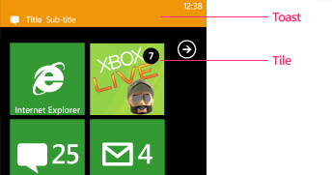
Communications: Cloud-initiated
Push Notifications
!Raaawww
Push data to your application
If app is not currently running MPNS discards the message.
Watch out for max payload size. If exceeds use to drive app to pull content from service
Single connecting between the device and the notification service
Bandwidth- and battery-friendly
Note: no guarantee of delivery
Notes:
Raw notifications payload size http://msdn.microsoft.com/en-us/library/ff402558(v=vs.92).aspx

Slide 23
Communications: Subscribing to Push
Device requests a channel
*NS returns channel
Device sends URL to cloud
Channel URL is stored in cloud
Cloud sends notification
*NS pushes to device
(4)
*NS
(1)
(2)
(5)
Web Role
(3)

Slide 24
Communications: Cloud-initiated to device?
Common pattern
Use cloud-initiated push to tell the device to call to a service
Cloud sends notification
Notification services pushes to device
Device receives message and calls to a service
Web Role sends a response
(1)
*NS
(2)
Web Role
(3)
(4)

Slide 25
Notifications: Different services
Windows 8:
Windows Push Notification Service (WNS)
Windows Phone:
Microsoft Push Notification Service (MPNS)
iOS:
Apple Push Notification Service (APNS)
Android:
Google Cloud Messaging (GCM)

Slide 26
Demonstrate Push Notifications on Windows Phone using NuGets
demo
Notes:
Start 10:40
End 10:45
Phone:
Install-Package Phone.Notifications.BasePage
Properties/WMAppManifest --> Default Task /Pages/NotificationsPage.xaml
Cloud:
add project cloud mvc 3
In nuget package console change the dropdown from Phone project to MVC project
install-package CloudServices.Notifications
install-package WindowsPhone.Notifications.ManagementUI.Sample
optional – if 80 is already used by iis 81 will be selected auto - Endpoints to 81

Slide 27
Platform Services

Slide 28
Platform Services
Access Control Service
Caching
Content Delivery Network (CDN)
SQL Database Data Sync
Traffic Manager

Slide 29
Tools & Resources

Slide 30
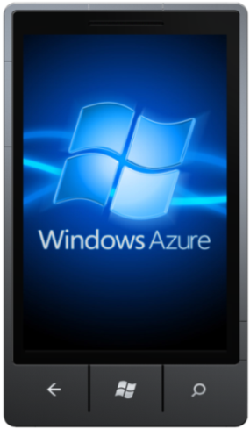
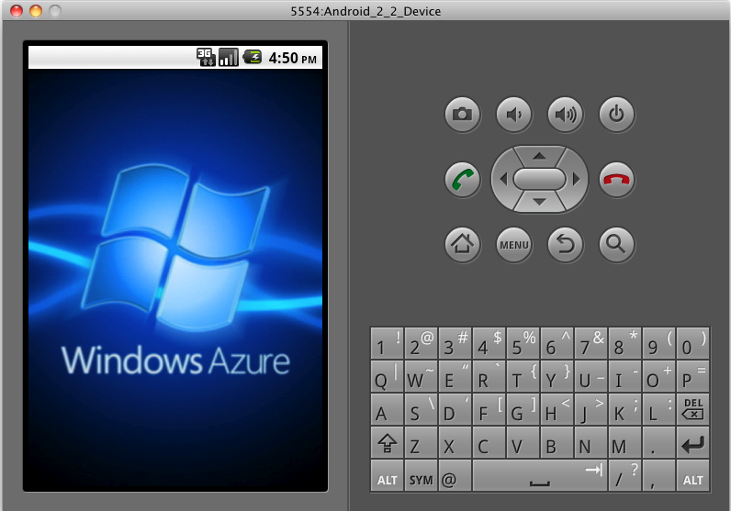
Windows Azure Toolkits for Devices
Easier for device developers to use Windows Azure
Windows Phone
iOS
Android
http://bit.ly/watwp7
http://bit.ly/watios
http://bit.ly/watandroid

Slide 31
Summary
Devices + Cloud
Storage
Identity
Communications
Platform Services
Toolkits

Slide 32
Summary

Slide 33


