Slide 1
软件工程实践 (SEP)
Hashing & Cuckoo

Slide 2
Review: Hashing

Slide 3
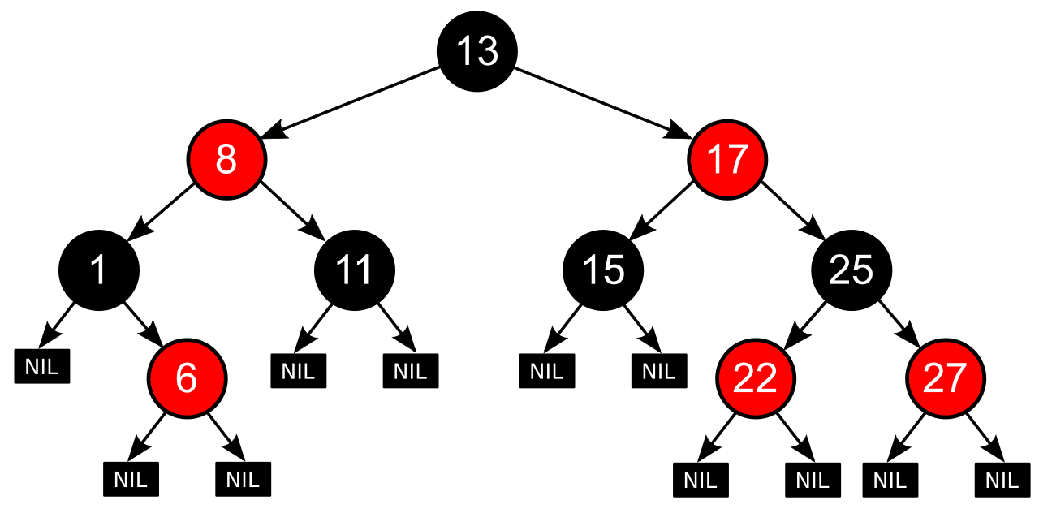
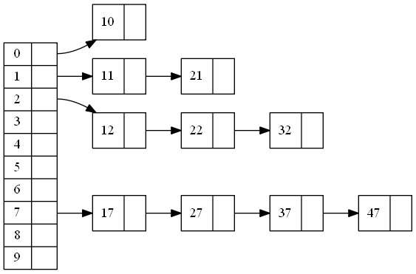
std::map
Tree
字典/映射 是怎么实现的？
map<int, string> fib;
fib[1896] = “Athens”;
fib[2008] = “Beijing”;
fib[2012] = “London”;
fib[2020] = “Tokyo”;
cout << fib[1896] << endl;
Hashing
Figs: https://commons.wikimedia.org/wiki/File:Red-black_tree_example.svg https://jasonlue.github.io/algo/2019/08/20/clustered-hashing.html

Slide 4
基本操作
—— Dict/Map ——
Insert(key, value)
Lookup(key) → value / Not Found
Delete(key)
—— Set ——
Insert(key)
Lookup(key) -> Found / Not Found
Delete(key)

Slide 5
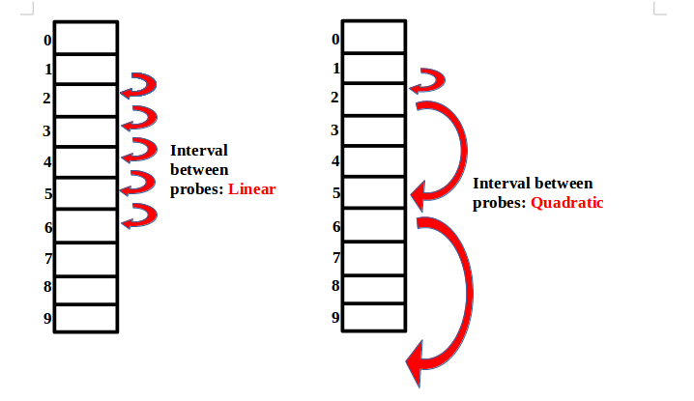
Hashing
Open Hashing
分离链表法
Closed Hashing / Open Addressing
线性探测、二次探测和再散列法
再散列： h’(K, i) = (h₁(K) +ih₂(K)) mod m
Figs: https://jasonlue.github.io/algo/2019/08/20/clustered-hashing.html
https://www.codingeek.com/data-structure/complete-guide-open-addressing-classification-eliminate-collisions/

Slide 6

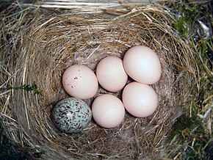
Cuckoo, The Bird
布谷鸟，又称杜鹃、子规
部分种类的布谷鸟会将他们的卵产在其他鸟的巢中，由其他鸟代为孵化和育雏
Figs: https://commons.wikimedia.org/wiki/File:Cacomantis_flabelliformis.jpg
https://commons.wikimedia.org/wiki/File:Eastern_Phoebe-nest-Brown-headed-Cowbird-egg.jpg

Slide 7
Cuckoo Hashing 基本思想
Open addressing
可使用两个数组或一个数组实现
每个 Key 有且仅有两个位置
查找时间复杂度： O(1)
但插入的时候，需要进行 Kick 等额外操作

Slide 8
H₁(x) = x mod 8
H₂(x) = (x div 8) mod 8
0
0
1
89
1
2
50
2
3
3
93
3
4
4
5
13
5
6
6
7
7

Slide 9
H₁(x) = x mod 8
H₂(x) = (x div 8) mod 8
0
0
1
89
1
2
50
2
3
3
93
3
4
4
5
13
5
6
6
7
7
H₁(1) = 1
Insert(1, 2)

Slide 10
H₁(x) = x mod 8
H₂(x) = (x div 8) mod 8
0
0
1
1
13
1
2
50
2
3
3
89
3
4
4
5
93
5
6
6
7
7
H₁(1) = 1
After Insert(1, 2)

Slide 11
H₁(x) = x mod 8
H₂(x) = (x div 8) mod 8
0
0
1
1
13
1
2
50
2
3
3
89
3
4
4
5
93
5
6
6
7
7
Delete(1)

Slide 12
H₁(x) = x mod 8
H₂(x) = (x div 8) mod 8
0
0
1
13
1
2
50
2
3
3
89
3
4
4
5
93
5
6
6
7
7
After Delete(1)

Slide 13
H₁(x) = x mod 8
H₂(x) = (x div 8) mod 8
0
16
0
1
13
1
2
50
2
3
3
89
3
4
4
5
93
5
6
6
7
7
Insert(16, 90)

Slide 14
H₁(x) = x mod 8
H₂(x) = (x div 8) mod 8
0
16
0
1
13
1
2
50
2
3
3
89
3
4
4
5
93
5
6
6
7
7
Insert(80, 90)

Slide 15
H₁(x) = x mod 8
H₂(x) = (x div 8) mod 8
0
80
0
1
13
1
2
50
16
2
3
3
89
3
4
4
5
93
5
6
6
7
7
After Insert(80,90)

Slide 16
H₁(x) = x mod 8
H₂(x) = (x div 8) mod 8
0
80
0
1
13
1
2
50
16
2
3
3
89
3
4
4
5
93
5
6
6
7
7
Insert(0, 90)

