Slide 1
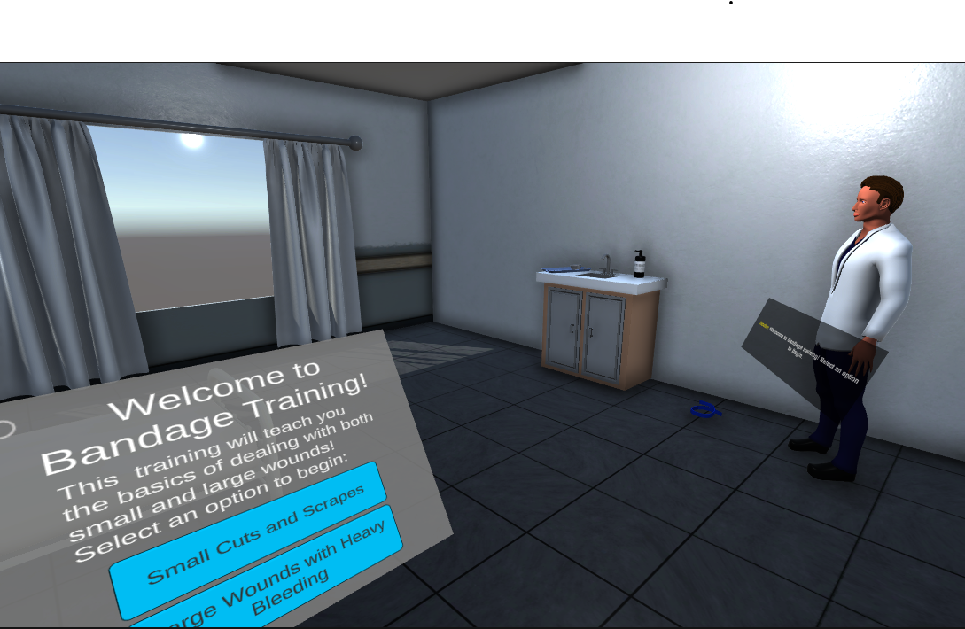
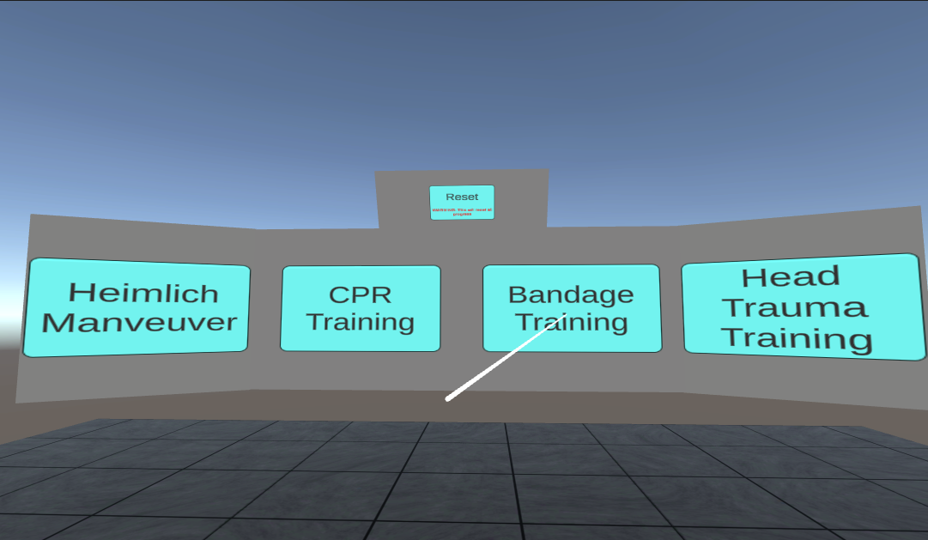



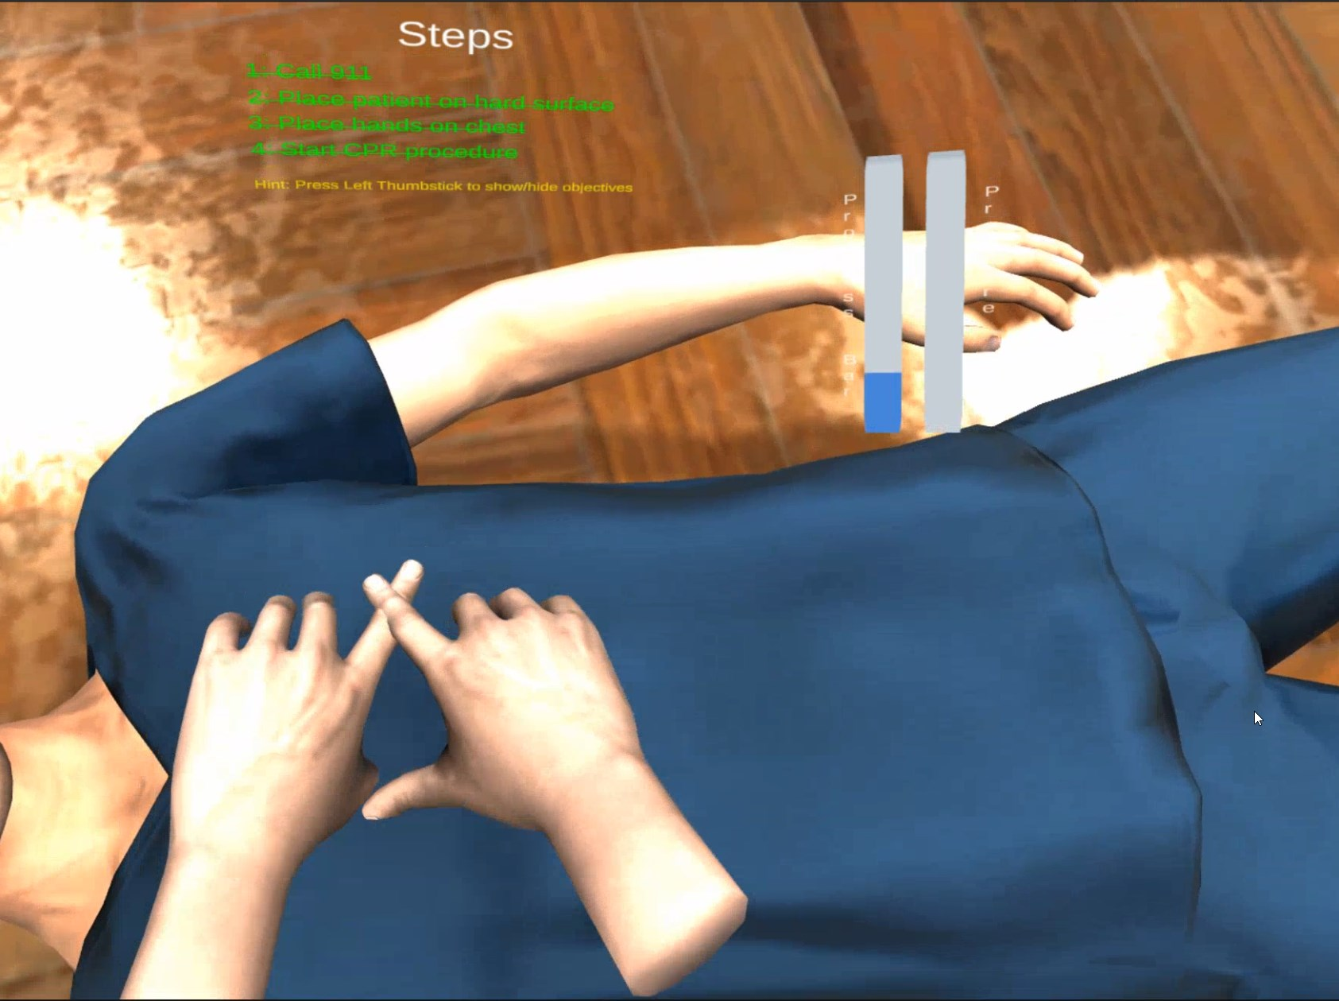
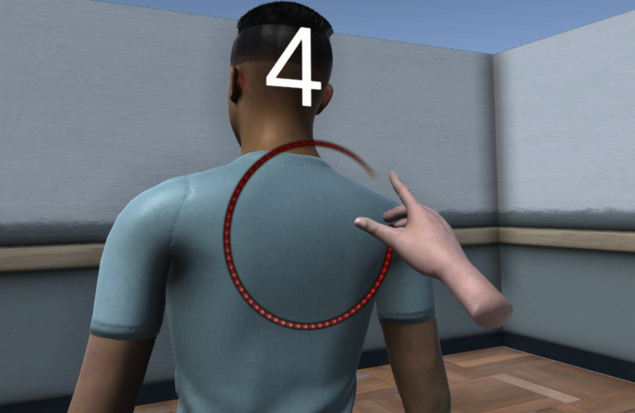
VR First Aid Training Tool
Jeremy Cavallo Luka Cvetko
Robert Tedeschi Slav Ivaskiv
Dr. Seyed Ziae Mousavi Mojab
Problem and Goal
First aid training is an important skill to have and can save lives. However, in-person first aid and CPR classes cost money and are inconvenient, while online classes lack the hands-on experience needed for people to feel comfortable applying the skills they learn. The goal of this project was to bridge the gap and provide hands-on first aid training via Virtual Reality.
Accomplishments and Results
We were able to successfully accomplish the goal of this project, and we have produced a fully functional VR medical training tool. Screenshots of the tool are provided below. Feel free to try it out on the headset as well for a fully immersive experience!
Technical Approach
To address this problem, we aimed to create a Virtual Reality tool that is accessible across various VR devices. To do this, we utilized the Unity game engine, which comes with the necessary packages and libraries for Virtual Reality development. 3D models were created using Blender. Progress is saved in JSON file format, which acts as the database for this software.
We decided to focus on five different aspects of first aid training, which were:
Treating small cuts and scrapes
Treating large wounds with heavy bleeding
CPR
Handling head trauma
Handling choking and the Heimlich maneuver
Some issues we ran into relate mostly to the limitations of the Virtual Reality devices themselves. Fine motor interactions, such as unwrapping bandages or applying bandages, cannot be captured with current VR technology. However, providing the exposure to the steps required in each situation is enough for our users to gain the confidence required to be prepared for a real-life scenario.
References
“First Aid.” Mayo Clinic, Mayo Foundation for Medical Education and Research, https://www.mayoclinic.org/first-aid.

