Slide 1
Agentic World Modeling for Agent TTS:
Next-state Prediction with Multi-turn Interaction with Real Environment
Research intuition, exploration journey, and the latest framework
Trajectory-level, read-grounded test-time scaling over real non-forkable environments
August 2026

Slide 2
INTUITION
Reformulation: context becomes an interaction
Ask for evidence only when the simulated trajectory makes it relevant
1
Observe candidate action
2
Identify uncertain state
3
Issue bounded read-only probes
4
Compute observation
FROM
TO
One compressed prompt
Fixed before candidate generation
No adaptive state discovery
A multi-turn simulator
Action-conditioned evidence gathering
Explicit budget and stopping rule
3

Slide 3
INTUITION
Why a compressed prompt is not enough
A static context must anticipate every state, dependency, and failure mode
COMPRESSED PROMPT
THE PROBLEM
THE CONSEQUENCE
Pack task rules, tool docs, state summaries, and examples into one fixed context.
Exclude necessary information without knowing the exact action.
The context is either becoming longer and more expensive, or easier to exclude information
Our solution: Reformulate it as a
sequential information-gathering problem.
2

Slide 4
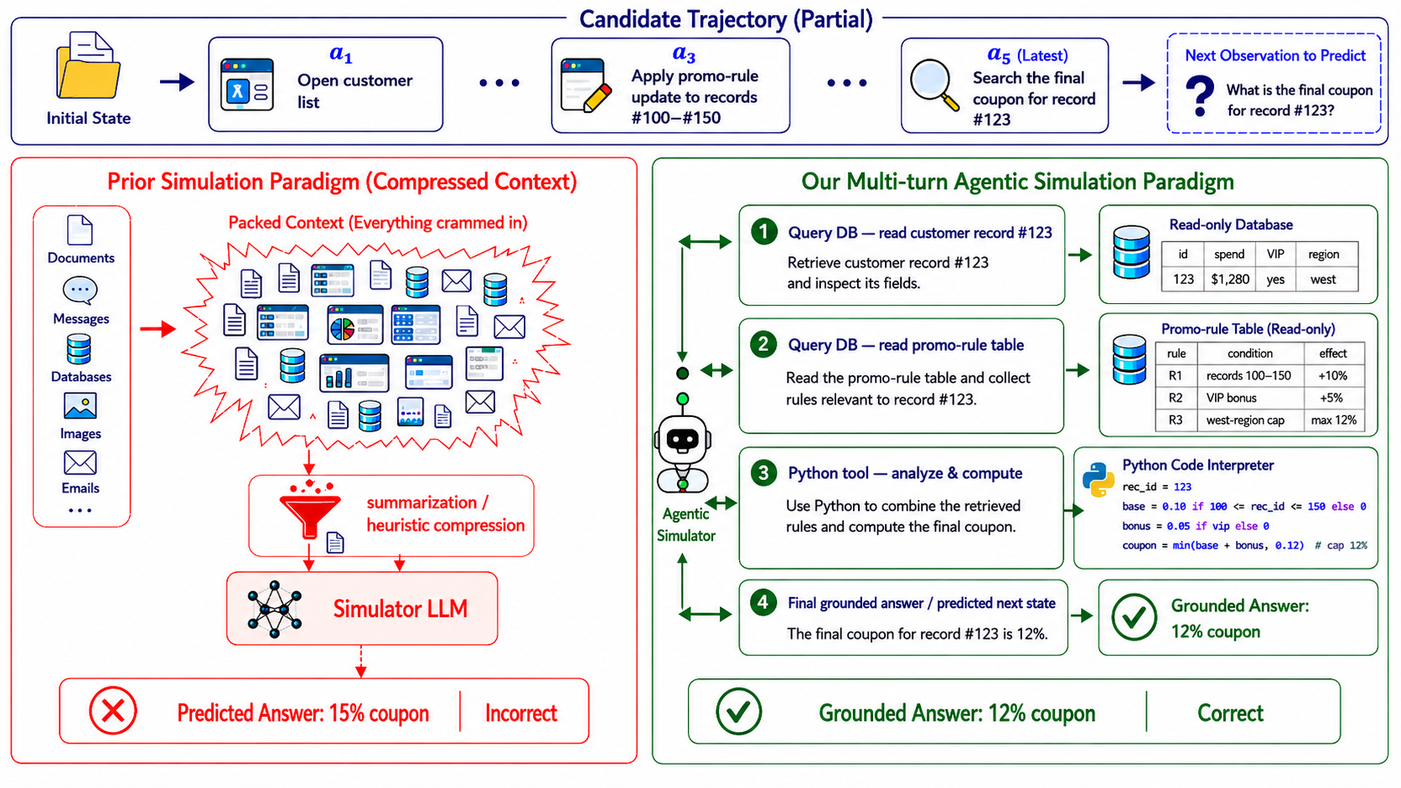
INTUITION
3

Slide 5
INTUITION
More problems
Ask for evidence only when the simulated trajectory makes it relevant
More interaction turns, longer context
Tool set
3

Slide 6
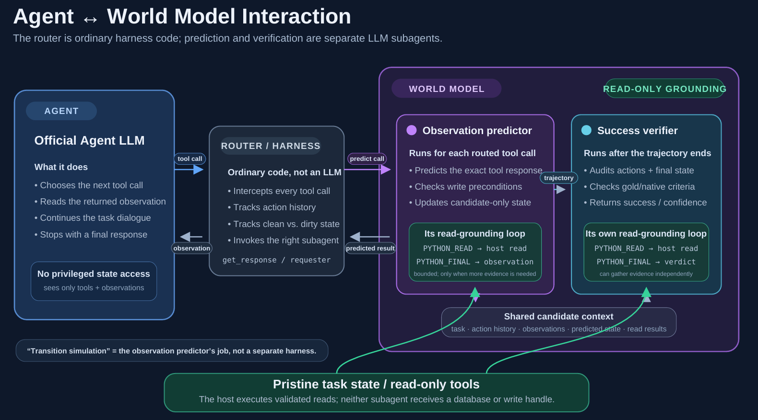
5

Slide 7
READ
From textual tools
to Python-only mode
CALL
A contrast of the interaction model, safety boundary,
and migration path
LIST
Same read-only capabilities. One structured control plane.
TRACE
LEGACY: TEXT
CURRENT: PYTHON
OfficeBench world-model tool protocol
5
1

Slide 8
EXECUTIVE TAKEAWAY
The capability did not disappear; the interface changed
Legacy verbs are now data emitted by restricted Python rather than top-level model commands.
BEFORE
NOW
Command-oriented
Program-oriented
• Emit READ / LIST / CALL / TRACE directly
• Typically one textual operation per turn
• Host parses free-form lines and returns text
• Finish with PREDICT: or VERDICT:
• Emit PYTHON_READ to produce validated JSON queries
• Batch several read-only operations in one turn
• Evidence is copied into data['reads'] / data['facts']
• Use PYTHON_FINAL for exact structured output
Tool access is still host-validated and read-only
Implementation: src/tts/env/officebench_wm_python.py; tests/test_officebench.py
2

Slide 9
CURRENT MODE
An example:
The Python program never receives the environment; it only emits requests and transforms copied evidence.
1
2
3
4
5
PYTHON_READ
HOST GATE
EXECUTE
COPY DATA
PYTHON_FINAL
Program emits a JSON
queries array
Parse schema; validate
read-only operations
Run underlying READ /
LIST / CALL / TRACE
Append results to
reads and facts
Compute and print
structured result
data = {
'reads': [...],
'facts': {...},
...copied context
}
No session object. No filesystem handle. No apps, network, subprocess, or process environment.
Protocol: src/tts/env/officebench_wm_python.py:180-299, 380-500
5

Slide 10
INTUITION
Test-time scaling
Generate diverse trajectories; improve the signal used to choose one
1
Sample N candidates
2
Simulate each safely
(with simulator)
3
Estimate success
(with simulator)
4
5
Officially evaluate
Select the best
0
1
N
simulator writes
real commit
candidate trajectories
5

Slide 11
EXPLORATION HISTORY
Experimental Setting
Page 1 of 2 — goal and experiments
Dataset
Baselines
Models
Tau Bench
AppWorld
Office bench
Rule-based selection
SFT+RL (Qwen-WM)
GPT-4.1
GPT-5.4
Qwen3.5-32B
RECOVERED
12

Slide 12
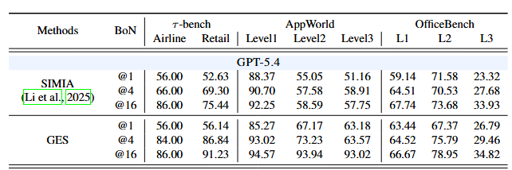
EXPLORATION HISTORY
Experimental Results
Simulating from the first write action.
Simulating from the beginning
12

Slide 13

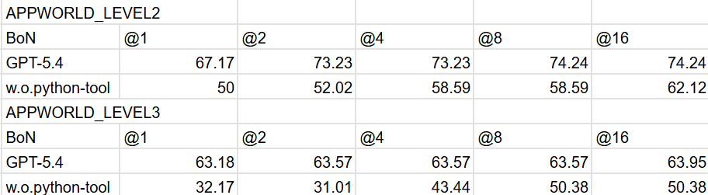
EXPLORATION HISTORY
Experimental Results
Comparison to world model fine-tuning
Tool selection
12

Slide 14
EXPLORATION HISTORY
More Experiments to Supplement
Regard world simulation as a new axis of TTS
Incorporate with different aggregation methods
More Ablation
Thanks to Wei-Ning, Yan-Zhi, Huseyin for the valuable discussion and feedback throughout the internship!
12

