Slide 1
Beam Finite Element Analysis
Recall the problem
Modal analysis
Programming solution
Hangyu Fy
2021.03.17

Slide 2
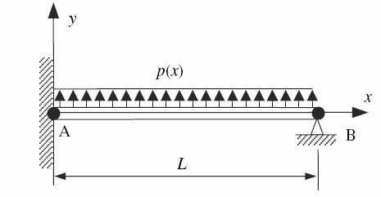

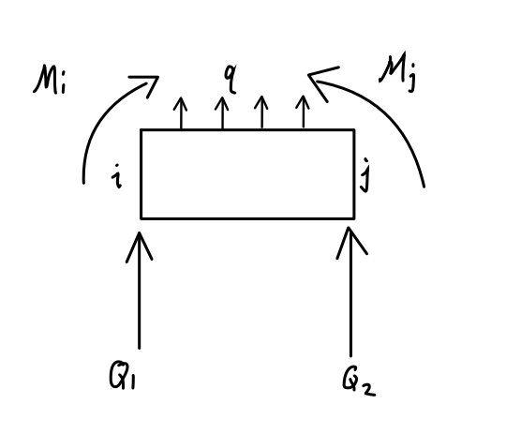
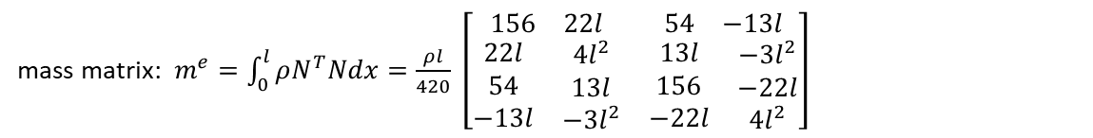



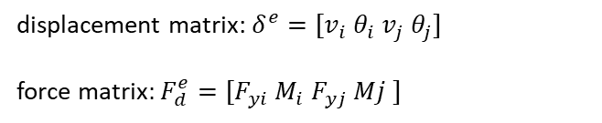

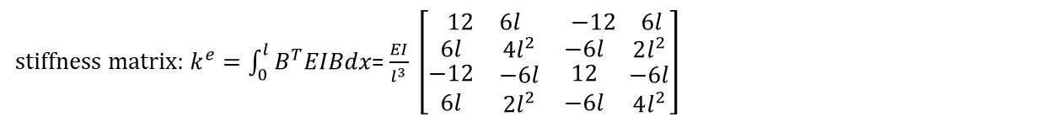
Recall the problem
A cantilever beam, subjected to uniform force q,
q
For each element, we have obtained the following dynamics equation
$$L$$
$$m^{e}\ddot{δ^{e}}+C^{e}\dot{δ^{e}}+k^{e}δ=F^{e}$$
mass matrix: $m^{e}=\int_{0}^{l}{ρN^{T}Ndx}=\frac{ρl}{420} \left[\begin{matrix}\begin{matrix}156 & 22l\end{matrix} & \begin{matrix}54 & −13l\end{matrix} \\ \begin{matrix}\begin{aligned}22l \\ 54 \\ −13l\end{aligned} & \begin{aligned}4l^{2} \\ 13l \\ −3l^{2}\end{aligned}\end{matrix} & \begin{matrix}\begin{aligned}13l \\ 156 \\ −22l\end{aligned} & \begin{aligned}−3l^{2} \\ −22l \\ 4l^{2}\end{aligned}\end{matrix}\end{matrix}\right]$
where
l
stiffness matrix: $k^{e}=\int_{0}^{l}{B^{T}EIBdx}$= $\frac{EI}{l^{3}} \left[\begin{matrix}\begin{matrix}12 & 6l\end{matrix} & \begin{matrix}−12 & 6l\end{matrix} \\ \begin{matrix}\begin{matrix}6l \\ \begin{matrix}−12 \\ 6l\end{matrix}\end{matrix} & \begin{matrix}4l^{2} \\ \begin{matrix}−6l \\ 2l^{2}\end{matrix}\end{matrix}\end{matrix} & \begin{matrix}\begin{matrix}−6l \\ \begin{matrix}12 \\ −6l\end{matrix}\end{matrix} & \begin{matrix}2l^{2} \\ \begin{matrix}−6l \\ 4l^{2}\end{matrix}\end{matrix}\end{matrix}\end{matrix}\right]$
$$F_{yi}$$
$$F_{yj}$$
displacement matrix: $δ^{e}=[v_{i} θ_{i} v_{j} θ_{j}]$
force matrix$:F_{d}^{e}=[F_{yi} M_{i} F_{yj} Mj ]$
damping matrix : $c^{e}$

Slide 3
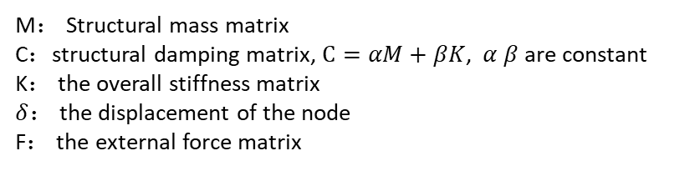
The overall dynamic equation is assembled ：
$$M\ddot{δ}+C\dot{δ}+Kδ=F$$
where
M： Structural mass matrix
C：structural damping matrix, $C=αM+βK$, $α β$ are constant
K： the overall stiffness matrix
$δ$： the displacement of the node
F： the external force matrix
In this equation, only the node displacement is unknown, so a series of second order ordinary differential equations about node displacement need to be solved, but it should be noted that every displacement inside is coupled. So we should choose the right way to solve this problem

Slide 4

Modal analysis
According to Vibration Mechanics^{[1]}, to find the dynamic response of a structure is to find the vibration frequency and vibration shape of the structure.
Because damping has little effect on the evaluation rate and mode shape, it can be solved by solving the following equation:
$M\ddot{δ}+Kδ=0$ (1)
The general solution of displacement is expressed as: $δ=∅cos⁡(ωt+φ)$ (2)
Where $ω$ is frequency, $φ$ is phase angle, $∅$ is amplitude vector also vibration shape
Substitute formula (2) into formula (1) and eliminate cos($ωt+φ$), we get:
$\left(K−ω^{2}M\right)∅=0$ (3)
By solving Equation 3, we can get the eigenvalue and the corresponding eigenvector
[1] Yanzhu Liu, Liqun Chen. Vibration Mechanics[M].Beijing: Higher Education Press,2019

Slide 5

The basic idea of ​​modal analysis is: to transform the coupled motion equations into uncoupled motion equations through coordinate transformation.
$δ= ∅Y$ (4)
where $∅=[∅_{1},∅_{2},∅_{3},∅_{4}$, … , $∅_{n}$] is vibration shape matrix, $Y={\left[y_{1} y_{2} y_{3} …y_{n}\right]}^{T}$is generalized coordinate vector, is a function of time.
From a mathematical point of view, this formula is the basis transformation that represents the transformation from the node displacement basis vector to the vector based on $∅$
$M\ddot{δ}+C\dot{δ}+Kδ=F$ (5)
Substituting (4) into (5) we get:
$M∅\ddot{Y}+C∅\dot{Y}+K∅Y=F$ (6)
consider the orthogonality condition, and multiply the $∅_{i}$ in the left to the eq(6),
$M_{i}\ddot{y}+C_{i}\dot{y}+K_{i}y_{i}=F_{i}$ (7)
This represents a set of n-decoupled second-order linear ordinary differential equations.
where $M_{i}=∅_{i}^{T}M∅_{i}$, $K_{i}=∅_{i}^{T}K∅_{i}$, $C_{i}=∅_{i}^{T}C∅_{i}$, $F_{i}=∅_{i}^{T}F$

Slide 6
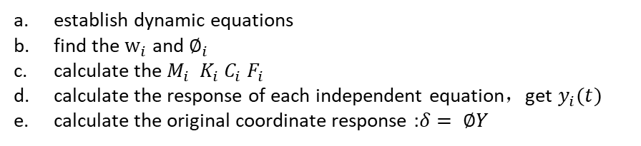
The same transformation should be done for the initial conditions, and wo get the:
$y_{i}\left(0\right)=∅_{i}^{T}Mδ(0)/M_{i}$ , $\dot{y_{i}}\left(0\right)=∅_{i}^{T}M\dot{δ} (0)/M_{i}$
(i = 1,2,…,n )
Solve equation (7) to get the response of each mode coordinate$y_{i}$, and then superimpose to get the response of the original coordinate: $δ= ∅Y$
Summary steps:
establish dynamic equations
find the $w_{i}$ and $∅_{i}$
calculate the $M_{i}$ $K_{i} C_{i} F_{i}$
calculate the response of each independent equation，get $y_{i}(t)$
calculate the original coordinate response :$δ= ∅Y$

Slide 7
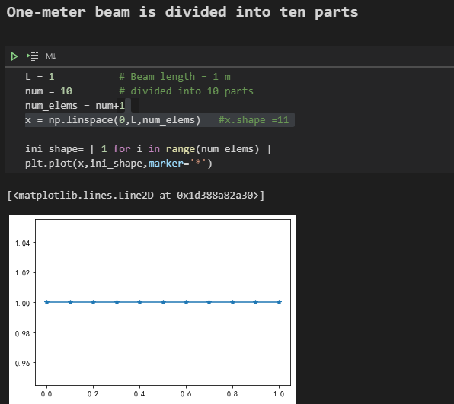
Programming solution
One-meter beam is divided into ten parts,
Now we have ten elements and eleven nodes

Slide 8
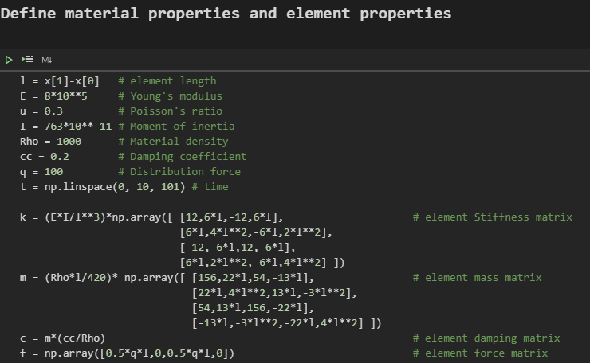
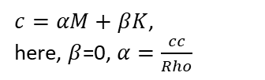
$c=αM+βK$,
here, $β$=0, $α=\frac{cc}{Rho}$

Slide 9
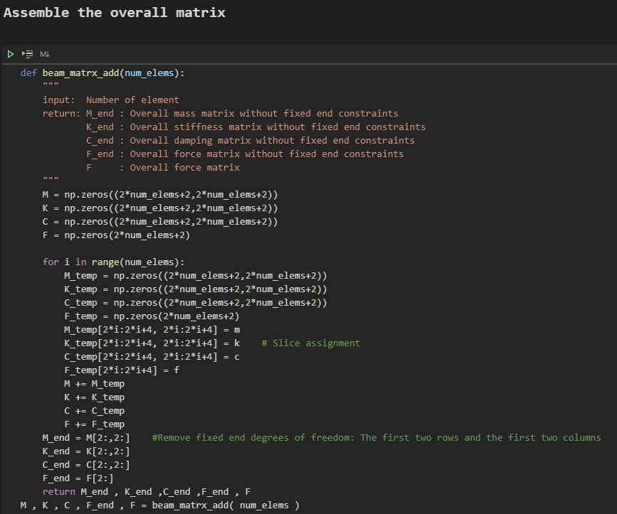

Slide 10
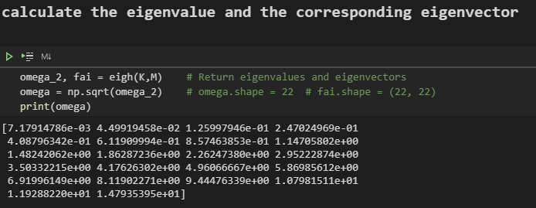

Slide 11
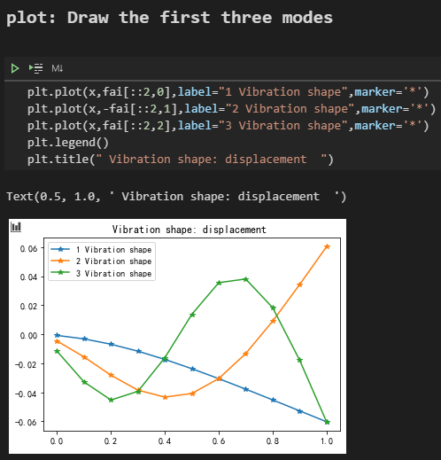
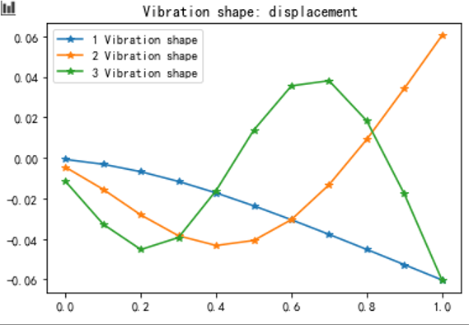

Slide 12
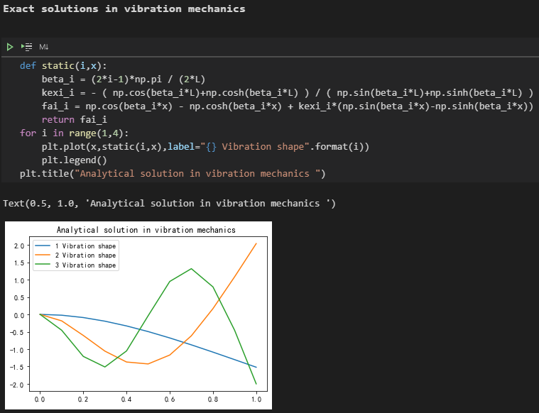
I found the vibration shape of the cantilever beam in the textbook of vibration mechanics^{[1]}
It has formulas, then I coded them
They have the same trend,
Notes:
So I think my calculation may be correct

Slide 13
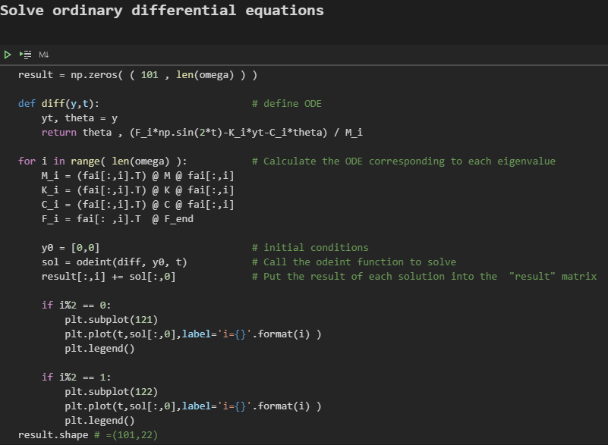
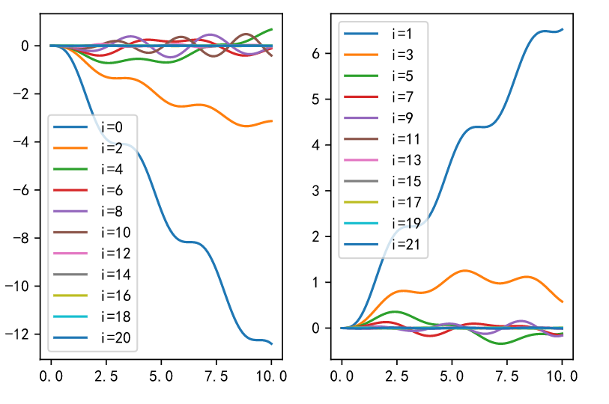
Find the result graph
of ODE every time:

Slide 14
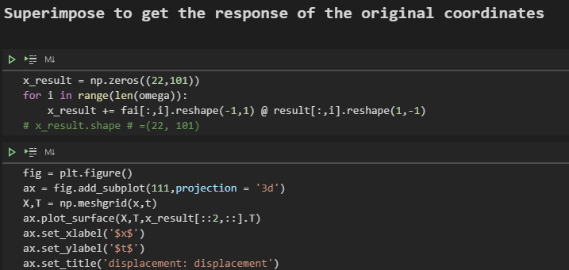
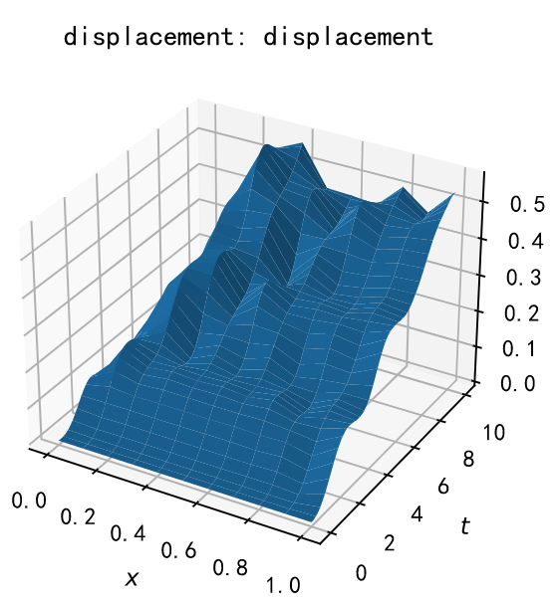

Slide 15
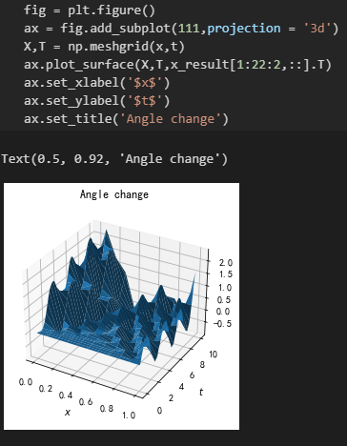

Slide 16
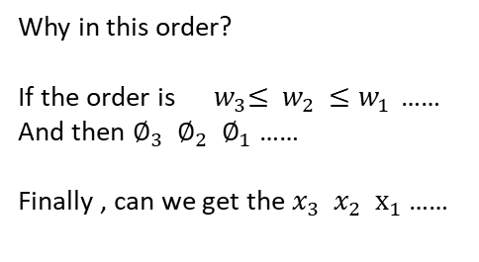
question
The frequencies calculated through modal analysis are in no order. We generally arrange them in ascending order: $w_{1}≤w_{2}≤w_{3}$ ……
The modal vector corresponds to the frequency one-to-one： $∅_{1}{ ∅}_{2}$ $∅_{3}$ ……
According to the previous calculations, after solving the ODEs, convert to the original coordinates：
$δ= ∅Y$ (4)
the final matrix we get has a certain correspondence with the original node coordinates $x_{1} x_{2} x_{3}$ ……
Why in this order?
If the order is${ w}_{3}≤ { w}_{2}$ $≤w_{1 }$……
And then $∅_{3}$ ${ ∅}_{2} ∅_{1}$ ……
Finally , can we get the $x_{3}$ $x_{2}$ $x_{1}$……

