Slide 1
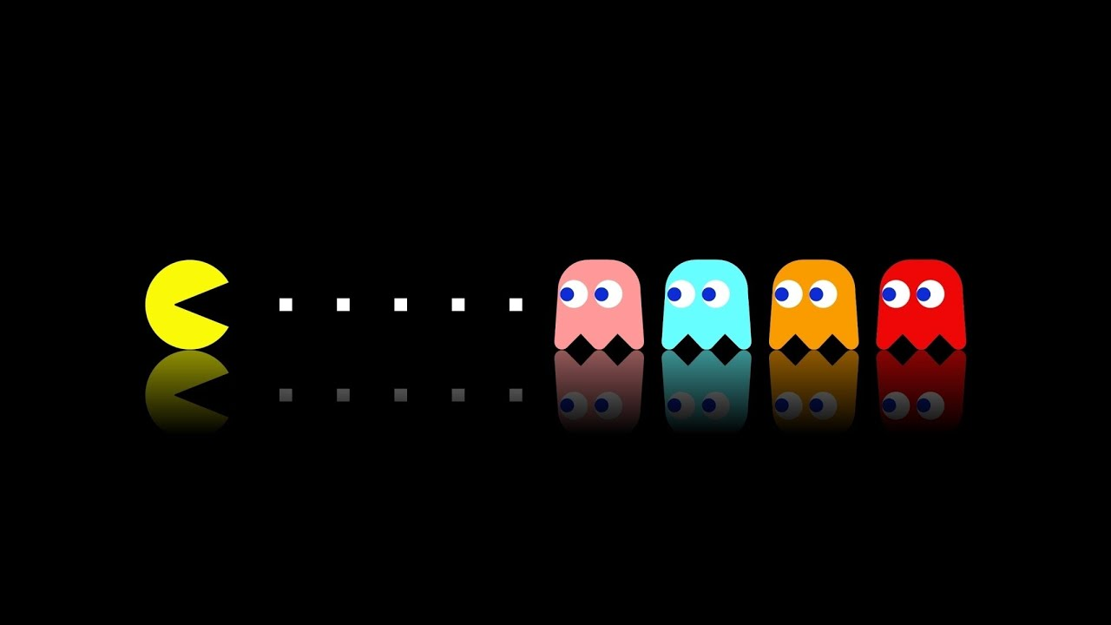

Project Presentation
PACMAN
Student: PHAN MINH PHONG – ITITWE17015
DATA STRUCTURES AND ALGORITHMS – MR.TRAN THANH TUNG
COMPUTER SCIENCE DEPARTMENT
INTERNATIONAL UNIVERSITY FALL 2019

Slide 2

PROJECT OVERVIEW
INTRODUCTION
INSTALLATION GUIDE
DEMO TEST
GOAL
RULE

Slide 3

Design & implement algorithms to
  control the Pac-Man &
  control the Ghosts
Algorithm
  Input
    the maze, location of dots
    location of the agents (Pac-Man & Ghosts)
  Output
    Next move of the agents (left, right, up or down)
Objectives
  PacMan: avoid the ghosts & eat the dots
  Ghosts: attack the PacMan

Slide 4

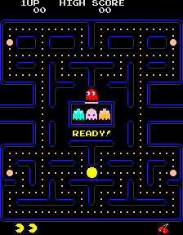
  Pac-Man is a classic video game
  Icon of the 1980s popular culture
  Environment is a maze with dots & fruits
  Pac-Man is an agent that eats the dots & fruits
  Ghosts are agents that attack the Pac-Man

Slide 5

Extract the zip file “PhanMinhPhong_ITITWE17015.zip” to get the folder.
Open Eclipse
    File → Import → General → Existing Project into Workspace → Browse
Search for the location that have the folder just extracted.
    Click finish.

Slide 6

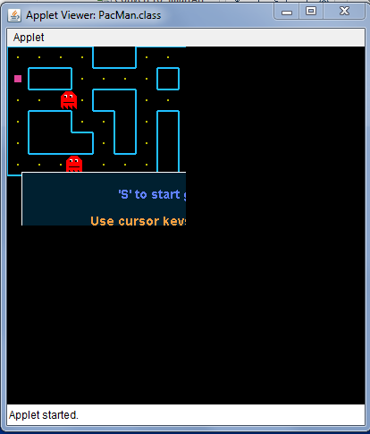
RIGHT CLICK THE PACMAN.JAVA -> RUN AS –> JAVA APPLET
It should run like this

Slide 7
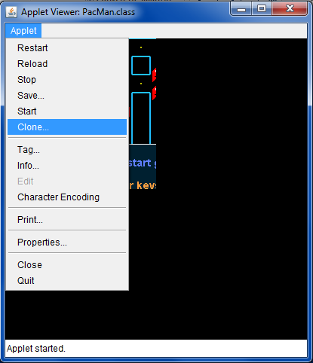
IN THE LEFT CORNER, CLICK APPLET → CLONE…

Slide 8

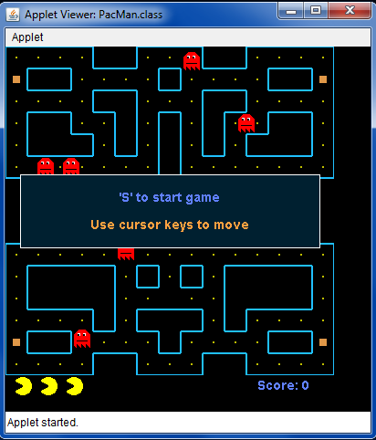
NOW YOU CAN PLAY THE GAME, CLICK ‘S’ TO START THE GAME,
CONTROL BY THE ARROWS KEY, HAVE FUN!!!
OH YEAH, GAMING TIME!!!

Slide 9

Pac-man
Ghosts
Collect all dots
Stay alive
Eat the ghosts
Find
Pac-man
Kill
Pac-man
Repeat

Slide 10





Small dots
Big dot
Pac-Man
    Score the most points
    Eating Pills = 1 points
    Eating big dot = able to eating ghosts
    Eating Ghosts = 10 points per Power Pill
Ghosts
• Stop Pac-Man from scoring
Kill him!!!

Slide 11

Open the file on Eclipse, all the function name have been changed to easily understand.

Slide 12

https://www.google.com
https://en.wikipedia.org/wiki/Pac-Man
https://www.is.ovgu.de/is_media/Teaching/Vorlesung+CIG/SS17/introduction.pdf
https://www.slideshare.net/grimlockt/pac-man-6561257

Slide 13
Thanks for your attention!

