Slide 1
2.0 Fundamentals of Speech Recognition
References for 2.0
1.3, 3.3, 3.4, 4.2, 4.3, 6.4, 7.2, 7.3, of Bechetti

Slide 2

$$∈$$

Slide 3
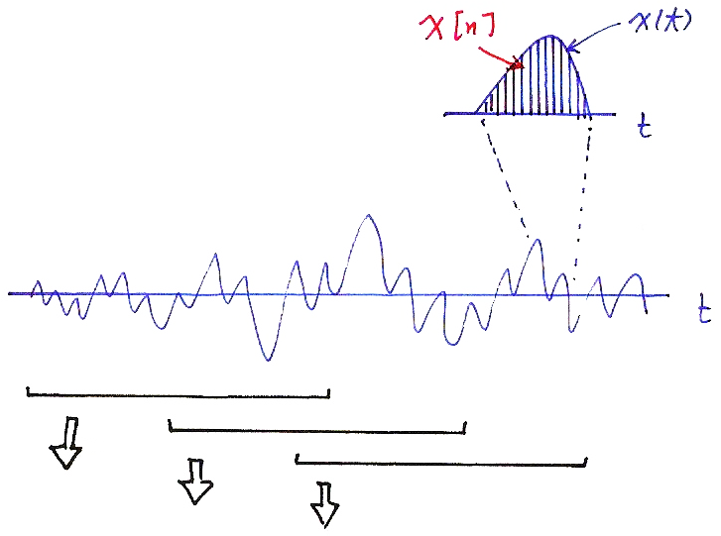
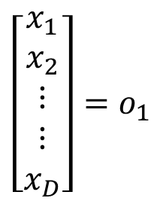
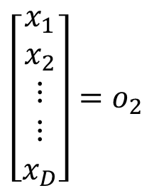
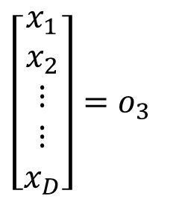




Observation Sequences
$$x[n]$$
$$x(t)$$
$$t$$
$$t$$

Slide 4
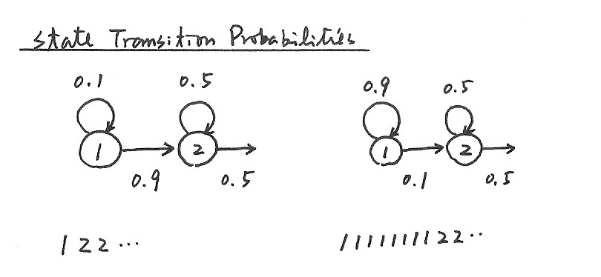
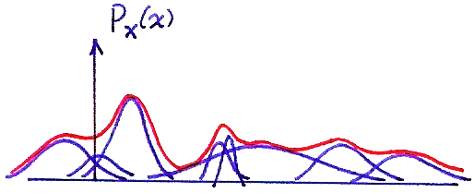

State Transition Probabilities
0.1
0.5
0.9
0.5
0.9
0.5
0.1
0.5
1 2 2 ⋯
1 1 1 1 1 1 1 1 2 2 ⋯
1-dim Gaussian Mixtures
$$P_{x}(x)$$

Slide 5
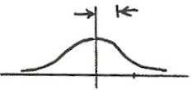






$$f_{x}(x)$$
$$σ^{2}$$
$$x$$
$$m$$
$$x$$
$j$
$$\sum{=\left[\begin{matrix} & ⋮ & \\ ⋯ & σ_{ij} & ⋯ \\ & ⋮ & \end{matrix}\right]} i$$
$$σ_{ij}=E[(x_{i}−μ_{x_{i}}) (x_{j}−μ_{x_{j}})]$$

Slide 6
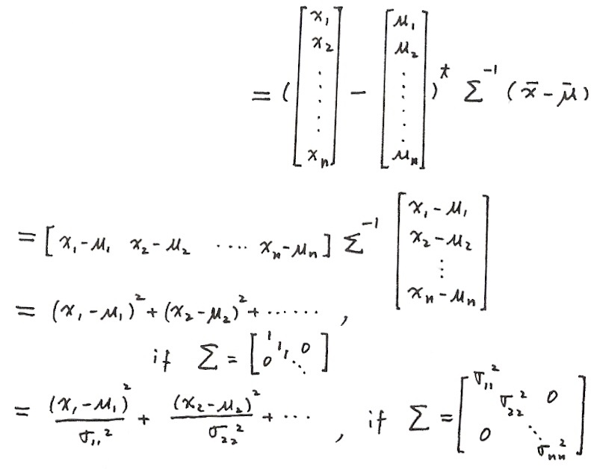

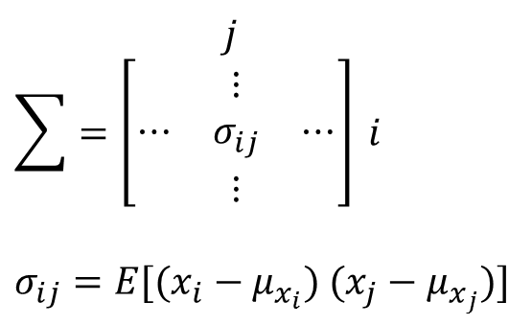
Multivariate Gaussian Distribution
$$f_{x}(x)$$
$$σ^{2}$$
$$x$$
$$m$$
$$x$$
$j$
$$\sum{=\left[\begin{matrix} & ⋮ & \\ ⋯ & σ_{ij} & ⋯ \\ & ⋮ & \end{matrix}\right]} i$$
$$σ_{ij}=E[(x_{i}−μ_{x_{i}}) (x_{j}−μ_{x_{j}})]$$

Slide 7
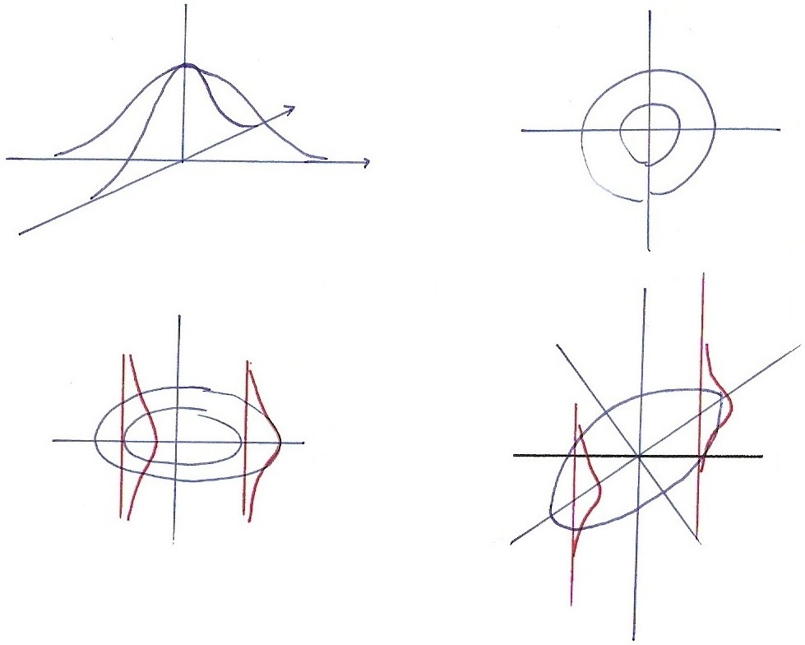


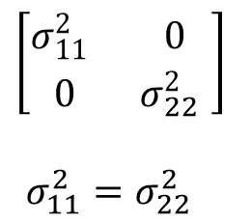
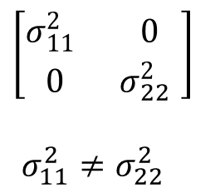





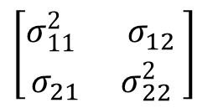

2-dim Gaussian
$$x_{2}$$
$$\left[\begin{matrix}σ_{11}^{2} & 0 \\ 0 & σ_{22}^{2} \end{matrix}\right]$$
$σ_{11}^{2}=σ_{22}^{2}$
$$x_{2}$$
$$x_{1}$$
$$x_{1}$$
$$x_{2}$$
$$\left[\begin{matrix}σ_{11}^{2} & 0 \\ 0 & σ_{22}^{2} \end{matrix}\right]$$
$σ_{11}^{2}≠σ_{22}^{2}$
$$x_{2}$$
$$\left[\begin{matrix}σ_{11}^{2} & σ_{12} \\ σ_{21} & σ_{22}^{2} \end{matrix}\right]$$
$$x_{1}$$
$$x_{1}$$

Slide 8
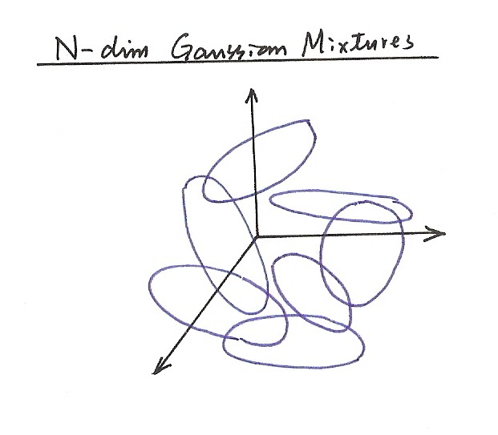
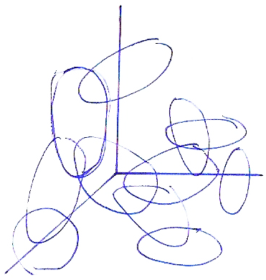
N-dim Gaussian Mixtures

Slide 10
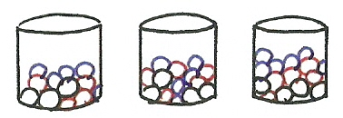
Simplified HMM
1
2
3
RGBGGBBGRRR……

Slide 12
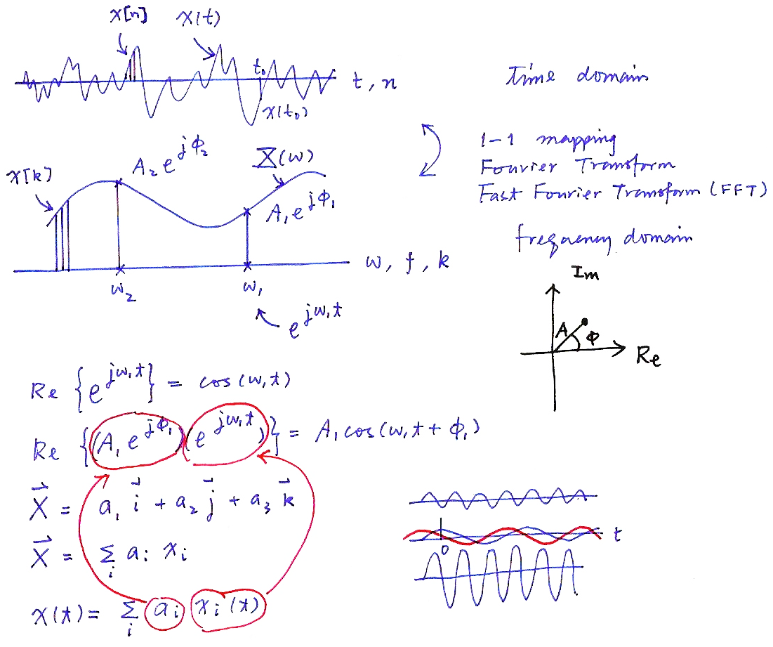
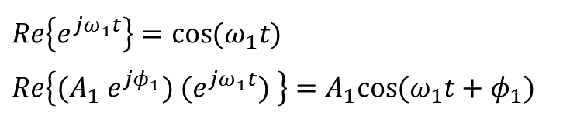

Time and Frequency Domains
time domain
1-1 mapping
Fourier Transform
Fast Fourier Transform (FFT)
frequency domain
X[k]
$$Re\left\{e^{jω_{1}t}\right\}=\cos{(ω_{1}t)}$$
$$Re\left\{(A_{1} e^{jφ_{1}}) (e^{jω_{1}t}) \right\}=A_{1}cos{(ω_{1}t+φ_{1})}$$
$$\vec{X}= a_{1}\vec{i }+a_{2}\vec{j }+a_{3}\vec{k}$$
$$\vec{X}= \sum_{i}{a_{i }x_{i}}$$
$$x\left(t\right)=\sum_{i}{a_{i} x_{i}}(t)$$

Slide 13
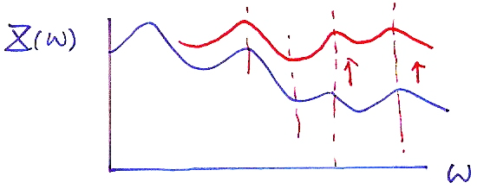


Pre-emphasis
$$X(ω)$$
$$ω$$
Pre-emphasis
H(z) = 1 − az⁻¹ , 0 << a < 1
x[n] = x′[n] − ax′[n−1]
pre-emphasis of spectrum at higher frequencies

Slide 14
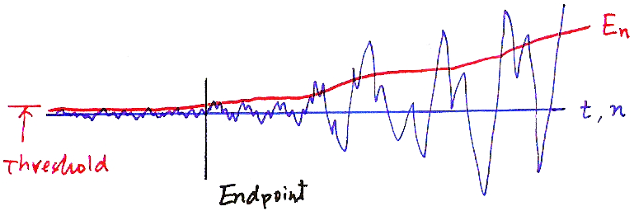
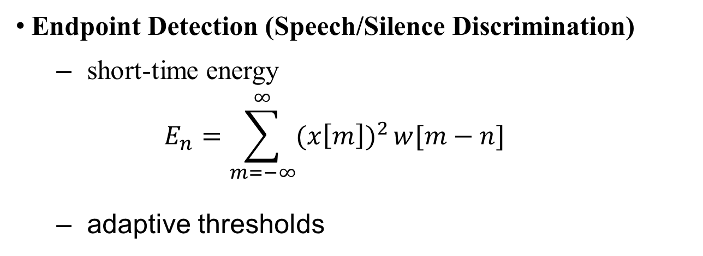


Endpoint Detection
$$E_{n}$$
$$t,n$$
Threshold
Endpoint

Slide 15
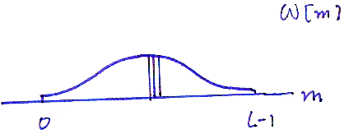
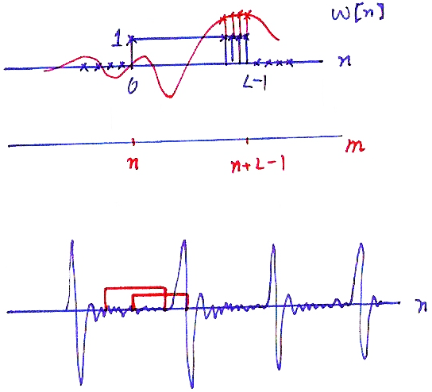







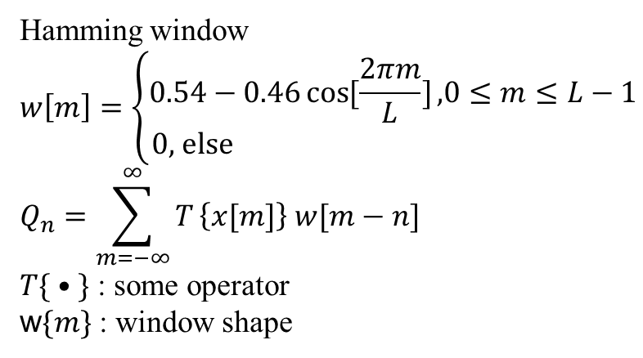




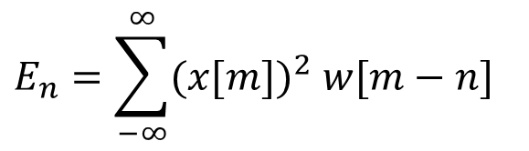


Endpoint Detection
◉ Rectangular Window
◉ Hamming Window
$$x[m]$$
$$w[m]$$
$$w[n]$$
$$1$$
$$n$$
$$0$$
$$L−1$$
$$m$$
$$0$$
$$L−1$$
$$n$$
$$n+L−1$$
$$m$$
Hamming window
$$w\left[m\right]=\left\{\begin{aligned}0.54−0.46\cos{[\frac{2πm}{L}]}\text{,}0≤m≤L−1 \\ \text{0, }\text{else} \end{aligned}\right.$$
$$Q_{n}=\sum_{m=−∞}^{∞}{T}\left\{x[m]\right\} w[m−n]$$
$T\{ • \}$ : some operator
w$\{m\}$ : window shape
$$E_{n}=\sum_{−∞}^{∞}{{(x[m])}^{2} w[m−n]}$$

Slide 17
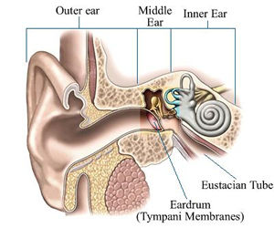
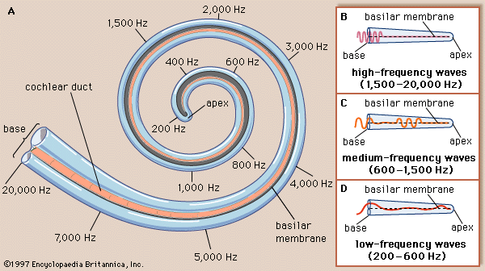
Peripheral Processing for Human Perception (P.34 of 7.0 )

Slide 18
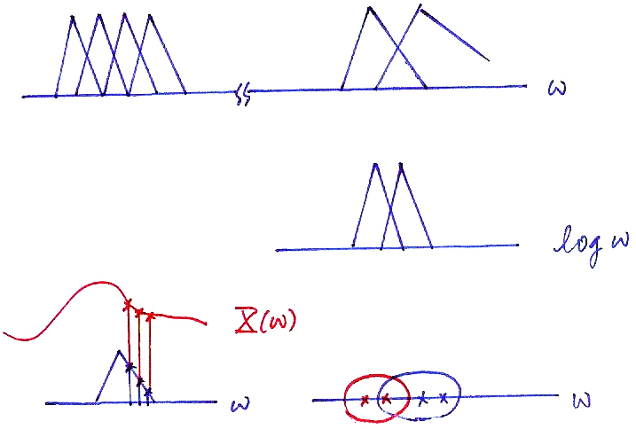





Mel-scale Filter Bank
$$ω$$
$$\log{ω}$$
$$X(ω)$$
$$ω$$
$$ω$$

Slide 19
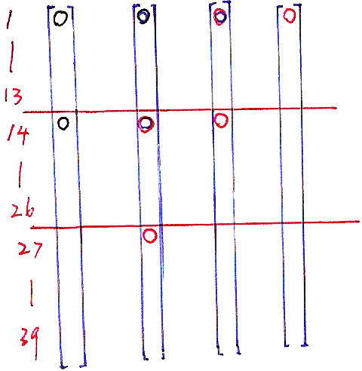
Delta Coefficients

Slide 21
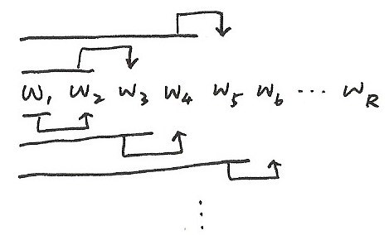

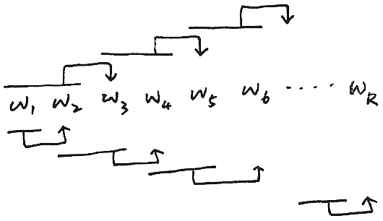

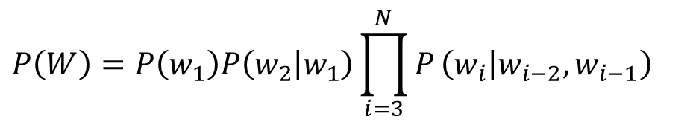
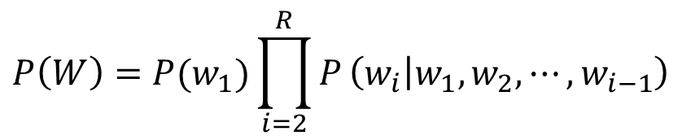
N-gram
$$P\left(W\right)=P(w_{1})\prod_{i=2}^{R}{P}\left(w_{i} | w_{1},w_{2},⋯,w_{i−1}\right)$$
W₁ W₂ W₃ W₄ W₅ W_{6 ......} W_{R}
$$⋮$$
◉ tri-gram
W₁ W₂ W₃ W₄ W₅ W_{6 ......} W_{R}
$$P\left(W\right)=P\left(w_{1}\right)P\left(w_{2} | w_{1}\right)\prod_{i=3}^{N}{P}\left(w_{i} | w_{i−2},w_{i−1}\right)$$

Slide 23
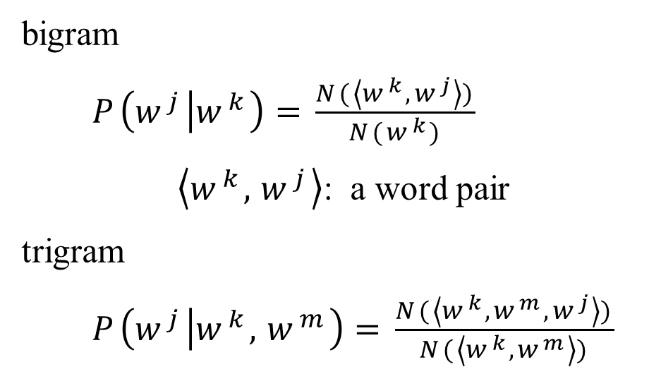
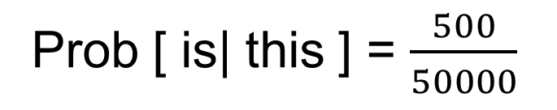
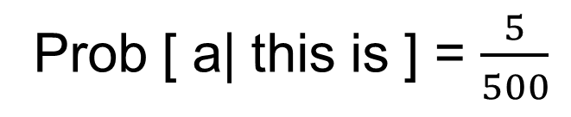
… this ……… 50000
… this is …… 500
… this is a … 5
Prob [ is| this ] = $\frac{500}{50000}$
Prob [ a| this is ] = $\frac{5}{500}$

Slide 24
A Posteriori Probability
Maximum A Posteriori (MAP) Principle

Slide 25
Maximum A Posteriori Principle (MAP)
W : { w₁ , w₂ , w₃ }
↑ ↑ ↑
sunny rainy cloudy
P(w₁)
P(w₂)
+ P(w₃)
1.0
$\vec{O}=({\vec{o}}_{1},{\vec{o}}_{2},{\vec{o}}_{3}, ⋯)$ weather parameters
◉ Problem
given $\vec{O}$ today, to predict W for tomorrow

Slide 26
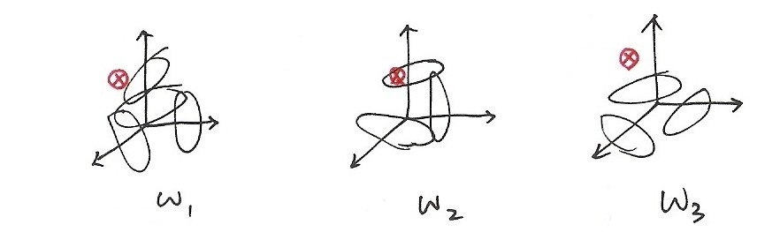
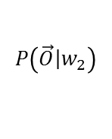
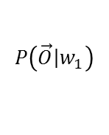
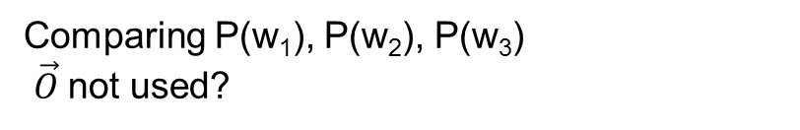
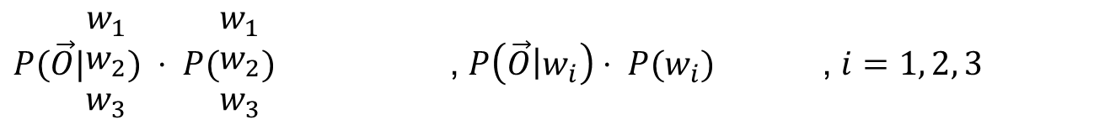
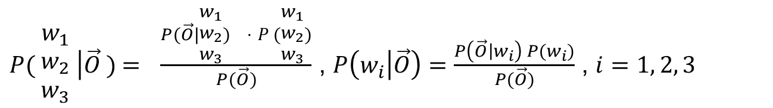
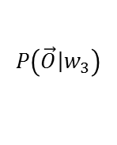
Maximum A Posteriori Principle (MAP)
◉ Approach 1
Comparing P(w₁), P(w₂), P(w₃)
$\vec{O}$not used?
◉ Approach 2
Likelihood
function
Prior Probability
事前機率
A Posteriori Probability
事後機率
$P( \begin{matrix}w_{1} \\ w_{2} \\ w_{3}\end{matrix} \left|\vec{O}\right. )\text{ = }\frac{P(\vec{O}|\begin{matrix}w_{1} \\ w_{2} \\ w_{3}\end{matrix}) ⋅ P(\begin{matrix}w_{1} \\ w_{2} \\ w_{3}\end{matrix})}{P(\vec{O})}$ , $P\left(w_{i}\left|\vec{O}\right.\right)=\frac{P\left(\vec{O}\left|w_{i}\right.\right) P(w_{i})}{P(\vec{O})}$ , $i=1, 2, 3$
compute
unknown
observation
$P(\vec{O}|\begin{matrix}w_{1} \\ w_{2} \\ w_{3}\end{matrix}) ⋅ P(\begin{matrix}w_{1} \\ w_{2} \\ w_{3}\end{matrix})$ , $P\left(\vec{O}\left|w_{i}\right.\right)⋅ P(w_{i})$ , $i=1, 2, 3$
compare
$$P\left(\vec{O}\left|w_{1}\right.\right)$$
$$P\left(\vec{O}\left|w_{2}\right.\right)$$
$$P\left(\vec{O}\left|w_{3}\right.\right)$$

Slide 27
Syllable-based One-pass Search
Finding the Optimal Sentence from an Unknown Utterance Using 3 Knowledge Sources:Acoustic Models, Lexicon and Language Model
Based on a Lattice of Syllable Candidates
t
Acoustic Models
Syllable Lattice
P(w₁)P(w₂ |w₁)......
P(w₁)P(w₂ |w₁)......
Word Graph
w₁ w₂
w₁ w₂
Language Models
Lexicon

