Slide 1
Dynamic Time Warping (DTW)
J.-S Roger Jang (張智星)
jang@mirlab.org
http://mirlab.org/jang
MIR Lab, CSIE Dept
National Taiwan University

Slide 2
Dynamic Time Warping
Goal
  To align two sequences of time under certain constraints, such that the distance between these two sequences is as small as possible.
Method
  Dynamic programming (DP)

Slide 3
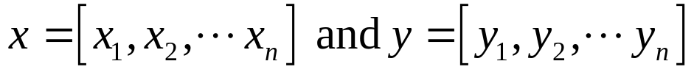

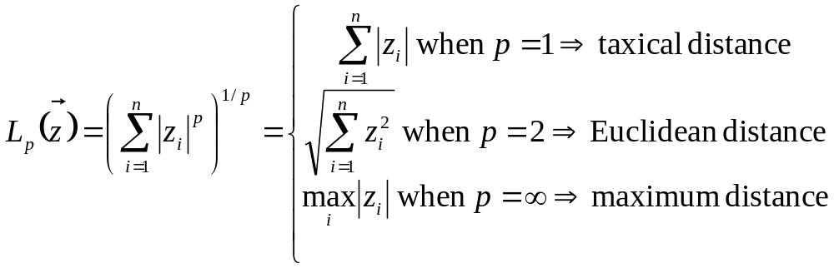
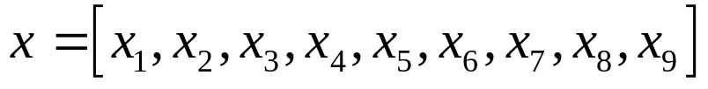
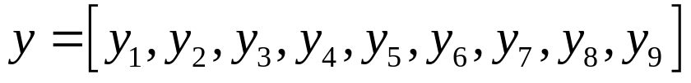
Distance between Same-length Sequences
Distance between can be denoted by L_{p} norm:
Alignment
Quiz!

Slide 4
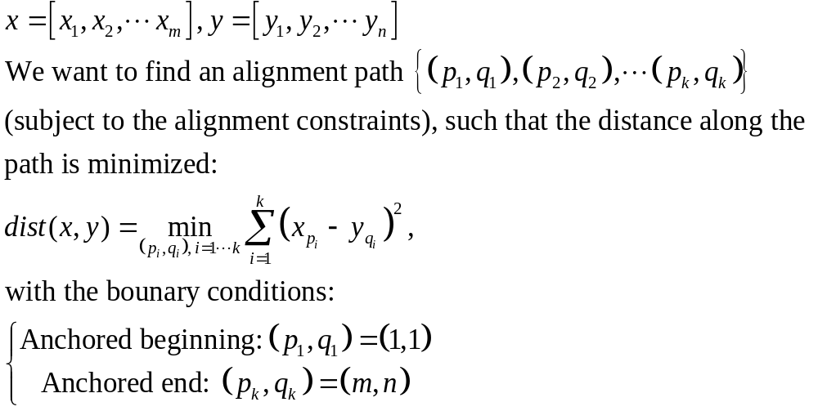
Distance between Different-length Sequences

Slide 5

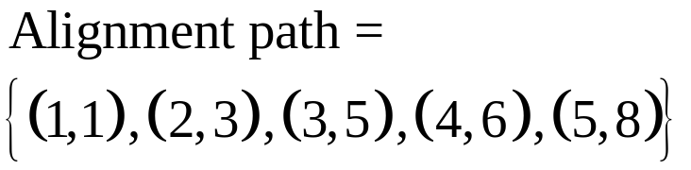
Type-1 DTW: Alignment Constraints
Temporal constraints
Alignment constraints
  One-to-one mapping
  One skip at most
x1
x2
x3
x4
x5
y1
y2
y3
y4
y5
y6
y7
y8

Slide 6

Type-1 DTW: Alignment Path
Alignment path (mapping path)
j
x1
x2
x3
x4
x5
8
7
y1
y2
y3
y4
y5
y6
y7
y8
6
5
4
3
2
1
i
1
2
3
4
5

Slide 7

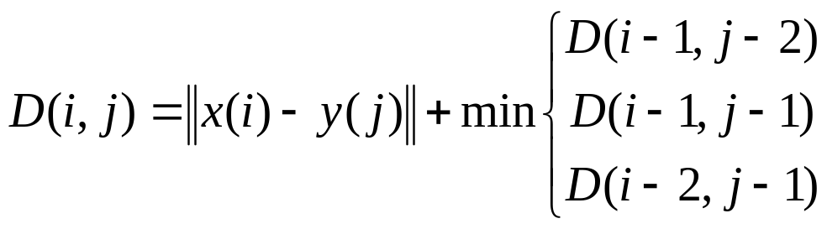



Type-1 DTW: Local Path Constraints
27-45-63 local paths

Slide 8
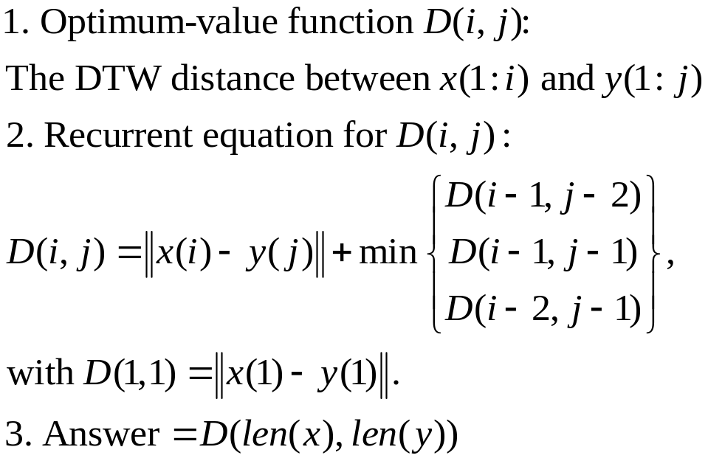
Type-1 DTW: 3-Step DP Formula
x, y: input vector/matrix
Local paths: 27-45-63 degrees
3-step DP formulation:
j
Quiz!
y(j)
y(j-1)
x(i-1)
x(i)
i

Slide 9

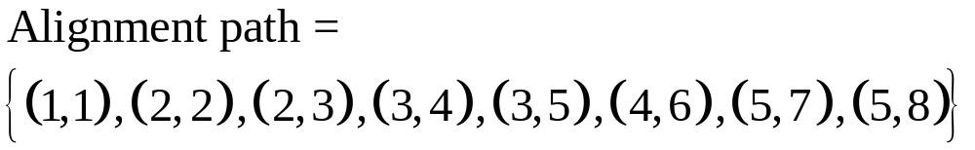
Type-2 DTW: Alignment Constraints
Temporal constraints
Alignment constraints
  1-to-1, 1-to-many, or many-to-1 mapping
  No skips at all
x1
x2
x3
x4
x5
y1
y2
y3
y4
y5
y6
y7
y8

Slide 10
Type-2 DTW: Alignment Path
Alignment path
j
x1
x2
x3
x4
x5
8
7
y1
y2
y3
y4
y5
y6
y7
y8
6
5
4
3
2
1
i
1
2
3
4
5

Slide 11
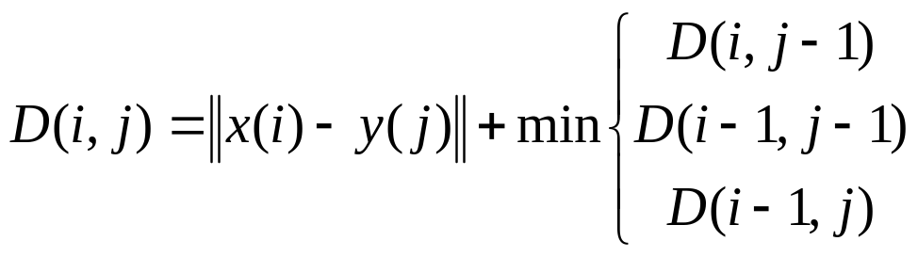


Type-1 DTW: Local Path Constraints
0-45-90 local paths

Slide 12
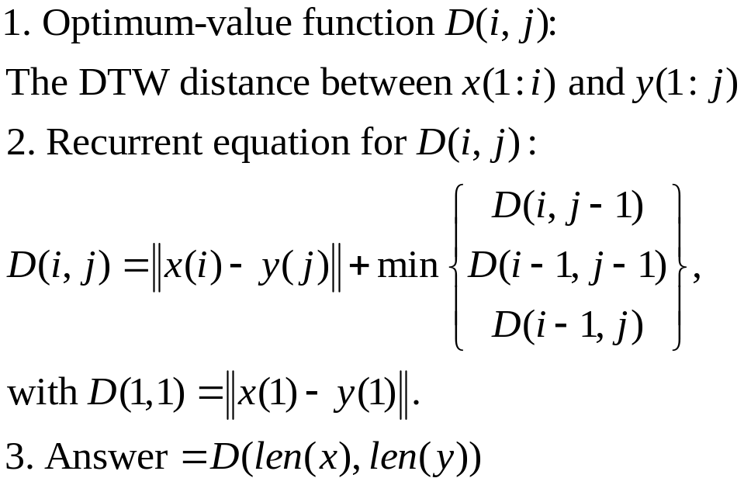
Type-2 DTW: 3-Step DP Formula
x, y: input vector/matrix
Local paths: 0-45-90 degrees
3-step DP formulation:
j
Quiz!
y(j)
y(j-1)
x(i-1)
x(i)
i

Slide 13
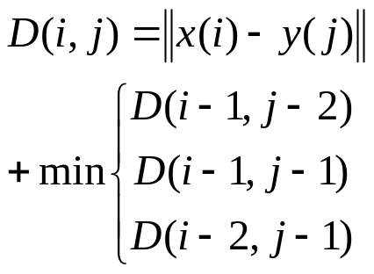
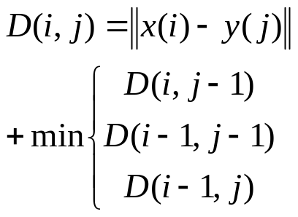
Comparison of Local Path Constraints
Type 1:
  27-45-63 local paths
Type 2:
  0-45-90 local paths

Slide 14
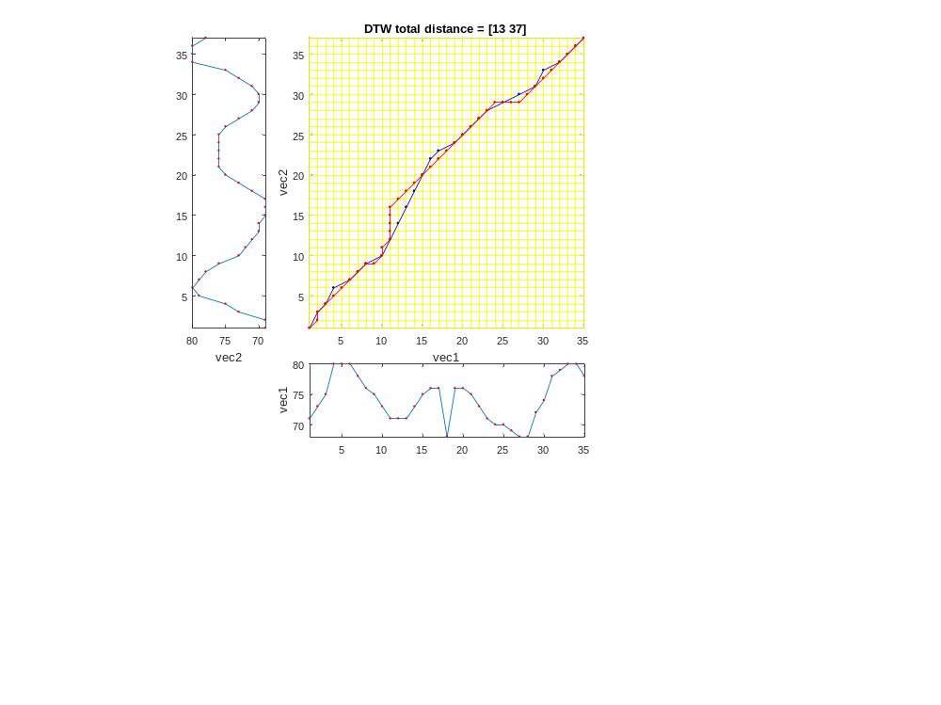
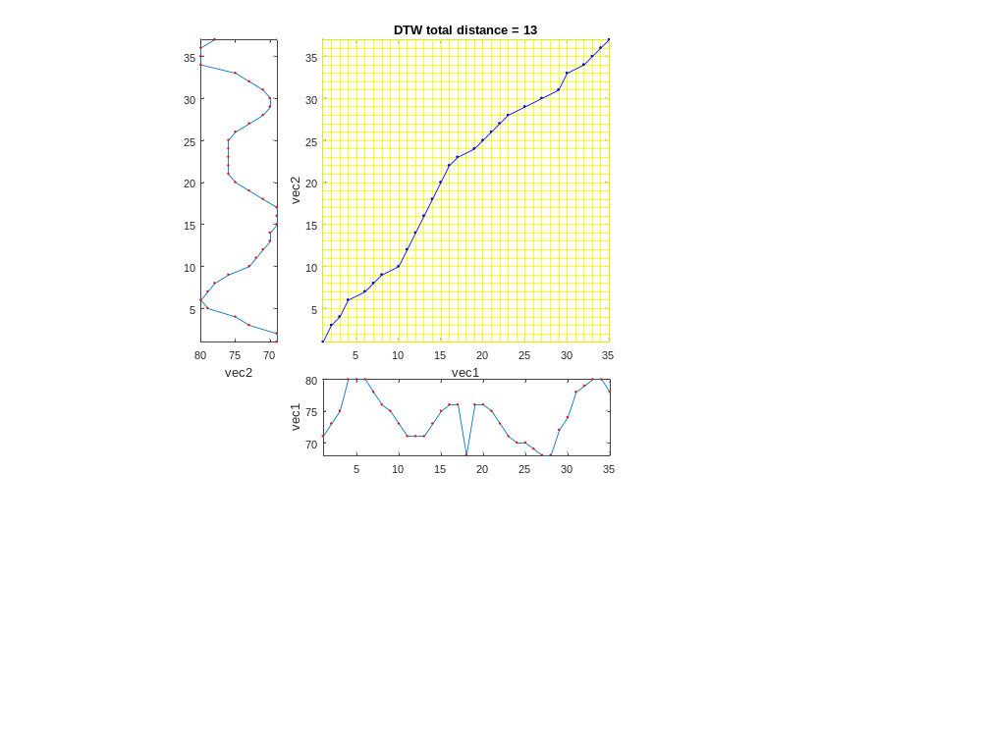
DTW Visualization via
Machine Learning Toolbox (1/2)
dtw (for type 1)
dtwPathPlot (for types 1 & 2)
0º and 90º are seldom!
45º is seldom!

Slide 15
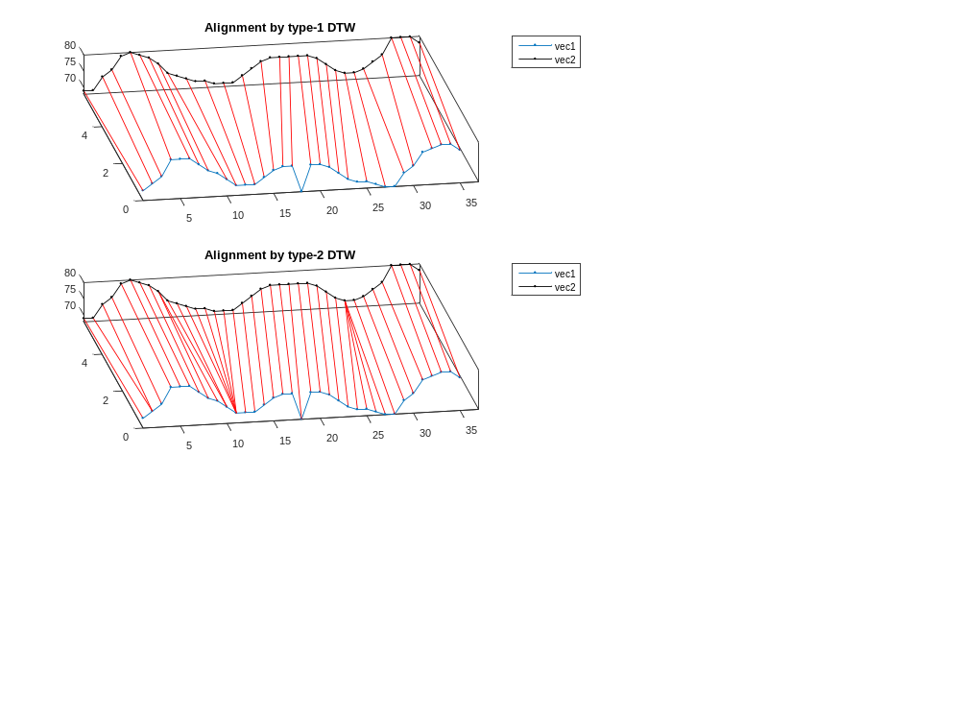
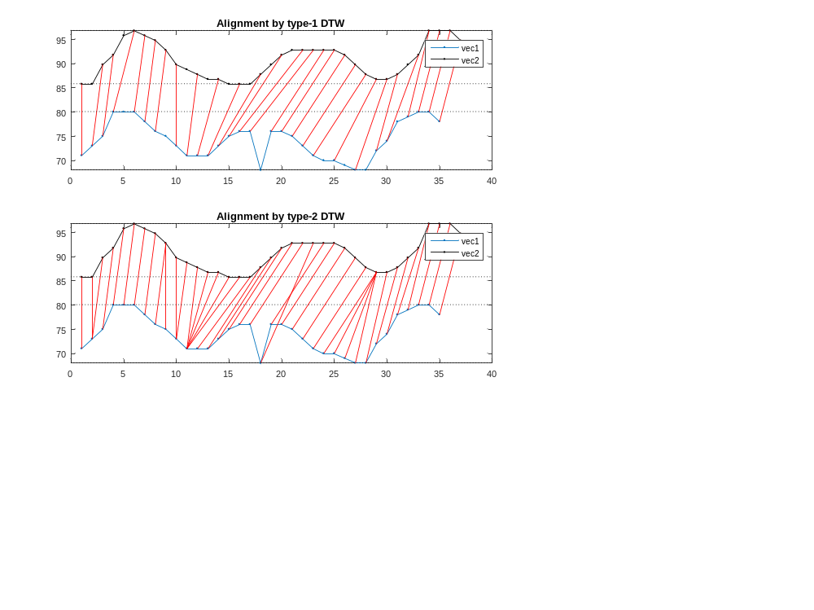
DTW Visualization via
Machine Learning Toolbox (2/2)
dtwBridgePlot
2D view
3D view
Type 1
Type 2

Slide 16

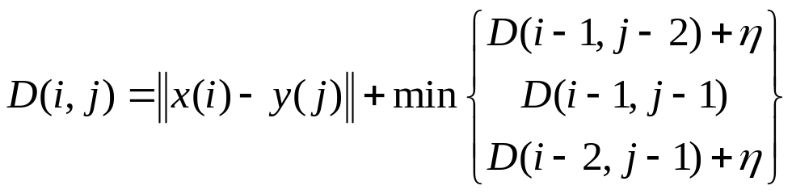

Path Penalty for Type-1 DTW
Alignment path of type-1 DTW
  45-degree paths are likely to be avoided since we are minimizing the total distance.
  So we can add penalty for paths deviated from 45-degree.

Slide 17
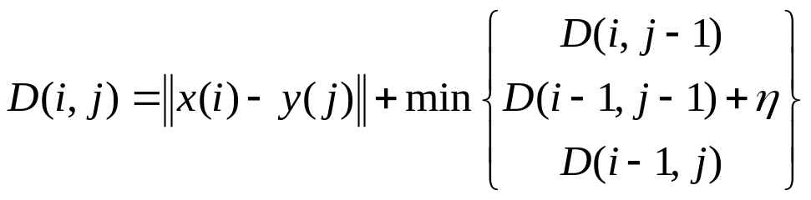
Path Penalty for Type-2 DTW
Alignment path of type-2 DTW
  45-degree paths are likely to be taken since we are minimizing the total distance.
  So we can add penalty for paths of 45-degree.

Slide 18
Comparison of Type-1 and Type-2
Time complexity is both O(mn).
Type-1 DTW is more efficient due to the global path constraint induced by local path constraints
Quiz!

Slide 19
Comparison
Quiz!
Type-1 DTW
  Tends to take 27º or 63º
  More efficient
Type-2 DTW
  Tends to take 45º
  Less efficient
Feasible region
Feasible region

Slide 20
More about DTW
Typical applications
  Speech recognition: MFCC matrices as inputs (where x(i) is the MFCC vector of frame i)
  Query by singing/humming: Pitch vectors as inputs (where x(i) is the pitch value of frame i)
Abundant variants of DTW
  Recurrent formulas
  Local path constraints
Speaker dependent!

Slide 21
Applications
Applications of DTW
  DTW for speech recognition
  DTW for query by singing/humming

