Slide 1
DTW for QBSH
J.-S Roger Jang (張智星)
http://mirlab.org/jang
MIR Lab, CSIE Dept.
National Taiwan University

Slide 2
Dynamic Time Warping (DTW)
Goal:
  Comparison with tolerance to tempo variation
Characteristics:
  Robust for irregular tempo variations
  Trial-and-error for dealing with key transposition
  Expensive in computation
  Does not conform to triangle inequality ➔ Hard to do indexing to speed up computation
  Some indexing methods available

Slide 3

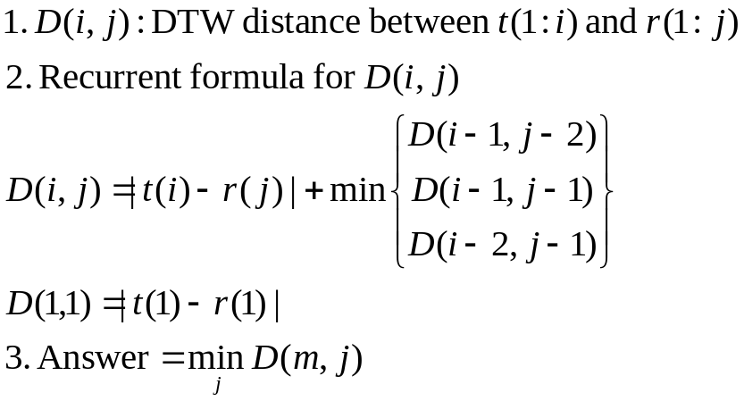
Type-1 DTW for QBSH
t: test input pitch vector (8 sec)
r: reference pitch vector
Local paths: 27-45-63 degrees
3-step formula for type-1 DTW
(with anchored beginning)
j
r(j)
r(j-1)
Database
t(i-1)
t(i)
i
Anchored beginning, free end
Query

Slide 4
Advantages of type-1 DTW for QBSH
Advantages of type-1 DTW for QBSH
  More efficient than type-2
  Can deal with spike-like noise in pitch when perform QBSH
Quiz!

Slide 5
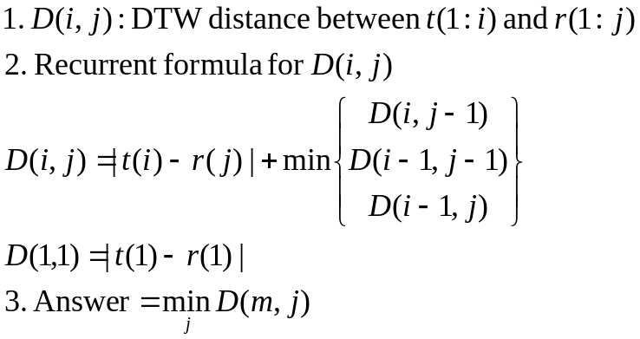
Type-2 DTW for QBSH
j
t: test input pitch vector (8 sec)
r: reference pitch vector
Local paths: 0-45-90 degrees
3-step formula for type-2 DTW
(with anchored beginning)
r(j)
r(j-1)
Database
t(i-1)
t(i)
i
Anchored beginning, free end
Query

Slide 6
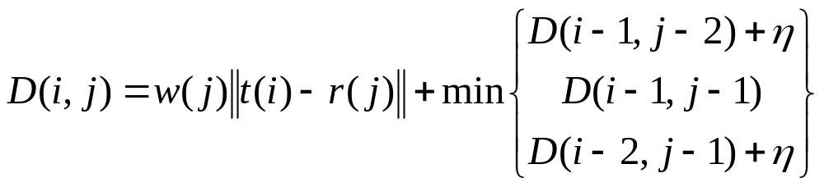



Weighted DTW Distance
觀察：
  在音符開始時，使用者的音高不穩定
  在音符後半部，使用者的音高較穩定且逼近音符音高
Weighted DTW Distance
  在音符開始時，權重函數 w(j) 較小
  在音符後半部，權重函數 w(j) 較大

Slide 7
Feasible Region of Type-1 DTW of “Anchored Beginning”
Anchored beginning & free end: Only the end position is free to move
Assumption: a user’s input tempo falls within 1/2 and 2 times of that of the intended song.
DTW table size for 8-sec query = 250x375
  250 = 31.25x8
  375 = 250x1.5
j
Quiz!
Feasible
region
i

Slide 8
Feasible Region of Type-1 DTW of “Free beginning”
Free beginning & free end: Both ends are free to move.
DTW table size for 8-sec query against 3-min song = 250x5620
  250 = 31.25x8
  5620 = 31.25x180
j
Quiz!
Feasible
region
i

Slide 9
4
2
1
3
4
2
5
4
0
1
5
Quiz!
7
2
0
1
5
6
0
8
6
5
1
0
6
8
6
5
1
0
6
2
0
1
5
6
0
3
1
0
4
5
1
4
2
1
3
4
2
1
1
2
6
7
1
2
3
7
8
2

Slide 10
4
2
1
3
4
2
2
7
5
4
0
1
5
0
4
6
2
0
1
5
6
0
0
7
10
7
1
8
6
5
1
0
6
6
5
3
1
7
8
6
5
1
0
6
6
5
1
2
12
2
0
1
5
6
0
0
2
6
7
6
3
1
0
4
5
1
1
1
6
7
5
4
2
1
3
4
2
2
2
4
1
1
2
6
7
1
1
2
3
7
8
2

Slide 11




DTW程式碼解說
j
D(i,j)的計算：
11
10
9
8
7
6
5
4
}Two-element layer
3
2
1
0
i
0
1
2
3
4
0
5
6
7
8
9

Slide 12
Implementation Issues
To save memory
  Use 2-column table for type-1 DTW
  Use 1-column table for type-2 DTW
To avoid if-then statements in loop
  Pad type-1 DTW with two-layer
  Pad type-2 DTW with one-layer
To find a suitable path
  Minimize total distance
  Minimize average distance ➔ Harder!

Slide 13
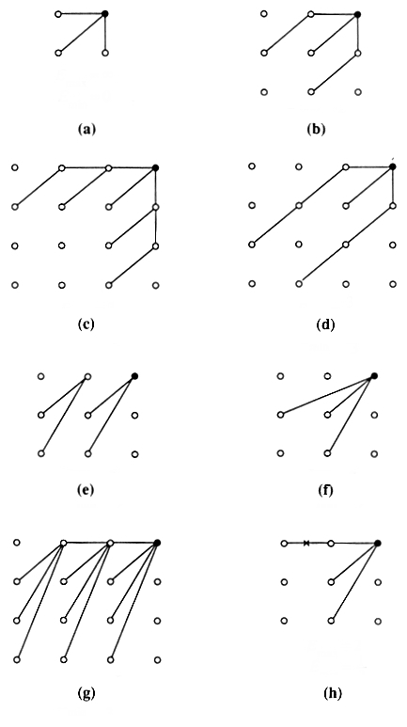
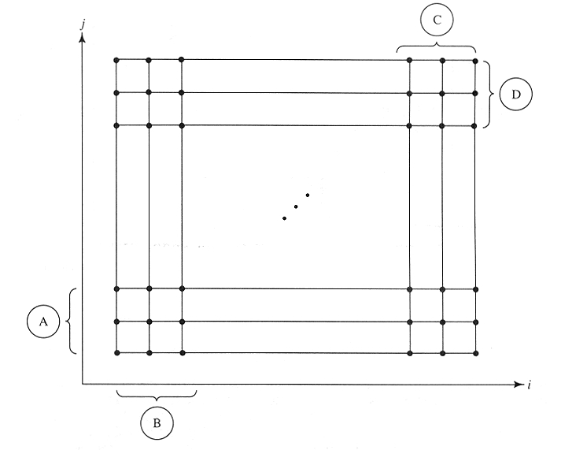
Other Variants
Local path constraints
Flexible start & ending pos.
Type 2
Type 1

Slide 14
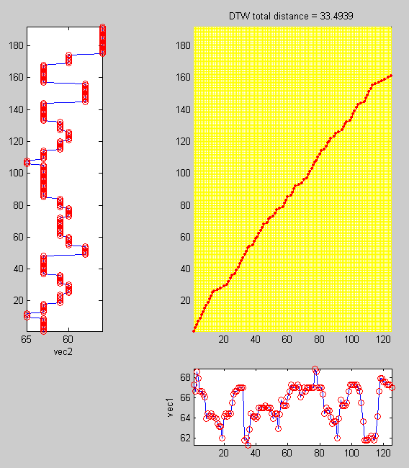


Type-1 DTW Path of
“Anchored Beginning”

Slide 15
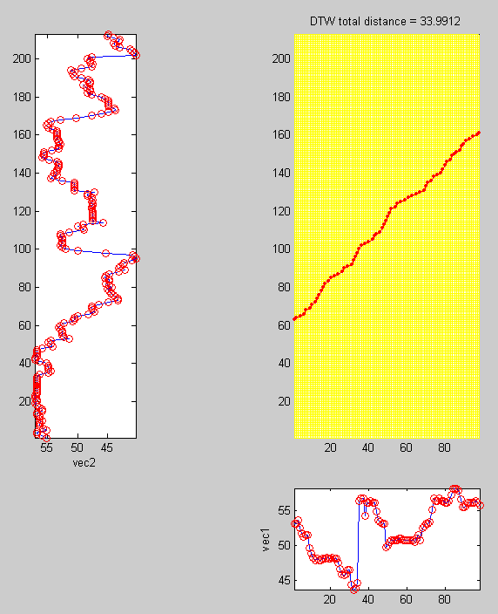
Type-1 DTW Path of
“Free Beginning”

Slide 16
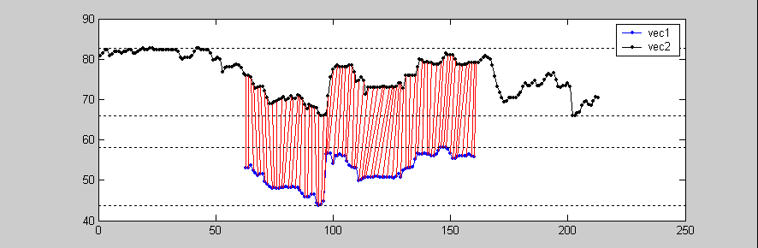
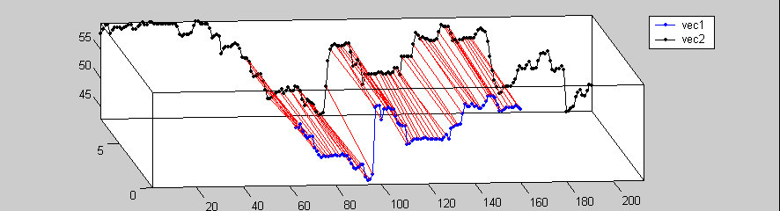
Another Two Views of DTW Path of “Free Beginning”

Slide 17
Demos of DTW
Match beginning
  toolbox/dcpr/dtw/goDemoMelodyPath01.m
Match anywhere
  toolbox/dcpr/dtw/goDemoMelodyPath02.m
Alignment and note segmentation
  Toolbox/dcpr/dtw/goDemoNoteCut.m

Slide 18
Key Transposition (1/2)
Goal:
  Allow users’ input of different keys
Method 1: Line minimization
  Mean shift and heuristic modification
  5 DTW computation when compared to each song
t+2
(t’)
t-2
t
t’-1
t’+1
Mean
-4
-2
0
1
2
3
4

Slide 19
Key Transposition (2/2)
Method 2: Fixed point iteration
  Step 1: DTW alignment
  Step 2: Stop if mapping path fixed
  Step 3: Shift to the same mean based on the alignment
  Step 4: Go back to step 2.
Characteristics
  DTW distance monotonically non-increasing to guarantee convergence

Slide 20
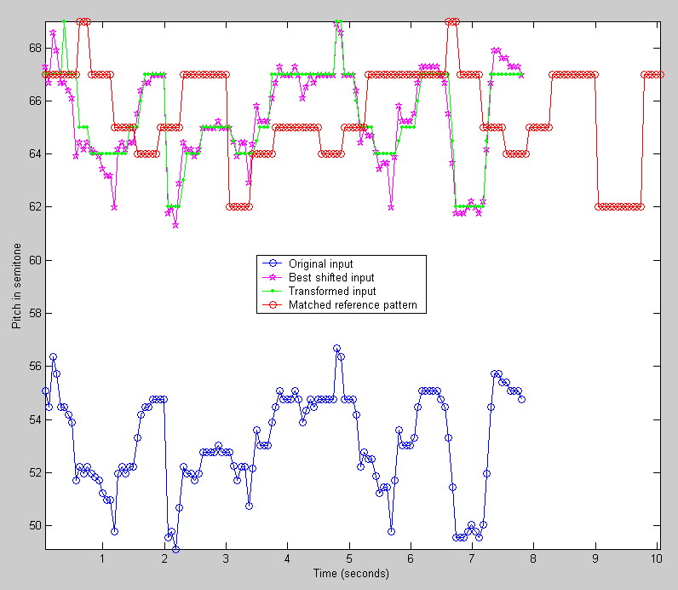
Example of Key Transposition

Slide 21
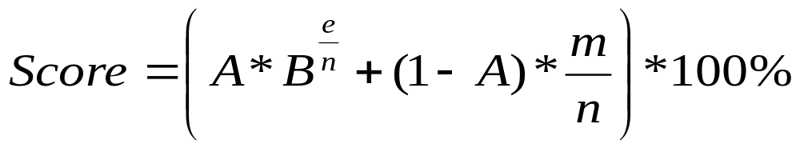
Score Function
Score function
    m : length of matched string
    n : length of input string
    e : DTW distance
    A = 0.8
    B = 0.6

Slide 22
DTW Demos
Match corners with key transposition:
  toolbox/dtw/demoDtwPitch.m

Slide 23



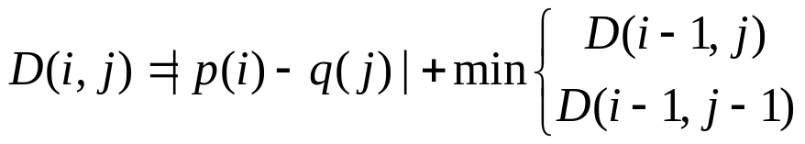
Type-3 DTW:
Frame to Note Alignment
DP-based method for filling the table:
Alignment path:
65
Local path constraint:
62
65
Music notes q in DB
64
67
Frame-level pitch vector p
Note duration
Is not used.
Recurrent formula:

Slide 24
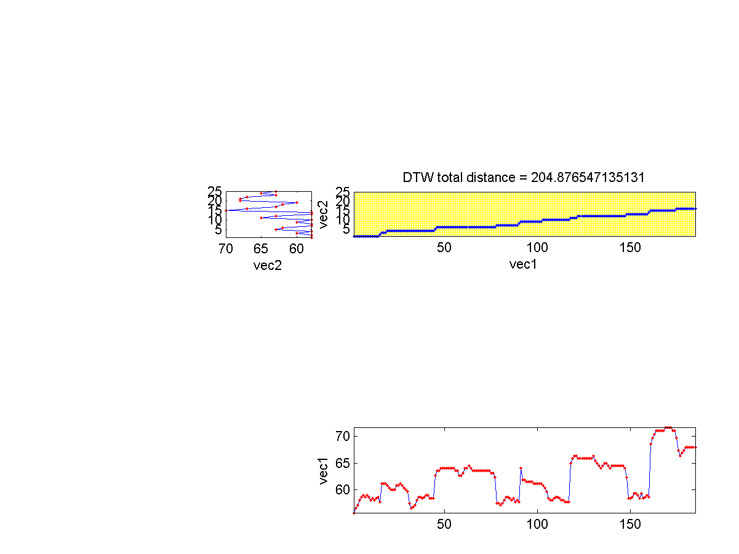
Type-3 DTW
Characteristics
  Frame-based query input vs. note-based music database
  Note duration not used
  More efficient, less effective
  Heuristics for key-transposition
Mapping path

Slide 25
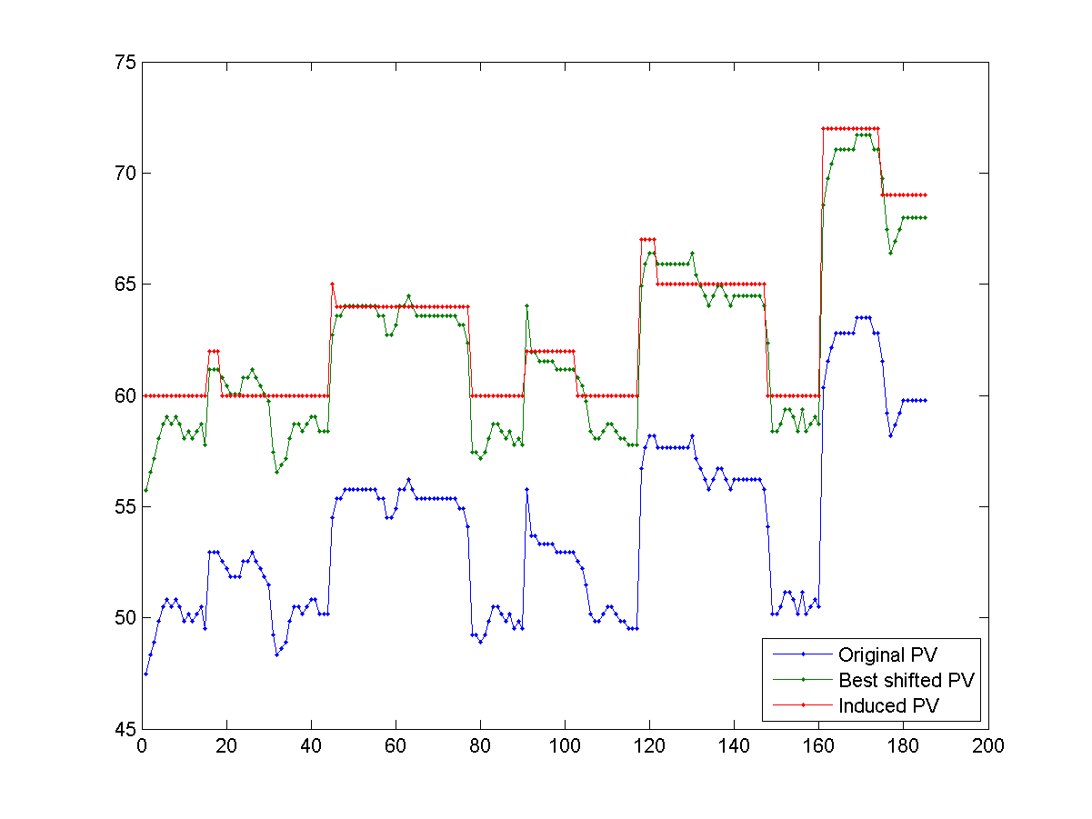
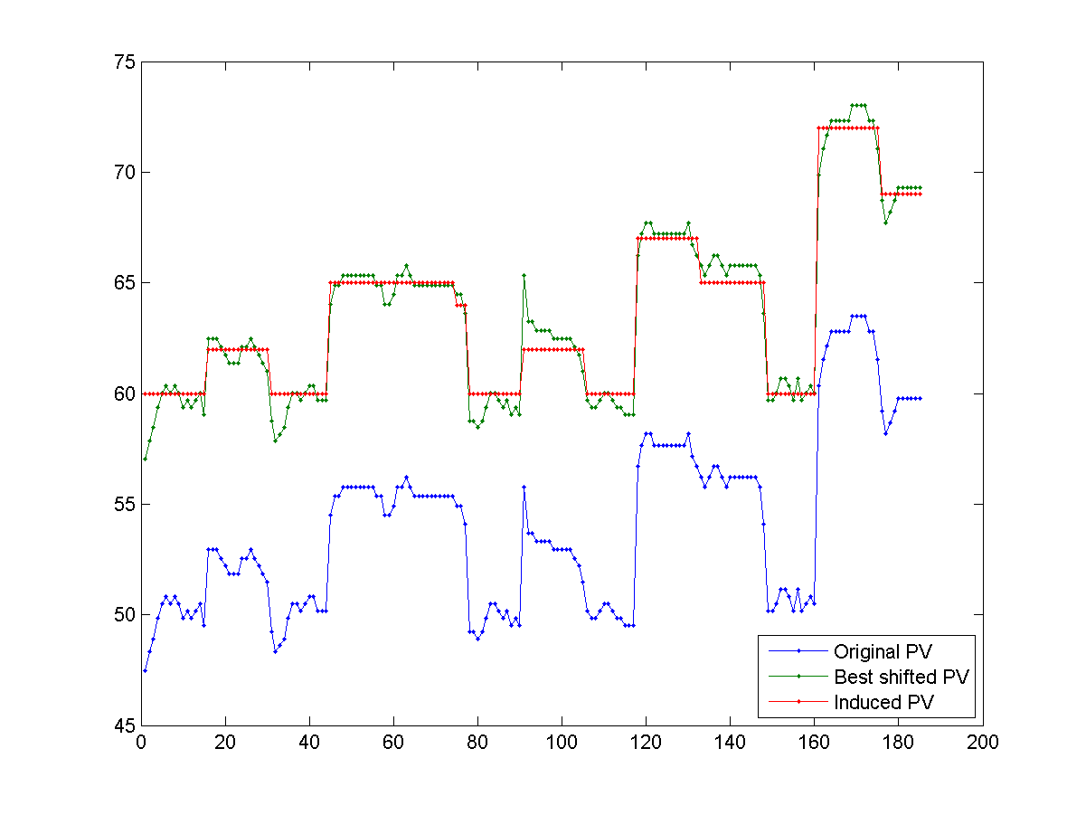
Type-3 DTW:
Effects of Key Transposition
Rough key transpos.
Fine key transpos.
Please refer to the online tutorial page for playback.

