Slide 1
Wine or
Leaving Windows Behind?
Bring your apps with you!
Dan Kegel
Cebit 2009
Very hyperlinked presentation online at www.kegel.com/cebit
The opinions expressed in this talk are my own, and not those of my employer
Pay attention, there will be a quiz at the end

Slide 2
The world is changing...
Linux spreading beyond servers

Slide 3
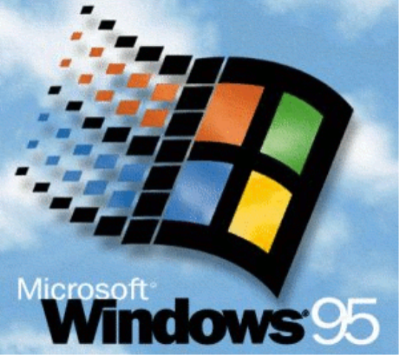
The world fell in love with Windows in 1995...

Slide 4
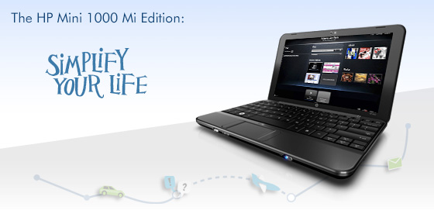
But now HP uses Ubuntu Linux on the $280 Mini Mi netbook

Slide 5

And Dell uses Ubuntu Linux on the $250 Mini 9n netbook

Slide 6

Why did Dell and HP choose Linux?
Isn't it geeky and hard to use?

Slide 7
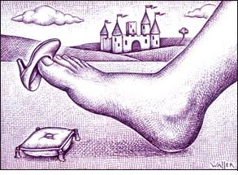
Windows Vista doesn't fit on most netbooks

Slide 8

Windows costs netbook vendors $20-$50 per unit which hurts their bottom line

Slide 9

Microsoft limits Windows netbooks to
1GB RAM, 1GHz CPU
10.2” Screen, no DirectX 10
to protect sales of more expensive computers

Slide 10


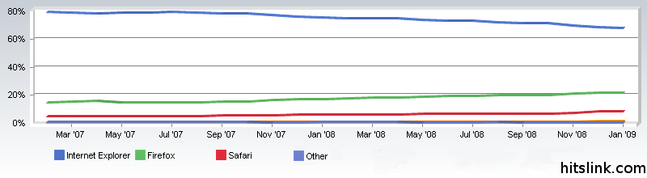
Windows-only websites used to be common, but Firefox and Webkit are making that rare

Slide 11

Linux now easy to use thanks to vendors like Ubuntu

Slide 12

Linux now comes with a capable free office suite

Slide 13
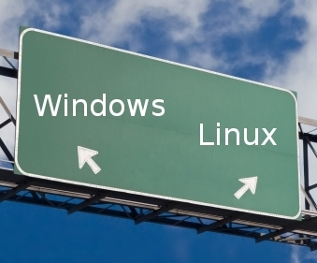
But why should you try Linux?

Slide 14
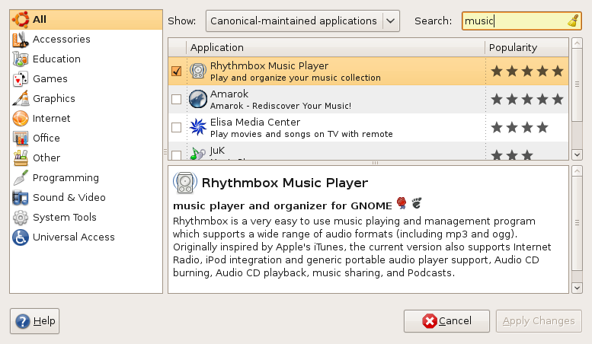
Linux comes with thousands of apps and free updates

Slide 15

You're free to install Linux wherever and whenever you like

Slide 16
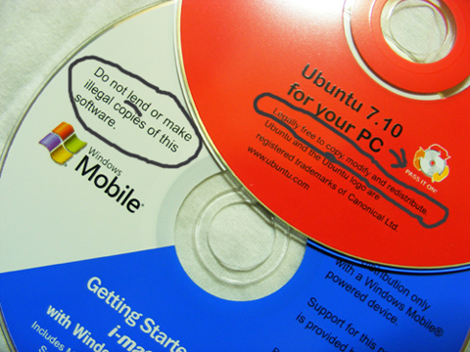
You're even encouraged to share Linux with your friends

Slide 17

Any programmer in the world can fix or improve Linux

Slide 18

Linux upgrades never forced
New versions of Ubuntu always free

Slide 19

Linux has ~1% as many viruses

Slide 20




Munich, Niedersachsen, France, Spain,
China, Russia, Brazil are using desktop Linux
Reasons: flexibility, independence, cost

Slide 21

OK, I'm convinced, I should try Linux.
But there's just one more thing:

Slide 22
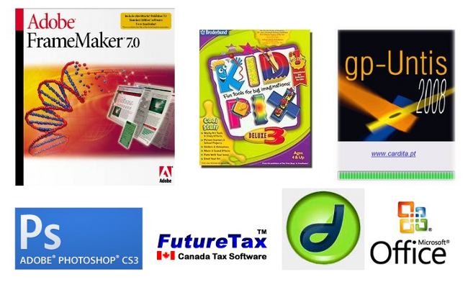
I need this one app, can I take it with me?

Slide 23

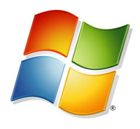
You could use VMWare and Windows, but then you still have to deal with Windows licensing and upgrades

Slide 24
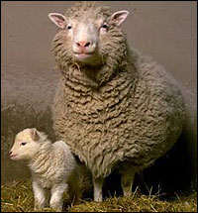
Linux cloned Unix
Can't we clone Windows, too?

Slide 25
Under construction
See html presentation for rest

