Slide 1
Wine or
Leaving Windows Behind?
Bring your apps with you!
Dan Kegel
Cebit 2009
Very hyperlinked presentation online at www.kegel.com/cebit
The opinions expressed in this talk are my own, and not those of my employer
Pay attention, there will be a quiz at the end

Slide 2
The world is changing...

Slide 3

For decades, it was hard to imagine life without Windows, but now...

Slide 4
People are switching to the Mac

Slide 5
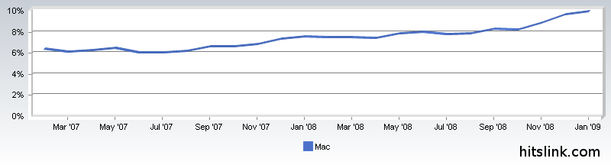
Mac now has 10% of the market

Slide 6
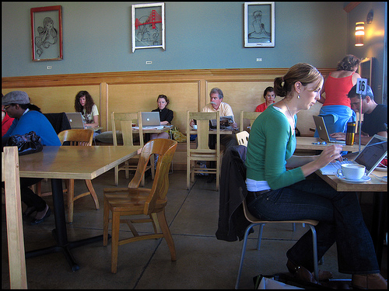
Coffee lovers seem to like the Mac

Slide 7
People are switching to
Open Source

Slide 8


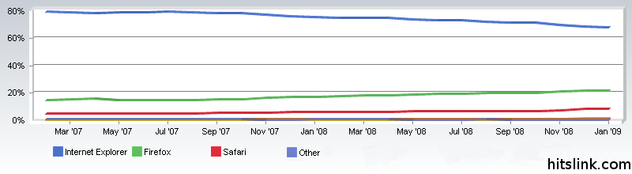
Firefox/Webkit/Safari have 30% of the market, up from 25% last year

Slide 9

OpenOffice has 2.5 million downloads per day
That's 3% of Microsoft Office's installed base per week

