Slide 1
PHY-Layer Spoofing Detection Through Reinforcement Learning
“PHY-Layer Spoofing Detection With Reinforcement Learning in Wireless Networks,” Liang Xiao (Chinese Academy of Sciences), et. al.
Presentation by Kevin Liu and Winfred Darko (Princeton University)

Slide 2

Who are we?
We are rising third-year students
We are here through the International Research Exchange Program (REACH)

Slide 3
Current Insecurities with Spoofing Detection
Spoofers can imitate identity of a legitimate receiving router, interfering with transmission of data
PHY-layer authentication can exploit radio channel information to detect spoofing attacks, but difficult for receiver to choose proper test threshold in a dynamic environment
How can we detect spoofers in a dynamic environment?
Notes:
Currently, wireless networks are vulnerable to spoofing attacks, in which a router node can claim the identity of a legitimate router, thereby interfering with the transmission of information between routers. Fortunately, there have been studies into physical layer authentication of routers, in which the physical characteristics of the routers, such as their channel states, are used for authentication for their legitimacy. However, the accuracy of the authentication process depends on the test threshold, which is difficult to predict without complete knowledge of the channel parameters in a dynamic radio environment in which spoofers can change their attack probabilities. So the question this paper is attempting to solve is, “How can we detect spoofers in a dynamic environment?” First we will explain the physical-layer authentication process used in this paper, and then detail the use of reinforcement learning to change the threshold in response to a dynamic environment.

Slide 4
System Model
Determine legitimacy of a router packet by hypothesis test, consisting of hypotheses H₀ accepting and H₁ rejecting the node as legitimate
Chanel vectors based upon Received Signal Strength Indicators (RSSIs)
Test statistic L as the normalized Euclidean distance between the router’s channel vector and a previously accepted channel
If the distance L is less than a test threshold x, accept packet. Otherwise reject
The detection rate depends on the threshold x, which determines the missed detection rate P_{m} and the false alarm rate P_{f}
Notes:
In this experiment, a packet’s legitimacy is determined by a hypothesis test, in which the packet is either accepted or rejected as legitimate. We compare the received signal strength of the incoming node, which is influenced by the physical location of the router, with the RSSI collected from a known legitimate packet. If the test statistic L, the normalized distance between those two vectors, is lower than the test threshold, the packet is accepted. Otherwise the packet is rejected. Because of this relationship between the statistic and the threshold, the threshold is a factor in the rate at which a node is accurately and falsely identified

Slide 5
PHY-Spoofing Detection Game
At basic level, consists of a receiver r with test threshold x ∈ [0 , ∞), and a spoofer s, with an attack frequency y ∈ [0 , 1]
Receiver chooses the test threshold to maximize its utility
Utilities of the players determined by the missed detection rate and false alarm rate, weighted with parameters relating to the gain and cost of accepting and rejecting a packet
Notes:
In this situation, there is a single receiver node with a non-negative test threshold, and a spoofer with a variable attack frequency. The goal is for the receiver to maximize its utility, which is determined by the missed detection rate and the false alarm rate, alongside constant weights that determine the impact of these rates

Slide 6
Reinforcement learning
Agent
State s_{n}
Reward (utility)
Action
Environment

Slide 7
The algorithm (Q-learning)
Observe current state, s_{n}
Select threshold, x_{n} from Q(s_{n}, x_{n})
Authenticate MAC address
Calculate test statistic and compare to threshold to accept/reject
Update Q(s_{n}, x_{n}) with receiver utility
Observe s_{n+1} and receiver utility

Slide 8
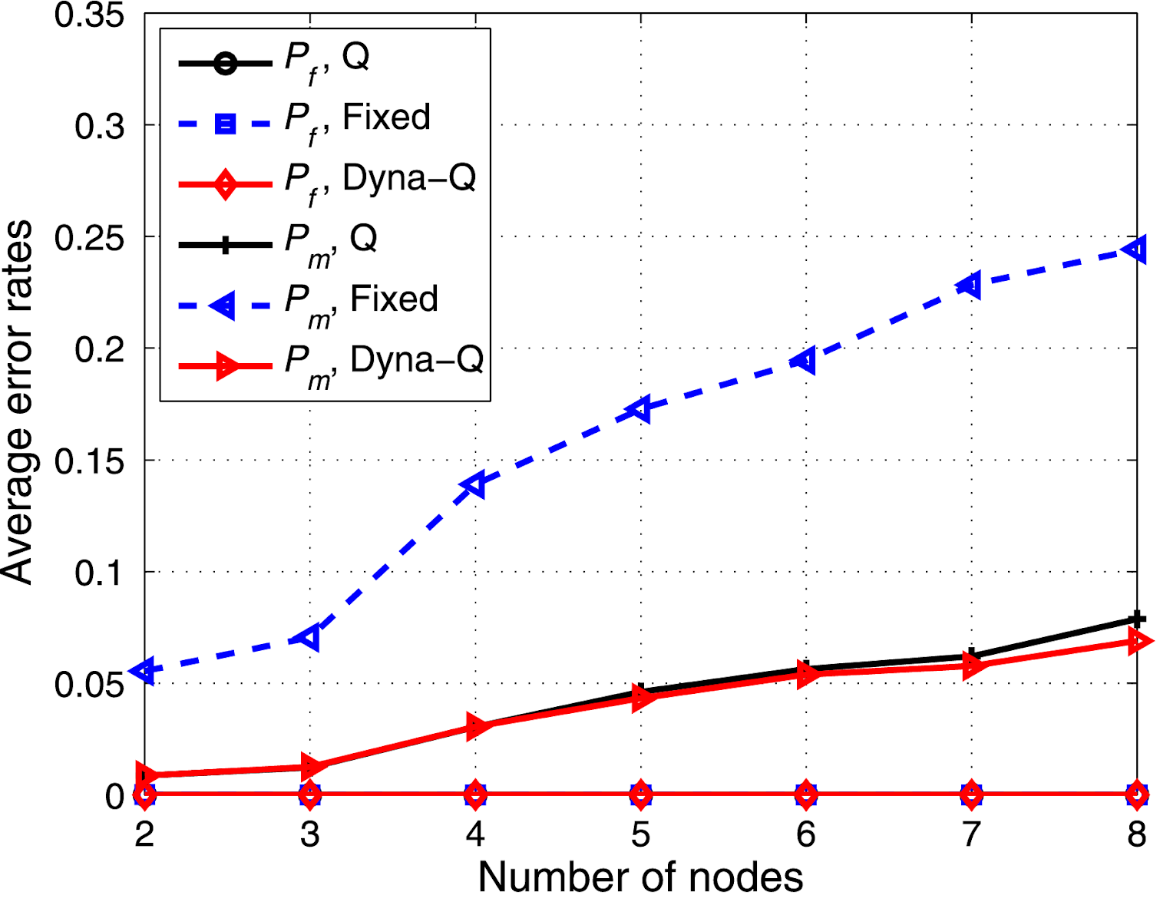
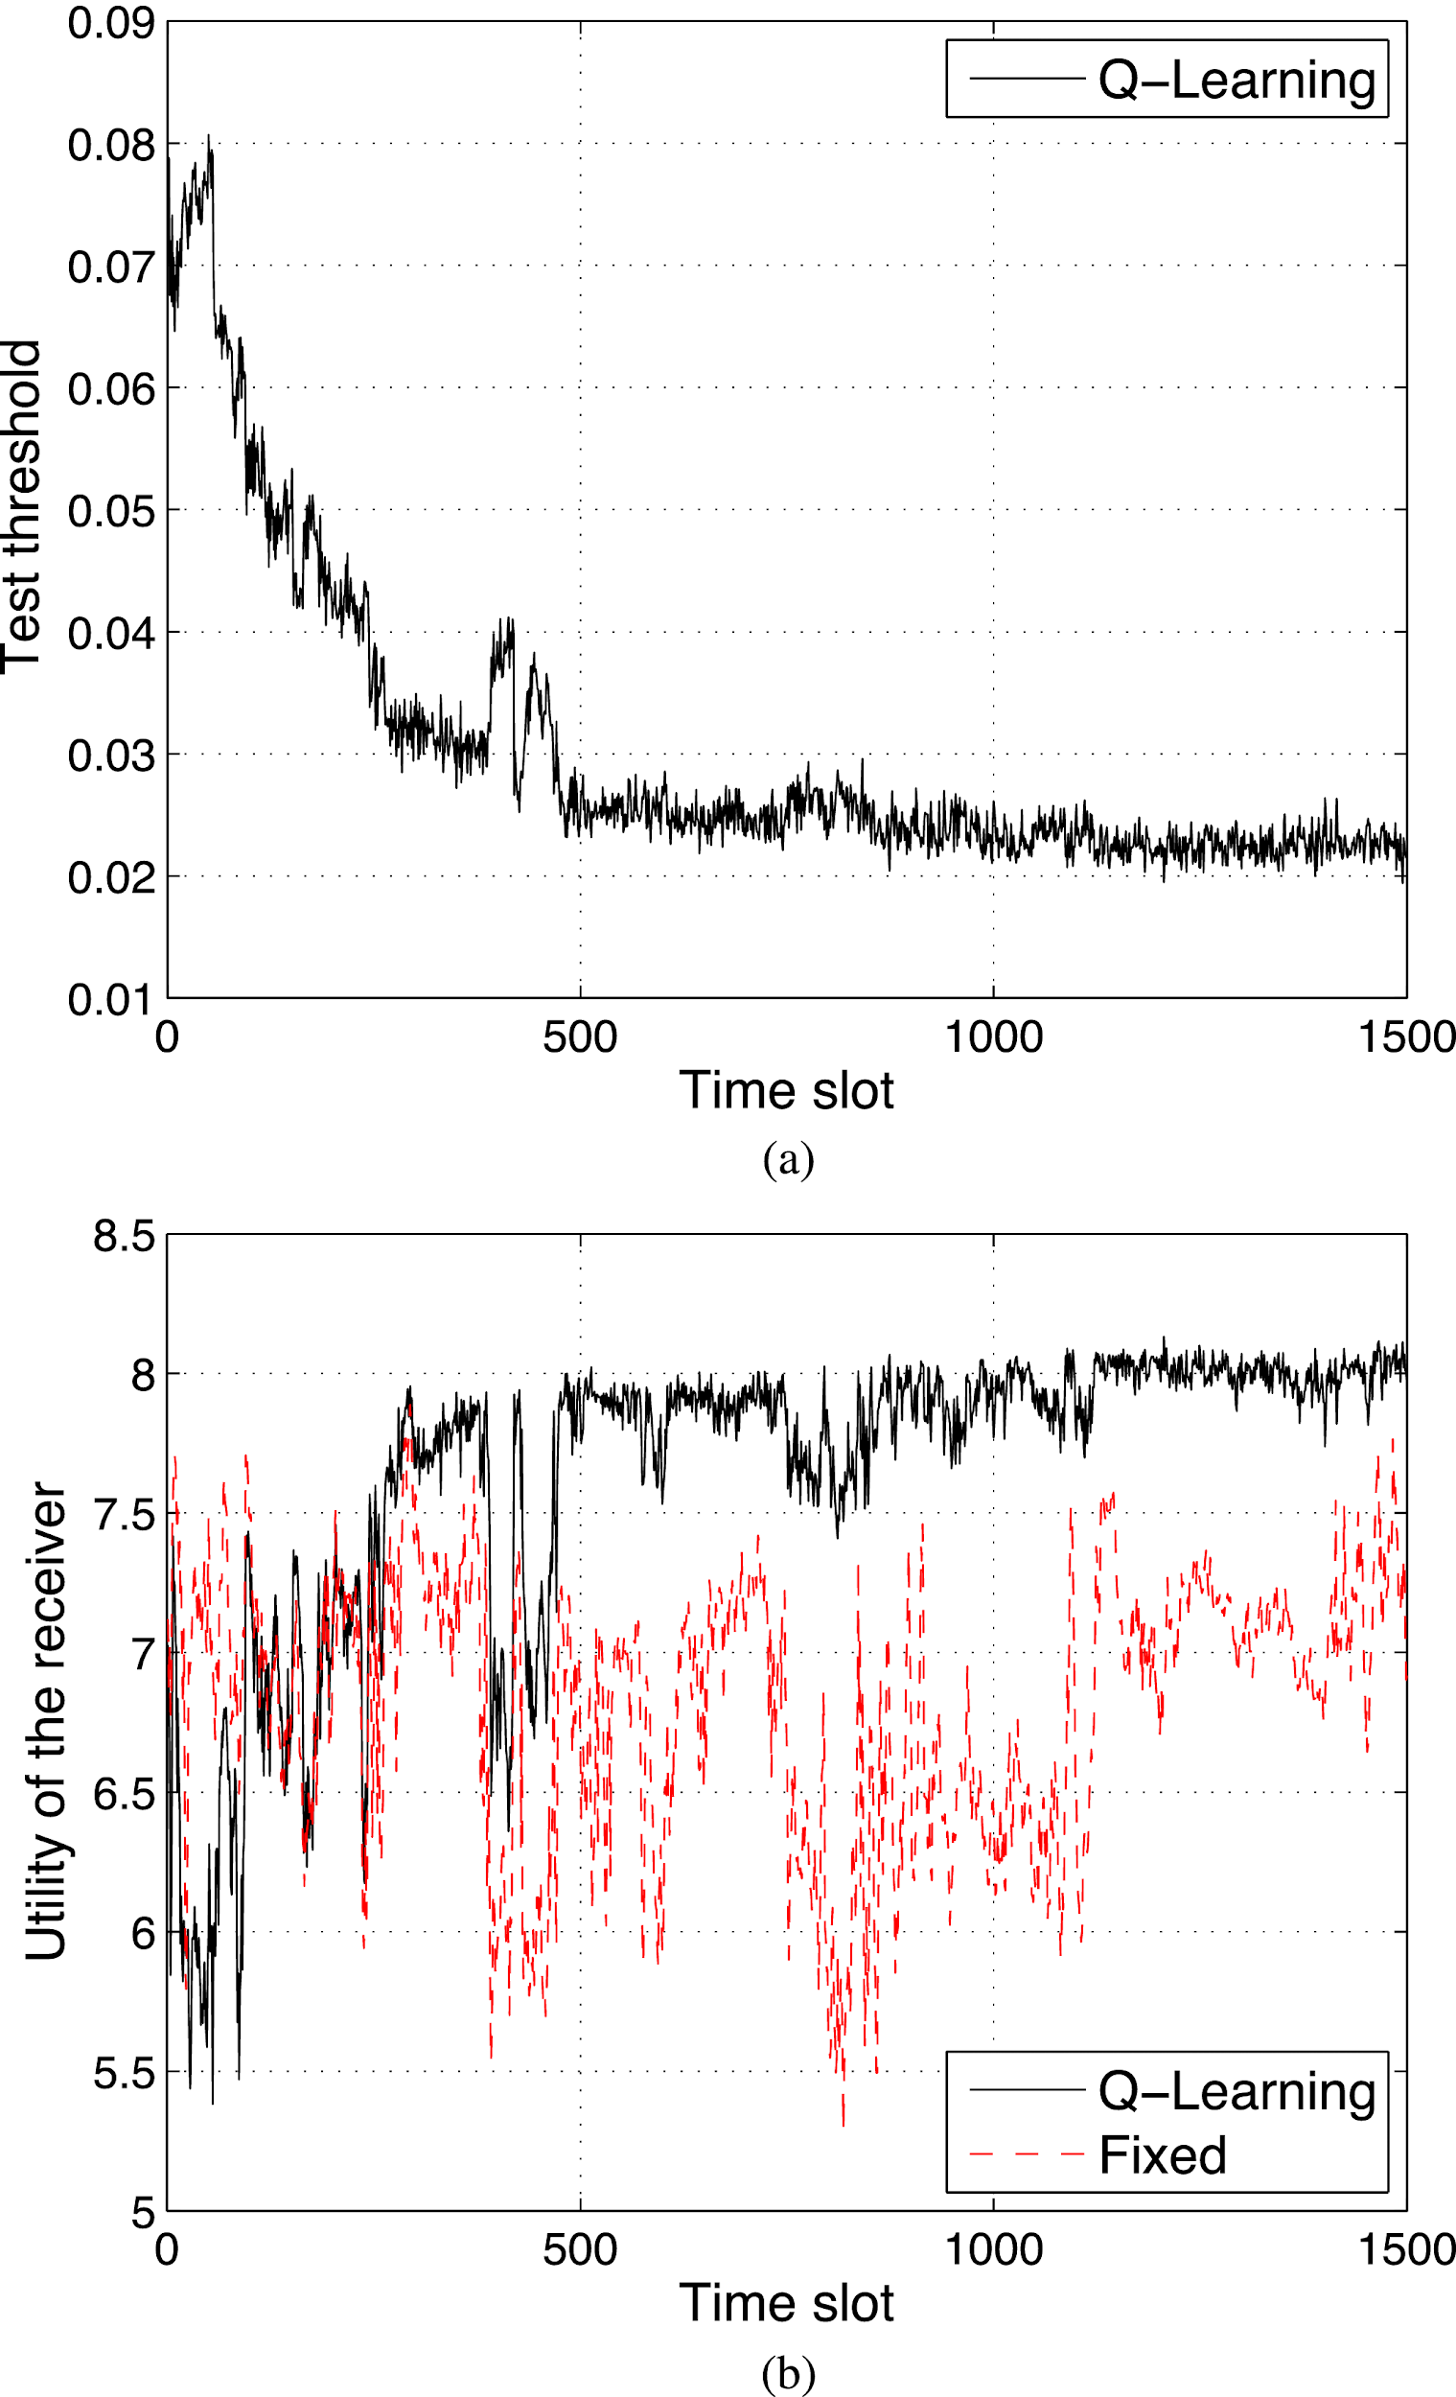
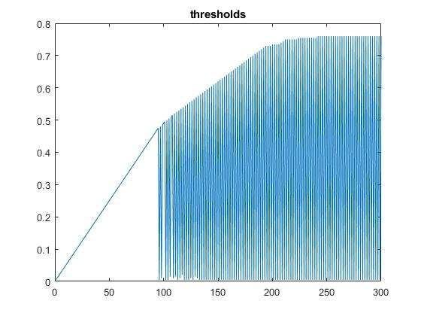
Experimental results
Test threshold
Error rates
Results from paper
Our results
Why does our implementation not converge?

Slide 9
Conclusion
Overall, have
Presented interactions between a receiver and spoofers in a zero-sum spoofing detection game
Used a PHY-authentication method based on Q-learning to handle a dynamic radio environment
Simulated results to examine how spoofing detection is robust
Can be applied to
Confirming secure transmission of data between routers
Internet of Things (IoT) devices
Notes:
In this experiment, we have… This process of confirming the the secure transmission of data between nodes can be applied to the growing number of internet devices both in the home and elsewhere

Slide 10
Thank you
We would like to give thanks to Hendrik Vogt, Kevin Ramm, Professor Aydin Sezgin, and everyone else who assisted us in this project

