Slide 1
手寫數字辨識
報告人：周哲煒

Slide 2
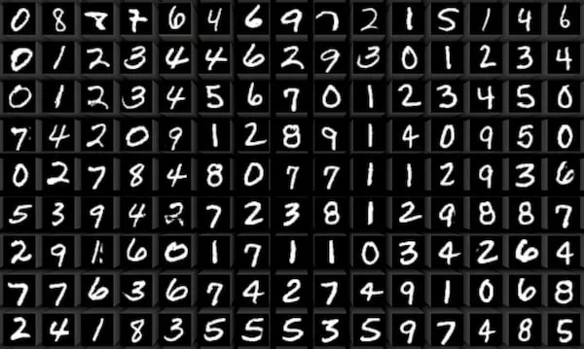
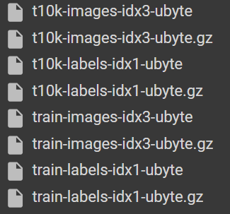


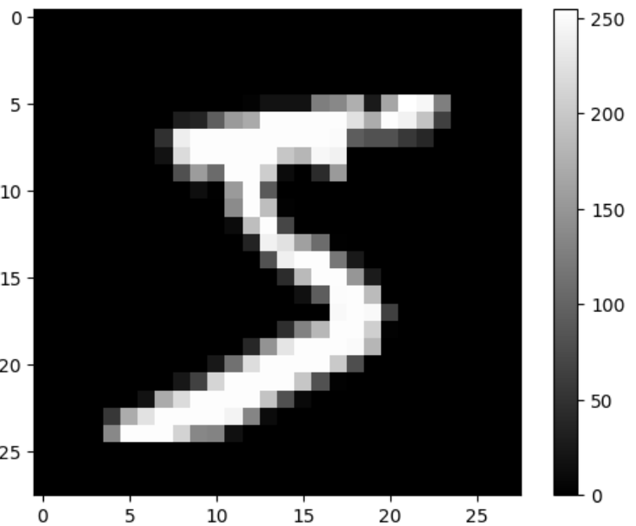

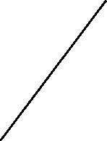

數據集
0,1,2,3,4,5,6,7,9

Slide 3
CNN結構
Conv(1,16)
ReLU
Maxpool(2*2)
Conv(16,32)
ReLU
Maxpool(2*2)
Linear(32*7*7,10)

Slide 4
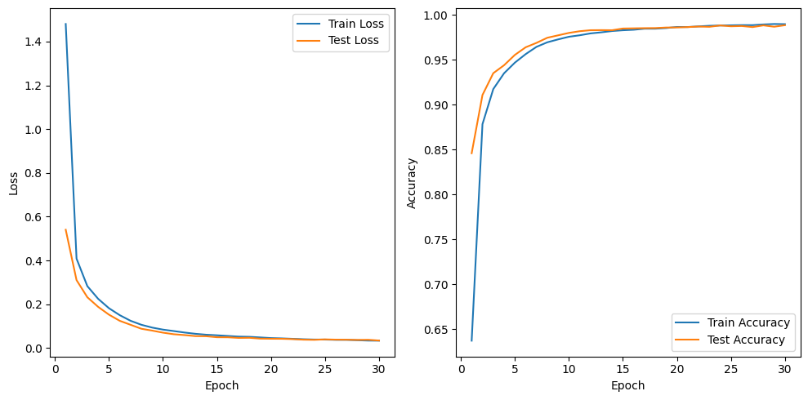
Learning curve & Loss curve

Slide 5
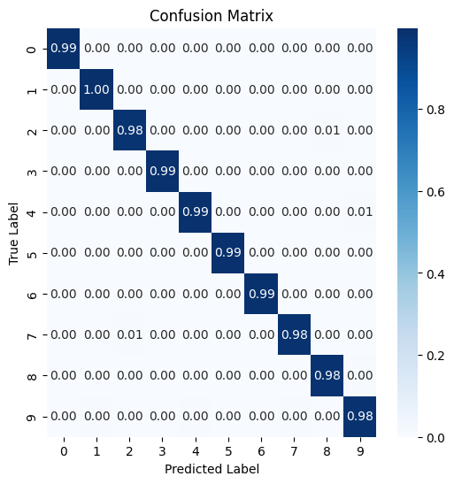
Confusion matrix
Number | Index
0 | 0
1 | 1
2 | 2
3 | 3
4 | 4
5 | 5
6 | 6
7 | 7
8 | 8
9 | 9

Slide 6

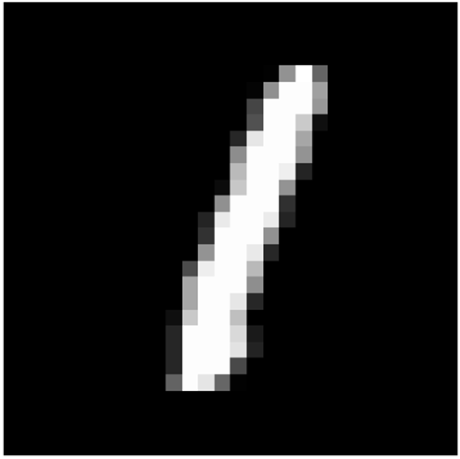

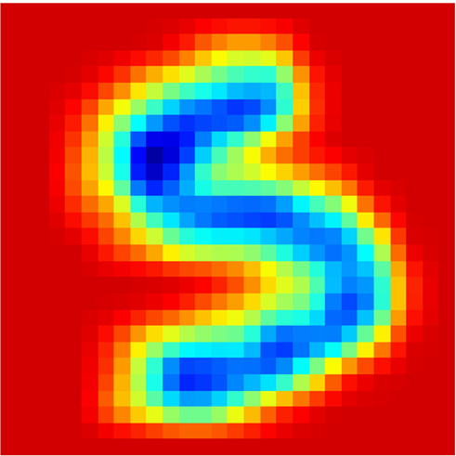
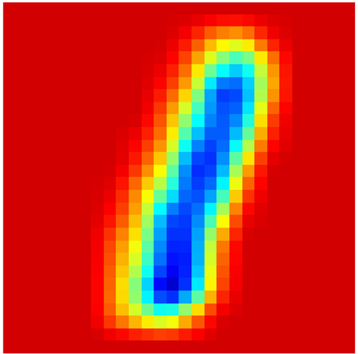
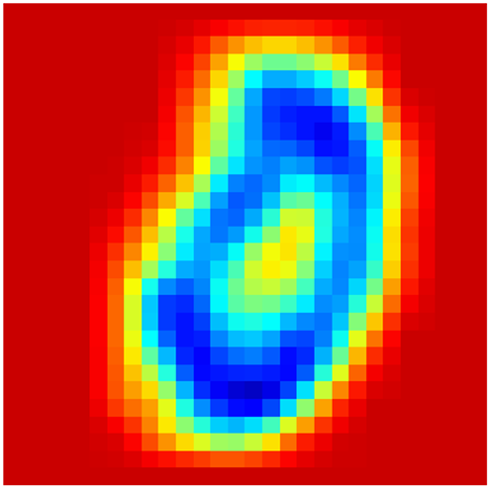
Gradcam

Slide 7


