Slide 1
HCI
The Paper Reading and HCI Survey
2351299 王雷
2354400 李昊天

Slide 2
03
04
04
02
01
Content
Paper Reading
Enhancing UX Evaluation Through Collaboration with Conversational AI Assistants: Effects of Proactive Dialogue and Timing
Reference
Conclusion
Introduction
HCI Survey
On Virtual Reality
The Comprehensive Overview and Detailed
Information Presented in the Research

Slide 3
01
02
03
04
Introduction
HCI Survey
On Virtual Reality
Paper Reading
Enhancing UX Evaluation Through Collaboration with Conversational AI Assistants: Effects of Proactive Dialogue and Timing
Reference

Slide 4
Introduction
01

Slide 5
Virtual Reality Interaction
Technology Development
HCI Survey
Paper Reading
Enhancing UX Evaluation Through Collaboration with Conversational AI
Assistants: Effects of Proactive Dialogue and Timing

Slide 6
HCI Survey
02

Slide 7
What VR Exactly Is
Ivan Sutherland (1965)
Ultimate Display
Theory Implematation
First HMD(Human Mobile Devices) (1968)
Immersion Interaction Imagination

Slide 8
What is the
Interaction
Of Virtual Reality
Vision:
Most important for structuring a world
Hearing:
Clear audio enhances virtual world’s realism

Slide 9
What is the
Interaction
Of Virtual Reality
Vision:
Most important for structuring a world
Hearing:
Clear audio enhances virtual world’s realism

Slide 10
What is the
Interaction
Of Virtual Reality
Vision:
Most important for structuring a world
Hearing:
Clear audio enhances virtual world’s realism
Touch:
The essence of Virtual Reality lies in
direct interaction

Slide 11
What is the
Interaction
Of Virtual Reality
Vision:
Most important for structuring a world
Hearing:
Clear audio enhances virtual world’s realism
Touch:
The essence of Virtual Reality lies in
direct interaction

Slide 12
Current Challenges
Hardware Limitation:
Enhancing the integration between human and virtual environments
Limited realism and discomfort
Content Gaps:
Focusing On the Personalization
Totalitarianism: definitely new system
High Cost:
Cost Reduction and Device Optimization
Hard to afford for devices

Slide 13
Paper Reading
03

Slide 14
Enhancing UX Evaluation Through Collaboration with Conversational AI Assistants: Effects of Proactive Dialogue and Timing
Emily Kuang, Minghao Li,
Mingming Fan, and Kristen Shinohara.
Research Background
Explore the value of proactive AI assistants in UX evaluation
Analyze the impact of suggestion timing on evaluators' behavior

Slide 15
Automated Methods:
Related
Research
ML, NLP, and multimodal analysis aid UX evaluation but lack human-like intuition and contextual understanding.
Human-AI Collaboration:
Current tools rely on static visualizations, limiting evaluators' ability to interact and seek explanations.
Proactive Dialogue:
Effective in various domains, but poorly designed interactions can cause distraction or distrust.

Slide 16
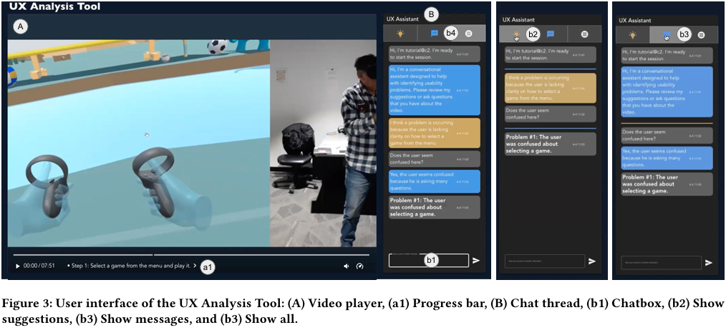
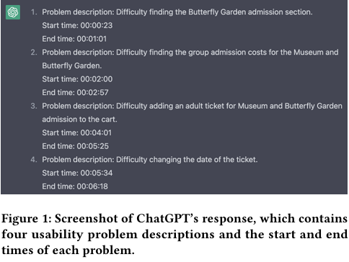
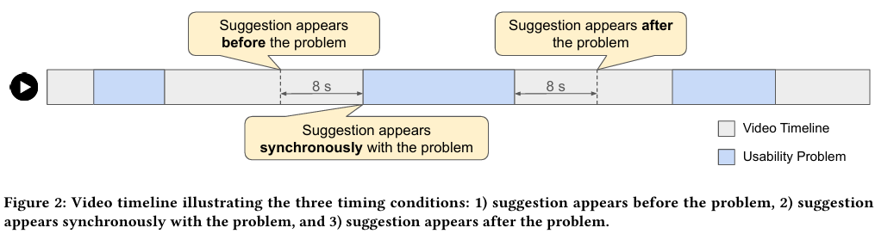
ChatGPT-Based Automated Suggestion Generation Temporal Conditioning Strategy
Research
Methods
Wizard of Oz Real-Time Response
Bimodal Interaction Interface Design

Slide 17
Research
Results
Timing of suggestions has no significant
impact on issue quantity
Post-problem suggestions significantly
improve trust and efficiency
Evaluators approved the suggestions but
thought they were not comprehensive.
High-agreement suggestions directly
confirmed, low-agreement sought clarification
With good user interaction, AI's suggestions will be more effective

Slide 18
Reference
04

Slide 19
Reference
Jiang, X., & Li, Z. (2004). 国内外虚拟现实技术的研究现状 [Research status of virtual reality technology at home and abroad]. Journal of Liaoning Technical University, 20(02), 238-240.
Zhang, F., Dai, G., & Peng, X. (2016). 虚拟现实的人机交互综述 [A review of human-computer interaction in virtual reality]. Science China: Information Sciences, 46(12), 1711-1736.
Su, J., Zhang, X., & Hu, Q. (2004). 展望虚拟现实技术 [Prospects for virtual reality technology]. Computer Simulation, 20(01), 18-21.
iMedia Research. (2024). 2024年中国虚拟现实（VR）行业研究报告 [2024 China Virtual Reality (VR) Industry Research Report]. Beijing: iMedia Research Group.
Dincelli, E., & Yayla, A. (2022). Immersive virtual reality in the age of the Metaverse: A hybrid-narrative review based on the technology affordance perspective. The Journal of Strategic Information Systems, 31(2), 101717. https://doi.org/10.1016/j.jsis.2022.101717
Rokhsaritalemi, S., Sadeghi-Niaraki, A., & Choi, S. M. (2020). A review on mixed reality: Current trends, challenges and prospects. Applied Sciences, 10(2), 636.
Mehrfard, A., Fotouhi, J., Taylor, G., & others. (2019). A comparative analysis of virtual reality head-mounted display systems. arXiv preprint arXiv:1912.02913.
Jensen, L., & Konradsen, F. (2018). A review of the use of virtual reality head-mounted displays in education and training. Education and Information Technologies, 23, 1515-1529.
Dargan, S., Bansal, S., Kumar, M., & others. (2023). Augmented reality: A comprehensive review. Archives of Computational Methods in Engineering, 30(2), 1057-1080.
Qiu, R., He, Z., Ji, F., & others. (2021). 基于人机交互的虚拟现实技术在军事中的研究综述 [A review of virtual reality technology in the military based on human-computer interaction]. Software, 42(06), 123-125.

Slide 20
Thanks for Listening
2351299 王雷
2354400 李昊天

