Slide 1
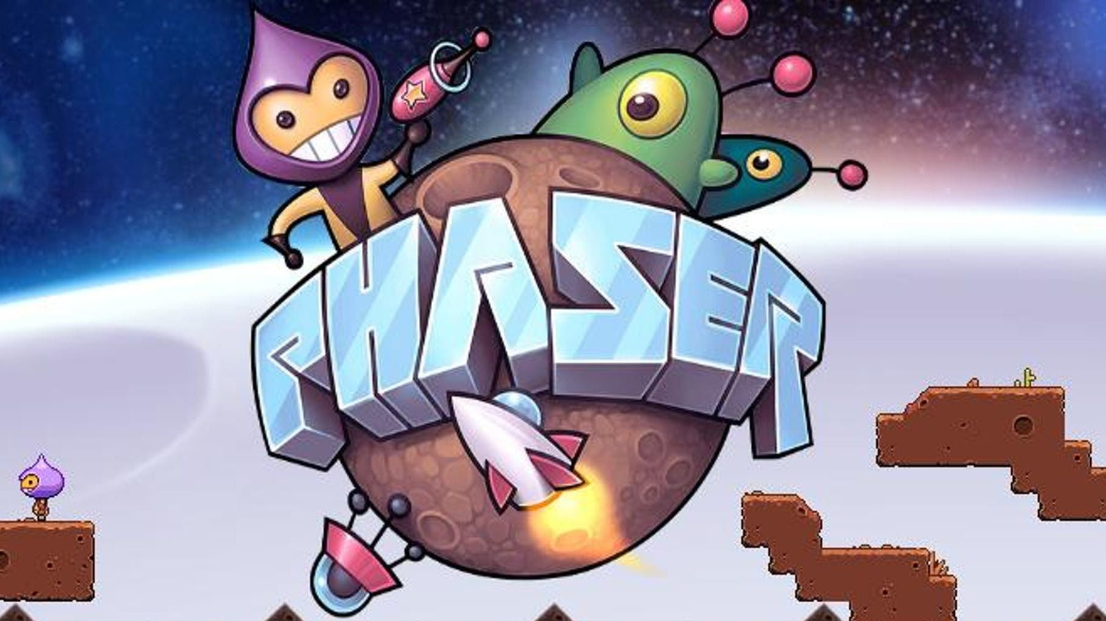

Electron & Phaser - Let's Build a Desktop+ Game
Logan Trecartin - TheCodeFrog

Slide 2
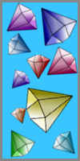
Why are we here?
ToC
Prerequisites
Computer with Node.js/npm installed.
Step 1 : Setting up Electron
Step 2 : Setting up Phaser
Step 3 : Game Code
Questions/Comments/Concerns/General Conversation/Pats on the Back

Slide 3
Logan
Who?
Developer since 2009
Started with programming classes in HS (VB, Java)
Programmer in the USAF for 4 years, completed AAS during that time.
Worked at various jobs, and with various clients, in various technologies.
Currently prefers dotnet core, react, and cross platform mobile development (Have worked with Ionic, Cordova, and Xamarin).
Current Sr. Developer for National Inventors Hall of Fame, and owner of TheCodeFrog LLC.
Disclaimer: I am not a NIHF spokesperson, any and all work, verbiage, and opinions expressed in this presentation and by me are mine alone, and do not represent those of NIHF

Slide 4
Javascript Card Match game
What?

Slide 5
Card Match
Requirements
Custom Cards (I’ve got these pre-created)
Different Screens:
Main/Menu
Game
Game over
Sounds:
Game, Title Screen, Game Over Music
Flip, Match, Not Match Sound
Animations:
Card Flips
Extra:
Different game modes
Variable card counts
Scale for variable screen resolutions
Base game Variables:
20 cards (10 pairs) : rows of 4x5
once you see a card once, the next time you have to match it to get points
10 points possible

Slide 6
Electron
Setting up Electron
Electron is a framework for creating desktop applications from web technology( js + html5 + css). I wanted something a little more than putting out games that are hosted somewhere, where you have to have an internet connection etc to see what it is, so with deciding on testing out Phaser, Electron was a natural choice.

Slide 7
Phaser 3
Setting up Electron
Phaser is an open source framework for creating games with web technology (js + html5 + css ). I've fiddled with it in the past, and wanted to make something more cool + to have a concrete example to share on how easy it is to use phaser to make games in technology that all of my developer colleagues and friends should be familiar with.

Slide 8
Step 1
Setting Up Electron
Open a new terminal
Navigate to wherever you want your project to live `cd {The_Promised_Land}`
Create a new directory where you want your project `mkdir {your_project_name}`
Open that folder in VSCode (or your environment of choice if not using VSCode) `code {your_project_name}`
Open our integrated terminal in VSCode (via the VSCode Terminal menu option or ctrl + ~ )
From here on all terminal/cmd commands are entered in the integrated terminal in VSCode

Slide 9
Step 1
Setting Up Electron
My Install methods for Electron and Phaser are going to be via npm, so when we reference the js files, we're going to reference our node_modules folder.
Install Node : https://nodejs.org/
With node installed, you should be able to run `npm init` to start a new project in your folder, run through the options in the terminal/cmd line, and after that you should have a package.json ready to go.
Install Electron https://electronjs.org/ `npm install electron`
Install Phaser https://phaser.io/ - https://phaser.io/download/stable `npm install phaser`

Slide 10
Step 1
Setting Up Electron
const { app, BrowserWindow } = require('electron')
let win
function createWindow () {
win = new BrowserWindow({
width: 1000,
height: 750,
webPreferences: {
nodeIntegration: true
},
minWidth: 1000,
minHeight: 750,
resizable: false
})
win.loadFile('index.html')
win.on('closed', () => {
win = null
})
}
app.on('ready', createWindow)
app.on('window-all-closed', () => {
if (process.platform !== 'darwin') {
app.quit()
}
})
app.on('activate', () => {
if (win === null) {
createWindow()
}
})
index.js

Slide 11
Step 1
Setting Up Electron
index.html
<!DOCTYPE html>
<html>
<head>
<meta charset="UTF-8">
<title>Electron</title>
</head>
<body>
<h1>HELLO ELECTRON</h1>
</body>
</html>

Slide 12
Step 1
Setting Up Electron
We save our files, and we've got one last prep step to do before we get to see our electron app running. We're going to open up our package.json file, and edit the scripts section, to add or change the start script to read: `"start": "electron index.js"` . This allows us to start the applicatoin from the terminal by running `electron index.js` when we enter `npm start`.

Slide 13
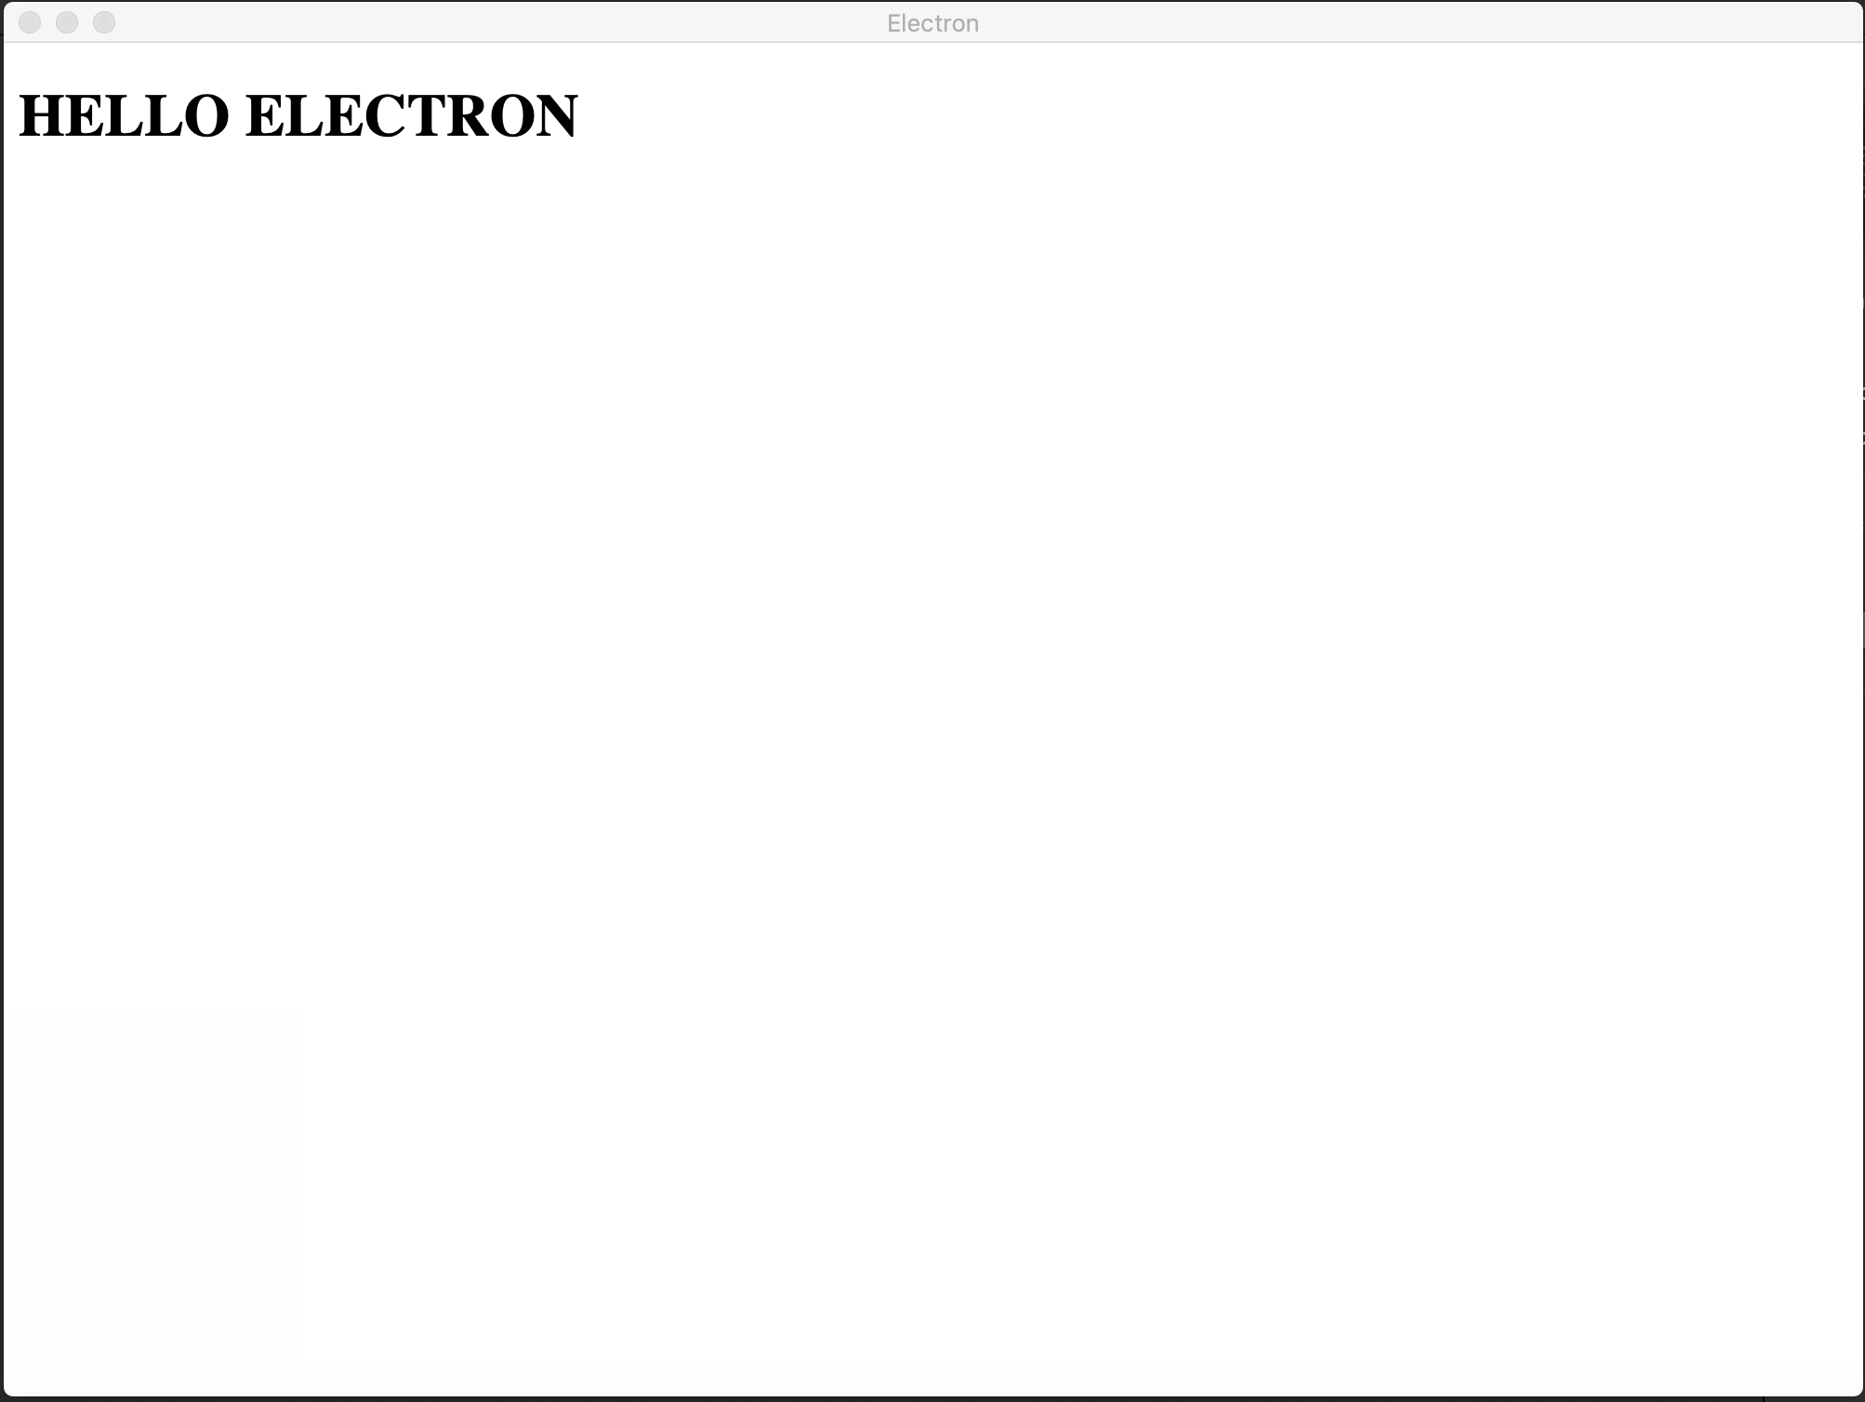
Step 1
Setting Up Electron
Now if we run `npm start` in the terminal, we should see the app start and be presented with this beauty:

Slide 14
Step 2
Setting Up Phaser
First thing we’re going to do is create some files and a directory.
Create a ‘Scenes’ folder in the project root folder
Create 3 files, [GameOverScene.js, GameScene.js, and MenuScene.js] inside the ‘Scenes’ folder
Create an ‘index.css’ file in the project root
Create a ‘Match-Game.js’ file in the project root

Slide 15
Step 2
Setting Up Phaser
Inside of index.css, we’re going to add a couple quick styles to make it easier to see if things are working. (And also the angsty black background color, no red text though)
body{
background-color: #000000;
color: #cccccc;
text-align: center;
}
canvas{
border: 1px solid #99bbff;
}

Slide 16
Step 2
Setting Up Phaser
We’re also going to make a couple adjustments to our index.html now. We remove some of our test code and swap it out for importing our new match-game.js and index.css. Additionally we add in a div with the id of ‘match-game’ that phaser will use.
<!DOCTYPE html>
<html>
<head>
<meta charset="UTF-8">
<title>Electron</title>
<script src="node_modules/phaser/dist/phaser-arcade-physics.min.js" > </script>
<script src="./Match-Game.js"></script>
<link href="./index.css" rel="stylesheet"/>
</head>
<body>
<div id=“match-game"></div>
</body>
</html>

Slide 17
Step 2
Setting Up Phaser
MenuScene.js
class MenuScene extends Phaser.Scene{
constructor ()
{
super();
}
create ()
{
this.add.text(200, 500, 'Menu Scene', { fill: '#ffffff' });
}
}
module.exports = MenuScene;

Slide 18
Step 2
Setting Up Phaser
GameScene.js
class GameScene extends Phaser.Scene{
constructor ()
{
super();
}
create ()
{
this.add.text(200, 500, 'Game Scene', { fill: '#ffffff' });
}
}
module.exports = GameScene;

Slide 19
Step 2
Setting Up Phaser
GameOverScene.js
class GameOverScene extends Phaser.Scene{
constructor ()
{
super();
}
create ()
{
this.add.text(200, 500, 'Game Over Scene', { fill: '#ffffff' });
}
}
module.exports = GameOverScene;

Slide 20
Step 2
Setting Up Phaser
Now we can bring all of these together in Match-Game.js.
const MenuScene = require('./Scenes/MenuScene');
const GameScene = require('./Scenes/GameScene');
const GameOverScene = require('./Scenes/GameOverScene');
var game_scene = new GameScene();
let menu_scene = new MenuScene();
var game_over_scene = new GameOverScene();
var config = {
type: Phaser.WEBGL,
width: 800,
height: 600,
parent: 'match-game',
scene: [menu_scene, game_scene, game_over_scene]
};
var game = new Phaser.Game(config);

Slide 21
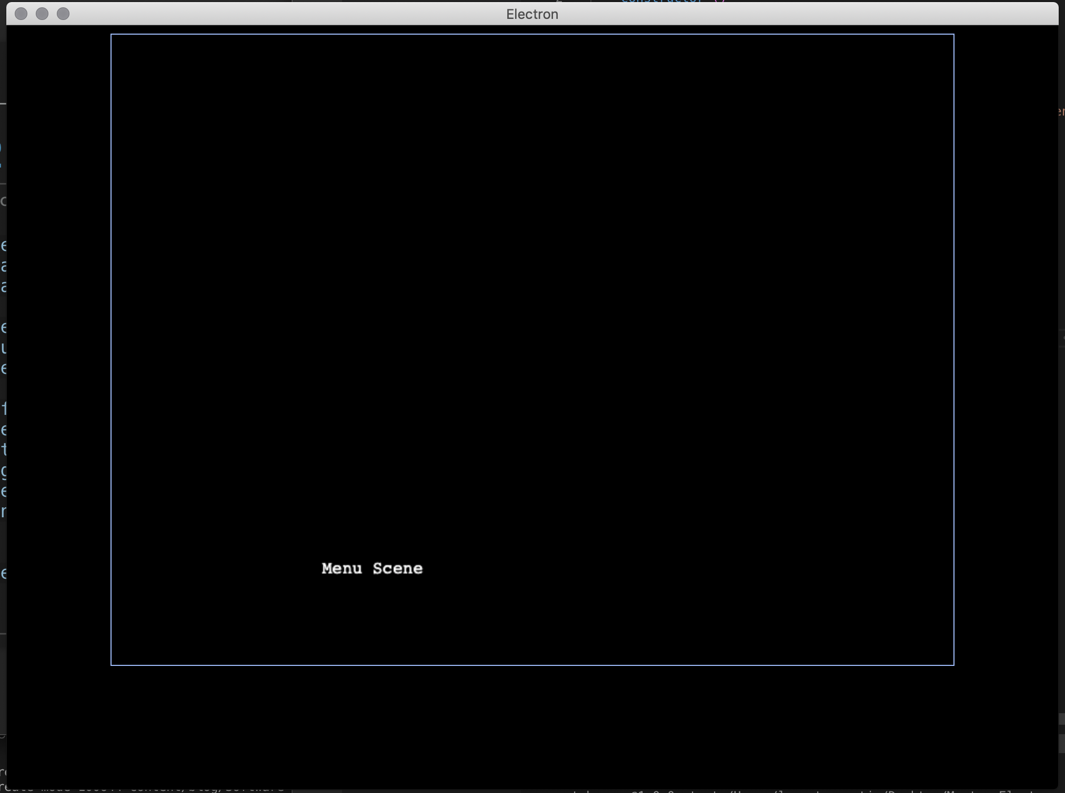
Step 2
Setting Up Phaser
Now if we run ‘npm start’ we should see an app like the screen below

Slide 22
Step 2
Setting Up Phaser
Now let’s get some flow going through the screens. We’re going to go into each of our scene files and and a simple input event so that we can navigate through them.
Inside our MenuScene.js file, add the following after our text render.
this.input.on('pointerdown', () => {
this.scene.start(game_scene);
this.scene.stop(menu_scene);
});
Then, inside of GameScene.js and GameOverScene.js, add the same lines but replace the ‘game_scene’ object, with the appropriate object to make the scenes flow like Menu -> Game -> Game Over (repeat)

Slide 23
Step 2
Setting Up Phaser
Now we should be able to click anywhere and see our scenes transition by.

Slide 24
Step 3
Game Code
Now we move on to the fun part, adding our game code
First thing is to create a Directory in our project root called ‘Cards’.
Once that’s created, copy over all of the card .png files from in Step 3 of the GitHub repo.

Slide 25
Step 3
Game Code
We need to modify GameOverScene.js and MenuScene.js slightly, altering the create method:
GameOverScene.js : create()
this.add.text(200, 500, 'Game Over Scene', { fill: '#ffffff' })
.setInteractive()
.on('pointerdown', () => {
this.scene.start(menu_scene);
this.scene.stop(game_over_scene);
});

Slide 26
Step 3
Game Code
MenuScene.js : create()
this.add.text(200, 500, 'Menu Scene', { fill: '#ffffff' })
.setInteractive()
.on('pointerdown', () => {
this.scene.start(game_scene);
this.scene.stop(menu_scene);
});

Slide 27
Step 3
Game Code
With those things out of the way, it’s time to get into the meat and potatoes: GameScene.js
GameScene.js properties to define and initialize:
cardsUnshuffled = [];
faces = ['RedGem', 'BlueGem', 'GreenGem', 'LavenderGem', 'LightBlueGem', 'OrangeGem', 'PinkGem', 'PurpleGem', 'TealGem', 'YellowGem']
card1 = null;
matches = 0;

Slide 28
Step 3
Game Code
We need to add a new preload() method, that will load our images into phaser
this.load.image('RedGem', 'Cards/RedGemCard.png');
this.load.image('BlueGem', 'Cards/BlueGemCard.png');
this.load.image('GreenGem', 'Cards/GreenGemCard.png');
this.load.image('LavenderGem', 'Cards/LavenderGemCard.png');
this.load.image('LightBlueGem', 'Cards/LightBlueGemCard.png');
this.load.image('OrangeGem', 'Cards/OrangeGemCard.png');
this.load.image('PinkGem', 'Cards/PinkGemCard.png');
this.load.image('PurpleGem', 'Cards/PurpleGemCard.png');
this.load.image('TealGem', 'Cards/TealGemCard.png');
this.load.image('YellowGem', 'Cards/YellowGemCard.png');
this.load.image('Back', 'Cards/CardBack.png');

Slide 29
Step 3
Game Code
Time to revamp our create() method:
this.matches = 0;
this.card1 = null;
for (let index = 0; index < this.faces.length; index++) {
this.cardsUnshuffled.push({ face: this.faces[index], back: 'Back' });
this.cardsUnshuffled.push({ face: this.faces[index], back: 'Back' });
}
this.cardsUnshuffled = this.shuffle(this.cardsUnshuffled);

Slide 30
Step 3
Game Code
create() method continued:
let counter = 0;
for (let width = 0; width < 5; width++) {
for (let height = 0; height < 4; height++) {
let card = this.add.sprite(700 - (800 / 5 * width), 525 - (600 / 4 * height), this.cardsUnshuffled[counter].back);
card.front = this.cardsUnshuffled[counter].face;
card.faceUp = false;
card.setScale(.6);
card.setInteractive()
.on('clicked', this.clickHandler, this);
counter++;
}
}

Slide 31
Step 3
Game Code
create() method continued:
this.input.on('gameobjectup', function (pointer, gameObject) {
gameObject.emit('clicked', gameObject);
}, this);

Slide 32
Step 3
Game Code
We need to create a shuffle() method:
Pretty sure I yoinked this off SO from an older project I was playing around with, but it works by starting at the end of the passed array, and working backwards to swap elements from random indexes. Taking code from the internet is fine, as long as you understand what it does, why, and how.
shuffle = function (array) {
var currentIndex = array.length;
var temporaryValue, randomIndex;
// While there remain elements to shuffle...
while (0 !== currentIndex) {
// Pick a remaining element...
randomIndex = Math.floor(Math.random() * currentIndex);
currentIndex -= 1;
// And swap it with the current element.
temporaryValue = array[currentIndex];
array[currentIndex] = array[randomIndex];
array[randomIndex] = temporaryValue;
}
return array;
};

Slide 33
Step 3
Game Code
We need to create a clickHandler() method that we called on pointer down on our gameObject:
clickHandler = function (card) {
if (!card.matched) {
if (!card.faceUp) {
this.flipToFront(card);
card.faceUp = true;
}
if (!this.card1) {
this.card1 = card;
}
else if (card === this.card1) {
//Do nothing
}
* NEXT SLIDE CODE
}
}

Slide 34
Step 3
Game Code
This code goes in the placeholder on from the previous slide:
else {
if (this.card1.front === card.front) {
this.card1.matched = true;
card.matched = true;
this.matches++;
this.card1 = null;
if (this.matches >= 10) {
setTimeout(() => {
this.scene.start(game_over_scene);
this.scene.stop(game_scene);
}, 5000);
}
}
else {
this.flipToBack(this.card1);
this.card1.faceUp = false;
this.flipToBack(card);
card.faceUp = false;
this.card1 = null;
}
}

Slide 35
Step 3
Game Code
Now for the first of our animation functions:
flipToBack = function (card) {
this.tweens.add({
targets: card,
scaleX: 0,
scaleY: .8,
ease: 'Sine.easeInOut',
delay: 1000,
duration: 150,
yoyo: false,
repeat: 0,
onComplete: () => {
card.setTexture('Back');
this.tweens.add({
targets: card,
scaleX: .6,
scaleY: .6,
ease: 'Sine.easeInOut',
duration: 150,
yoyo: false,
repeat: 0,
});
}
});
}

Slide 36
Step 3
Game Code
And the second:
flipToFront = function (card) {
this.tweens.add({
targets: card,
scaleX: 0,
scaleY: .8,
ease: 'Sine.easeInOut',
duration: 150,
yoyo: false,
repeat: 0,
onComplete: () => {
card.setTexture(card.front);
this.tweens.add({
targets: card,
scaleX: .6,
scaleY: .6,
ease: 'Sine.easeInOut',
duration: 150,
yoyo: false,
repeat: 0,
});
}
});
}

Slide 37
Step 3
Game Code
With that, we should be able to ‘npm start’ and play our currently very minimal game

Slide 38
Questions?
Great success
Going Further
Sound effects
Scoring
Different levels of difficulty
Timer
Menu Screen, Game Over Screen animations
That AAA Polish

Slide 39
Thanks!
Great success

