Slide 1
Courschemaster
>Frontend 沈静然 (Peter S) 11710116
>Frontend 孙挺 (Sunt) 11710108
>Frontend 孙龙朝 (LongZhao Sun) 11710511
>Backend 欧阳晖 (Hui Ouyang) 11710106
>Backend 王炜皓 (Mike Chester Wang) 11710403

Slide 2
What is Courschemaster
A platform provides high visualized graphic element to make the modification and creation of course schemas easier.
A platform provides a general representation method to unify all the course schemas in different departments.
A platform make the SUSTech life simple and easy.

Slide 3
Feature Description
Edit Course Schemas on highly visual window
Schedule for college life on highly visual window
User Group & Privacy

Slide 4
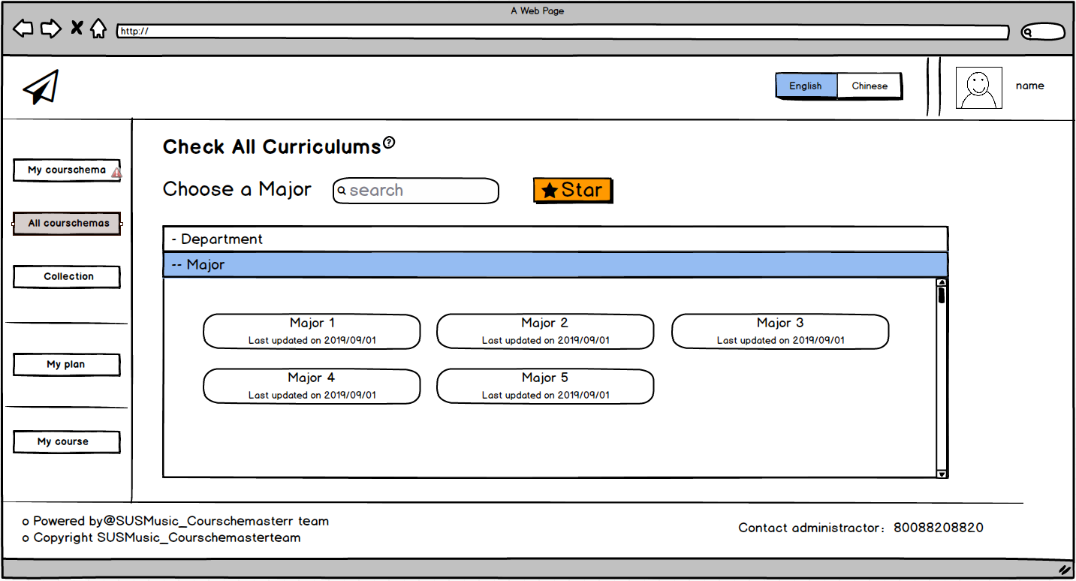
Students - check all curriculum

Slide 5
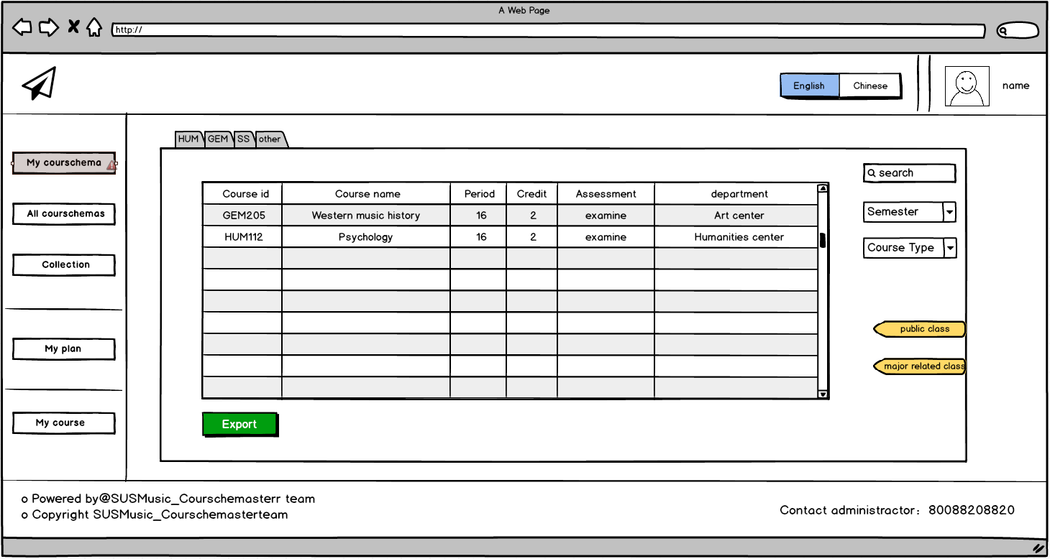
Students - my course schema

Slide 6
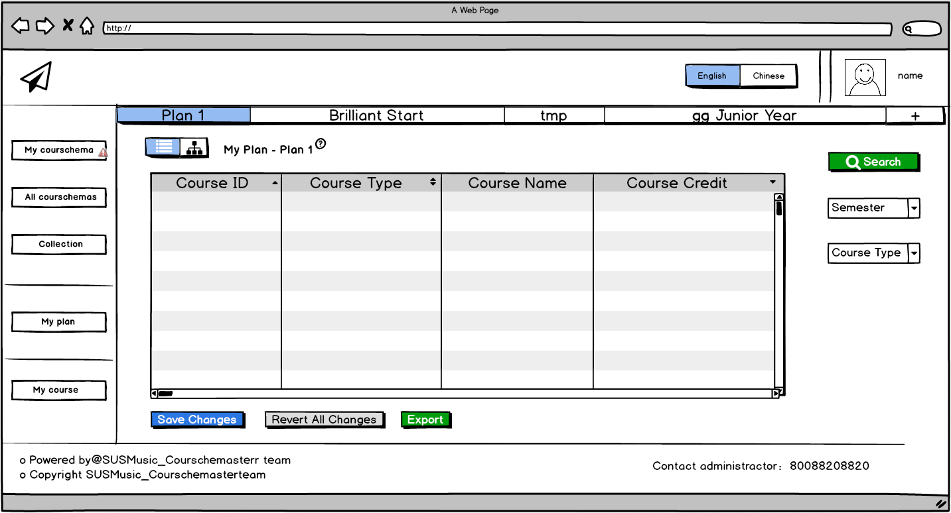
Students - my plan

Slide 7
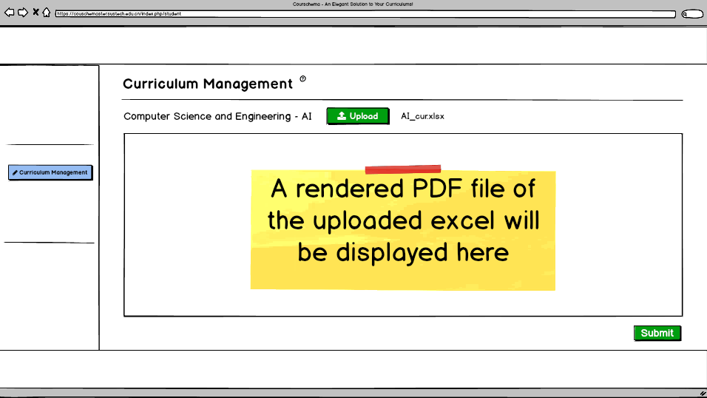
Department scretary - upload

Slide 8
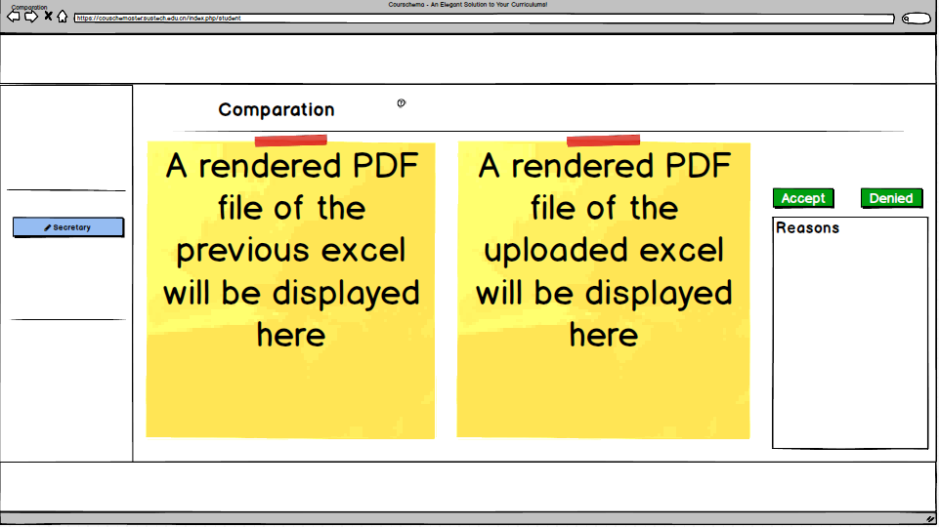
Department scretary - comparation

Slide 9
Feature Description – User Group
Staff Group
General
Secretary
Teaching Affairs Department
Mentor & College Instructor
Student Group
General
Visitor

Slide 10
Feature Description – Staff Group
General
Check all the course schemas
Check his/her visible students’ information
Secretary
Upload course schemas (Request)
Edit course schemas online (Request)
Delete course schemas (Request)
Contact Administrators
Assign course schemas to students (Request)

Slide 11
Feature Description – Staff Group
Teaching Affairs Department
Create New Courses
Synchronize course information
Audit course schemas deletion
Audit new course schemas
Audit course schemas modifications
Audit course schemas assignments

Slide 12
Feature Description – Student Group
General
Check all course schemas
Check his/her own course schema
Check “My Plan”
Edit “My Plan”
Collect course

Slide 13



Techniques
Teamwork Communication
UML Development
Code Management

Slide 14



Techniques
Server : Apache + PHP + MySQL

Slide 15
Techniques
Client : JavaScript + HTML5 + CSS3 + …

Slide 16

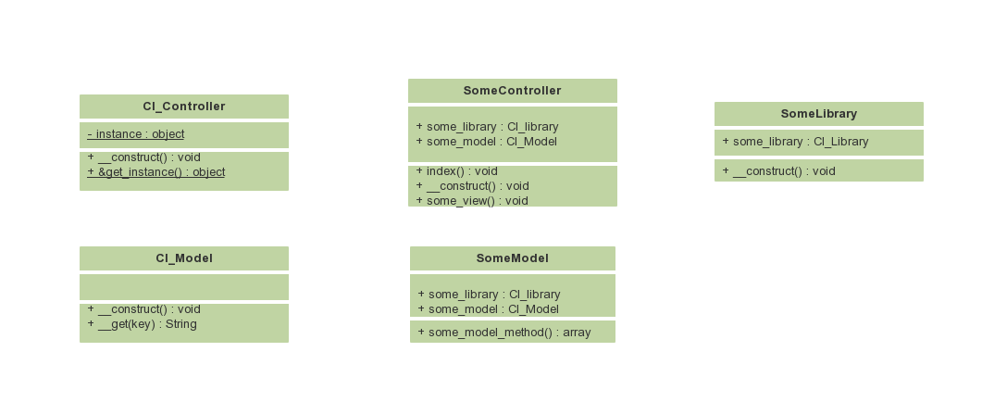
Techniques
Framework :

Slide 17
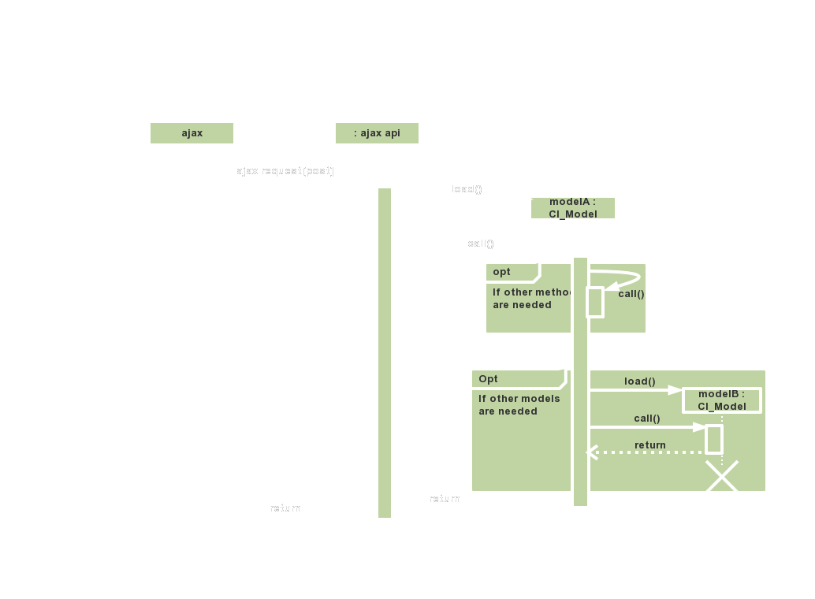

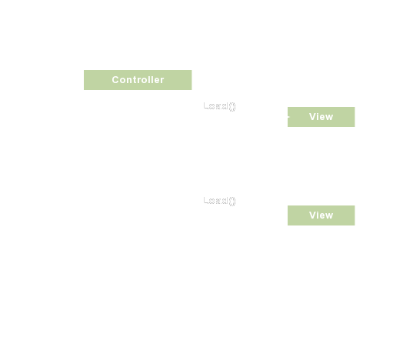
Techniques
Interaction between frontend and backend : and View

Slide 18
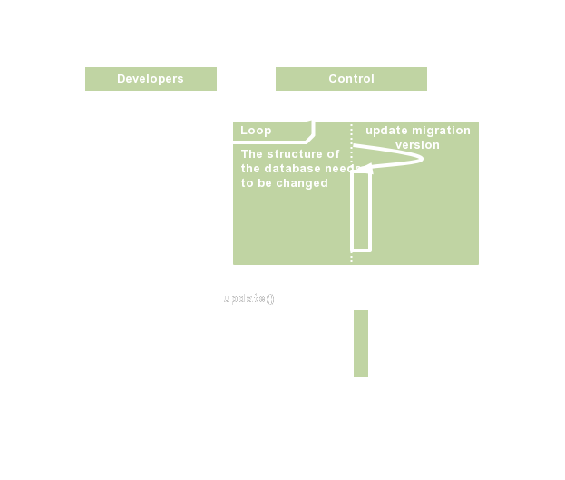
Techniques
Migration

Slide 19
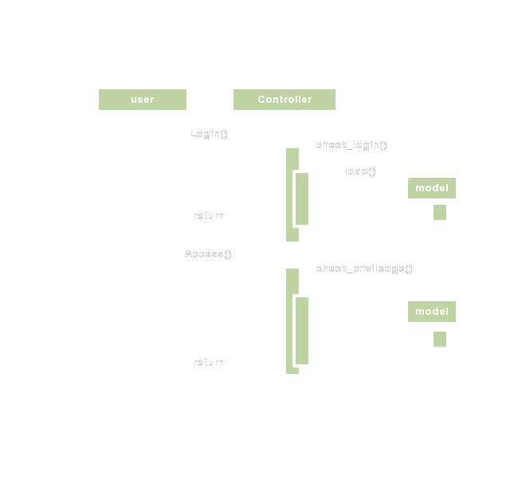
Techniques
Login and access

Slide 20
Timeline
Current progress :
Frontend : draft
Backend : UML, environment(framework Deployment, CAS)
Other : git deployment, README,
Oct. 10th, 2019 : Requirements & Designs
Before the next presentation : Fundamental Implementation
Before the last presentation : Advanced Implementation & Verification

