Slide 1
Courschemaster
>Frontend 沈静然 (Peter S) 11710116
>Frontend 孙挺 (Sunt) 11710108
>Frontend 孙龙朝 (LongZhao Sun) 11710511
>Backend 欧阳晖 (Hui Ouyang) 11710106
>Backend 王炜皓 (Mike Chester Wang) 11710403

Slide 2
What is Courschemaster

Slide 3
Feature Description
Edit Course Schemas on highly visual window
Schedule for college life on highly visual window
User Group & Privacy

Slide 4
Feature Description - Frontend

Slide 5
Feature Description – User Group
Staff Group
General
Secretary
Teaching Affairs Department
Mentor & College Instructor
Student Group
General
Visitor

Slide 6
Feature Description – Staff Group
General
Check all the course schemas
Check his/her visible students’ information
Secretary
Upload course schemas (Request)
Edit course schemas online (Request)
Delete course schemas (Request)
Contact Administrators
Assign course schemas to students (Request)

Slide 7
Feature Description – Staff Group
Teaching Affairs Department
Create New Courses
Synchronize course information
Audit course schemas deletion
Audit new course schemas
Audit course schemas modifications
Audit course schemas assignments

Slide 8
Feature Description – Student Group
General
Check all course schemas
Check his/her own course schema
Check “My Plan”
Edit “My Plan”
Collect course

Slide 9



Techniques
Teamwork Communication
UML Development
Code Management

Slide 10



Techniques
Server : Apache + PHP + MySQL

Slide 11
Techniques
Client : JavaScript + HTML5 + CSS3 + …

Slide 12

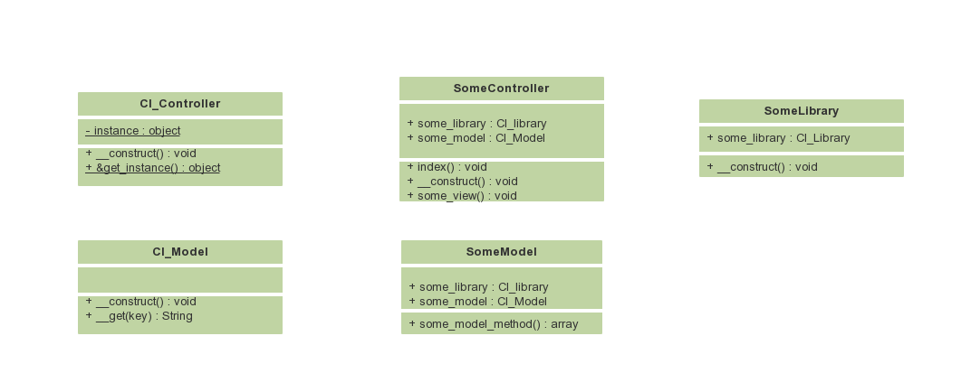
Techniques
Framework :

Slide 13
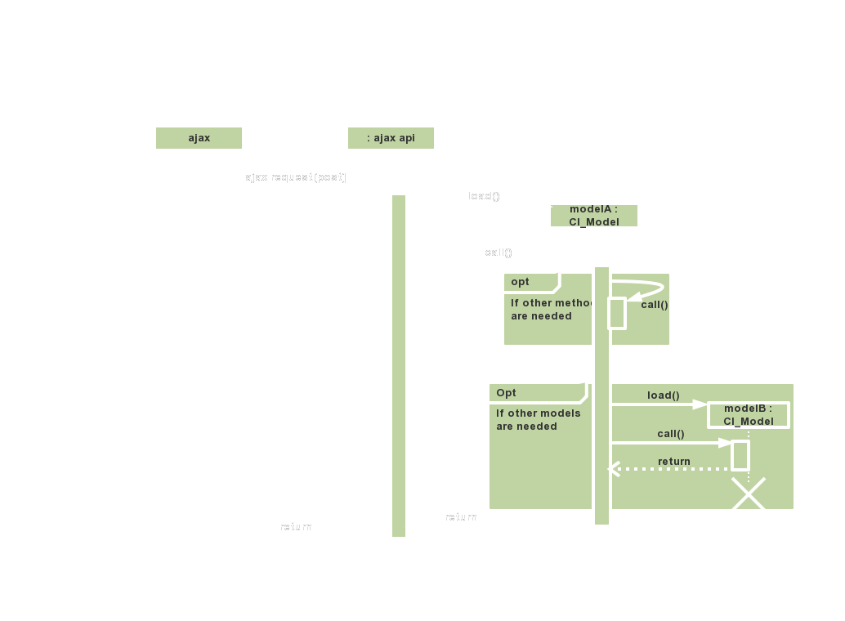

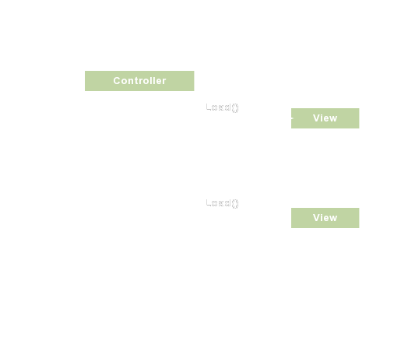
Techniques
Interaction between frontend and backend : and View

Slide 14
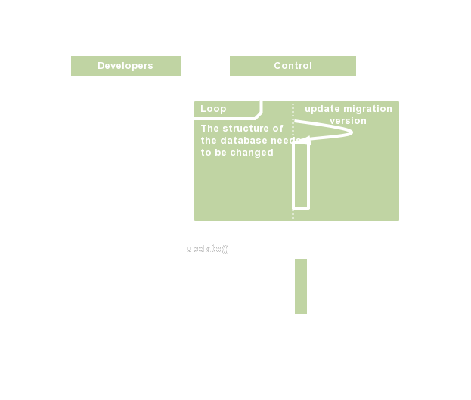
Techniques
Migration

Slide 15
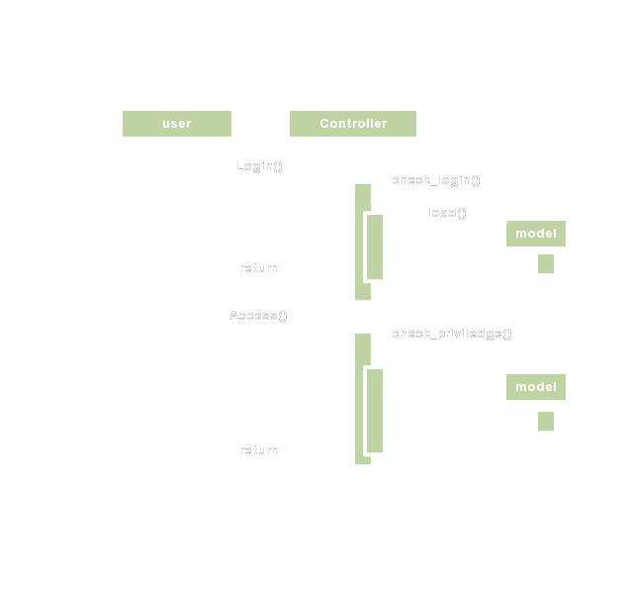
Techniques
Login and access

Slide 16
Timeline
Current progress :
Frontend : draft
Backend : UML, environment(framework Deployment, CAS)
Other : git deployment, README,
Oct. 10th, 2019 : Requirements & Designs
Before the next presentation : Fundamental Implementation
Before the last presentation : Advanced Implementation & Verification

