Slide 1
Health Care System

Slide 2
Introduction
Health care, or healthcare, is the improvement of health via the prevention, diagnosis, treatment, amelioration or cure of disease, illness, injury, and other physical and mental impairments in people. Health care is delivered by health professionals and allied health fields.

Slide 3


Slide 4
Table of Contents
01
02
03
Admin
Doctor
The main Admin person of the whole project.
The doctor responsible for patient health care.
Patient
The patient related to their health.

Slide 5
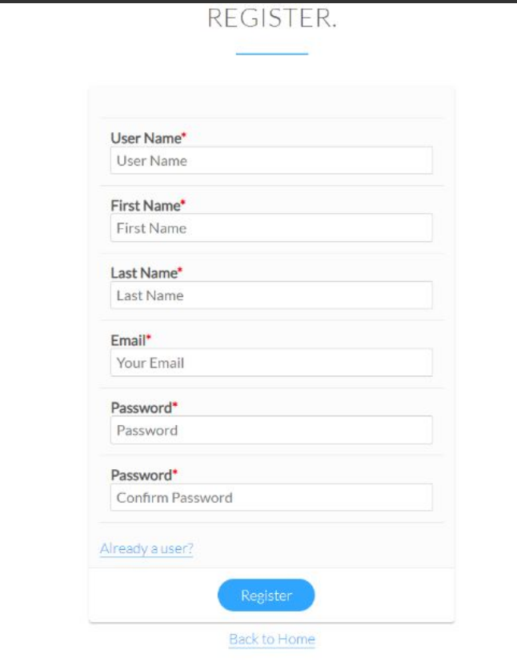
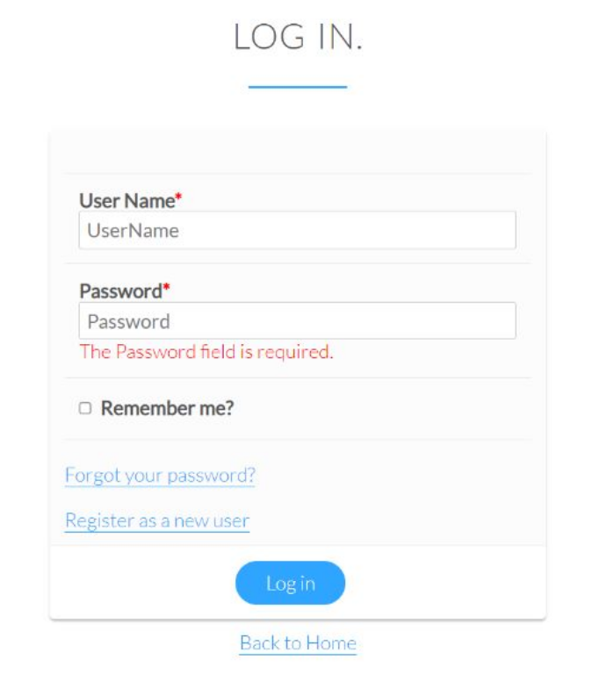
Identifying Information
Register / Sign Up
Sign In

Slide 6
01
About the Admin
The main Admin person of the whole project.

Slide 7
Module of Admin
01DOCTORS
03
04
0
DEPARTMENTS
Appointment
Doctor
Complaint
Patient
Medicine
Schedule
Ambulance
Manage
Announcement

Slide 8
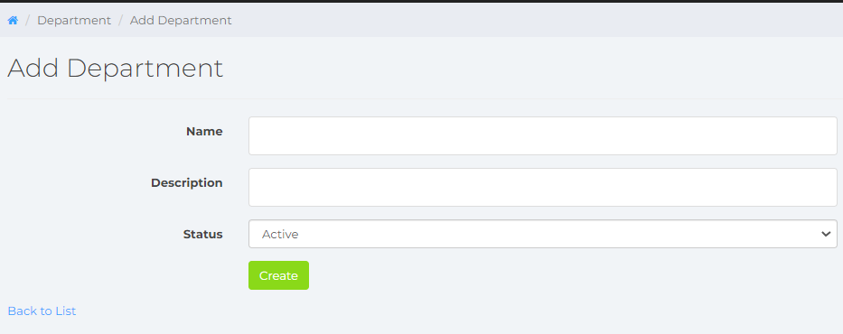
Module of Admin
01DOCTORS
04
0
DEPARTMENTS
A department is one of the sections in an organization such as a government, business, or Hospital
Admin can add / edit / view / delete the Department
The department will show to their respective employee like doctor.

Slide 9
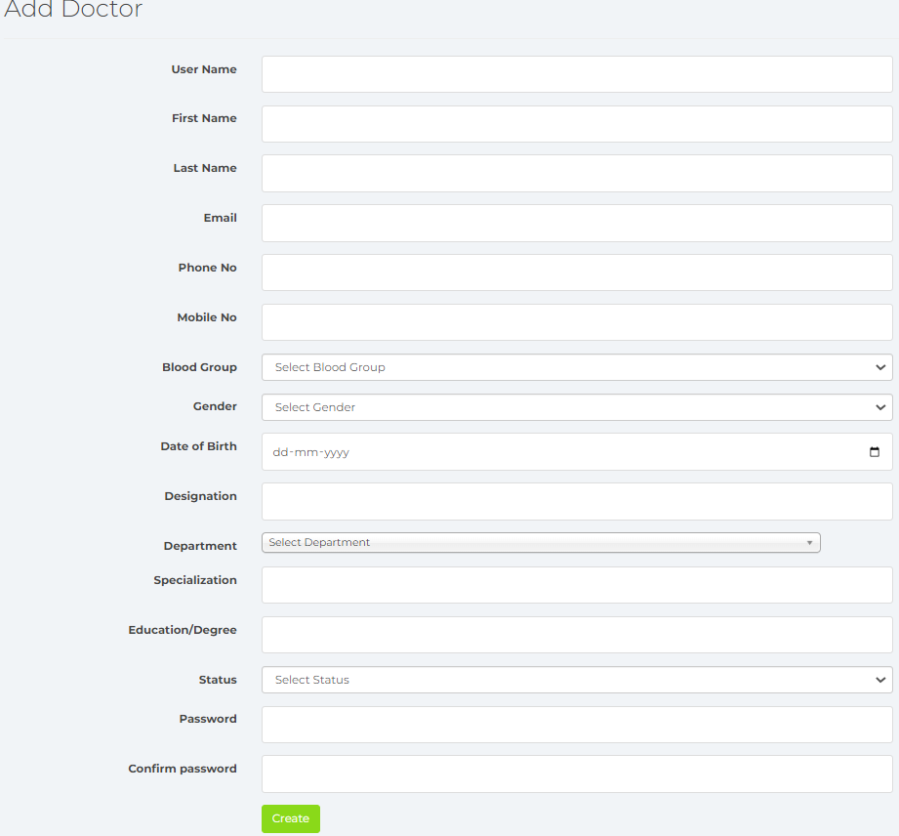
Module of Admin
01DOCTORS
04
0
Doctor
A person who has been trained in medicine and who treats people who are ill.
Admin can add / edit / delete the Doctor
The doctor will show to their respective patient.

Slide 10
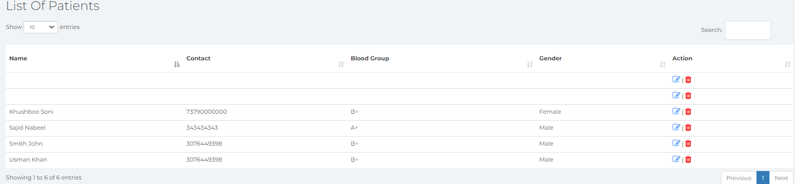
Module of Admin
01DOCTORS
04
0
Patient
Admin can only view the list of patient.
Admin can edit / delete the information of patient

Slide 11
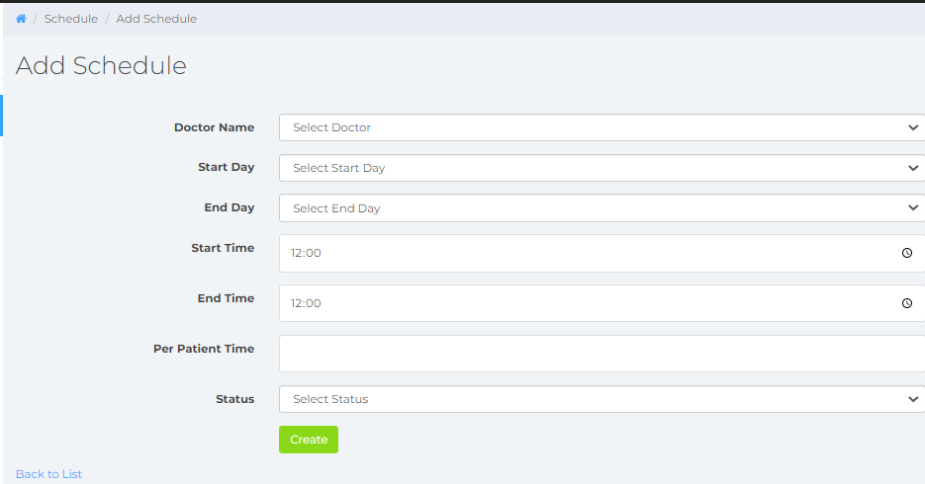
Module of Admin
01DOCTORS
04
0
Schedule
Admin can add / edit / view / delete the schedule.
Admin can schedule the timing for the doctor, he will assign the start and end time.
The schedule will show to their respective employee like doctor.

Slide 12
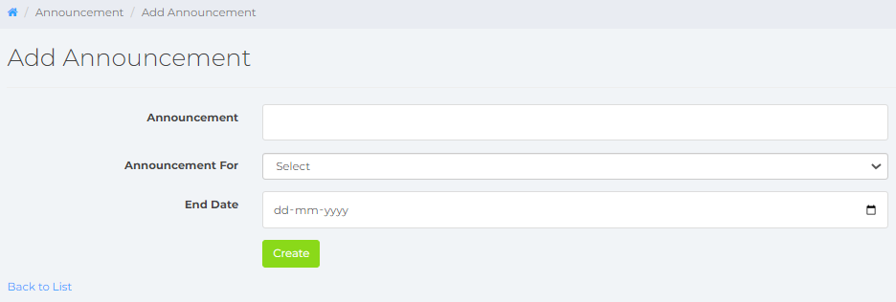
Module of Admin
01DOCTORS
04
0
Announcement
Announcement will apply to their staff and employee, like notice
Admin can add / edit / view / delete the announcement
Announcement will notify that the announcement goes to whom.

Slide 13
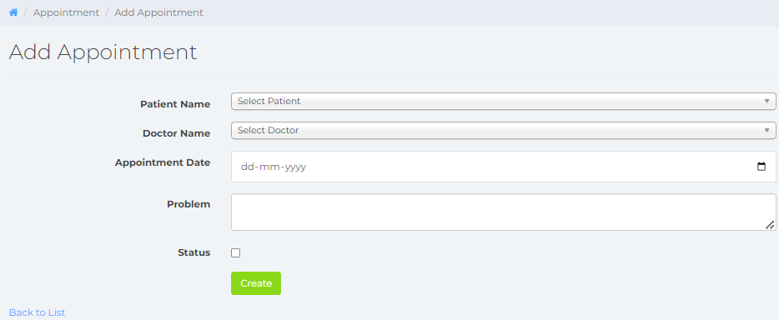
Module of Admin
01DOCTORS
04
0
Appointment
The appointment will decide that who’s doctor will appoint to their patient on specified date
Admin can add / edit / view / delete the announcement
Patient and doctor will include to their appointment

Slide 14
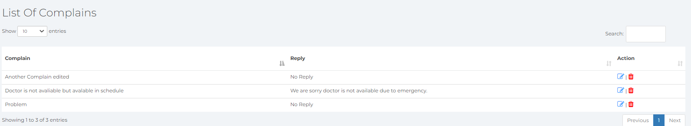
Module of Admin
01DOCTORS
04
0
Complaint
The List of complaint will show to admin, he can view patient’s complaint
Admin can edit / delete the Complaint

Slide 15
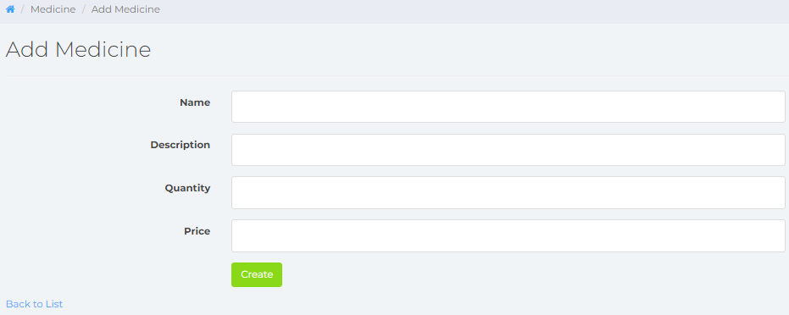
Module of Admin
01DOCTORS
04
0
Medicine
Admin will add the medicine and their description about instruction, quantity and price.
Admin can add / edit / view / delete the Medicine

Slide 16
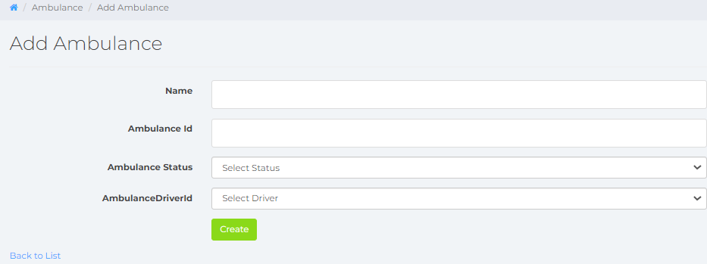
Module of Admin
01DOCTORS
04
0
Ambulance
Admin will add the ambulance based on her status like - free, busy
Admin can add / edit / view / delete the ambulance
Admin will add Driver first and then add it to ambulance.
Then it will decide like which driver assigned to which ambulance

Slide 17
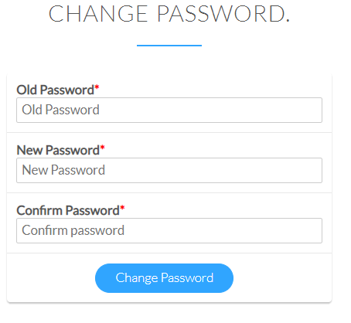
Module of Admin
01DOCTORS
04
0
Manage
Manage is just like the Setting of password
Admin can their password.
Manage(Setting) page is same for – 1. Patient 2. Doctor 3. Admin

Slide 18
02
About the Doctor
The doctor responsible for patient health care.

Slide 19
Module of Doctor
01DOCTORS
Prescription
Appointment
Schedule
Manage

Slide 20
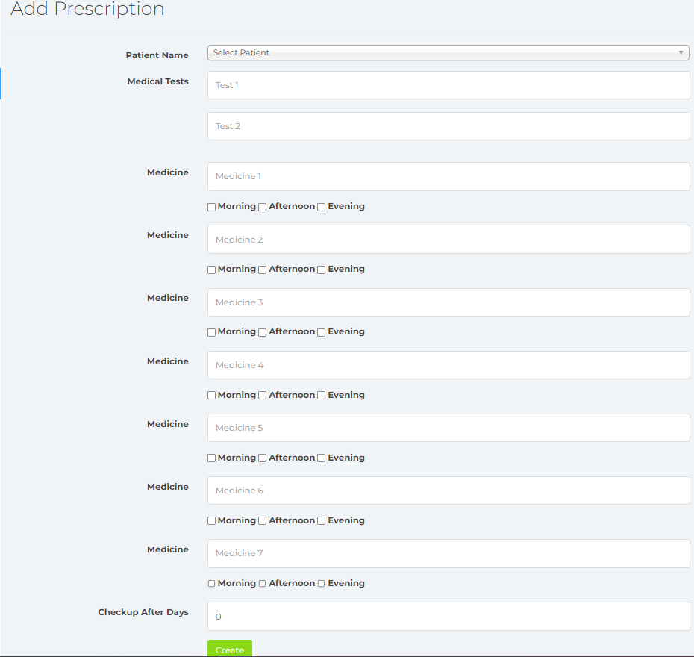
Module of Doctor
01DOCTORS
04
0
Prescription
Doctor will create the Prescription (status of patient’s), like – 1. how many test 2. how much medicine will take patient 3. needs to be checked up after number of days
Doctor can add / edit / view / delete the Prescription
Prescription will show into patient dashboard.

Slide 21
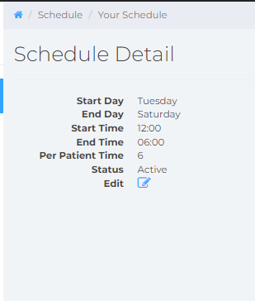
Module of Doctor
01DOCTORS
04
0
Schedule
The Schedule details created by Admin to doctor
Doctor can edit / view his own Schedule details
The Schedule will decide from which date - to date doctor will work for patient

Slide 22
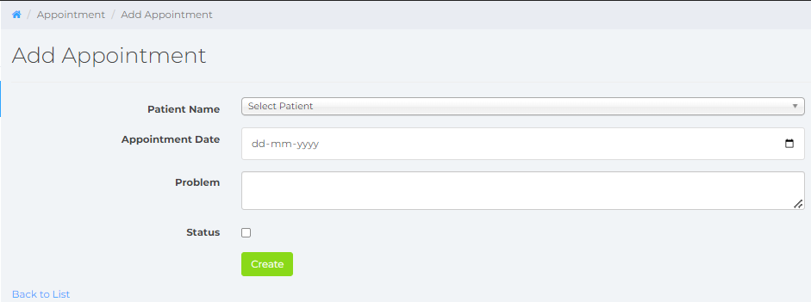
Module of Doctor
01DOCTORS
04
0
Appointment
Doctor can add on which date the appointment will be with which patient
Doctor can add / edit / view / delete the appointment
Doctor can see that which appointment is pending and who to work for.

Slide 23
03
About the Patient
The patient related to their health.

Slide 24
Module of Patient
01DOCTORS
Profile
Appointment
Available Doctor
Complaint
Prescription
Manage

Slide 25
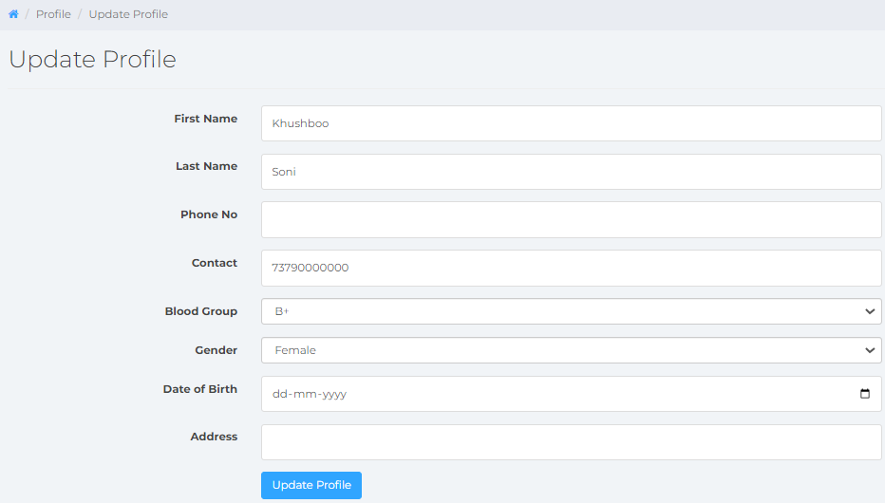
Module of Patient
01DOCTORS
04
0
Profile
Patient can update his own profile on the Dashboard.
Patient can edit / view his details.

Slide 26
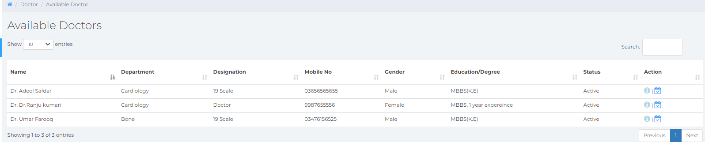
Module of Patient
01DOCTORS
04
0
Available Doctors
Patient will see the doctor details like – Schedule time, doctor info
After confirmation the details patient can book his appointment to specified doctors.
When Doctor will approve the appointment the patient can do the checkup.

Slide 27
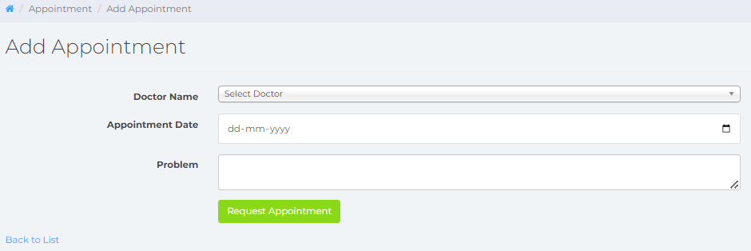
Module of Patient
01DOCTORS
04
0
Appointment (Add / Request)
Patient can book his appointment to specified doctors.
Patient can see the requested appointment The appointment will not until doctor will not approved the status.
Patient can add/ edit / view / delete the created appointment.

Slide 28
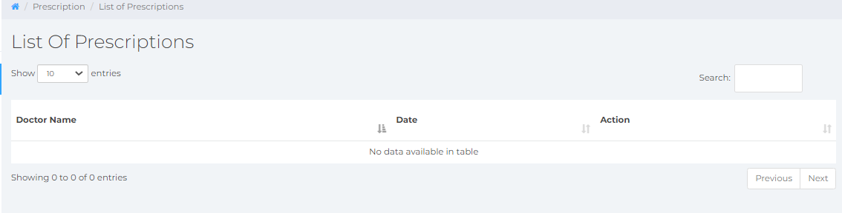
Module of Patient
01DOCTORS
04
0
List of Prescription
Doctor will the Prescription for patient.
Patient can see the Prescription(Total checkup and medicine Information) given by doctor.

Slide 29
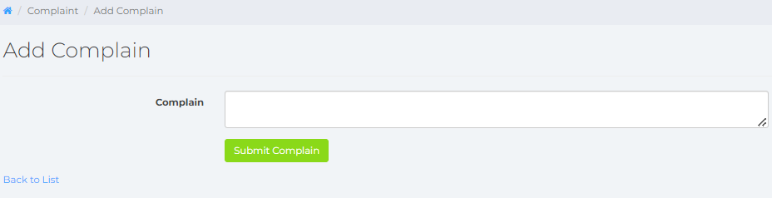
Module of Patient
01DOCTORS
04
0
Complaint
If Patient have any issue related to service then he can apply a complaint for Doctor or Admin.
Patient can add / edit / view / delete the Complaint.

Slide 30

Our Mission, To Improve the patient health

Slide 31
Treatment
Week 1
Checkup and Medicine
If Patient took the medicine properly then next chekup will close
Week 2
Week 3
Checkup the Tests & Results, Then according to their problem we will treated emergency.
Medicine, Tests, Results positivie or negative checkup
Week 4

Slide 32
Important Part
Patient Care
Emergency Service
Doctor
Staff
Nurse
Good Treatement

Slide 33
Conclusions
Health care, or healthcare, is the improvement of health via the prevention, diagnosis, treatment, amelioration or cure of disease, illness, injury, and other physical and mental impairments in people.

Slide 34
Thanks
Do you have any questions?
youremail@freepik.com
yourcompany.com

