Slide 1

Challenge
【Text】
Today, my company started to use a new video chat application which can be used
from a web browser (Chrome) for working from home.
After trying out the new video chat application at local network without turning on
a microphone, I left my room to eat lunch without shutting down the web browser.
Following is the pcap file that was captured during the lunch time.
【file】
videochat_wfh.pcap

Slide 2

Writeup Summary
The video chat application is based on WebRTC
WebRTC (Web Real-Time Communication) is a free, open-source project providing web browsers and mobile applications with real-time communication (RTC) via simple application programming interfaces (APIs). It allows audio and video communication to work inside web pages by allowing direct peer-to-peer communication, eliminating the need to install plugins or download native apps.
The video can be reconstructed from the captured packet using a tool called video_replay, which has been published at WebRTC official web site.
By the default, a web browser (Chrome) encrypts the WebRTC packets. However, I have turned off the encryption by using following option to create this challenge.
C:\Users\username\AppData\Local\Google\Chrome\Application\chrome.exe --disable-webrtc-encryption

Slide 3
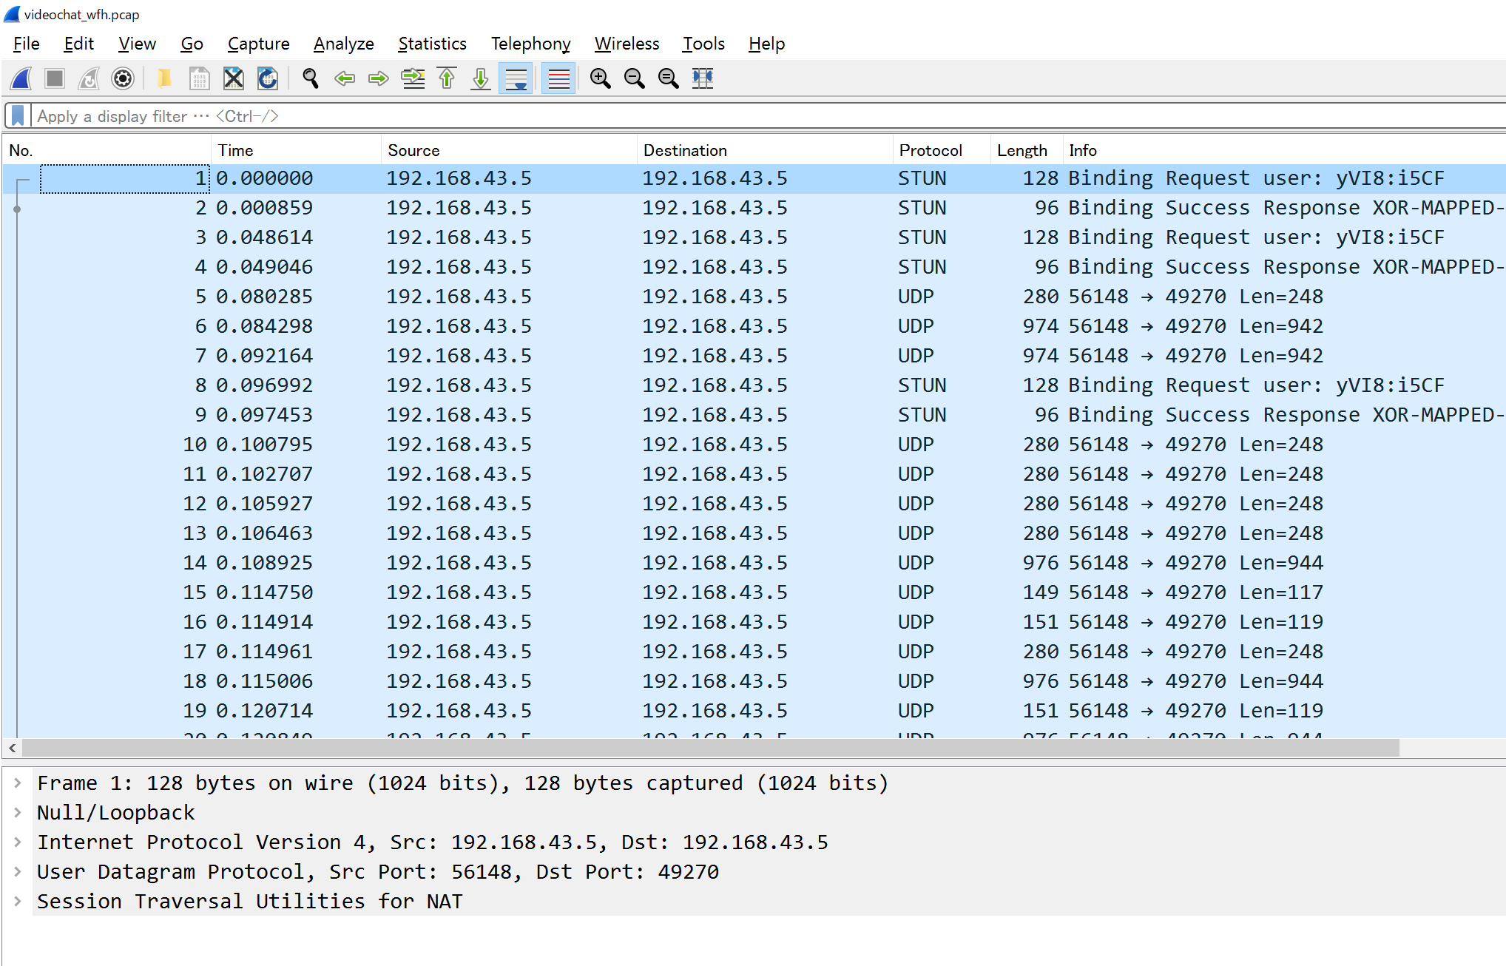
Writeup [1/9]
Open the pcap file using wireshark.

Slide 4
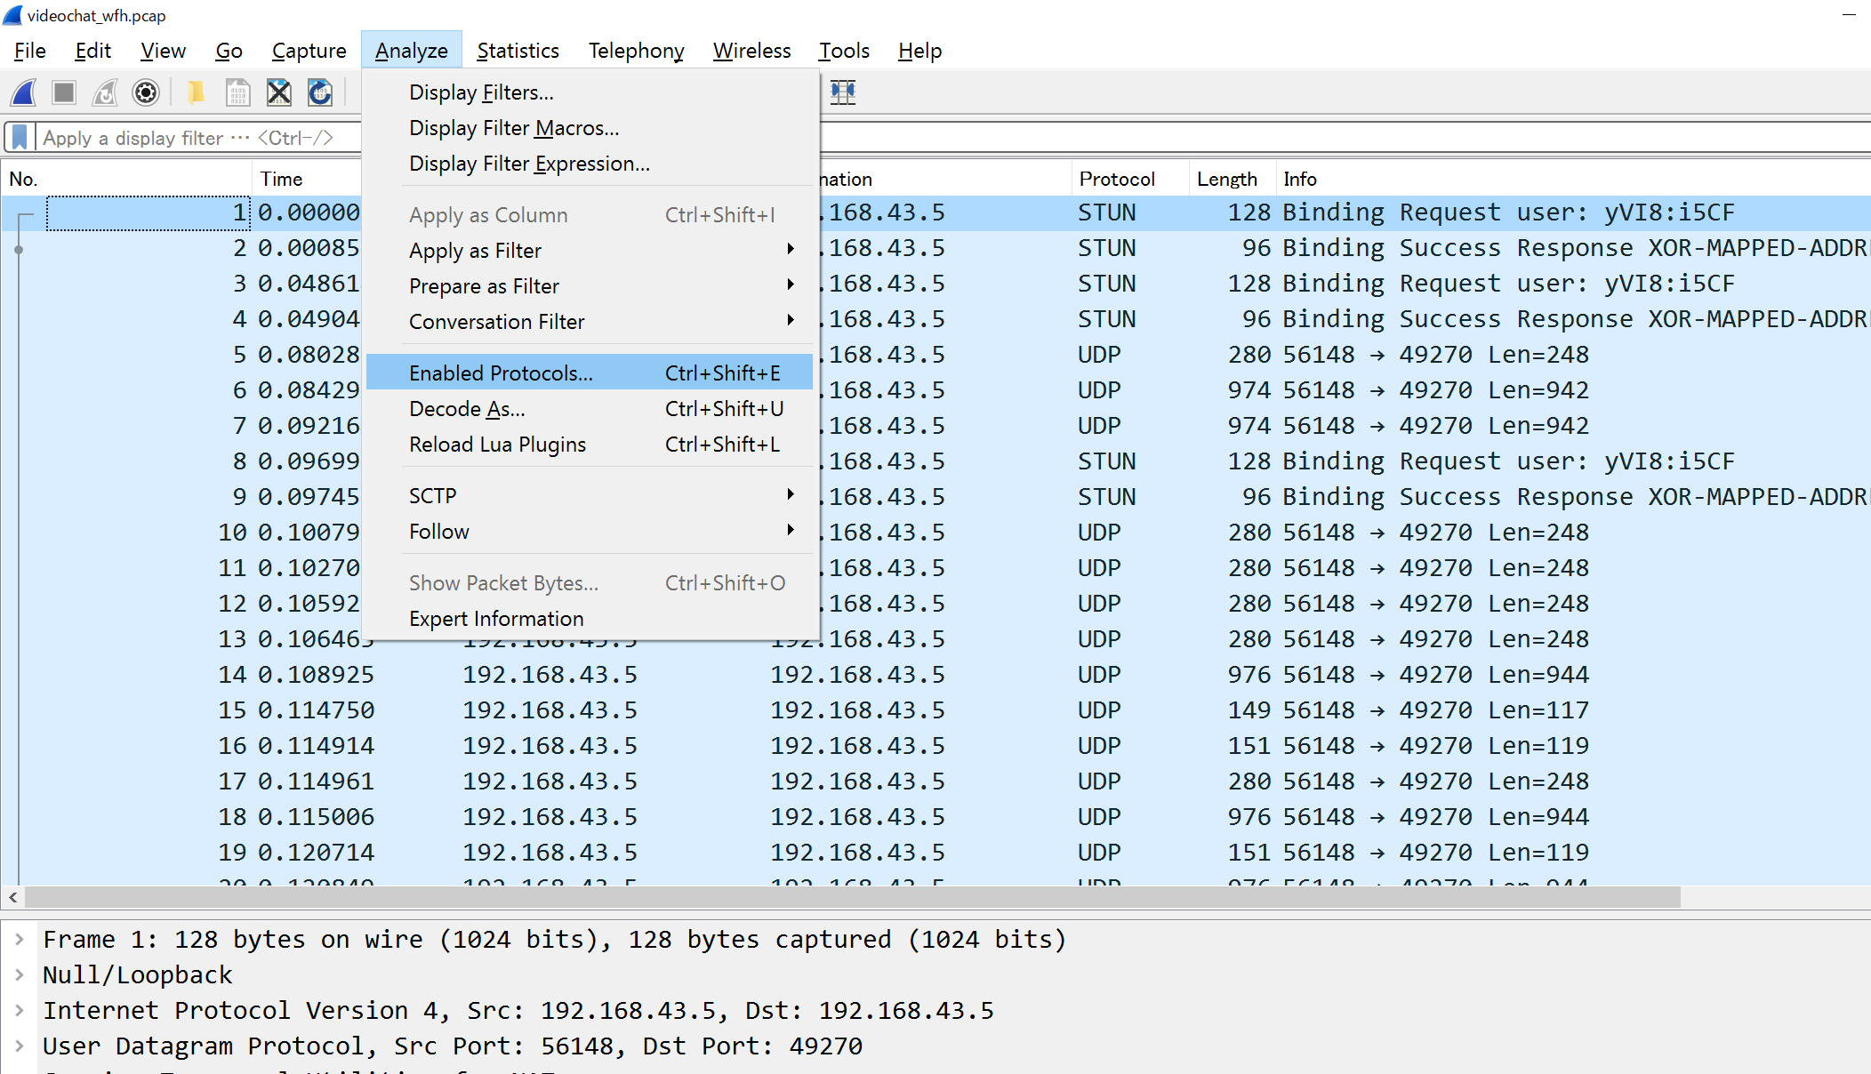
Writeup [2/9]
Clack “Analyze” tab, and select “Enabled Protocols”

Slide 5
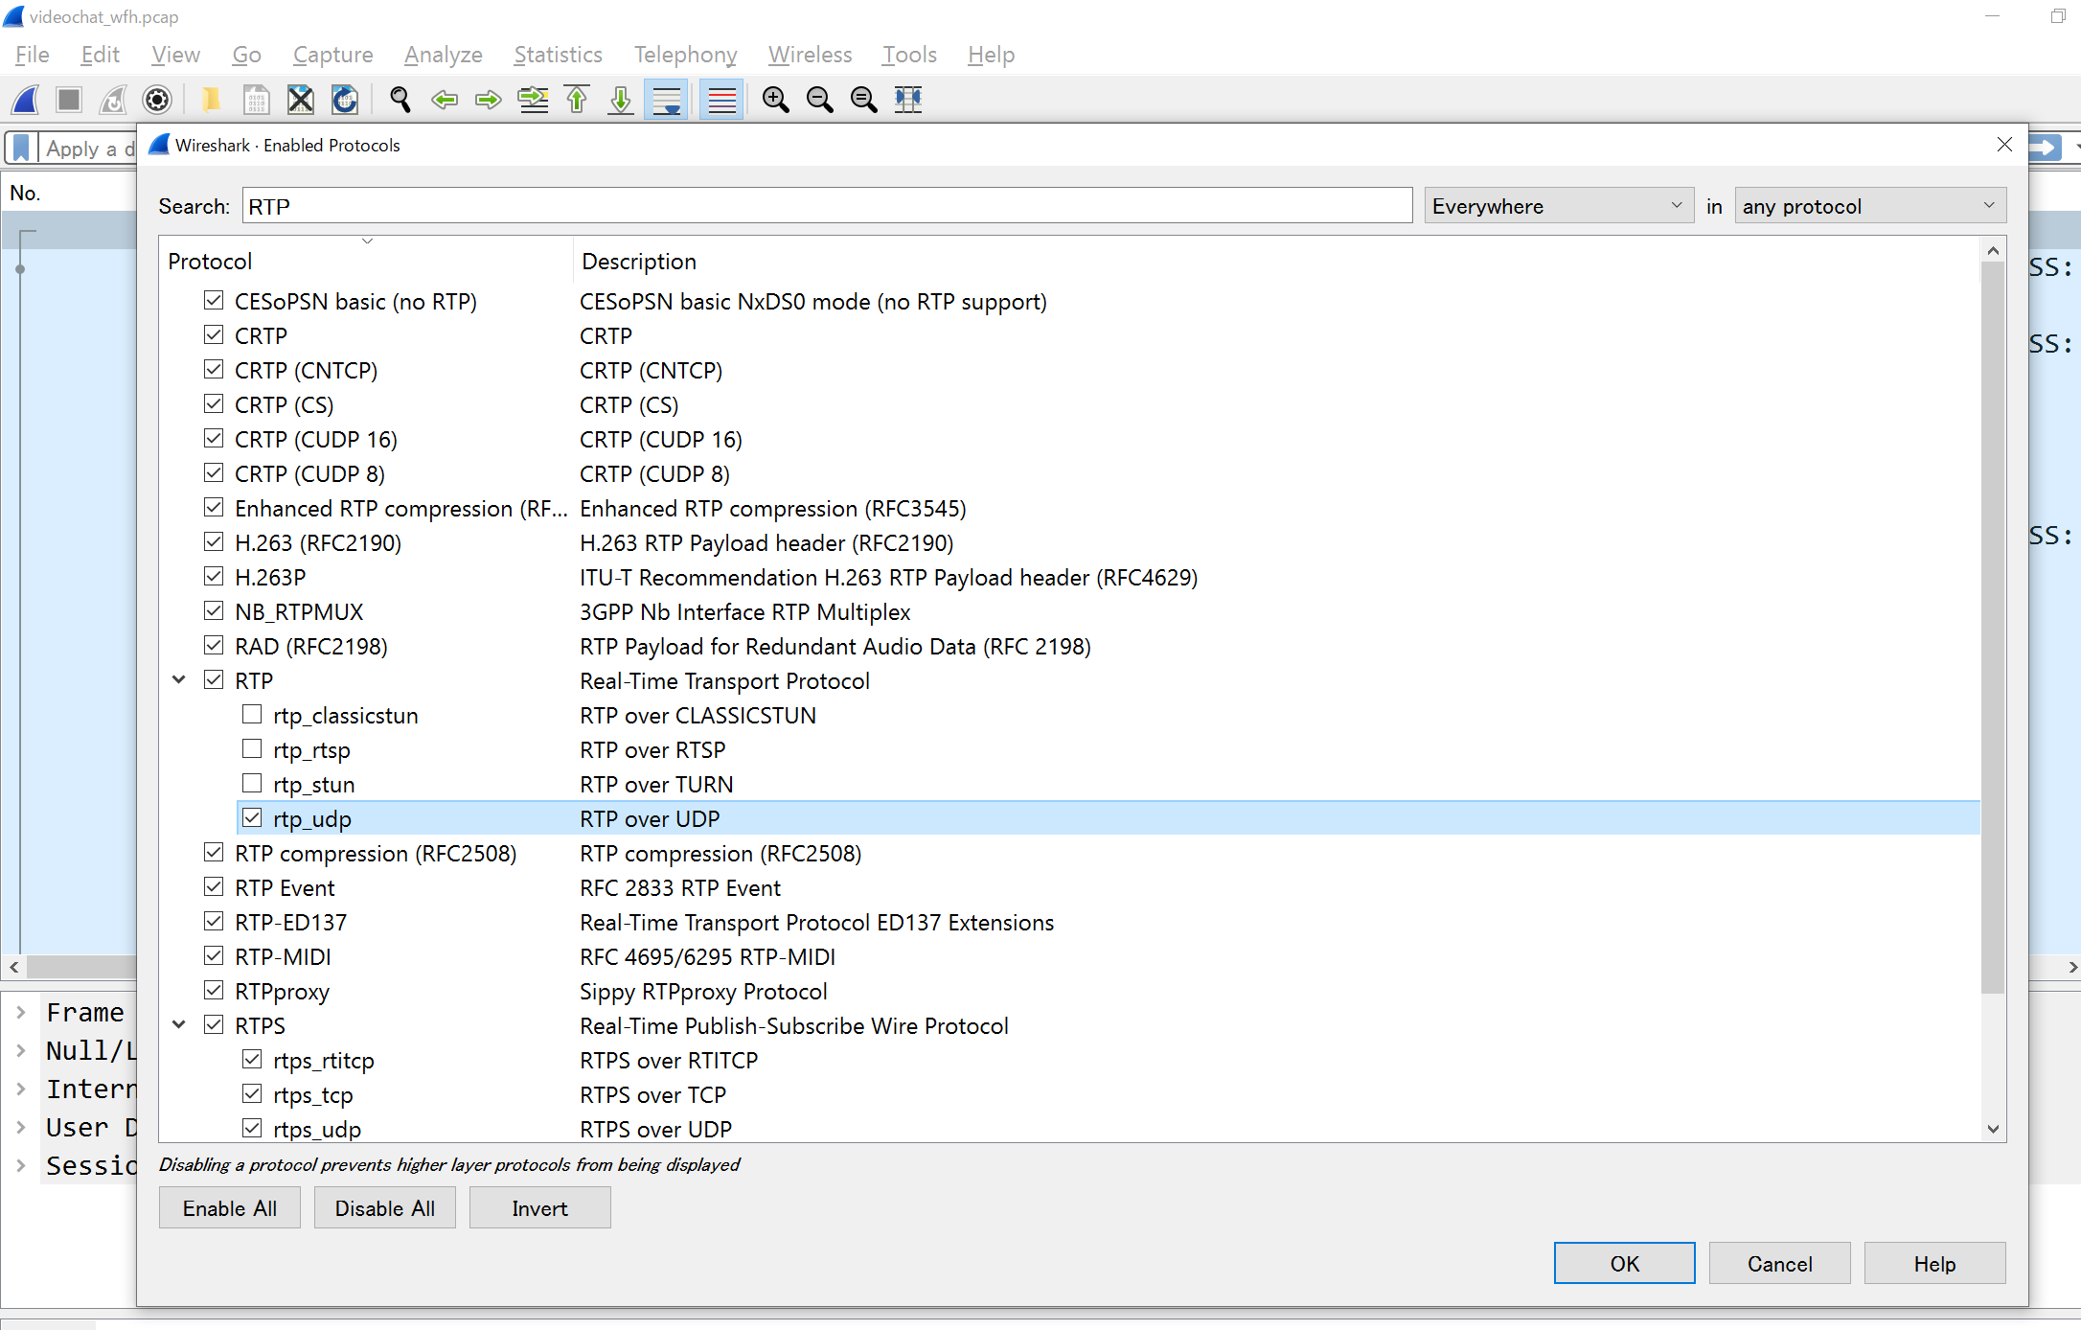
Writeup [3/9]
check the “rtp_udp” box → click “OK” button

Slide 6
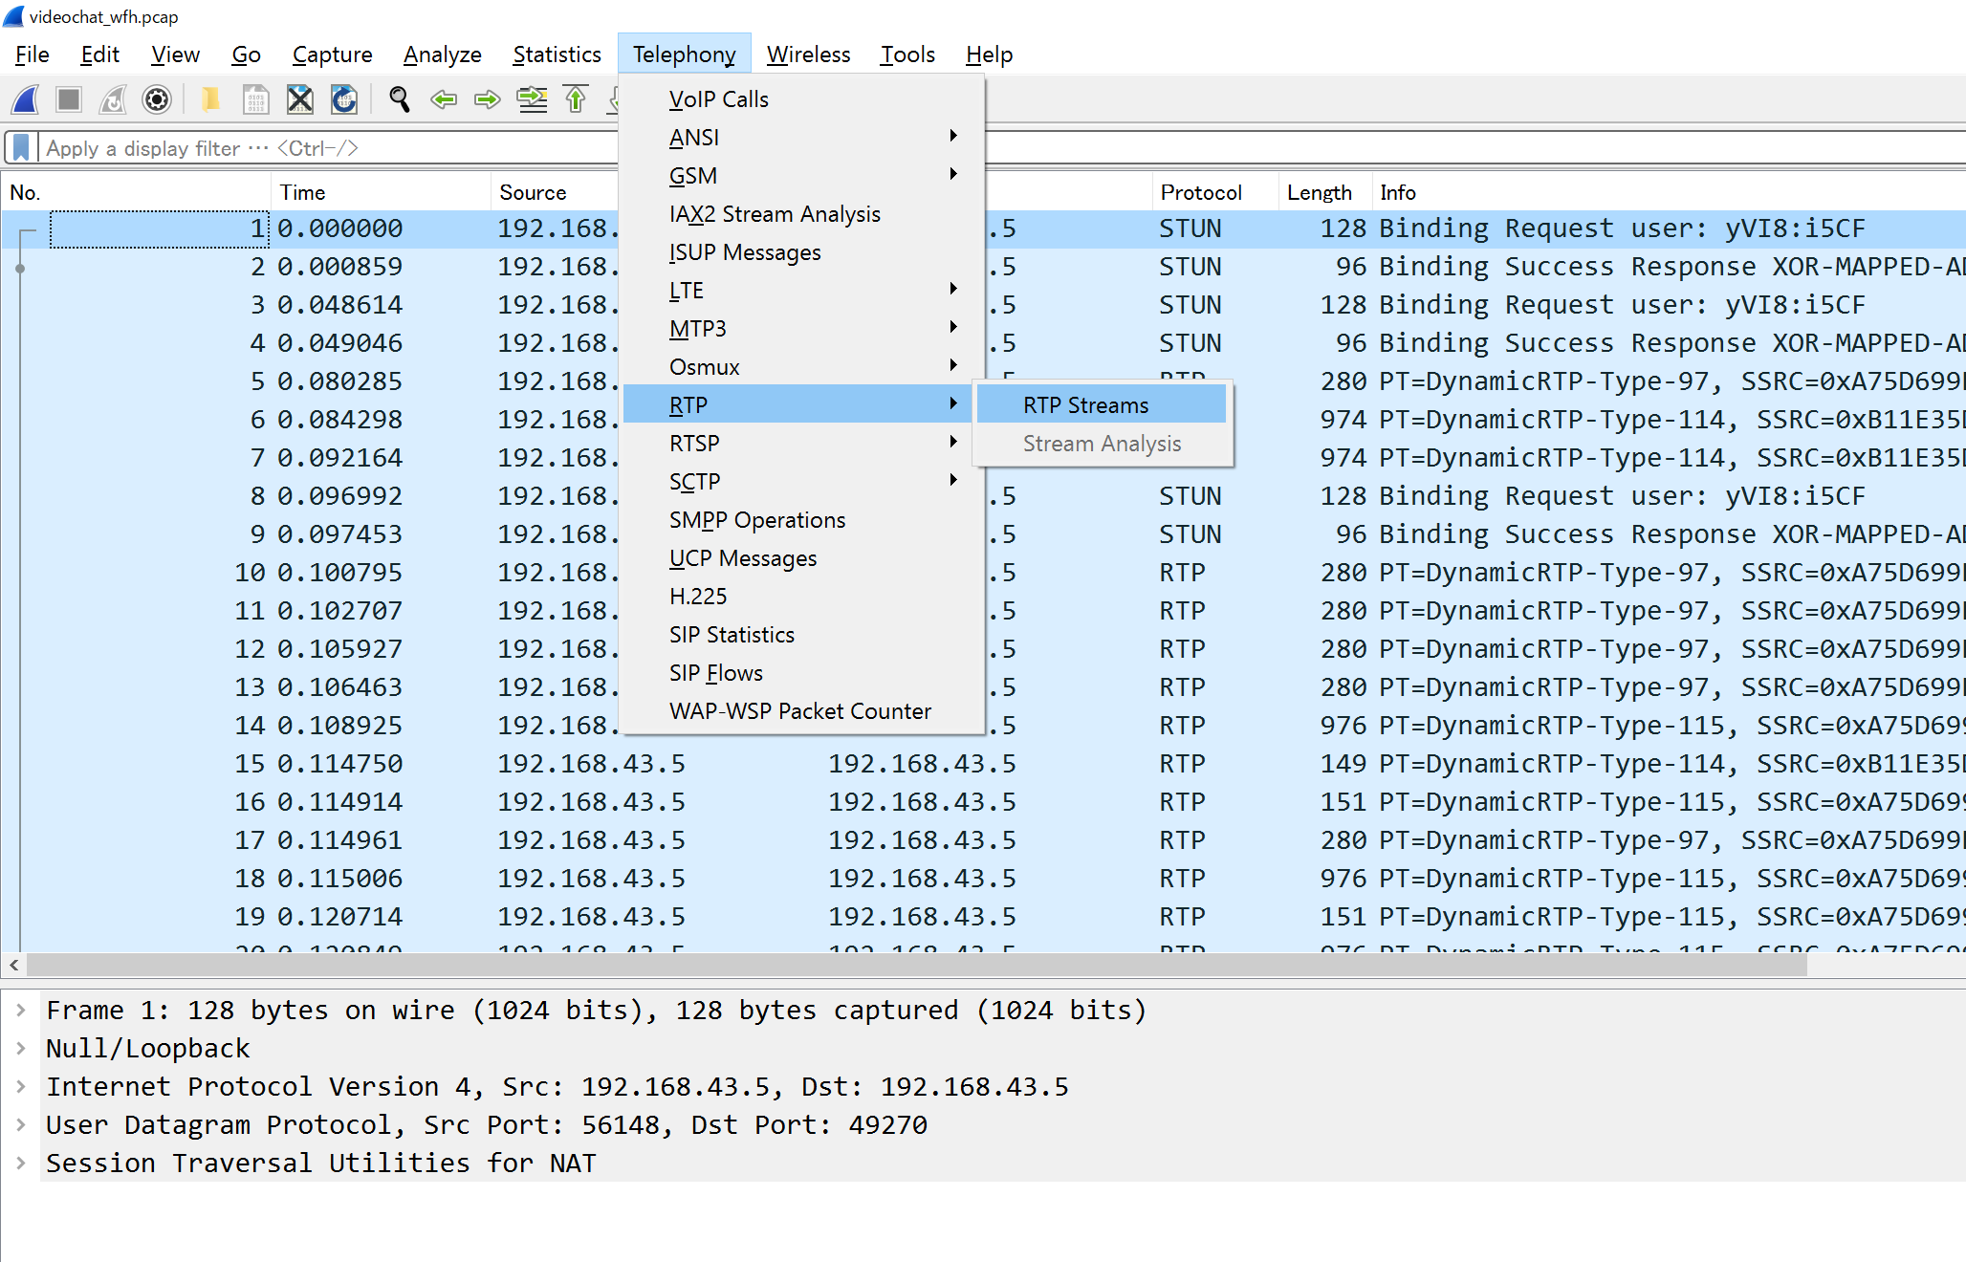
Writeup [4/9]
Click ”Tehephony” tab, and select “RTP ”-> “RTP Stream”

Slide 7
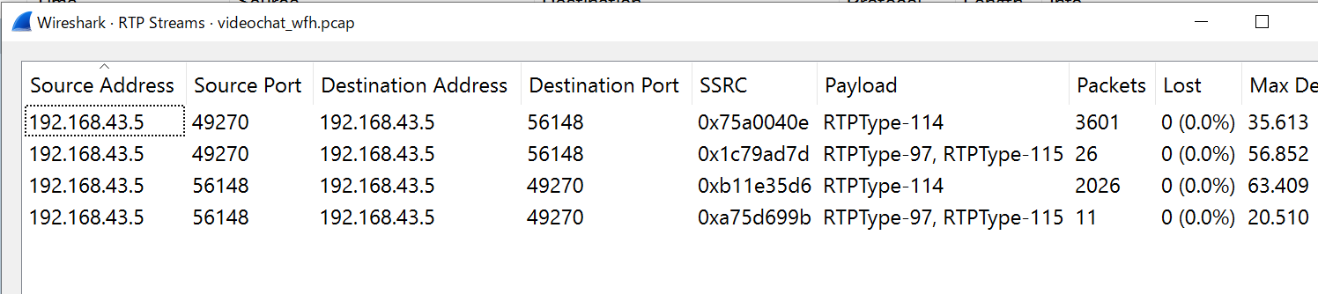

Writeup [5/9]
chat window 1
Video Stream (SSRC 0x75a005e) & Audio Stream (SSRC 0x1c79ad7d)
chat window 2
Video Stream (SSRC 0xb11e35d6) & Audio Stream (SSRC 0x75d699b)
Since the microphone was turned off, there are (almost) no packets on the audio stream
Chat window1
Chat window2
Video stream
Audio stream
Video stream
Audio stream

Slide 8
Writeup [6/9]
Reconstruct the video data using video_replay
How to build ＆install video_replay
1. Read and follow the following web page to create correct environment
http://webrtc.github.io/webrtc-org/native-code/development/prerequisite-sw/
2. Execute following commands.
$mkdir webrtc-checkout
$cd webrtc-checkout/
$fetch --nohooks webrtc
$gclient sync
$cd src
$gn gen out/Default
$ninja -C out/Default video_replay

Slide 9
Writeup [7/9]
How to use video_replay (/webrtc-checkout/src/out/Default/ )
./video_replay -input_file [target file] -codec [Type of codec]
-media_payload_type [Payload Type] -red_payload_type [Payload Type] -ssrc [id]
Options and the actual parameters
./video_replay
Program name
-input_file
Target file name (videochat_wfh.pcap)
-codec
Type of codec (Generally the codec is VP8)
-media_payload_type
Payload Type number (The Google Chrome sets 96 for the VP8)
http://webrtc.github.io/webrtc-org/testing/wireshark/
“The ones we are interested in typically have a payload type 96 (VP8 in Chrome)”
-red_payload_type
RED stands for REDundant coding and it is a RTP payload format defined in RFC 2198 for encoding redundant audio or video data (details are written in the next slide)
-ssrc
synchronization source identifier (details are written in the next slide)

Slide 10
Writeup [8/9]
[２]
[１]
[３]
RED_Payload_type can be identified from [1]
114
SSRC can be identified from [2] or [3]
0x75a0040e or 0xb11e35d6 (1973421070 or 2971547094 in Decimal)

Slide 11
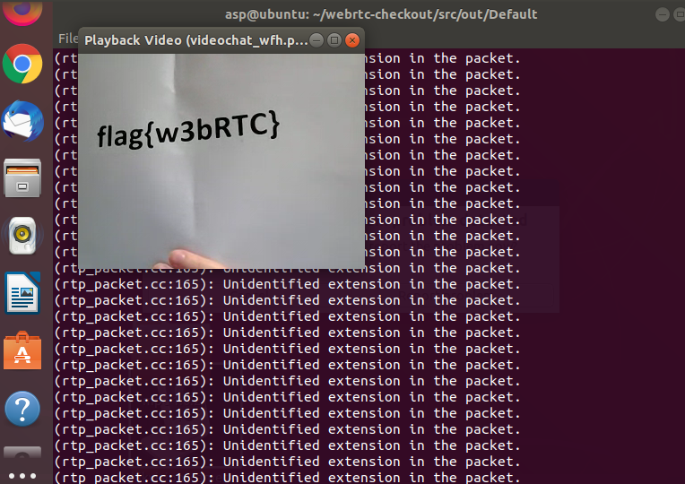
Writeup [9/9]
Actual commands
./video_replay -input_file videochat_wfh.pcap -codec VP8 -media_payload_type 96 -red_payload_type 114 -ssrc 2971547094
or
./video_replay -input_file videochat_wfh.pcap -codec VP8 -media_payload_type 96 -red_payload_type 114 -ssrc 1973421070
Result
Notes:
1973421070

Slide 12
flag
flag{w3bRTC}

