Slide 1
CONFERENCE PRESENTATION · 2026
Tracing Emotion Dynamics in Academic Writing
A Probe into Medical Research Articles
Ren Zhuoxuan
Center for Research in Applied Linguistics
Beijing Foreign Studies University
corpus.bfsu.edu.cn

Slide 2
CONTENTS
01
Research Questions
02
Literature Review
03
Research Design
04
Results
05
Implications
corpus.bfsu.edu.cn

Slide 3
01
SECTION ONE
Research Questions
What shape does emotion take as it unfolds across a medical research article?
corpus.bfsu.edu.cn

Slide 4
01 — RESEARCH QUESTIONS
4 / 15
Motivation & Questions
Emotion arcs have been studied in novels and films — but academic discourse has received little attention from this perspective. Most existing studies represent emotion as simply positive or negative. The VAD dimensional model offers a finer-grained analysis, yet has rarely been applied to academic writing.
RQ 1
Do medical research articles exhibit identifiable emotion trajectories across the three VAD dimensions (Valence, Arousal, Dominance)?
RQ 2
Do these trajectories differ systematically across the four IMRaD sections — Introduction, Methods, Results, and Discussion?
corpus.bfsu.edu.cn

Slide 5
02
SECTION TWO
Literature Review
What do we know about emotion in academic writing — and where are the gaps?
corpus.bfsu.edu.cn

Slide 6
02 — LITERATURE REVIEW
6 / 15
What We Know — and the Gaps
1. Positivity Bias
2. Section-Level Variation
Studies document a linguistic positivity bias across academic genres — a tendency toward positive expression that has strengthened over time.
Sentiment scores vary across discourse units (sections, moves), suggesting emotion is patterned by communicative function.
3. Methodological Limit
4. The VAD Model
Existing studies assign a single score to a predefined unit — they cannot capture how emotion shifts continuously over an article.
Valence (pleasant↔unpleasant) · Arousal (activated↔calm) · Dominance (in-control↔submissive) — rarely applied to academic writing.
Research Gap: Emotion arcs have been identified in novels and films — but academic discourse has received little attention, and the VAD model remains underused in genre analysis.
corpus.bfsu.edu.cn

Slide 7
03
SECTION THREE
Research Design
Corpus, lexicon, rolling-window method, and statistical framework.
corpus.bfsu.edu.cn

Slide 8
03 — RESEARCH DESIGN
8 / 15
Corpus & Method
CORPUS
ROLLING-WINDOW PROCEDURE
3,600
medical research articles IMRaD structure, auto-extracted
1
Score each word using the NRC-VAD Lexicon on V, A, D scales
13.6 M
total tokens across the corpus
2
Slide a 500-token window one token at a time; compute average VAD at each position
STATISTICAL TESTS
A
RQ1: Spearman's rho — each article vs. corpus median trajectory
3
Normalize each article's trajectory to a common scale (0–100%)
B
RQ2: Friedman test + Kendall's W (effect size) — section-level VAD differences
4
Map onto the IMRaD structure → three continuous emotion curves per article
corpus.bfsu.edu.cn

Slide 9
04
SECTION FOUR
Results
Valence and Dominance stay positive — but Arousal tells a different, highly consistent story.
corpus.bfsu.edu.cn

Slide 10
04 — RESULTS
10 / 15
VAD Trajectories: Overview
Valence & Dominance
V & D
Arousal
A ★
› Both remain positive throughout — consistent with the documented positivity bias
› Remains negative throughout — calm, low-activation register
› Cross-article shape consistency is low
› Traces a clear fall-rise arc: lowest in Methods, peak in Discussion
› Median Spearman's ρ for Valence = 0.064
› Median Spearman's ρ = 0.758 — strong cross-article consistency
Individual articles do NOT share a common trajectory shape on V and D. No identifiable arc.
This arc is reliably reproduced across individual articles, aligning closely with IMRaD boundaries.
corpus.bfsu.edu.cn

Slide 11
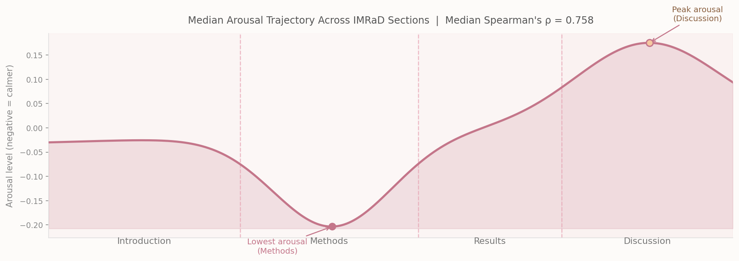
04 — RESULTS
11 / 15
The Arousal Arc Across IMRaD Sections
corpus.bfsu.edu.cn

Slide 12
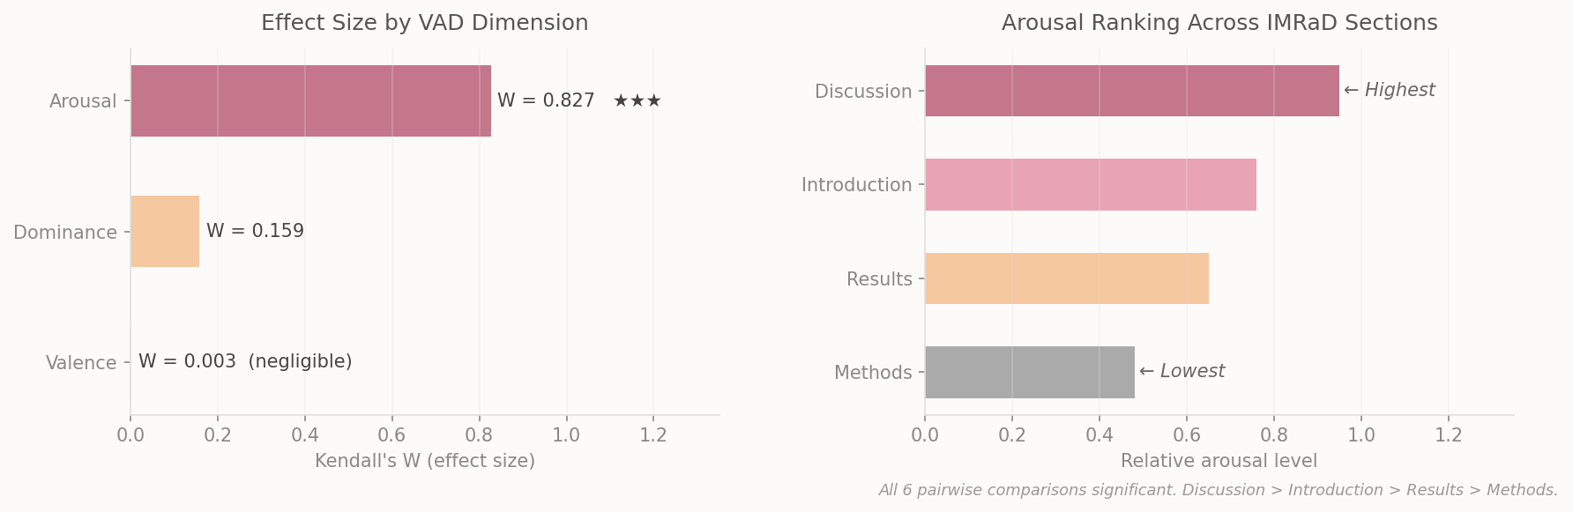
04 — RESULTS
12 / 15
Section-Level Differences (Friedman Tests)
corpus.bfsu.edu.cn

Slide 13
05
SECTION FIVE
Implications
What these findings mean for theory, methodology, and language teaching.
corpus.bfsu.edu.cn

Slide 14
05 — IMPLICATIONS
14 / 15
Three Layers of Significance
🔬
⚙
📚
THEORETICAL
METHODOLOGICAL
PEDAGOGICAL
› VAD dimensions capture distinct aspects of affect — they are not interchangeable
› Rolling window + time normalization + IMRaD mapping = replicable framework
› Different IMRaD sections carry different affective expectations
› Arousal is sensitive to genre-internal functional variation
› Applicable across disciplines, genres, historical periods
› Guide students to manage emotional resources deliberately across sections
› Dimensional models offer a richer lens than polarity analysis
› Adapts the emotion-arc approach from fiction to academic discourse
› High-contribution words → basis for an ESP-oriented pedagogical lexicon
corpus.bfsu.edu.cn

Slide 15
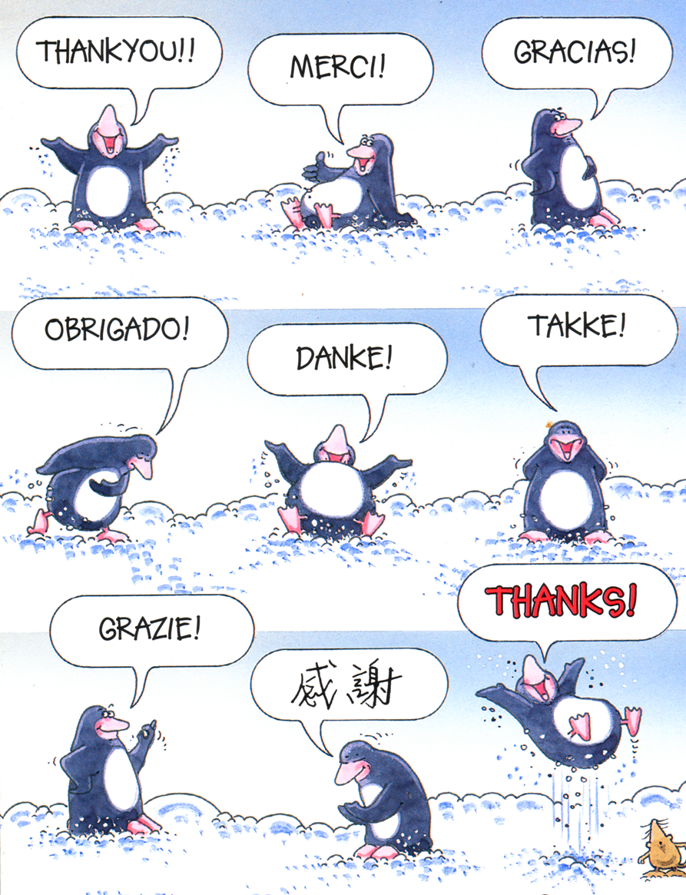
Thank You
Any questions, comments, or suggestions are most welcome.
Ren Zhuoxuan · corpus.bfsu.edu.cn

