Slide 1
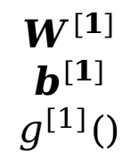







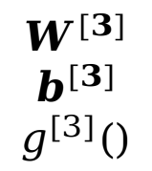
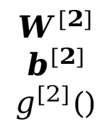

$$x$$
$$y$$
$$x_{1}$$
$$y_{1}$$
$$x_{2}$$
$$y_{2}$$
$$x_{3}$$
$$y_{3}$$
$$W^{[1]}$$
$$b^{[1]}$$
$$g^{[1]}()$$
$$W^{[2]}$$
$$b^{[2]}$$
$$g^{[2]}()$$
$$W^{[3]}$$
$$b^{[3]}$$
$$g^{[3]}()$$

Slide 2
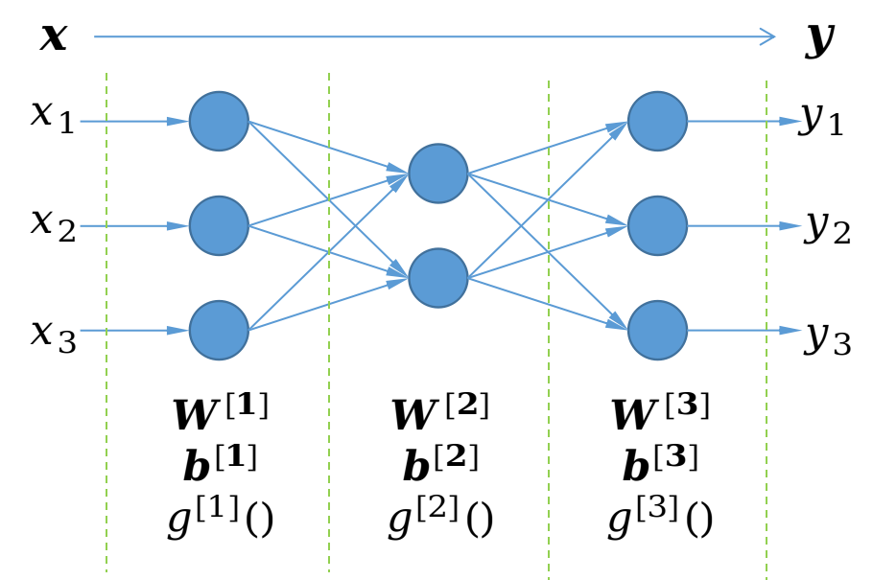
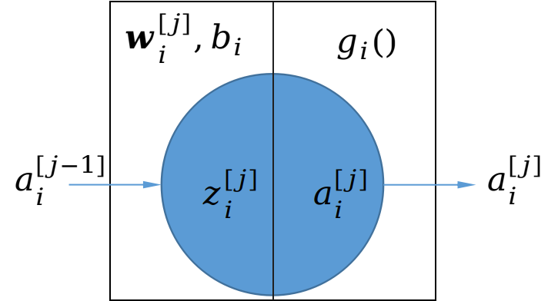

$$a^{[j−1]}$$

Slide 3
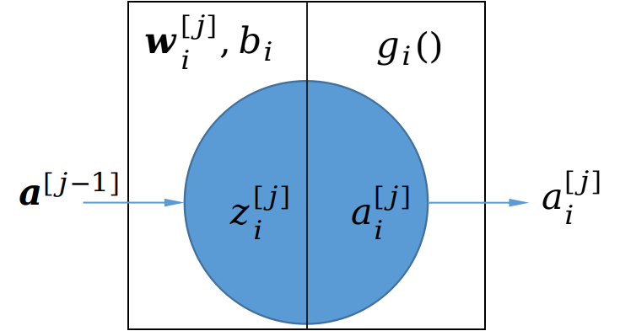

Slide 4
Conv
7F-2S-3P-64#
4a
aux-1
4b
max
3F-2S-0P
3a
5a
max
3F-2S-0P
max
3F-2S-0P
4c
max
3F-2S-0P
avg
7F-2S-0P
FC
#class
3b
5b
Conv
1F-1S-0P-64#
aux-2
4d
Conv
3F-1S-1P-192#
4e

Slide 5
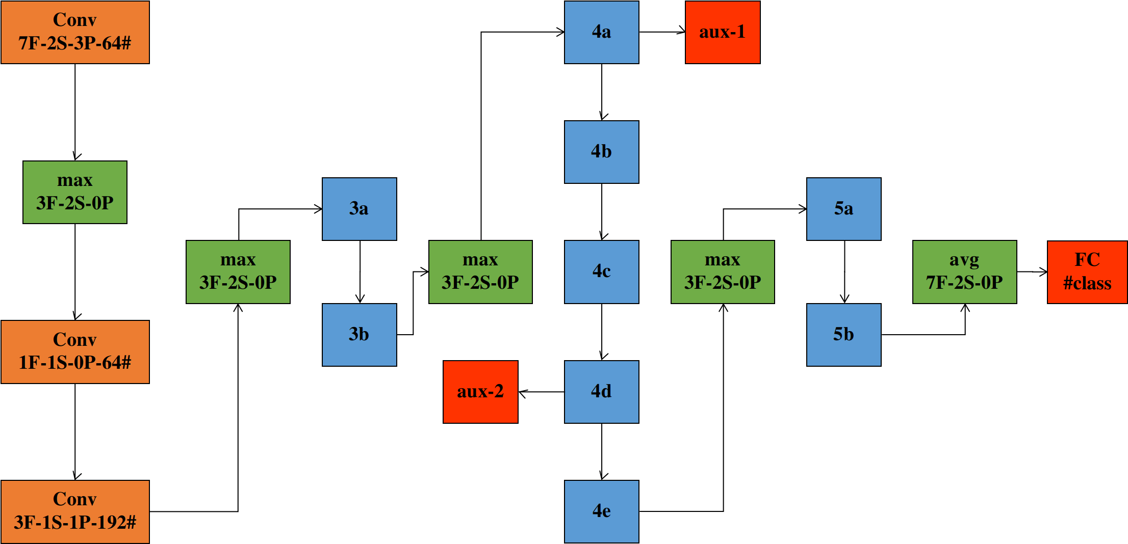

Slide 6
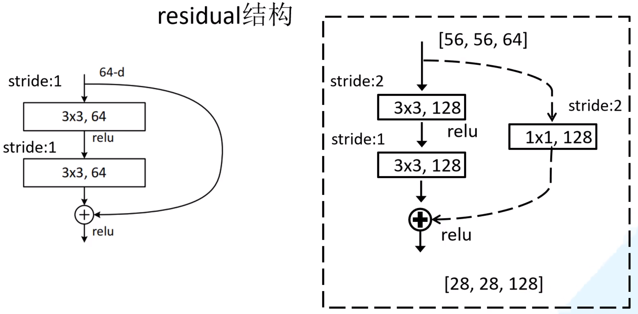
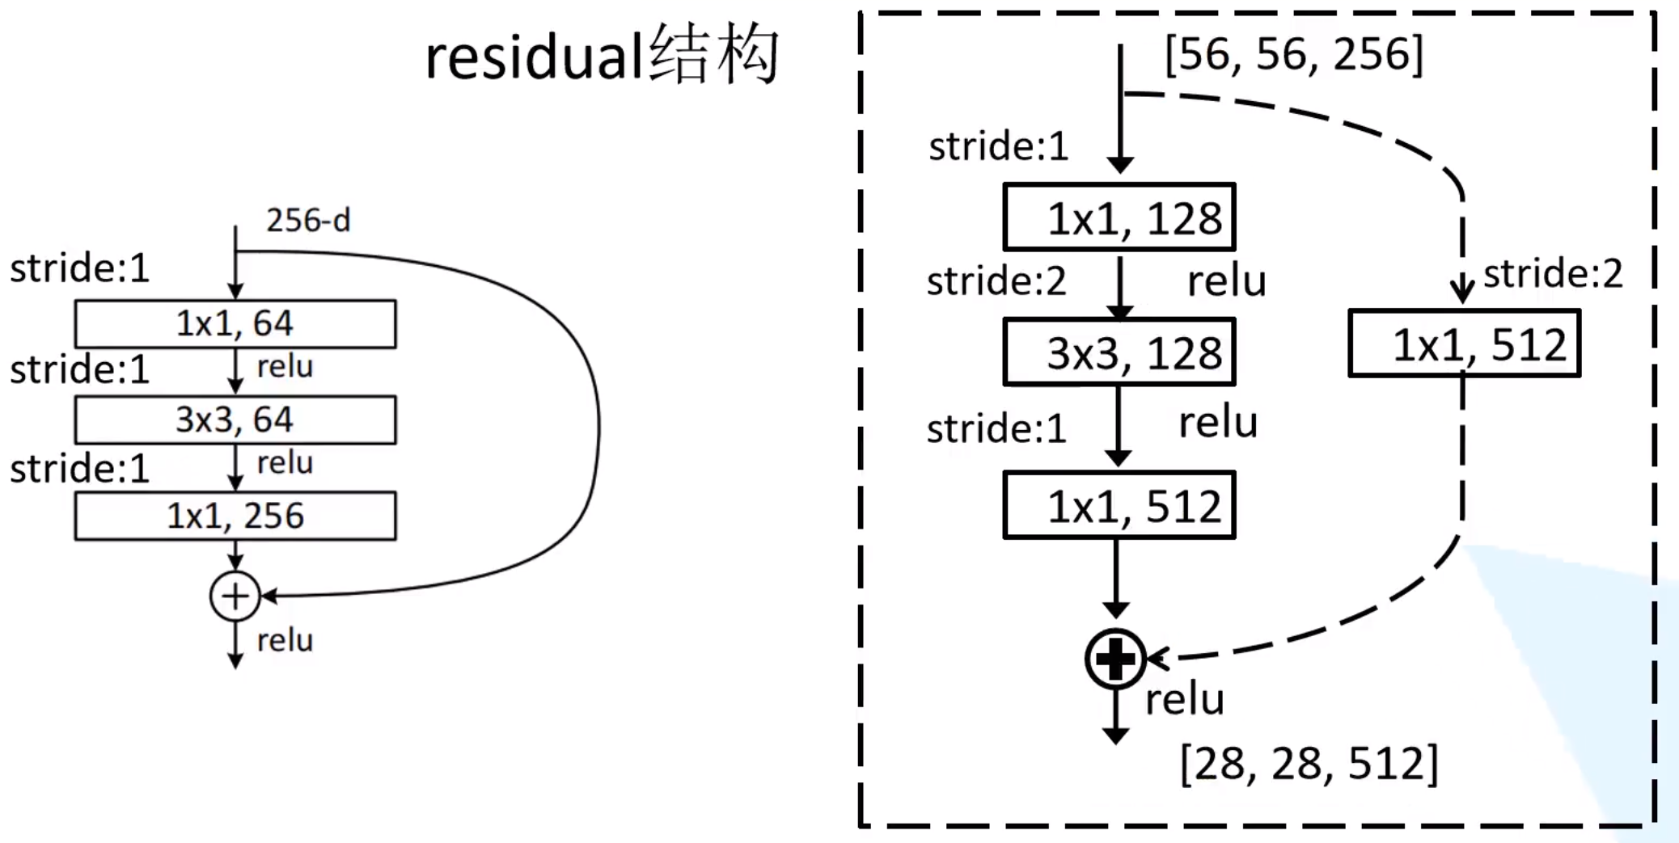

Slide 7
0
InvertedResidual
······
1
InvertedResidual
······
2
InvertedResidual
1.conv
Sequential
1.conv.1
Conv2d
1.conv.1.weight
1.conv.2
BatchNorm2d
1.conv.2.weight
1.conv.2.bias
1.conv.2.running_mean
1.conv.2.running_var
1.conv.2.num_batch_tracked
1.conv.0
ConvBNRelu
1.conv.0.0
Conv2d
1.conv.0.0.weight
1.conv.0.1
BatchNorm2d
1.conv.0.1.weight
1.conv.0.1.bias
1.conv.0.1.running_mean
1.conv.0.1.running_var
1.conv.0.1.num_batch_tracked
1.conv.0.2
Relu6

Slide 8
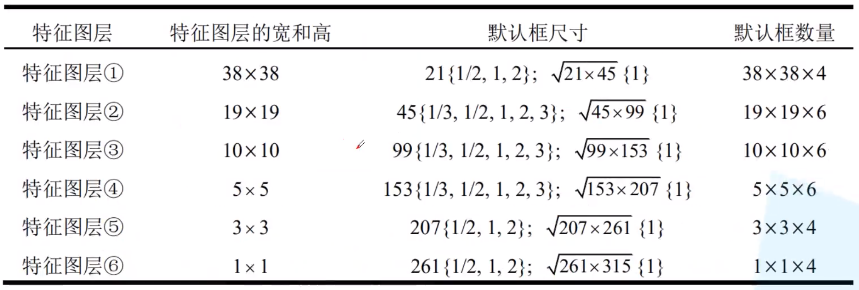

Slide 9
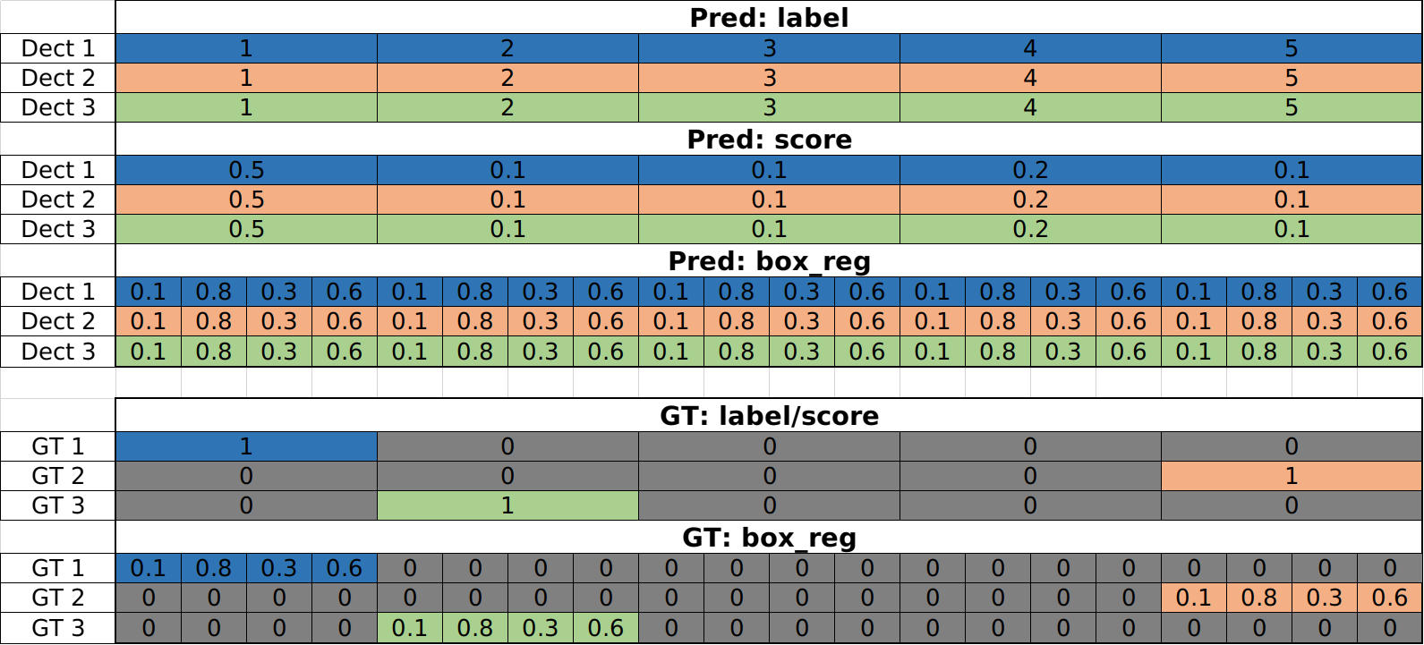
AssignGTbox2Anchor

Slide 10
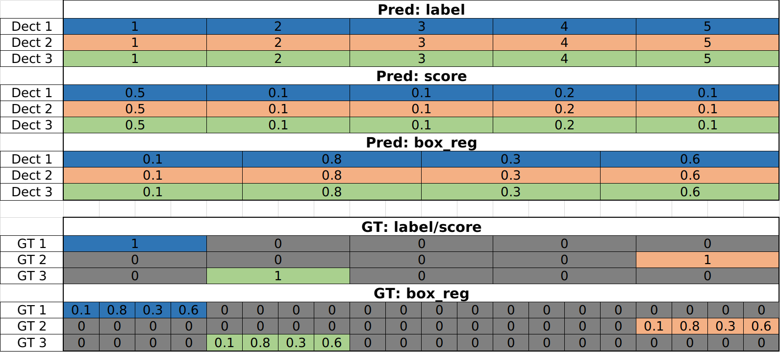
AssignGTbox2Anchor

Slide 11
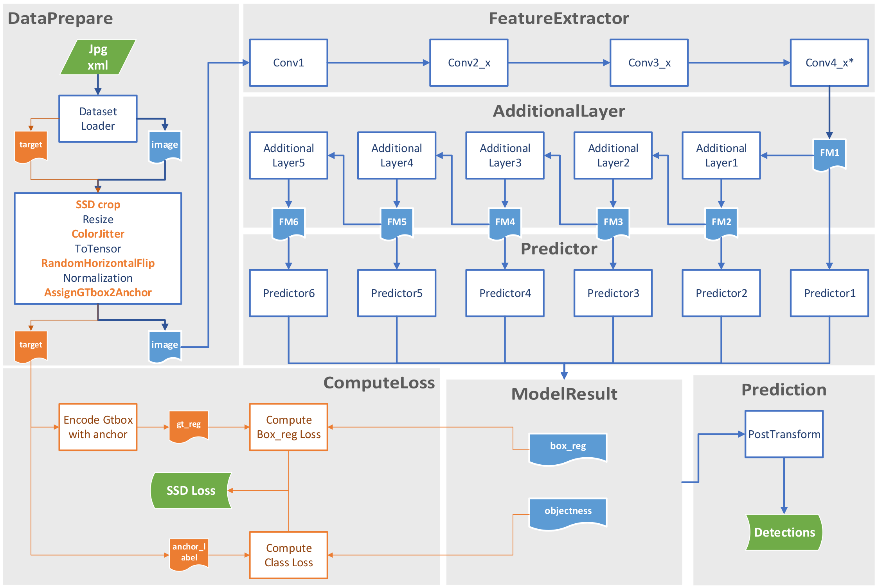

Slide 13
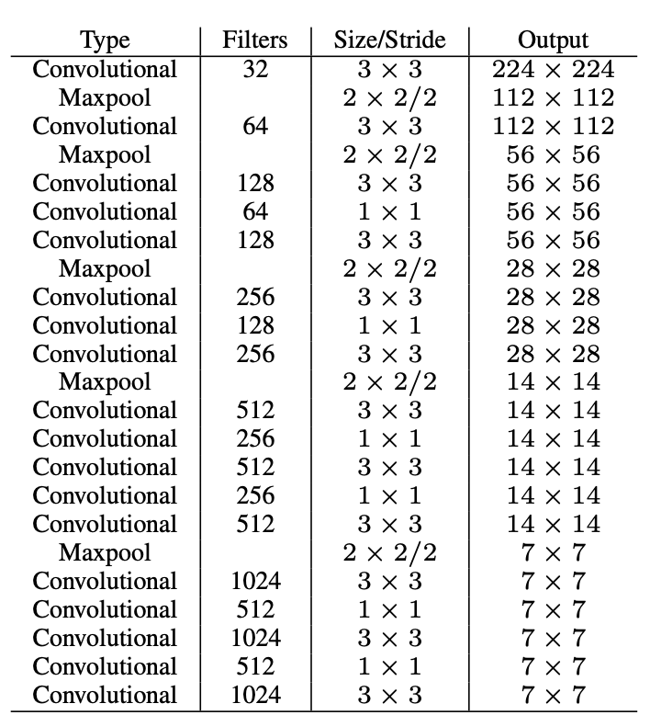
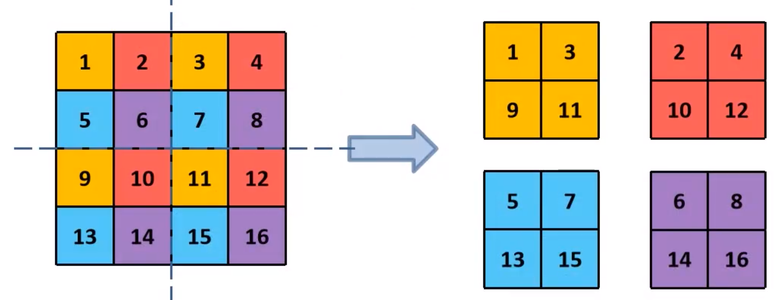
Convolutional
Conv2d
BN
LeakyRELU
Passthrough
HW减半
C乘以4
Convolutional
64# 1x1
Passthrough
Convolutional
1024# 3x3
14x14x512
14x14x64
7x7x256
7x7x1024
Concatenate
Conv2d
125# 1x1
7x7x1280
7x7x1024
7x7x1024
7x7x1024
Convolutional
1024# 3x3
Convolutional
1024# 3x3
output
7x7x(20+5)

Slide 14
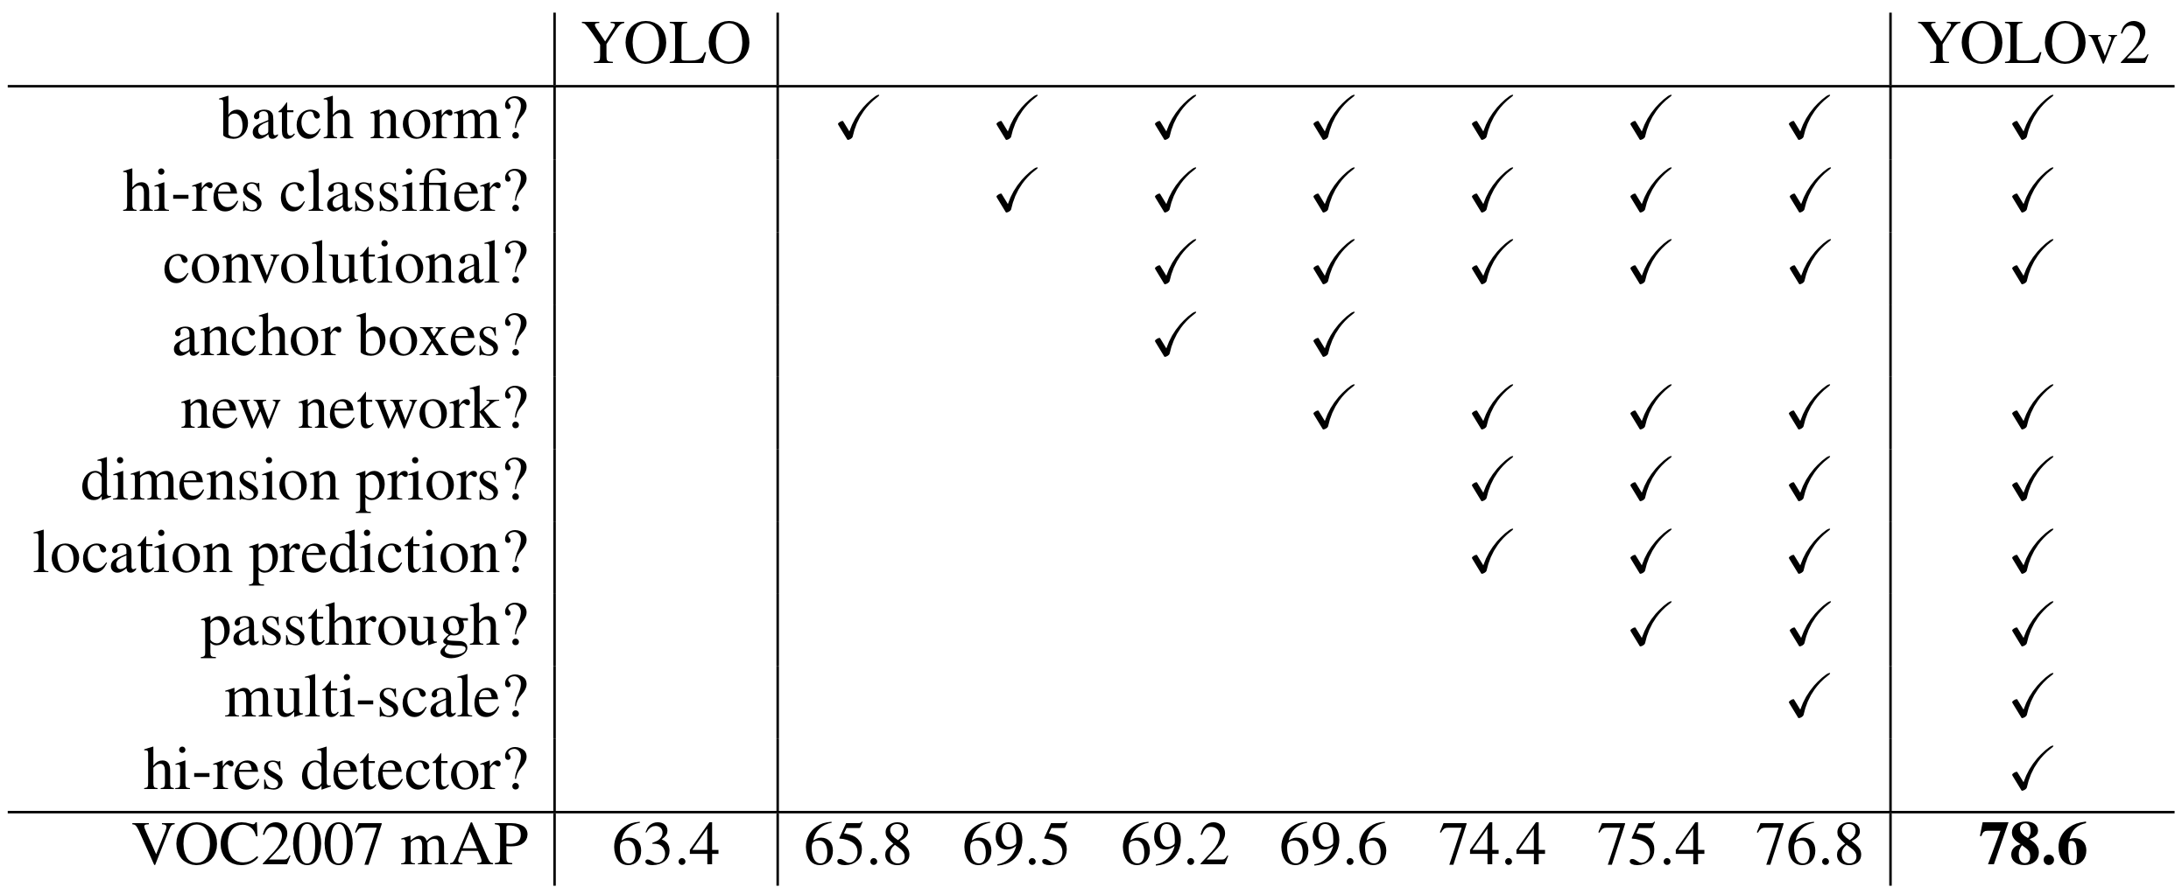

Slide 15
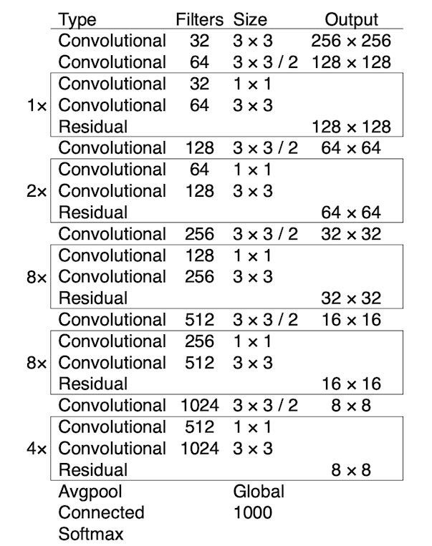
Convolutional
Conv2d
BN
LeakyRELU
Convolutional+Convolutional+Residual
Convolutional
Convolutional
+

Slide 16
Convolutional Set
Convln
1x1
Convln
3x3
Convln
1x1
Convln
3x3
Convln
1x1
set1:
set2:
set3:
512
256
128
1024
512
256
512
256
128
1024
512
256
512
256
128
output3
32x32x255
Convolutional Set3
Convolutional
256# 3x3
Conv2d
255# 1x1
32x32x384
32x32x128
32x32x256
32x32x256
Concatenate
以256x256的原始输入，80个类别，每个GridCell 3个anchor为例。
255 = 3 x (4 + 1 + 80)
COCO数据集聚类得到9个anchor尺寸，每层3个。
32x32x128
Upsampling
16x16x128
Convolutional
128# 1x1
16x16x768
16x16x256
16x16x512
Convolutional Set2
Convolutional
512# 3x3
Conv2d
255# 1x1
output2
16x16x5x255
16x16x768
Concatenate
16x16x256
Upsampling
8x8x256
16x16x512
Convolutional
256# 1x1
8x8x1024
8x8x512
8x8x1024
8x8x1024
Convolutional Set1
Convolutional
1024# 3x3
Conv2d
255# 1x1
output1
8x8x255

Slide 17
 | 0 | 1 | 2 | 3
logits1 | 2 | -3 | 0.8 | 1.2
logits2 | 1.5 | -0.1 | 0.9 | -1.3
 | 0 | 1 | 2 | 3
GT1 | 0 | 0 | 1 | 0
GT2 | 0 | 1 | 0 | 0
Given
CrossEntropyLoss
L1 = -(0*ln 0.5691
+ 0*ln 0.0038
+ 1*ln0.1714
+ 0*ln0.2557) = 1.7637
L2 = 2.1937
L = (L1 + L2) / 2 = 1.9790
softmax | 0 | 1 | 2 | 3
s1 | 0.5691 | 0.0038 | 0.1714 | 0.2557
s2 | 0.5520 | 0.1115 | 0.3030 | 0.0336
BCEWithLogitsLoss
L11 = - [0*ln0.8808 + (1-0)*ln(1-0.8808)] = 2.1269
L12 = - [0*ln0.0474 + (1-0)*ln(1-0.0474)] = 0.0485
L13 = - [1*ln0.6900 + (1-1)*ln(1-0.6900)] = 0.3710
L14 = - [0*ln0.7685 + (1-0)*ln(1-0.7685)] = 1.4631
L1 = (L11 + L12 + L13 + L14) / 4 = 1.0025
L2 = 0.9820
L = (L1 + L2) / 2 = 0.9922
sigmoid | 0 | 1 | 2 | 3
s1 | 0.8808 | 0.0474 | 0.6900 | 0.7685
s2 | 0.8176 | 0.4750 | 0.7109 | 0.2142
注：取消均值则两次平均都不做

Slide 18
A
D2
d
B
S = A + B + C + D1 + D2
I = B
U = A + B + C
c
D1
C

Slide 19
HARD
EASY
 | 0 | 1 | 2 | 3
GT | 0 | 1 | 0 | 0
logits | 0.7 | 0.1 | 0.1 | 0.1
 | 0 | 1 | 2 | 3
GT | 0 | 1 | 0 | 0
logits | 0.1 | 0.7 | 0.1 | 0.1
CE loss = -ln0.1 = 2.3
BCE loss = -ln0.3 - ln0.1 - ln0.9 - ln0.9 = 3.7
CE loss = -ln0.7 = 0.35
BCE loss = -ln0.9 - ln0.7 - ln0.9 - ln0.9 = 0.67

Slide 20
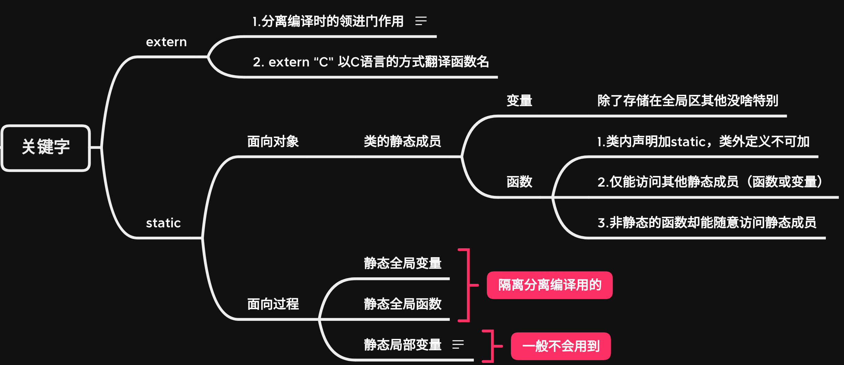

Slide 21
u
u
u.reset()
u
u.release()
null
null
p
obj
p
obj

Slide 22
事件：911事件元凶
假设空间：Θ={{本}，{萨}，{霍}，{本，萨}，{本，霍}，{萨，霍}，{本，萨，霍}}
令A={本，萨}，B为A的子集事件，C为A的关联事件
 |  |  |  | CIA | FBI | DS合成结果
 | A’ | A* | 本 | 0.4 | 0.2 | -
 | A’ | A* | 萨 | 0.3 | 0.2 | -
 |  |  | 霍 | 0.1 | 0.05 | -
A | A’ | A* | 本，萨 | 0.1 | 0.50 | -
 |  | A* | 本，萨，霍 | 0.1 | 0.05 | -
mass_{CIA}()
mass_{FBI}()

