Slide 1
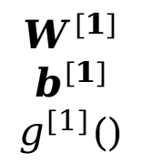







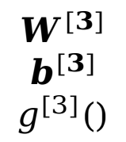
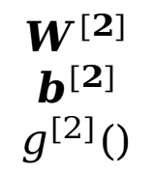

$$x$$
$$y$$
$$x_{1}$$
$$y_{1}$$
$$x_{2}$$
$$y_{2}$$
$$x_{3}$$
$$y_{3}$$
$$W^{[1]}$$
$$b^{[1]}$$
$$g^{[1]}()$$
$$W^{[2]}$$
$$b^{[2]}$$
$$g^{[2]}()$$
$$W^{[3]}$$
$$b^{[3]}$$
$$g^{[3]}()$$

Slide 2
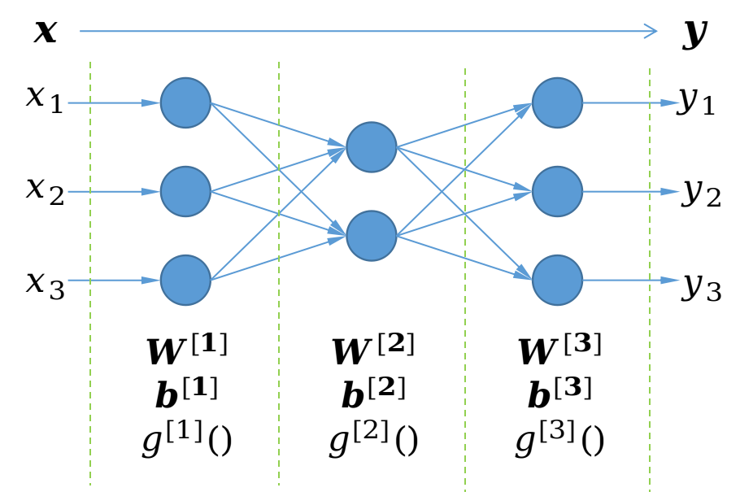
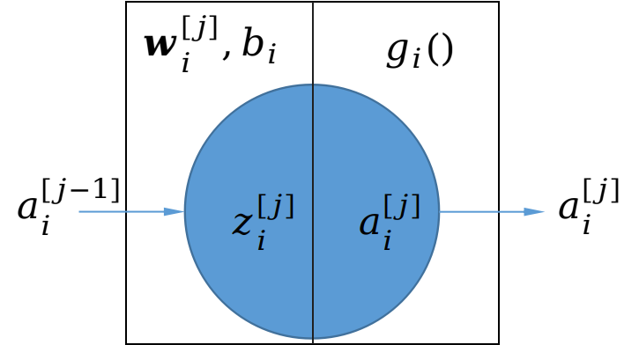

$$a^{[j−1]}$$

Slide 3
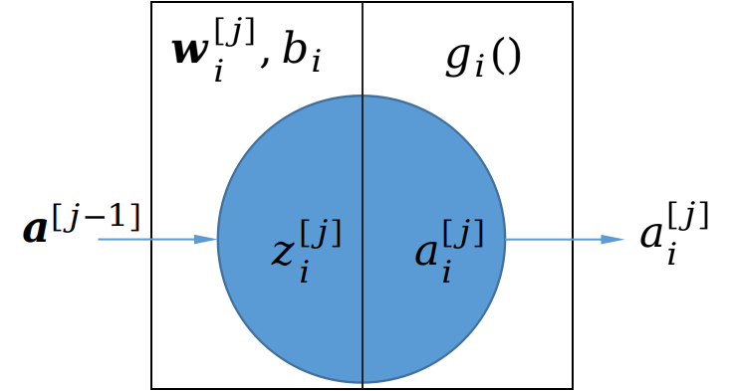

Slide 4
Conv
7F-2S-3P-64#
4a
aux-1
4b
max
3F-2S-0P
3a
5a
max
3F-2S-0P
max
3F-2S-0P
4c
max
3F-2S-0P
avg
7F-2S-0P
FC
#class
3b
5b
Conv
1F-1S-0P-64#
aux-2
4d
Conv
3F-1S-1P-192#
4e

Slide 5
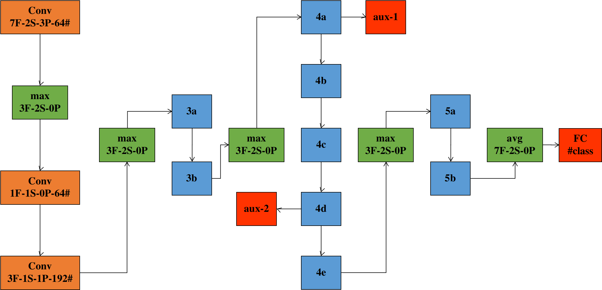

Slide 6
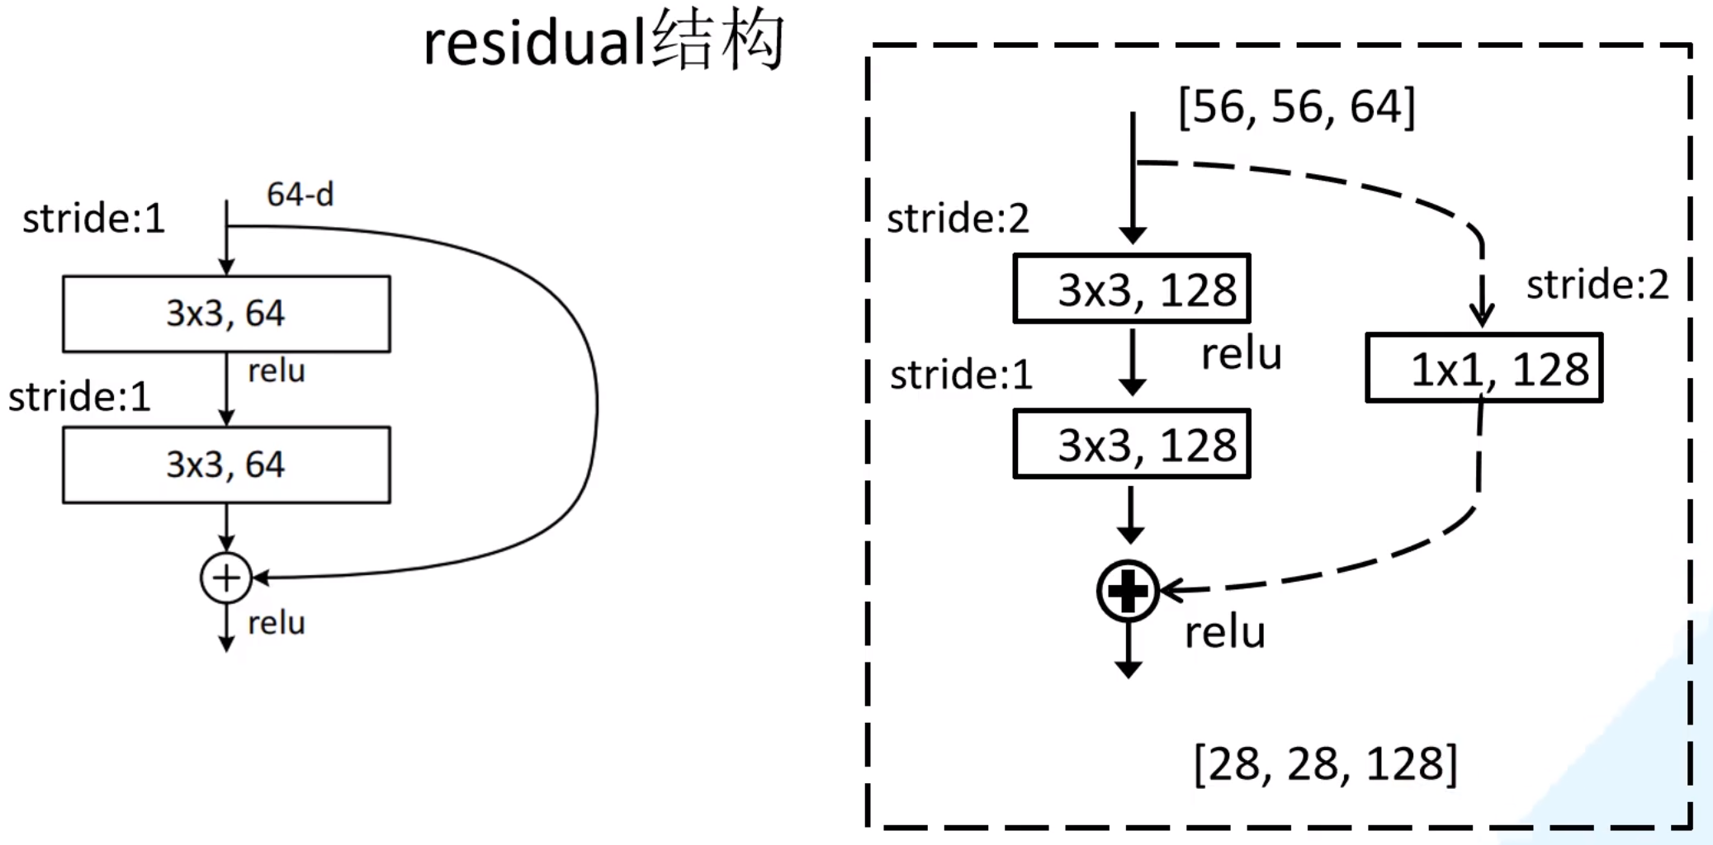
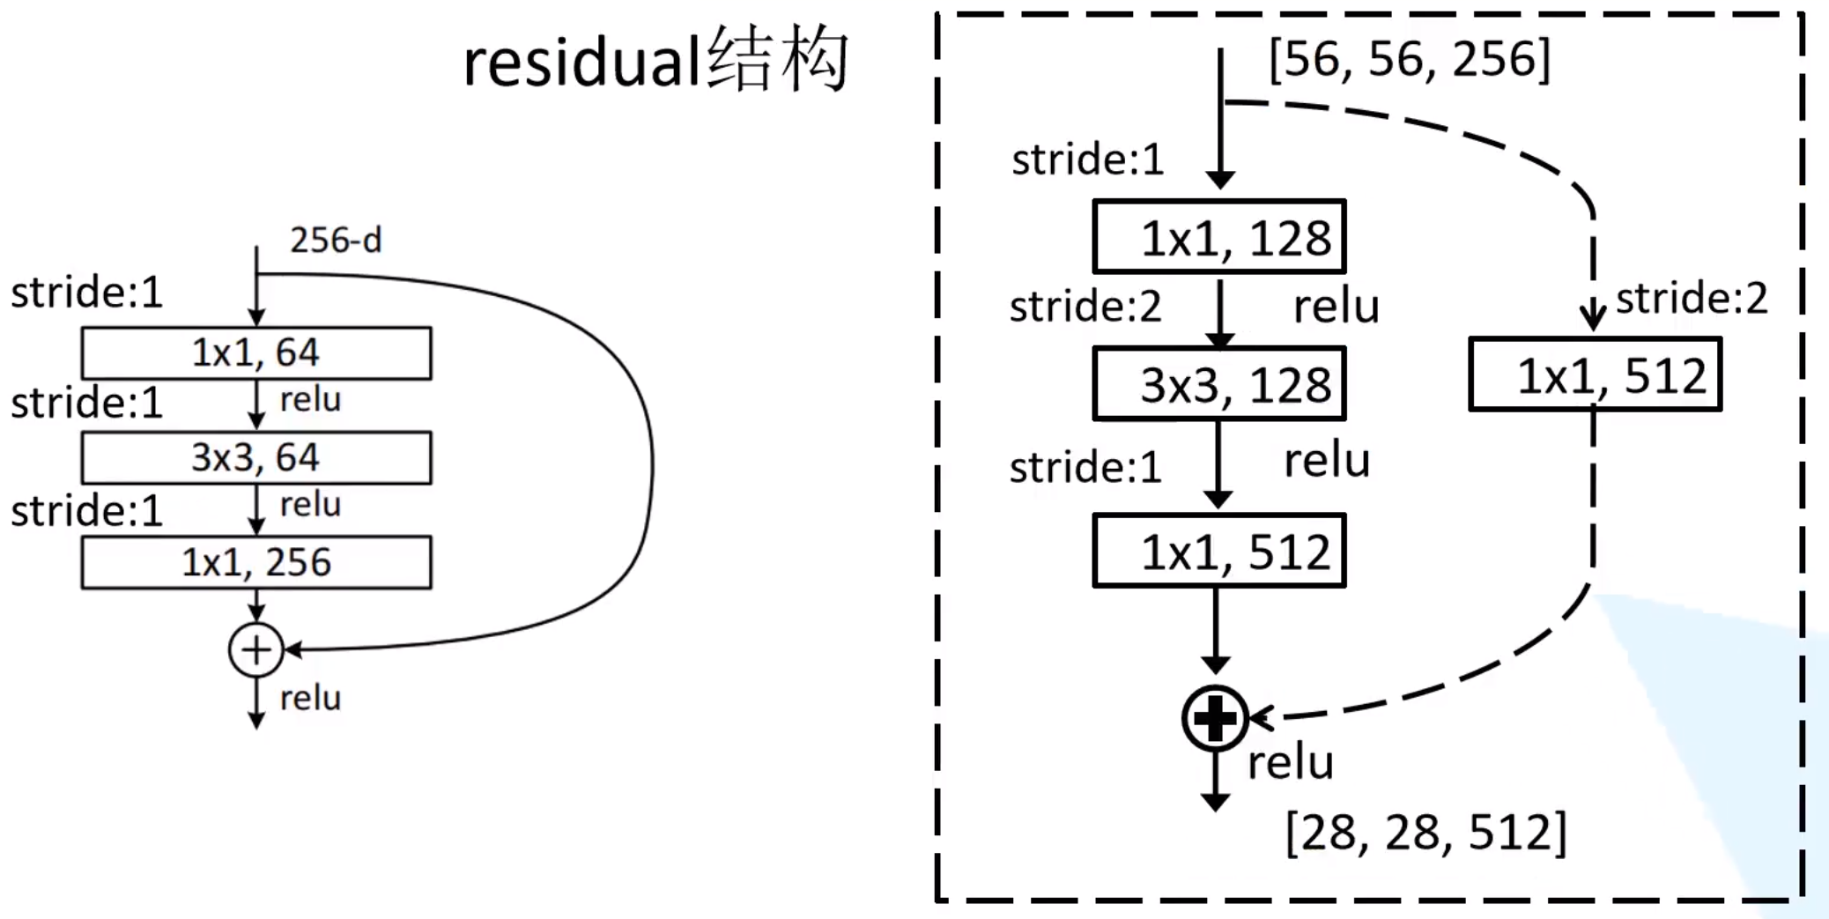

Slide 7
0
InvertedResidual
······
1
InvertedResidual
······
2
InvertedResidual
1.conv
Sequential
1.conv.1
Conv2d
1.conv.1.weight
1.conv.2
BatchNorm2d
1.conv.2.weight
1.conv.2.bias
1.conv.2.running_mean
1.conv.2.running_var
1.conv.2.num_batch_tracked
1.conv.0
ConvBNRelu
1.conv.0.0
Conv2d
1.conv.0.0.weight
1.conv.0.1
BatchNorm2d
1.conv.0.1.weight
1.conv.0.1.bias
1.conv.0.1.running_mean
1.conv.0.1.running_var
1.conv.0.1.num_batch_tracked
1.conv.0.2
Relu6

Slide 8
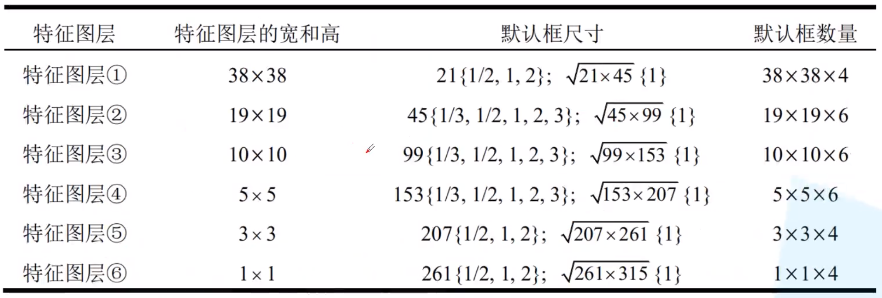

Slide 9
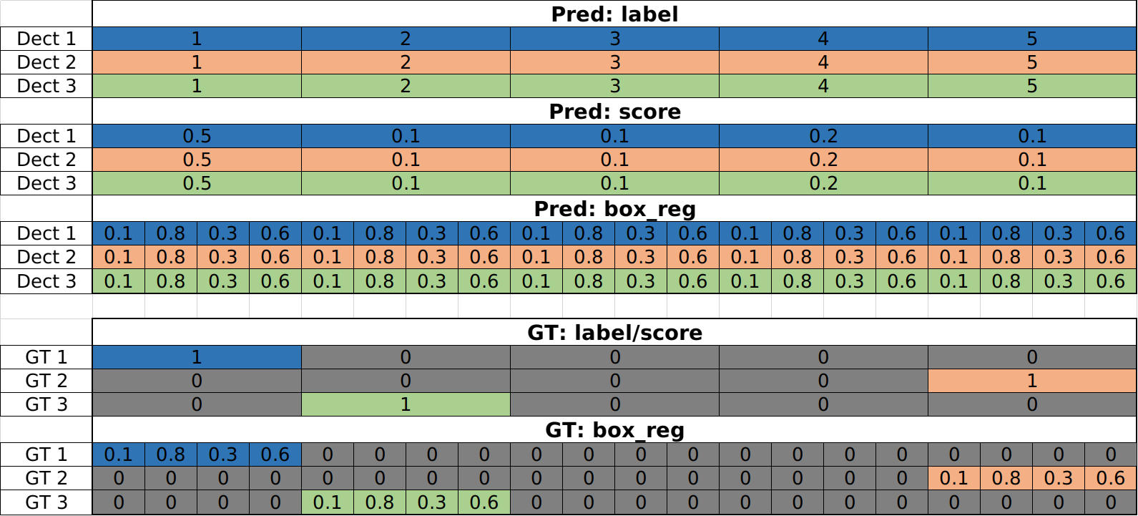
AssignGTbox2Anchor

Slide 10
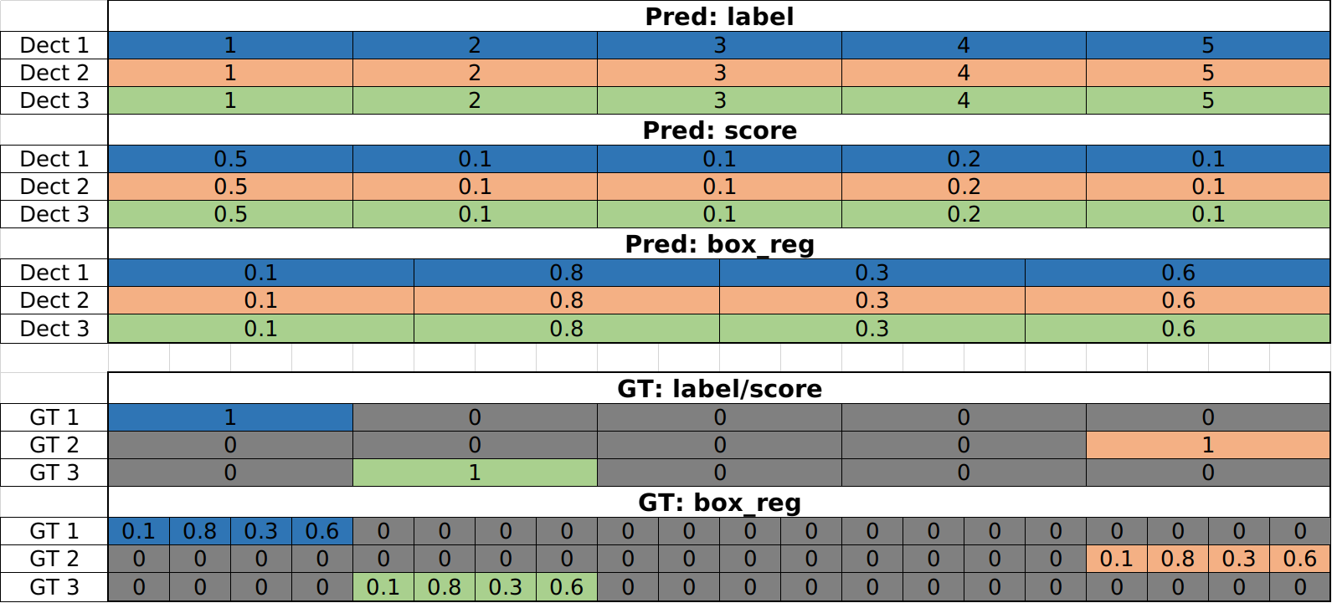
AssignGTbox2Anchor

Slide 11
