Slide 1

Created by:
Burak & Duarte
COUNTRY
CRM
MANAGER
Bachelor's Degree
Computer Engineering
& Data Science and A.I.

Slide 2
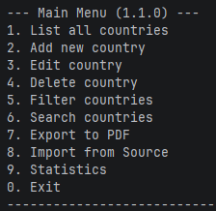
Introduction
Country CRM Manager is a robust Python console application designed to manage, analyze, and export country data. It provides a user-friendly interface for performing CRUD (Create, Read, Update, Delete)operations, advanced filtering, statistics visualization, and reporting.
This project demonstrates clean code principles, modular architecture, and real-world application features like PDF generation and bulk data handling.

Slide 3
Tools and Tech
Coding Language: Python
Development Environment: PyCharm
Data type: Json Files
Version Control System: Git
Library:
    FPDF2

Slide 4
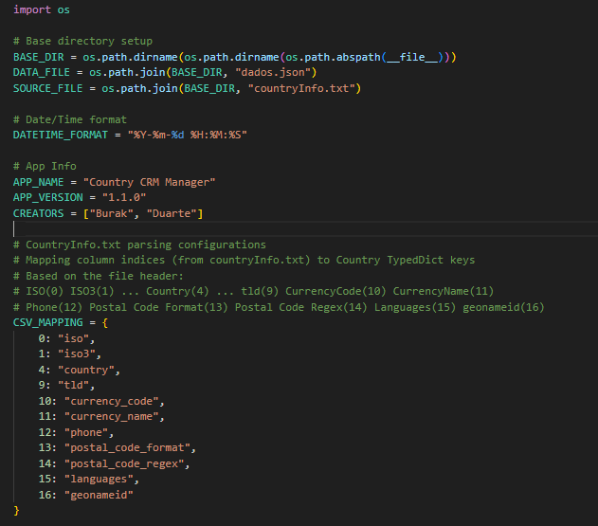
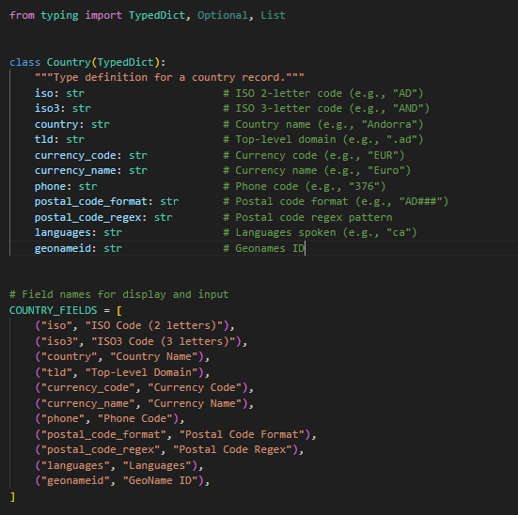
Application Structure
Constants
Types

Slide 5
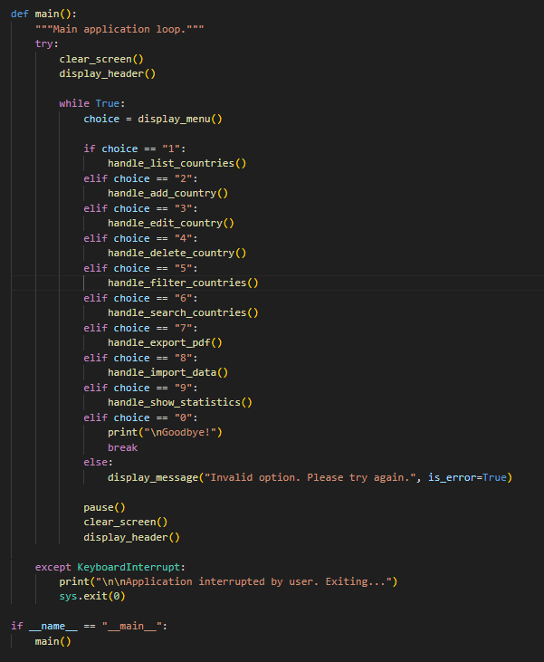
Functionalities
List all countries: View database. Options to sort and see details.
Add new country: Step-by-step wizard to create a record.
Edit country: Modify existing records by ISO code.
Delete country: Remove records.
Filter countries: Find specific subsets of data.
Search countries: Global text search.
Export to PDF: Generate countries_report.pdf.
Import from Source: Bulk load data from text files.
Statistics: View data insights.

Slide 6
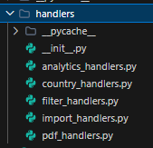
Handlers
What are Handlers? The handlers component acts as the Controller layer in our application's architecture. It serves as the bridge between:
Presentation Layer (menu_component): Reads user input and displays output.
Data Layer (data_handler, importer_component, pdf_component): Manages data storage and core business logic.
Key Responsibilities:
Orchestrating the flow for specific user actions (e.g., "Add Country").
Validating user input before passing it to the data layer.
Determining which UI messages to show based on operation success or failure.

Slide 7
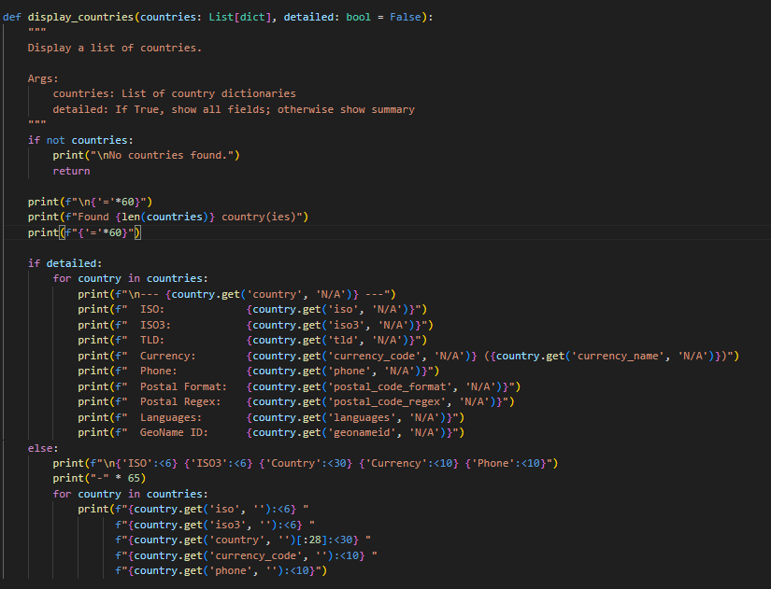
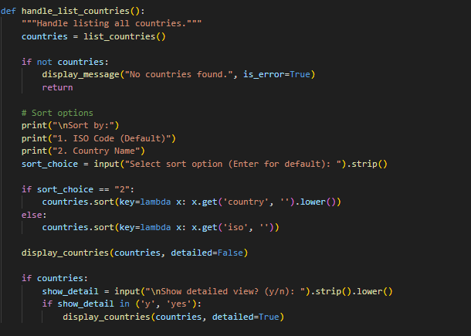
Handler
List Countries
Main Function

Slide 8
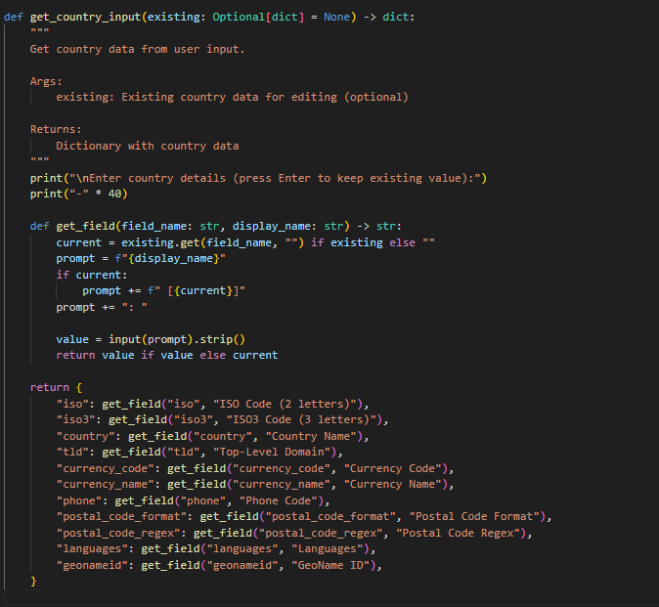
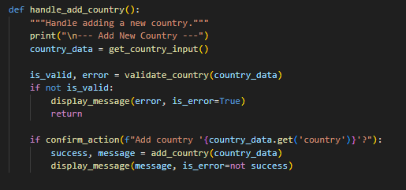
Handler
Add Country
Main Function

Slide 9
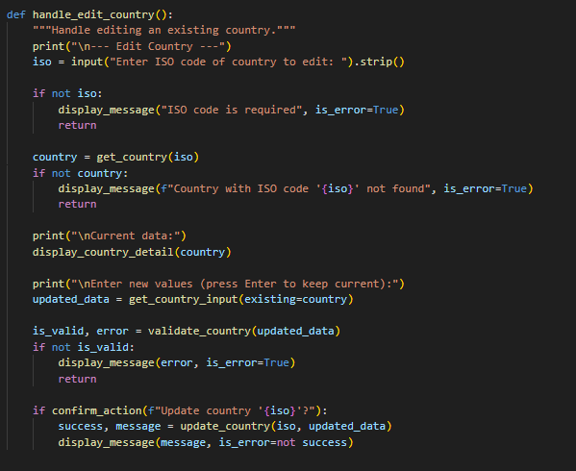
Handler
Edit Country
Main Function

Slide 10
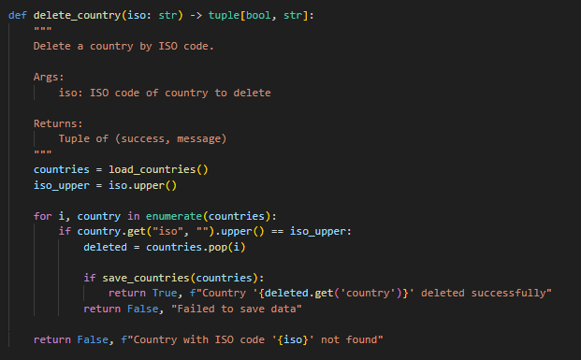
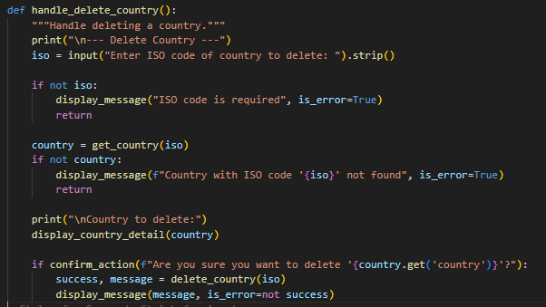
Handler
Delete Country
Main Function

Slide 11
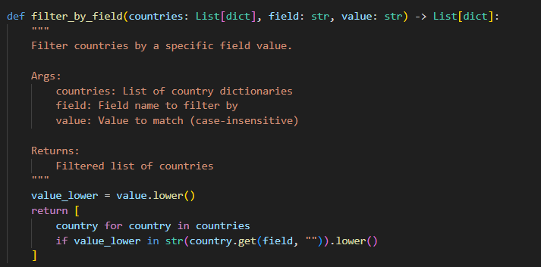
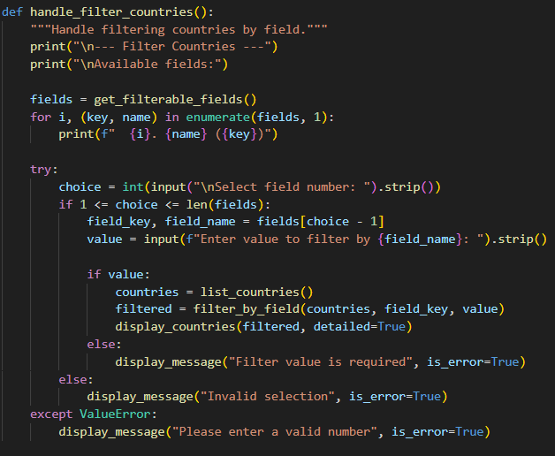
Handler
Filter Country
Main Function

Slide 12
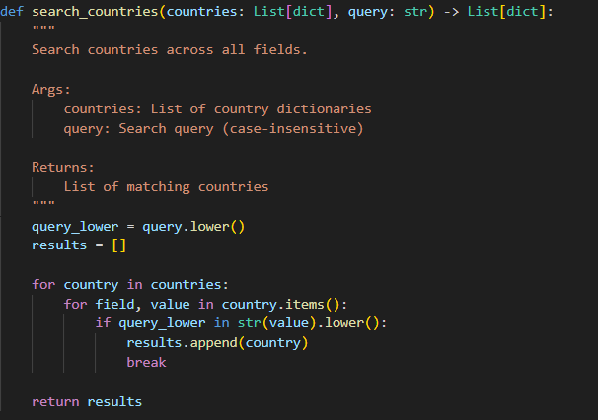
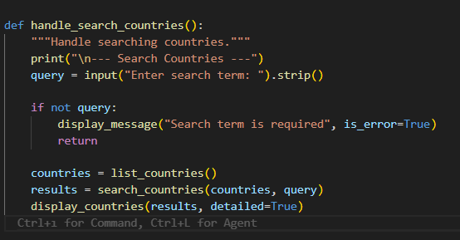
Handler
Search Country
Main Function

Slide 13
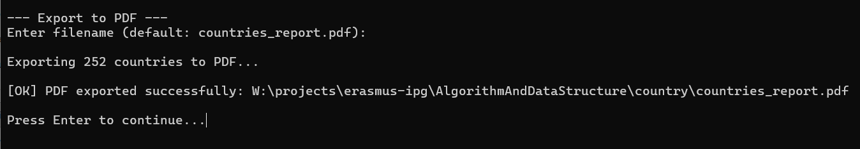
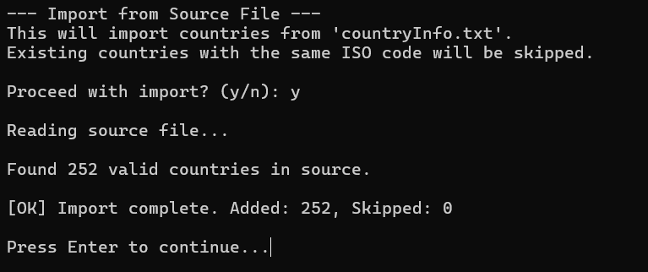
Export & Import
Export to PDF
It’s export Country Information as PDF
Import from Source File
It’s import countryInfo file which contain Country Info from GeoNames.Org
https://download.geonames.org/export/dump/countryInfo.txt

Slide 14
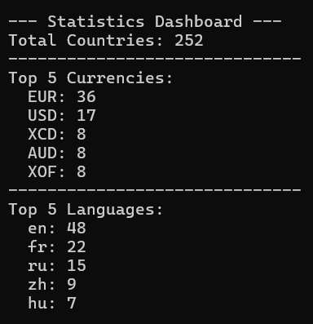
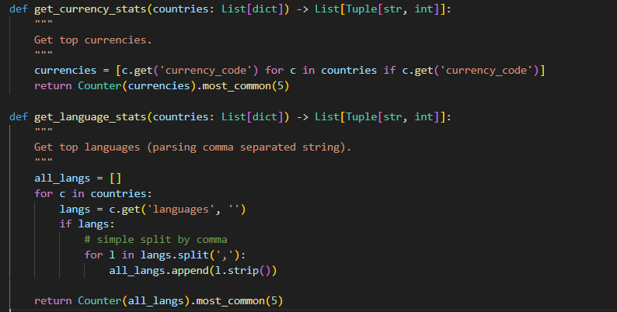
Statistics

Slide 15
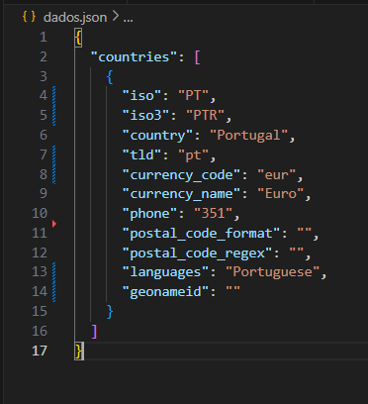
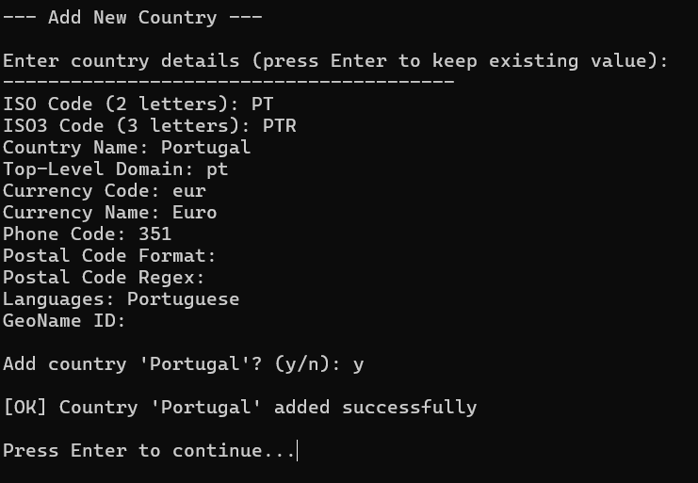
Example of Adding Country

Slide 16
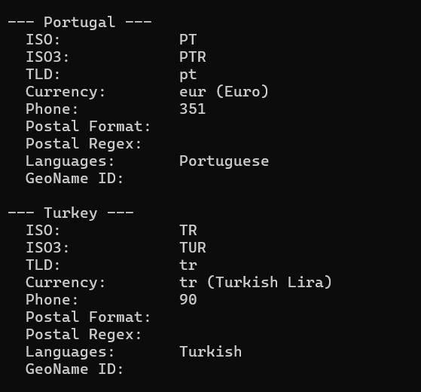
Example of Listing Country

Slide 17
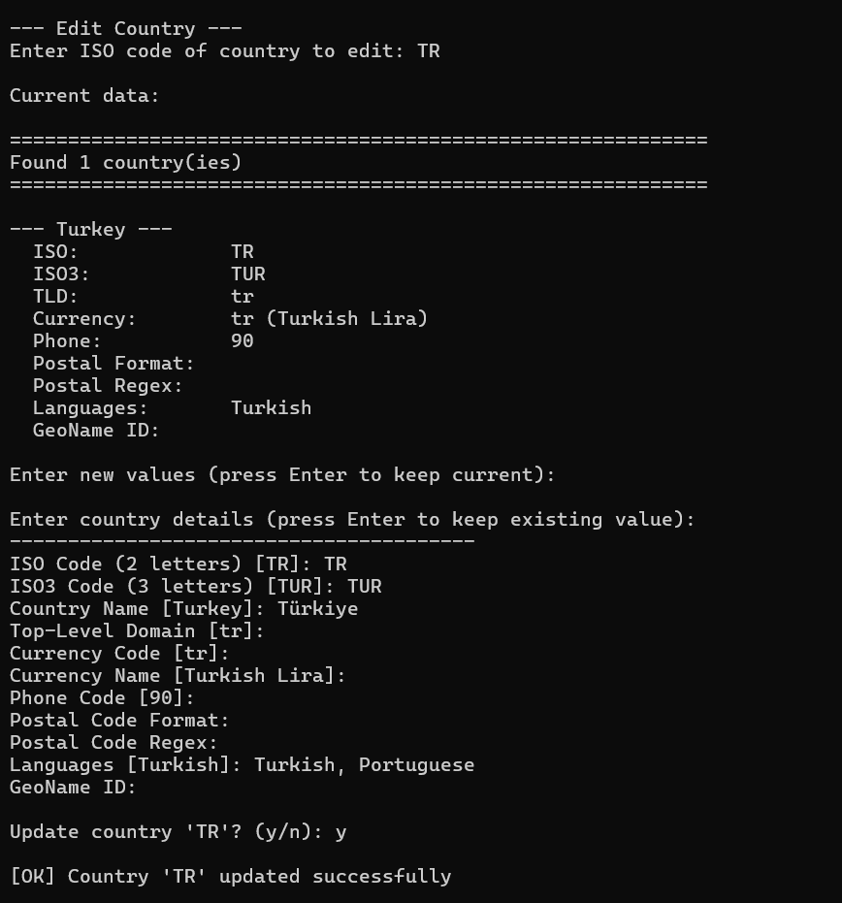
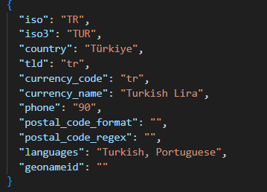
Example of Editing Country

Slide 18
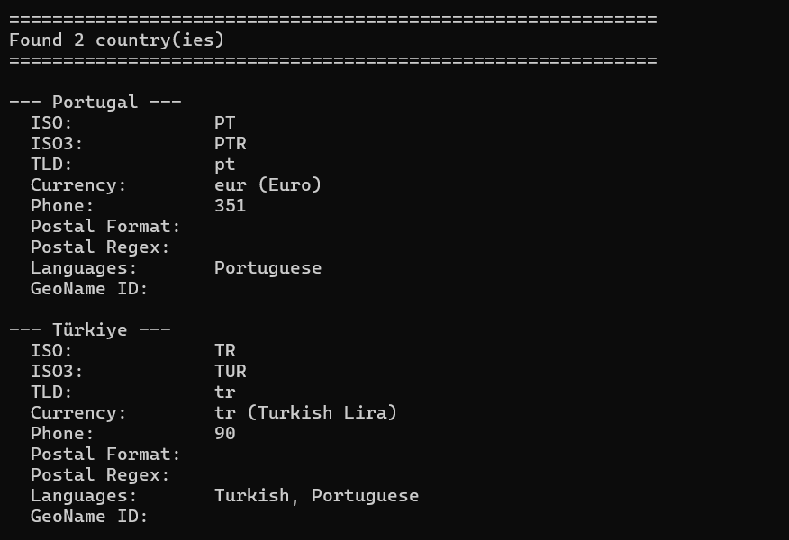
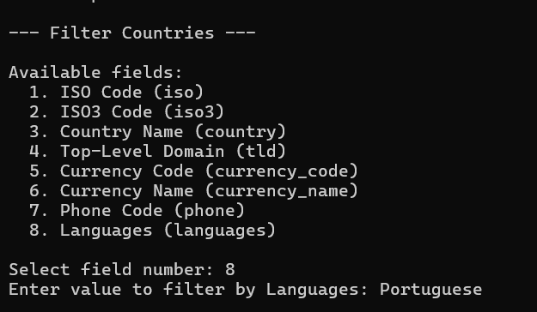
Example of Filtering Country

