Slide 1
Load Safety Gate
One photo at the gate. GO or NO-GO before the truck leaves.
Mode: Startup · Track: Computer Vision · Team Destroyerrrrs
GO
WARN
NO-GO
Body roll · Overhang · Height · Plates and people blurred before anything is shown

Slide 2
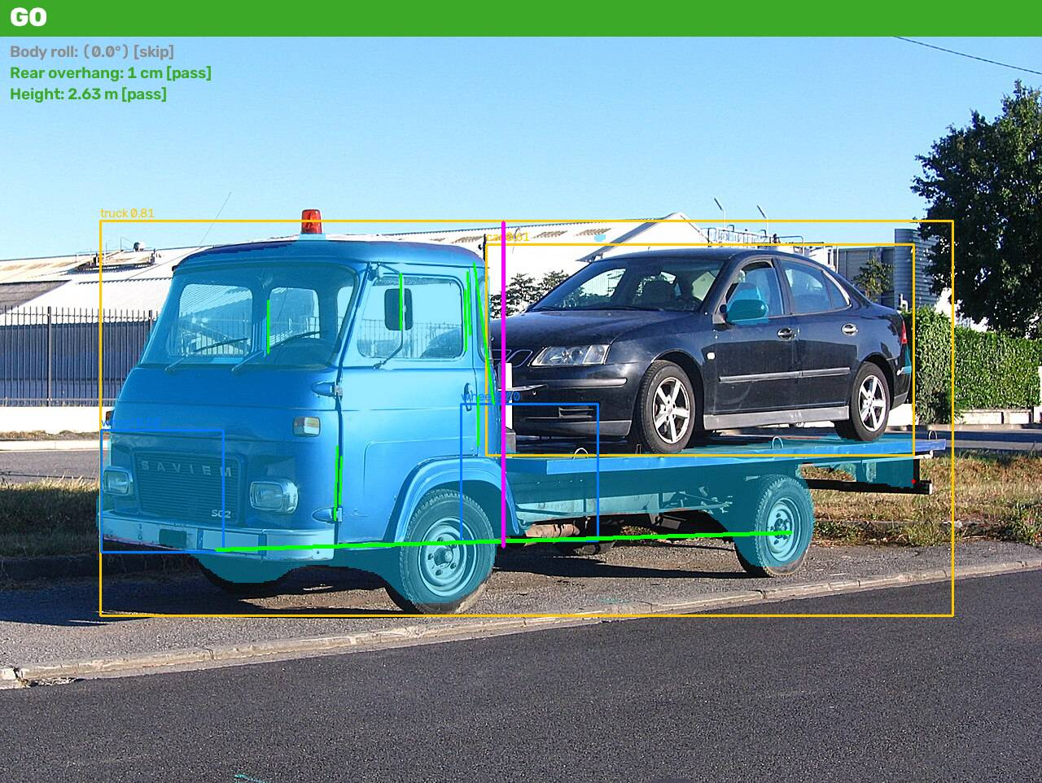
A badly loaded truck is checked by eye, or not at all
Who uses it
Gate operator or dispatcher at a terminal, fleet depot or dealer receiving yard. One photo, one answer, before the truck leaves.
What goes wrong today
One-sided loads roll over. Overhanging cargo hits bridges and other vehicles. Oversized loads draw fines and stop the truck at the first police post.
Who pays
Fleet owner or terminal, per gate. Every Toyota and BYD arrives on a car carrier into a Royal Motors yard, and car carriers are the classic over-height and rear-overhang offenders.
Regulation already exists
Live output of the deployed pipeline on a licensed test image (Wikimedia Commons, CC BY-SA 4.0).
Uzbekistan Decree 342, Annex 2: height 4.0 m, width 2.55 m, rear protrusion 2 m. Nobody measures it at the gate.

Slide 3
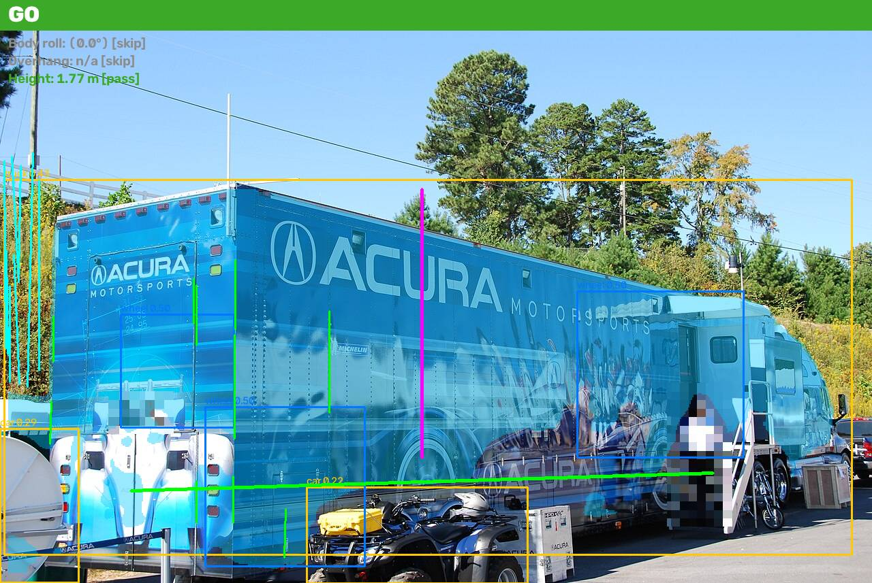
Live demo
amir-kuldashev--load-safety-gate-web.modal.run
Open it on your phone. Take a photo of any truck, or give us one. No login, no app.
Plates and people are pixelated first. The original is never stored.
Green lines: body vertical edges and the ground line the roll is measured against.
Red line: cargo beyond the body edge, in centimetres. Magenta: cargo top to ground, in metres.
Verdict banner, per-check confidence, and the measured latency on CPU.
Every run gets an inspection ticket and lands in the shift journal: counts of GO, WARN, NO-GO for the day. Numbers only, the photo is discarded.
When the photo does not allow a measurement the check says so. No guess, ever.

Slide 4
A pipeline, not a prompt
1
2
3
4
5
6
Photo
Detect
Blur
Measure
Decide
Report
phone or gate camera
YOLO-World boxes: truck, trailer, cargo, car, plate, person. YOLOv8-seg truck mask. Pretrained, no training.
plates and people pixelated before storage or display
wheel finder, ground line, body verticals vs scene verticals, scale from 2.55 m body or 1.05 m wheel
Decree 342 thresholds; GO, WARN, NO-GO, or CANNOT ASSESS
annotated image, checklist, confidence, latency
Ours
Borrowed, with attribution
Privacy stage, wheel finder, geometry, decision rules, the 301-image licensed set, the 120-image labelled evaluation, the app and the deployment.
Two pretrained Ultralytics models (AGPL-3.0). Open-vocabulary prompts, no fine-tuning needed for the demo. Runs on CPU in 0.19 s per image.

Slide 5
Measured relative to the truck itself, so a phone photo is honest
Body roll
Overhang
Height
Horizontal edges converge under perspective, so a level truck looks tilted if you compare top and bottom edges. We use the body's vertical edges instead: left and right halves converge in opposite directions and their mean cancels perspective. Reference: vertical lines in the scene (poles, walls), else the camera vertical at lower confidence.
Cargo extent beyond the body edge at cargo height. Rear overhang in a side view, side overhang in a rear view. Converted to centimetres with a known object in the same image: body width 2.55 m or wheel diameter 1.05 m.
Ground line through the tyre contact points to the top of cargo or body, same scale. Compared with the 4.0 m legal limit.
Product version
A fixed gate camera with known position and a reference marker removes the remaining ambiguity. The phone mode you see today is the degraded fallback, and it says CANNOT ASSESS when the view does not support a measurement.

Slide 6
Measured on a test set we built, including the bad news
Subset | Images | Truck found | Wheels | Scale | Roll reported
Car carriers | 70 | 0.89 | 0.60 | 0.71 | 0.21
Flatbeds | 55 | 0.87 | 0.71 | 0.76 | 0.27
Semi-trailers | 30 | 0.97 | 0.70 | 0.83 | 0.37
Oversized loads | 44 | 0.86 | 0.50 | 0.59 | 0.11
Night | 38 | 0.97 | 0.66 | 0.74 | 0.45
Check | Precision | Recall | tp/fp/fn
Tilted body | 0.33 | 0.09 | 1/2/10
Rear overhang | 0.00 | 0.00 | 0/1/7
Side overhang | n/a | 0.00 | 0/0/6
Over height | 0.33 | 0.06 | 1/2/16
Clean trucks, no false alarm | 41 of 44 |  | 93% specificity
Detector hit rate on 301 licensed Commons photos (no labels needed). Night holds up: the truck mask is the most robust stage.
Against 101 team-labelled images, 61 of them three-quarter views. Honest result: the phone mode is conservative. 93% of clean trucks pass without a false alarm, but it caught only 2 of 41 labelled positives, mostly three-quarter and rear views where no scale object is visible. The calibrated gate camera is the fix, not a bigger model.
1.63°
0.19 s
< $0.001
0 faces
roll instrument error, 56 rotated level photos at known angles, sign right 93% of the time
per image on 2 CPU cores, measured on the deployed server
compute per inspection; one warm server about $90 per month
stored. Plates and people pixelated before anything is kept

Slide 7
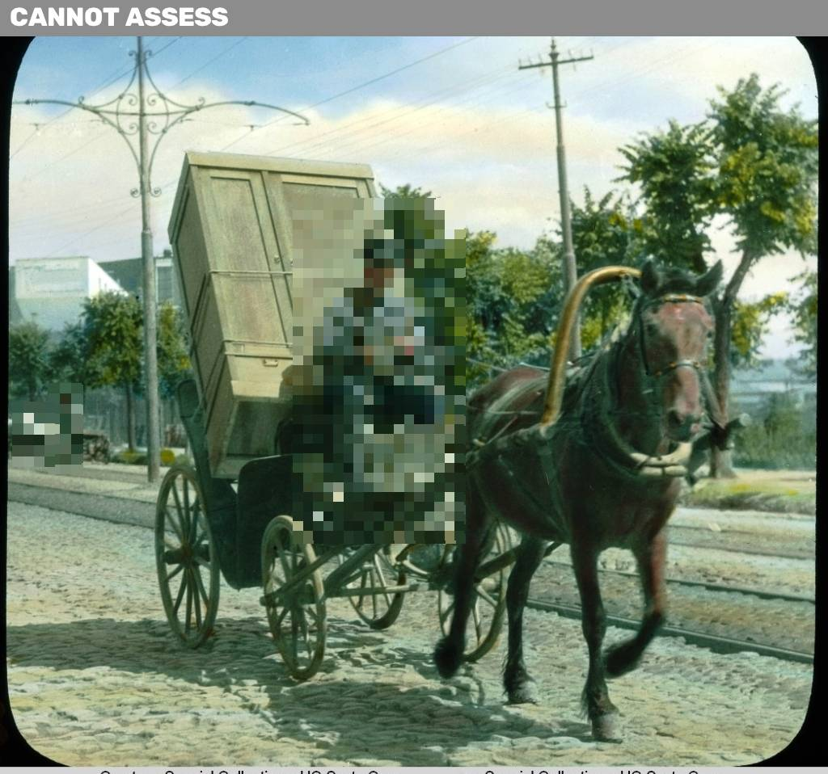
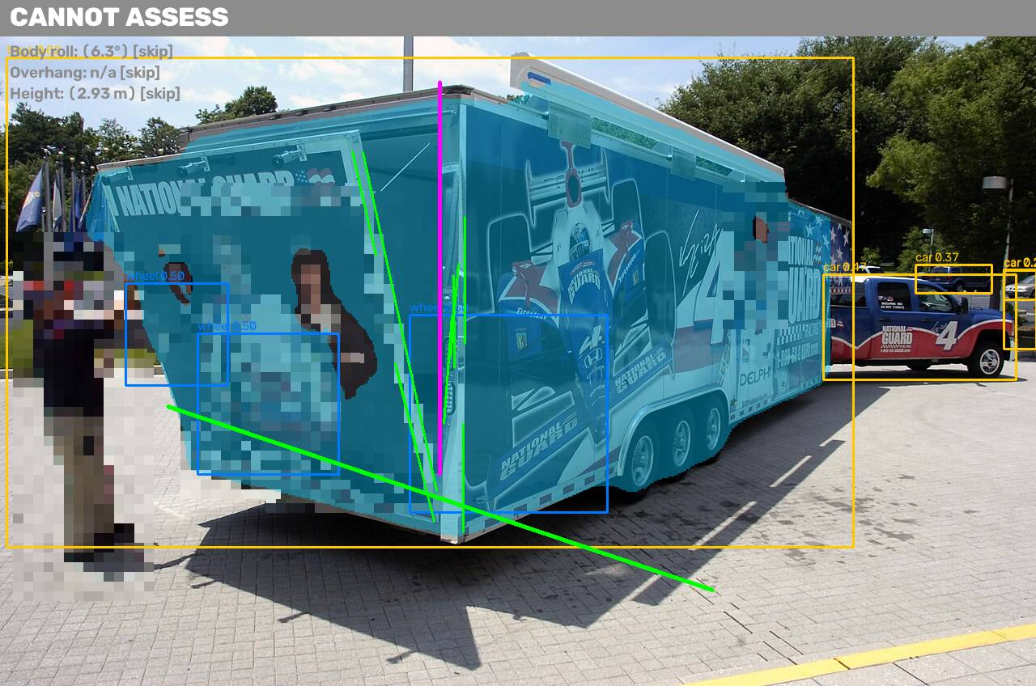
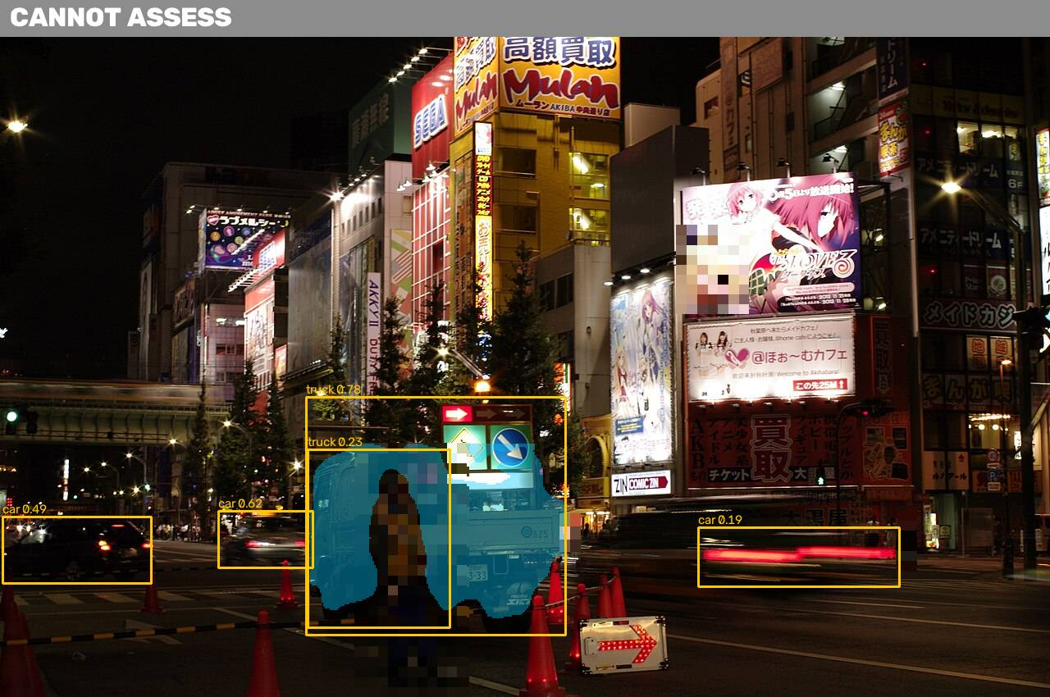
Where it breaks, and what it does instead of guessing
Not a truck, or a tiny truck in the frame. Result: CANNOT ASSESS. The overloaded-vehicles category on Commons is mostly carts and motorbikes.
Front or three-quarter views foreshorten the body. Roll confidence drops below the floor and the check is skipped.
Night street with no truck in frame: CANNOT ASSESS. Dark trucks at night give a noisy mask edge and lower roll confidence; cargo the same colour as the body can merge into the mask.
Design rule
Every check reports a confidence and is skipped below a floor. A skipped check is shown as such, never as a pass.

Slide 8
The replication test
A weekend with the same tools gets you
What they do not get
A detector that draws boxes around trucks and cargo
A prompt to a vision model that says "looks overloaded"
No measurement, no threshold, no number a gate operator can act on
Perspective-safe roll from vertical edges, with a gravity reference in the same image
Centimetres and metres from a known object in the frame, and a CANNOT ASSESS path
A decision layer written from Decree 342, the regulation a police post actually applies
A privacy stage that makes the product legal to pilot
301 licensed images with hit rates, 120 labelled, and a deployed gate product

Slide 9
Pilot budget and payback, every assumption on the slide
Pilot cost, 3 months | Amount | Assumption
Team: 3 people, 3 months | $7,200 | $800 per person per month
Cameras and mounts, 3 gates | $600 | $200 per gate, one-off
Hosting | $270 | one warm CPU server, $90 per month
Labelling and data | $500 | about 40 hours of labelling
Legal and privacy review | in team time | blur at ingest, no personal data stored, one-day legal check
Avoided loss, one fleet | Amount | Assumption, calibrated in the pilot
Departures screened | 200 per day | mid-size fleet, one gate camera
Dangerous departures caught | 1 per month | conservative: 1 in ~6,000 departures
Cost of one load incident | $5,000 | cargo loss + downtime + fine + claim handling; wide range
Avoided loss per year | $60,000 | 12 incidents x $5,000
Unit economics
Payback
Price per gate per month, software only. Compute per inspection is below $0.001, so margin is in the subscription, not the inference. One server serves dozens of gates.
Payback months = pilot cost / avoided loss per month. At one caught incident a month the avoided loss is $5,000 per month against $90 per month of hosting, so the one-off pilot cost is recovered within its first months. The fleet's own incident rate replaces the assumption after month one.

Slide 10
Next steps
Month 1
Month 2
Month 3
Fixed, calibrated camera at one gate. Reference marker removes scale ambiguity. Ten-second video mode.
Fine-tune the detector on our labelled set. Add open door, loose strap and missing marking classes.
Weighbridge and dispatch integration. Pilot at a Royal Motors receiving yard on incoming car carriers.
Repository: github.com/Winner-121/Destroyerrrrs_Final_Stage · Demo: amir-kuldashev--load-safety-gate-web.modal.run

