Slide 1
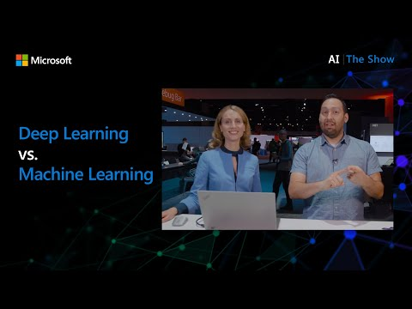
Introduction to machine learning
ML, AI, deep learning - What’s the difference?

Slide 2
Pre-lecture quiz

Slide 3
Welcome
Welcome to this course on classical machine learning for beginners! Whether you’re completely new to this topic, or an experienced ML practitioner looking to brush up on an area, we’re happy to have you join us! We want to create a friendly launching spot for your ML study and would be happy to evaluate, respond to, and incorporate your feedback.

Slide 4
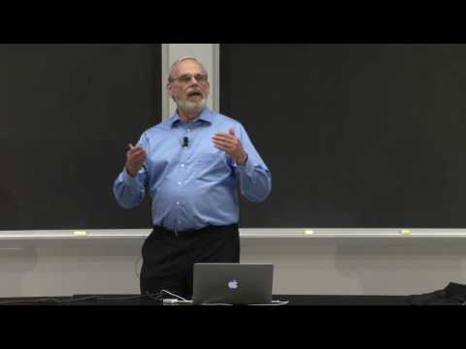
MIT’s John Guttag introduces machine learning
Introduction to ML

Slide 5
Getting started with machine learning
Before starting with this curriculum, you need to have your computer set up and ready to run notebooks locally.
Configure your machine with these videos. Use the following links to learn how to install Python in your system and setup a text editor for development.
Learn Python. It’s also recommended to have a basic understanding of Python, a programming language useful for data scientists that we use in this course.
Learn Node.js and JavaScript. We also use JavaScript a few times in this course when building web apps, so you will need to have node and npm installed, as well as Visual Studio Code available for both Python and JavaScript development.
Create a GitHub account. Since you found us here on GitHub, you might already have an account, but if not, create one and then fork this curriculum to use on your own. (Feel free to give us a star, too 😊)
Explore Scikit-learn. Familiarize yourself with Scikit-learn, a set of ML libraries that we reference in these lessons.

Slide 6
What is machine learning?
The term ‘machine learning’ is one of the most popular and frequently used terms of today. There is a nontrivial possibility that you have heard this term at least once if you have some sort of familiarity with technology, no matter what domain you work in. The mechanics of machine learning, however, are a mystery to most people. For a machine learning beginner, the subject can sometimes feel overwhelming. Therefore, it is important to understand what machine learning actually is, and to learn about it step by step, through practical examples.

Slide 7
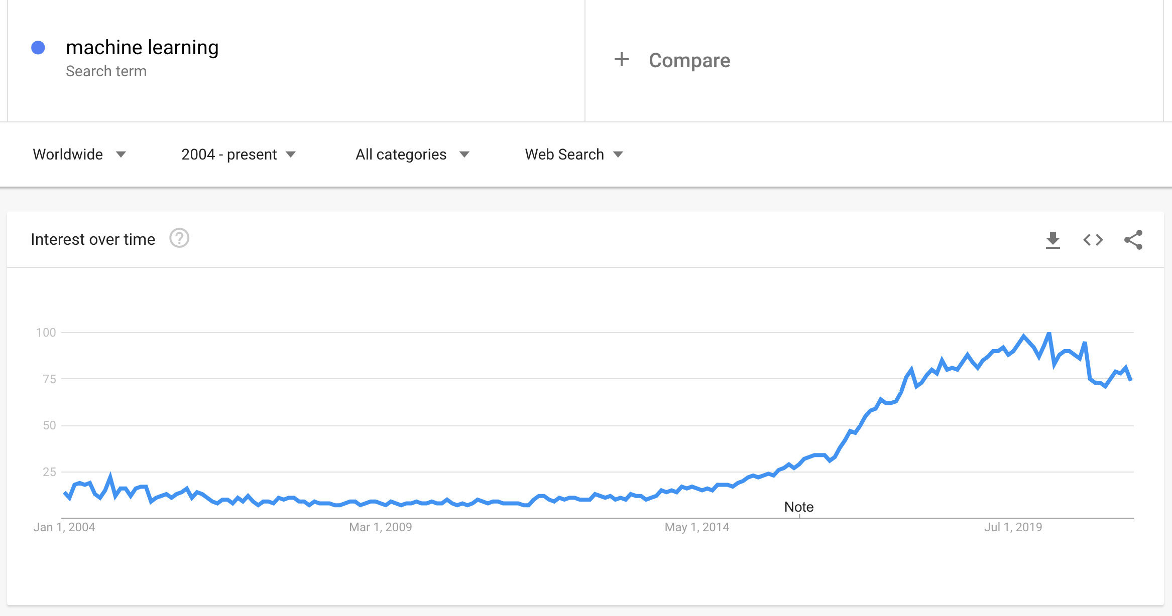
The hype curve
ml hype curve

Slide 8
A mysterious universe
We live in a universe full of fascinating mysteries. Great scientists such as Stephen Hawking, Albert Einstein, and many more have devoted their lives to searching for meaningful information that uncovers the mysteries of the world around us. This is the human condition of learning: a human child learns new things and uncovers the structure of their world year by year as they grow to adulthood.

Slide 9
The child’s brain
A child’s brain and senses perceive the facts of their surroundings and gradually learn the hidden patterns of life which help the child to craft logical rules to identify learned patterns. The learning process of the human brain makes humans the most sophisticated living creature of this world. Learning continuously by discovering hidden patterns and then innovating on those patterns enables us to make ourselves better and better throughout our lifetime. This learning capacity and evolving capability is related to a concept called brain plasticity. Superficially, we can draw some motivational similarities between the learning process of the human brain and the concepts of machine learning.

Slide 10
The human brain
The human brain perceives things from the real world, processes the perceived information, makes rational decisions, and performs certain actions based on circumstances. This is what we called behaving intelligently. When we program a facsimile of the intelligent behavioral process to a machine, it is called artificial intelligence (AI).

Slide 11
Some terminology
Although the terms can be confused, machine learning (ML) is an important subset of artificial intelligence. ML is concerned with using specialized algorithms to uncover meaningful information and find hidden patterns from perceived data to corroborate the rational decision-making process.

Slide 12
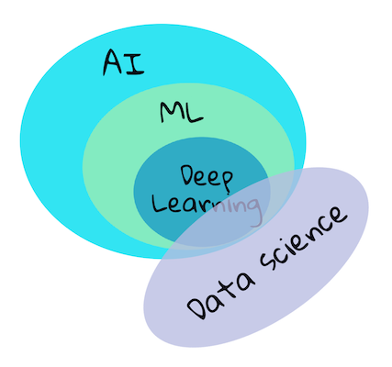
AI, ML, Deep Learning
AI, ML, deep learning, data science

Slide 13
Concepts to cover
In this curriculum, we are going to cover only the core concepts of machine learning that a beginner must know. We cover what we call ‘classical machine learning’ primarily using Scikit-learn, an excellent library many students use to learn the basics. To understand broader concepts of artificial intelligence or deep learning, a strong fundamental knowledge of machine learning is indispensable, and so we would like to offer it here.

Slide 14
In this course you will learn:
core concepts of machine learning
the history of ML
ML and fairness
regression ML techniques
classification ML techniques
clustering ML techniques
natural language processing ML techniques
time series forecasting ML techniques
reinforcement learning
real-world applications for ML

Slide 15
What we will not cover
deep learning
neural networks
AI
To make for a better learning experience, we will avoid the complexities of neural networks, ‘deep learning’ - many-layered model-building using neural networks - and AI, which we will discuss in a different curriculum. We also will offer a forthcoming data science curriculum to focus on that aspect of this larger field.

Slide 16
Why study machine learning?
Machine learning, from a systems perspective, is defined as the creation of automated systems that can learn hidden patterns from data to aid in making intelligent decisions.
This motivation is loosely inspired by how the human brain learns certain things based on the data it perceives from the outside world.
✅ Think for a minute why a business would want to try to use machine learning strategies vs. creating a hard-coded rules-based engine.

Slide 17
Applications of machine learning
Applications of machine learning are now almost everywhere, and are as ubiquitous as the data that is flowing around our societies, generated by our smart phones, connected devices, and other systems. Considering the immense potential of state-of-the-art machine learning algorithms, researchers have been exploring their capability to solve multi-dimensional and multi-disciplinary real-life problems with great positive outcomes.

Slide 18
Examples of applied ML
You can use machine learning in many ways:
To predict the likelihood of disease from a patient’s medical history or reports.
To leverage weather data to predict weather events.
To understand the sentiment of a text.
To detect fake news to stop the spread of propaganda.
Finance, economics, earth science, space exploration, biomedical engineering, cognitive science, and even fields in the humanities have adapted machine learning to solve the arduous, data-processing heavy problems of their domain.

Slide 19
Conclusion
Machine learning automates the process of pattern-discovery by finding meaningful insights from real-world or generated data. It has proven itself to be highly valuable in business, health, and financial applications, among others.
In the near future, understanding the basics of machine learning is going to be a must for people from any domain due to its widespread adoption.

Slide 20
🚀 Challenge
Sketch, on paper or using an online app like Excalidraw, your understanding of the differences between AI, ML, deep learning, and data science. Add some ideas of problems that each of these techniques are good at solving.

Slide 21
Post-lecture quiz

Slide 22
Review & Self Study
To learn more about how you can work with ML algorithms in the cloud, follow this Learning Path.
Take a Learning Path about the basics of ML.

Slide 23
Assignment
Get up and running

