Slide 1
Implementation of Supervised Learning on student’s performance dataset

Slide 2
Objectives
Our main goal of this project is to apply supervised learning techniques to predict the performance of students and get some conclusions.
Specifically:
We will implement basic data cleaning.
We will apply encoding for categorical data.
We will apply scaling for numeric data.
We will also apply dimension reductionality technique.
We will compare four different regression models to see which model will best predict the student’s performance most accurately with least errors.

Slide 3
Description of dataset
This data approach student achievement in secondary education of Portuguese school. The data attributes include student grades, demographic, social and school related features) and it was collected by using school reports and questionnaires. This dataset provides performance of several students in mathematics. In [Cortez and Silva, 2008], the dataset was modeled under binary/five-level classification and regression tasks.
Target variable G3 is the final year grade (issued at the 3rd period), while G1 and G2 correspond to the 1st and 2nd period grades.
Since target is numerical attribute, we will apply regression models for prediction.
Source : Paulo Cortez, University of Minho, Guimaraes, Portugal, http://www3.dsi.uminho.pt/pcortez

Slide 4
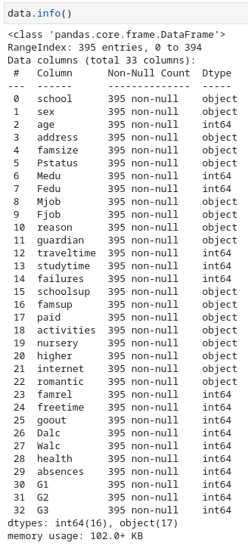

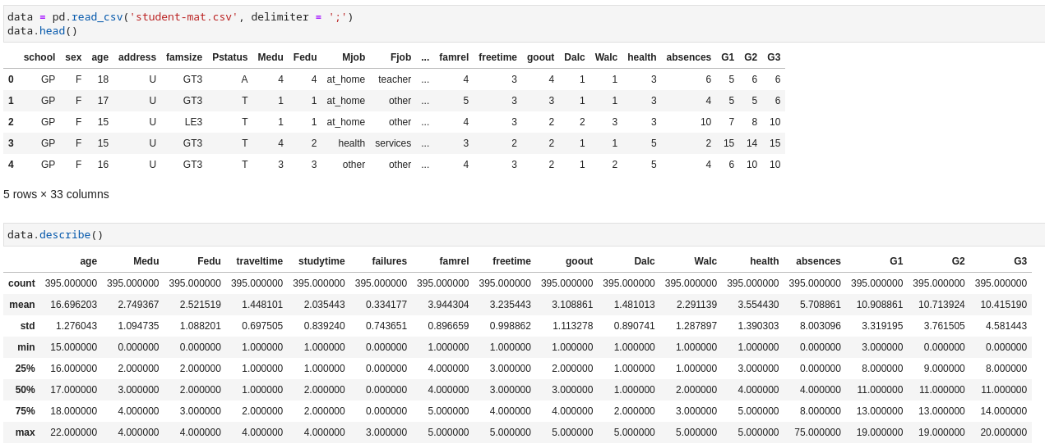
Data Loading and Descriptive Statistics
It is clear that dataset doesn’t need further cleaning.

Slide 5
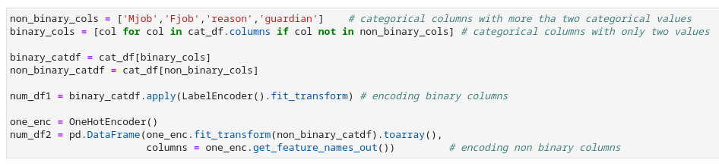
Data Preparation
First, we separate categorical and numerical columns.
To apply encoding, we further separate categorical features into binary and non binary and apply binary encoding to binary features and one hot encoding to non binary features.

Slide 6
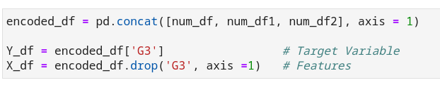
We now combine the encoded categorical features with numerical data.
Then we separate target and feature.
Now dataset is ready for dimensionality reduction.

Slide 7
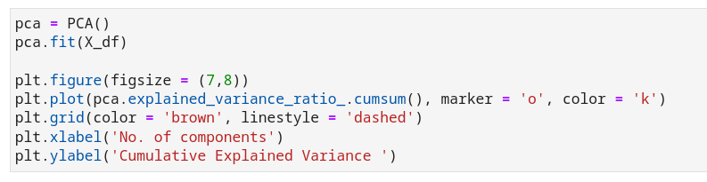
Principal Component Analysis Implementation
Since we have increased the no. of attributes even more after one hot encoding, we intend to reduce the dimension of attributes using PCA technique.
Let’s find out the suitable no. of components by observing cumulative observed variance for each no. of components we choose.

Slide 8
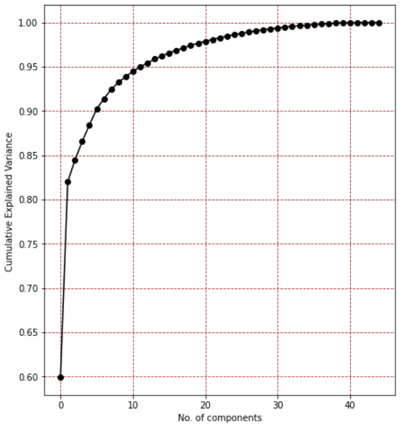
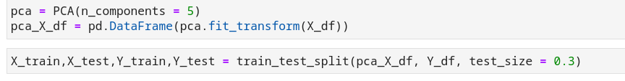
Since minimum of 5 components cover more than 85% variance in the dataset, let’s reduce all the features into just 5 components.
Now we split the dataset into training and testing set.
After this we apply regression models on the components to predict the G3 score.

Slide 9
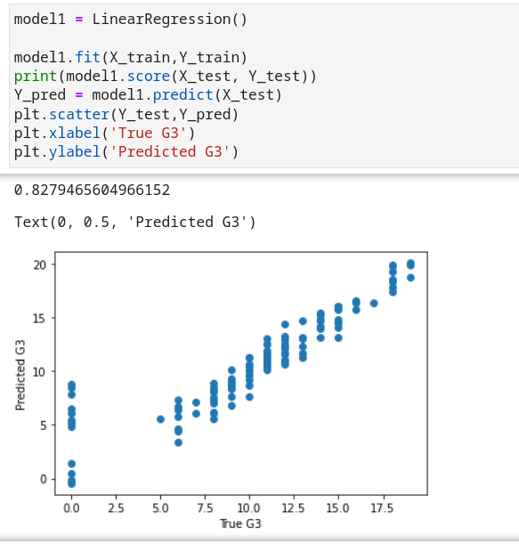
Model 1 : Linear Regression
Applying linear regression with default parameters.
Linear Regression achieved score of 0.82, i.e. it predicted 82% of test dataset correctly.

Slide 10
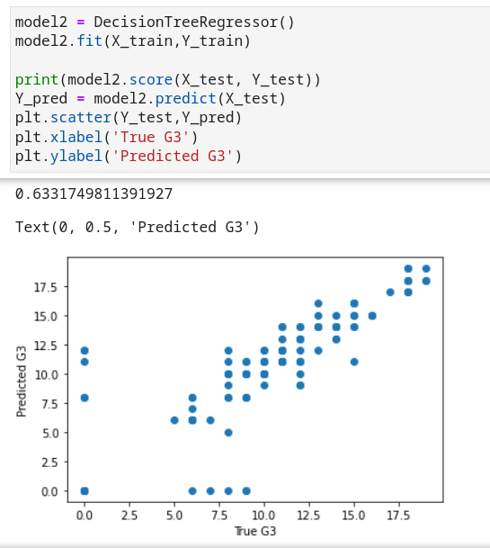
Model 2: Decision Tree Regression
Fitting decision tree regression on training set with default parameters.
Decision Tree Regression achieved score of 0.63, i.e. it predicted 63% of test dataset correctly.

Slide 11
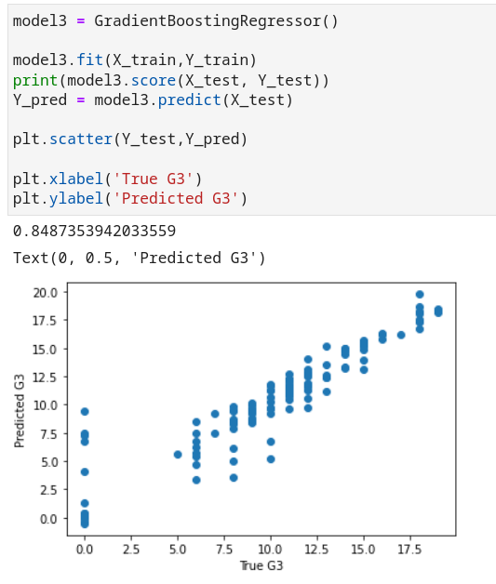
Model 3: Gradient Boosting Regressor
We didn’t tune hyperparameters while fitting training sets in the model.
We achieved score of 0.84 from GBR model i.e. 84% of instances in testing set gave correct prediction.

Slide 12
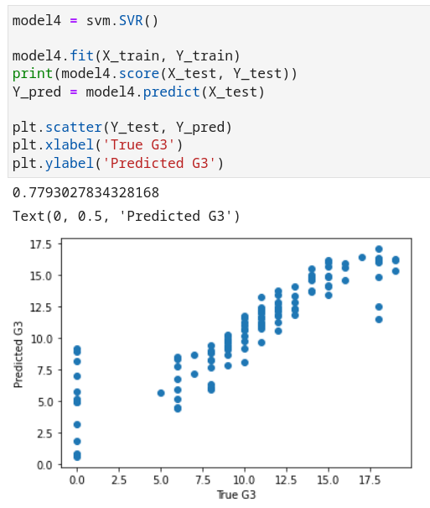
Model 4 : Support Vector Regression
Applying SVR with default parameters gave score of 0.77 .

Slide 13
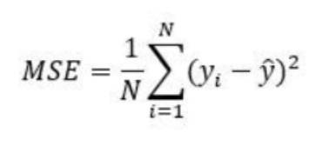
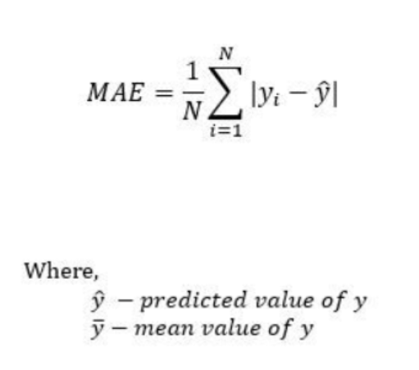
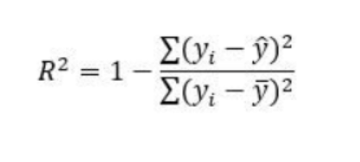
Evaluation Metrics
In regression, we will use mean squared error(MSE), mean absolute error (MAE) and R squared score (R² score) to evaluate and compare each model.
Picture Source: https://medium.com/analytics-vidhya/mae-mse-rmse-coefficient-of-determination-adjusted-r-squared-which-metric-is-better-cd0326a5697e

Slide 14
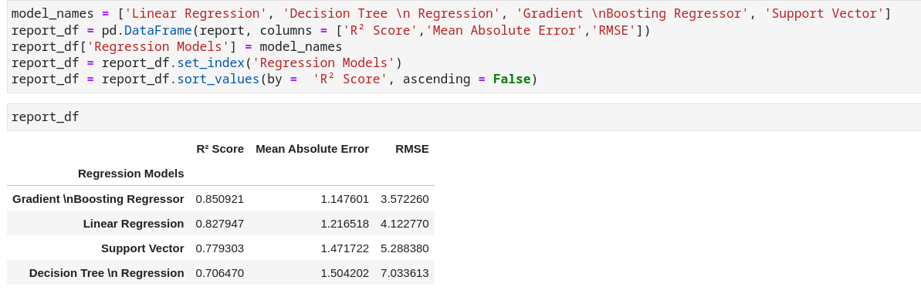
Visualization of Metrics Comparison for different models

Slide 15
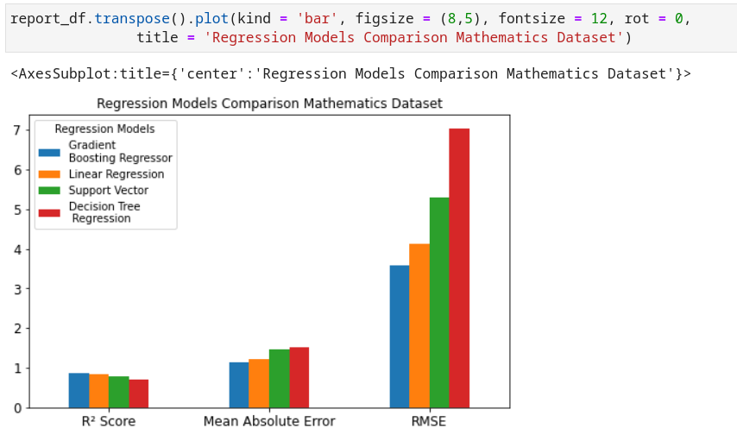

Slide 16
Conclusion
Comparison of decision tree model and gradient boosting regression is interesting since former is the worst of four models with R squared score of 0.70 and later is the best with R squared score of 0.85 .
Linear Regression performed good with R squared score of 0.82.
Greater score might be due to the strong dependence of G3 with G1 and G2.
As expected, models with greater score had smaller errors and vice versa.
Thus we conclude that we can use python modules to easily implement supervised machine learning models and also evaluate metrics like MSE, MAE and R-squared score and choose the based models based on these metrics.

