Slide 1
Analysis of Classification Models on A Dataset
Presented by:
Date:

Slide 2
Description of Dataset
Source of the datasets : [Moro et al., 2014] S. Moro, P. Cortez and P. Rita. A Data-Driven Approach to Predict the Success of Bank Telemarketing. Decision Support Systems, Elsevier, 62:22-31, June 2014
The data is related with direct marketing campaigns of a Portuguese banking institution. The marketing campaigns were based on phone calls.
The dataset has 17 features and 45,271 instances. 16 features record the banking and personal details of clients while remaining one feature has values ‘yes’ if client subscribes for deposit and ‘no’ if not.

Slide 3
Objectives
Our objective in this project is to implement various classification models to be able to predict whether or not client will subscribe for the term deposit based on the banking and personal details of the customers.
We also want to compare different classification models and conclude about the comparison of their performance on this dataset.

Slide 4
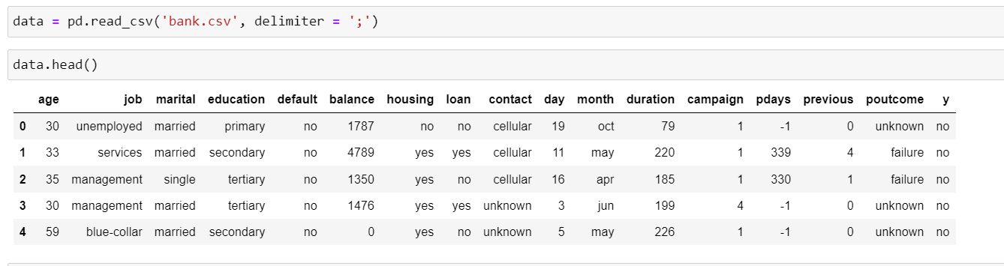
Data Loading

Slide 5
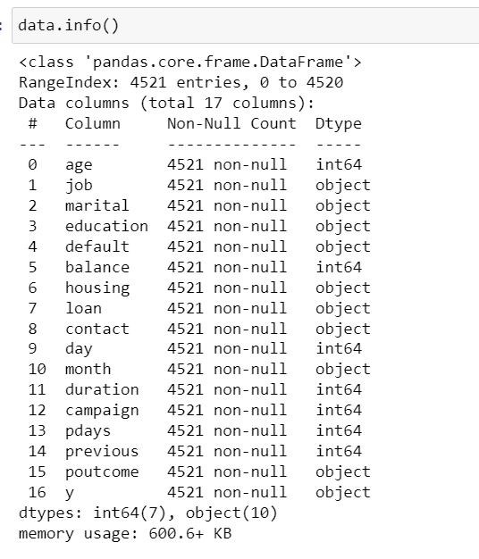
Data Inspection
We see there is combination of quite a lot of categorical features as well as numerical features.
There seems to be no null values.

Slide 6
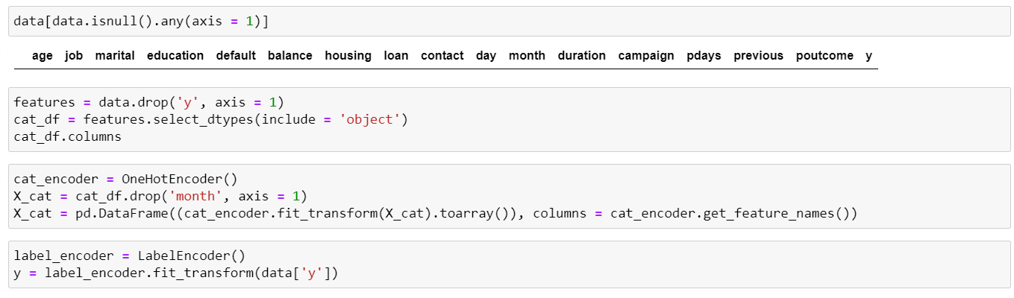
Data Cleaning
We separated features and target from the datasets.
We choose OneHotEncoding to all categorical features because features contain multiple categories and we don’t want to bias the weight given to any category for any feature.

Slide 7
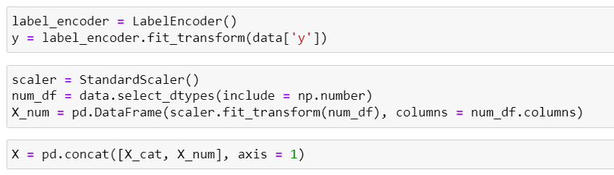
Target feature was encoded using LabelEncoder.
Numerical features were scaled using StandardScaler.
Encoded features were combined to get the whole data.
The data is now ready to be experimented with classification models after creating test and train sets..

Slide 8

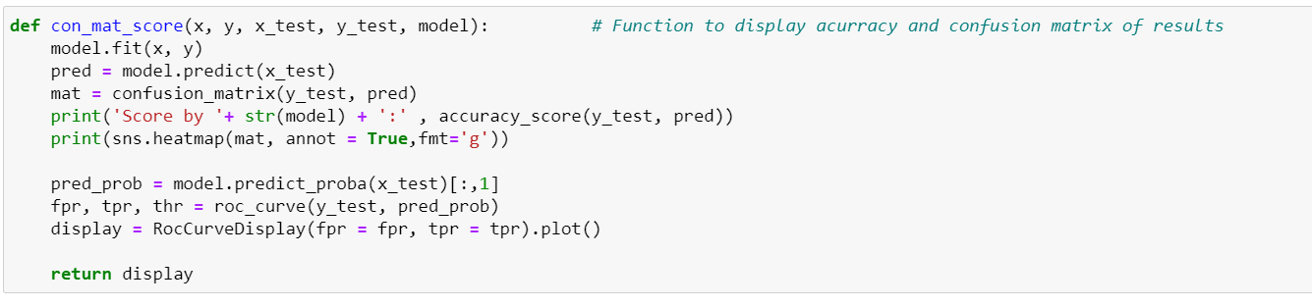
This function is designed to obtain acurracy score and confusion matrix of predicted and true targets so that it can be applied easily on several models.

Slide 9
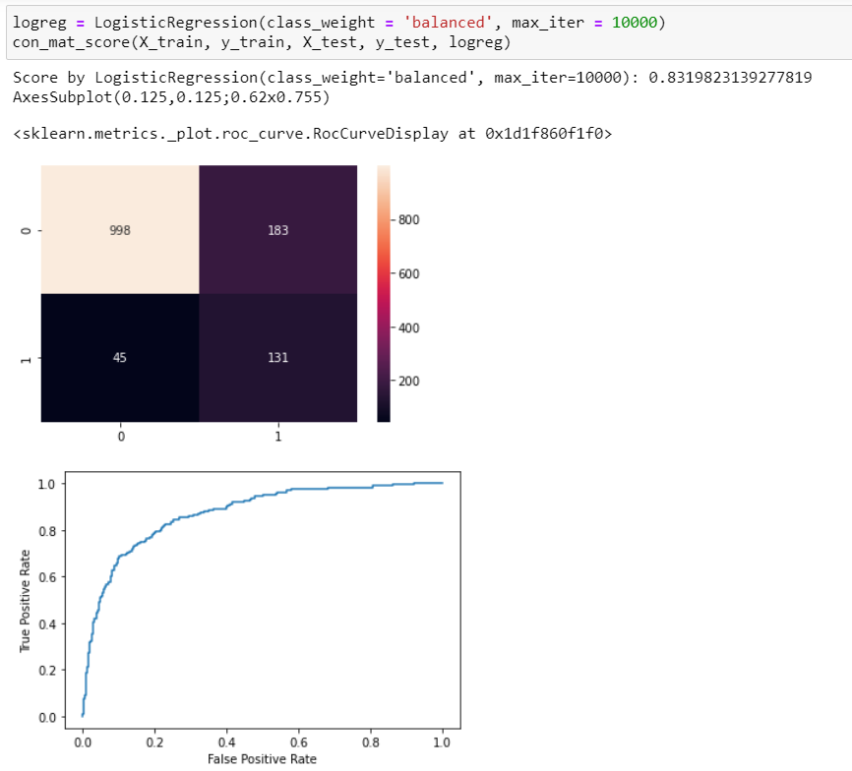
Logistic Regression
We got a 83% generalized acurracy without hyperparameter tuning.
ROC AUC curve looks pretty good.

Slide 10
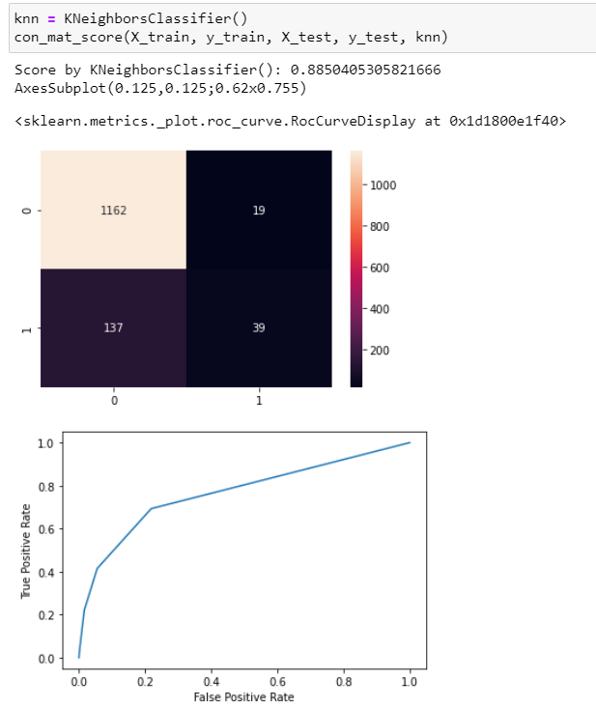
KNN Classifier
We got even better generalized acurracy i.e. 88.5% with KNN.
But the ROC AUC curve does not cover as much area as we saw with Logistic Regression.

Slide 11
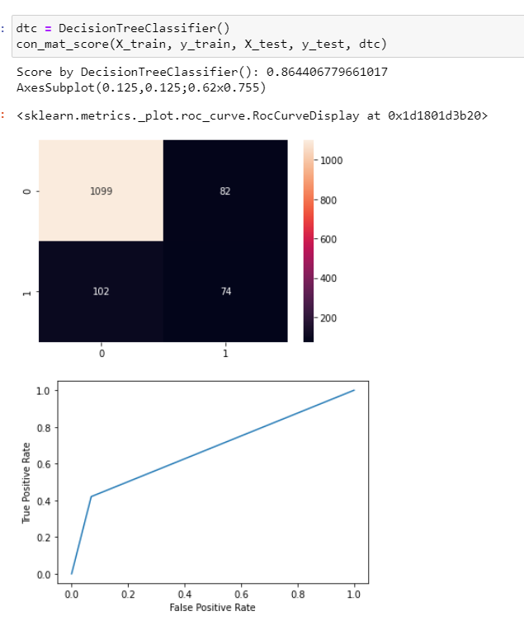
Decision Tree Classifier
It followed quite similar as KNN classifier.
It is not able to distinguish between classes properly.

Slide 12
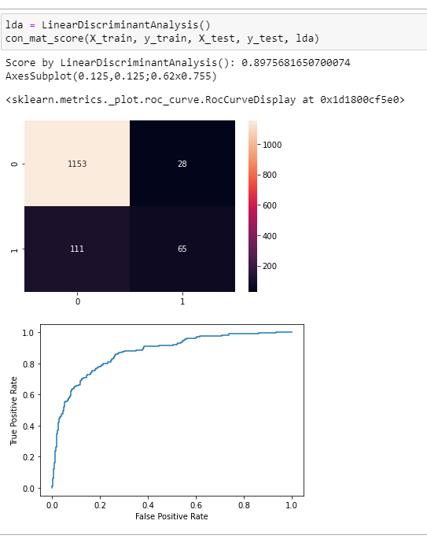
Linear Discriminant Analysis
We tried LinearDiscriminant Analysis too.
As we expected, this model was good with acurracy(89.75%) as well as it
had very good ROC AUC curve.

Slide 13
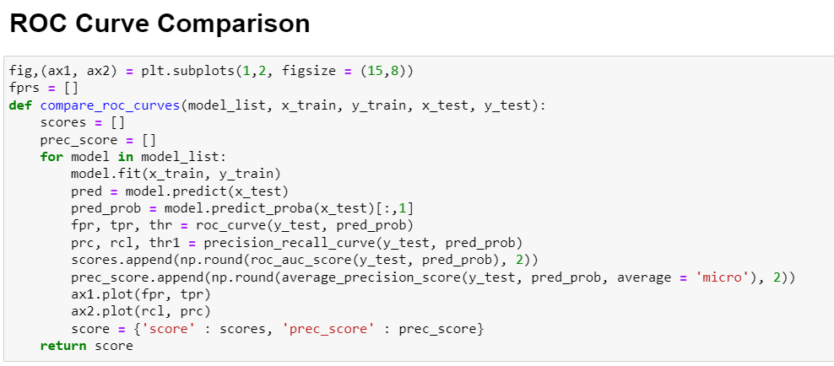
This function takes a list of classification models, train and test data and creates a line plot comparing ROC AUC curve as well as precision vs precall plot.

Slide 14
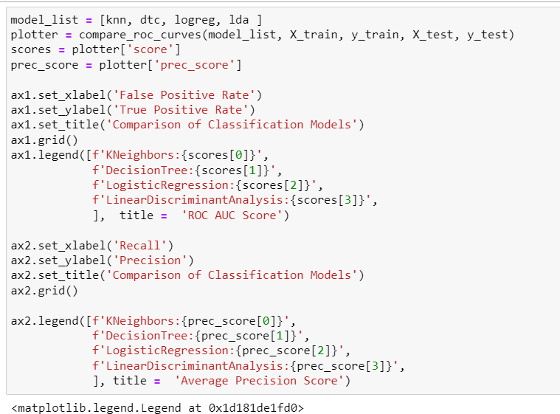
A little bit of work to make the plots plot look meaningful and beautiful.

Slide 15
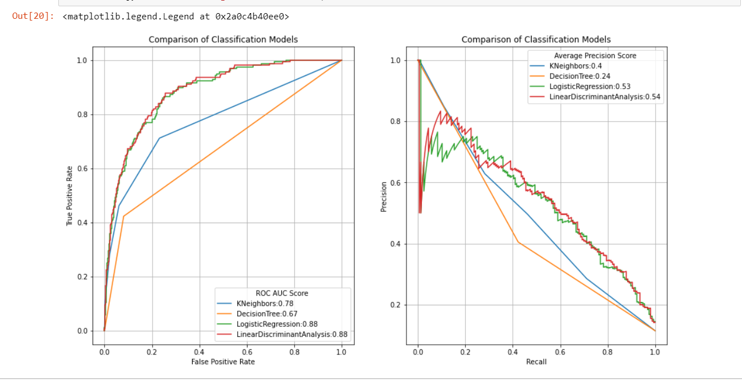
A comparison of five different models shows that Logistic regression and Linear Discriminant Analysis are best among the models for our datasets.

Slide 16
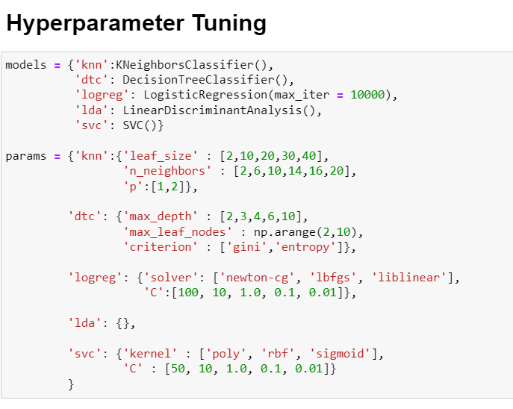
Assigning parameters that we want to tune
We added Support Vector model as well to see it’s performance.

Slide 17
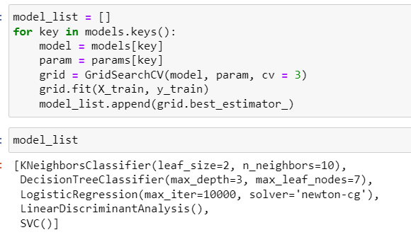
GridSearchCV can be used as shown to tune hyperparameters.
We simply run GridSearchCV for all models and stored the best models with best parameters

Slide 18
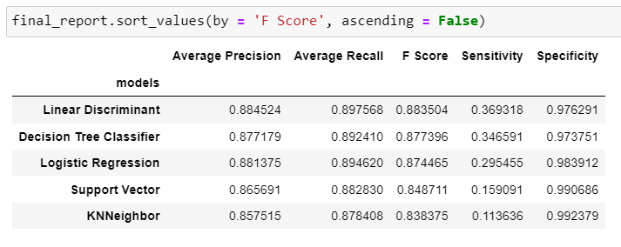
Performance Comparison of Several Classification Models

Slide 19
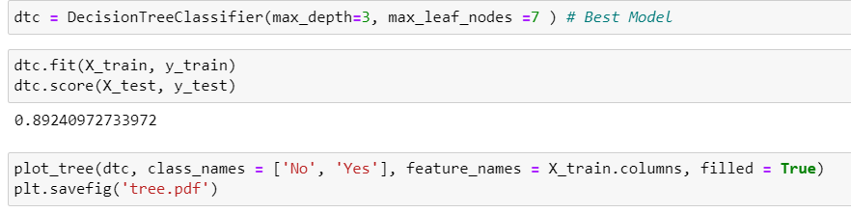
Sneaking a glance at the decision tree

Slide 20
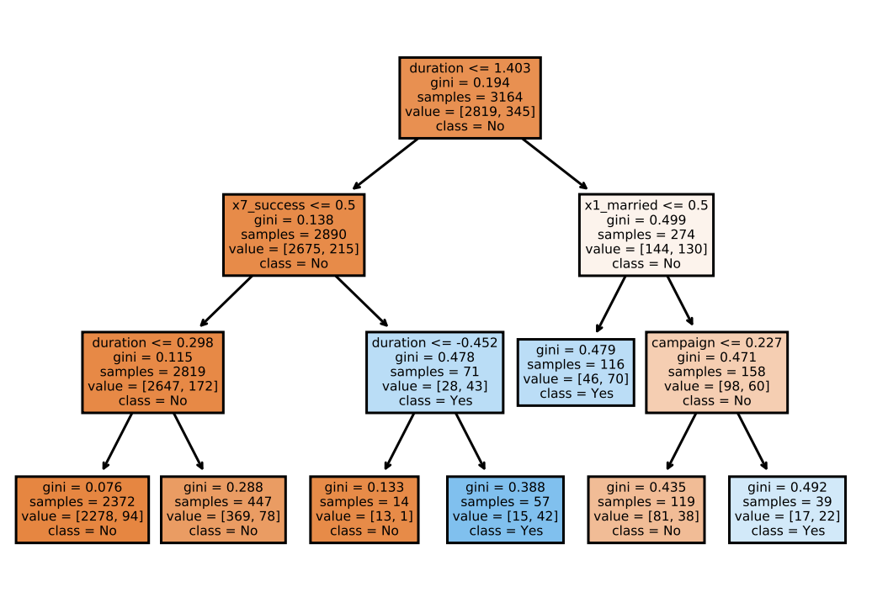

Slide 21
Obeservations from decision tree
We see that ‘duration’ played a major role in the decision. But other than that it was surprising to see marital status and ‘poutcome’ were very important variables.
In fact, if the marital status is single (described as x1_married < 0.5 in decision tree), the individual is more likely to subscribe for the term deposit and vice versa.
Similarly, if ‘poutcome' is not success (described by x7_success <= 0.5 in decision tree), the client is less likely to subscribe for the term deposit.

Slide 22
CONCLUSION
In this way, we found different classification models to be very useful in predictive analysis of the given dataset and whether the client will subscribe or not can be predicted with more than 85% precision using any of five models if we have their personal and banking details.

