Slide 1
Student Manager
Nguyen Huynh Dang Khoa
16ES

Slide 2
Problems and Requirement
Problem:
Design an application to manage the students for teachers.
Requirement:
Friendly to use.
Sufficient feature for managing the class.
Protected users (only teacher can edit the mark).

Slide 3
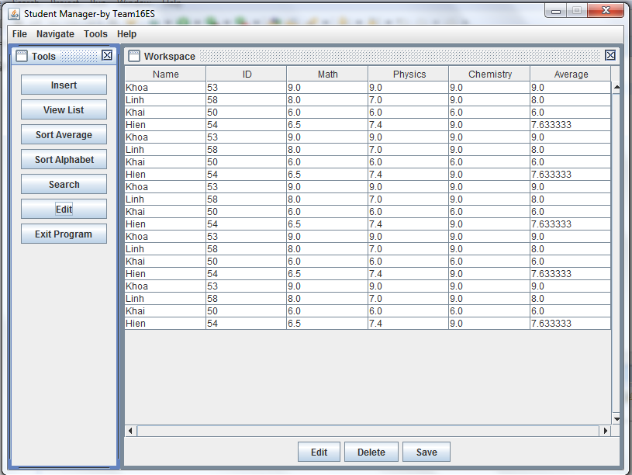

Solution
User Interface
StudentManager Vector<Student> and other methods.
Student

