Slide 1

晨间新闻

Slide 2








Slide 3
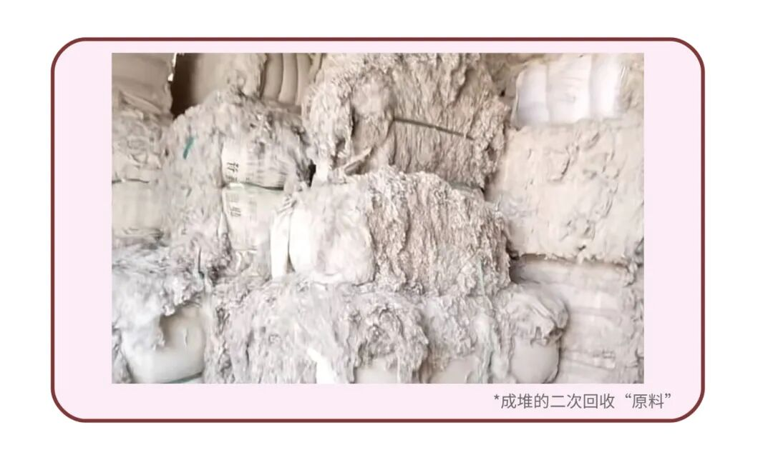

Slide 4

Unqualified sanitary pads
→ Bacterial vaginosis
Inflammation
→ Infection
→Gynecological diseases
→ Fertility

Slide 5
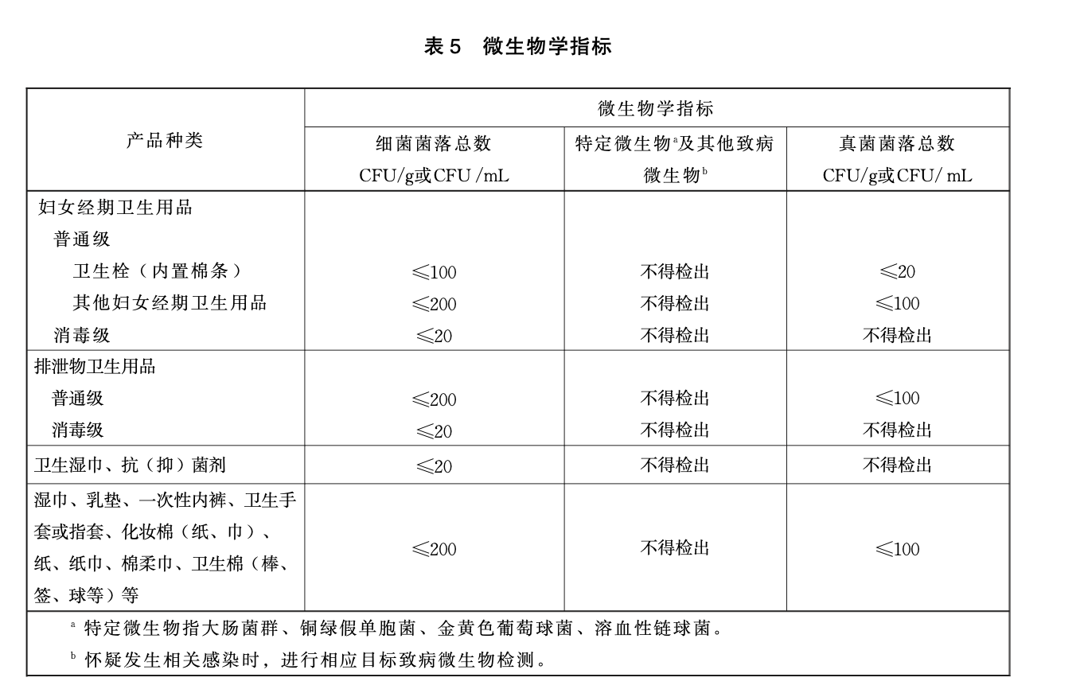
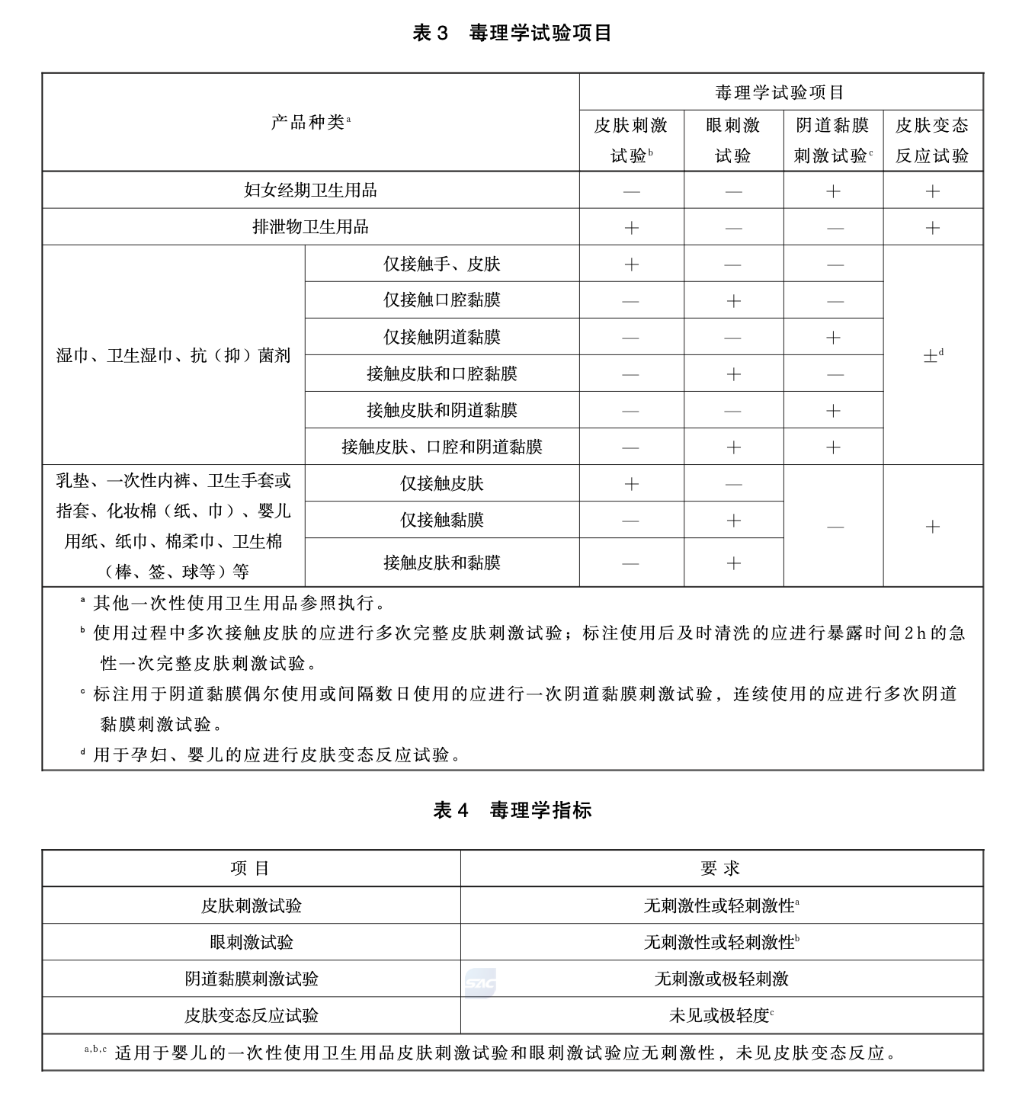
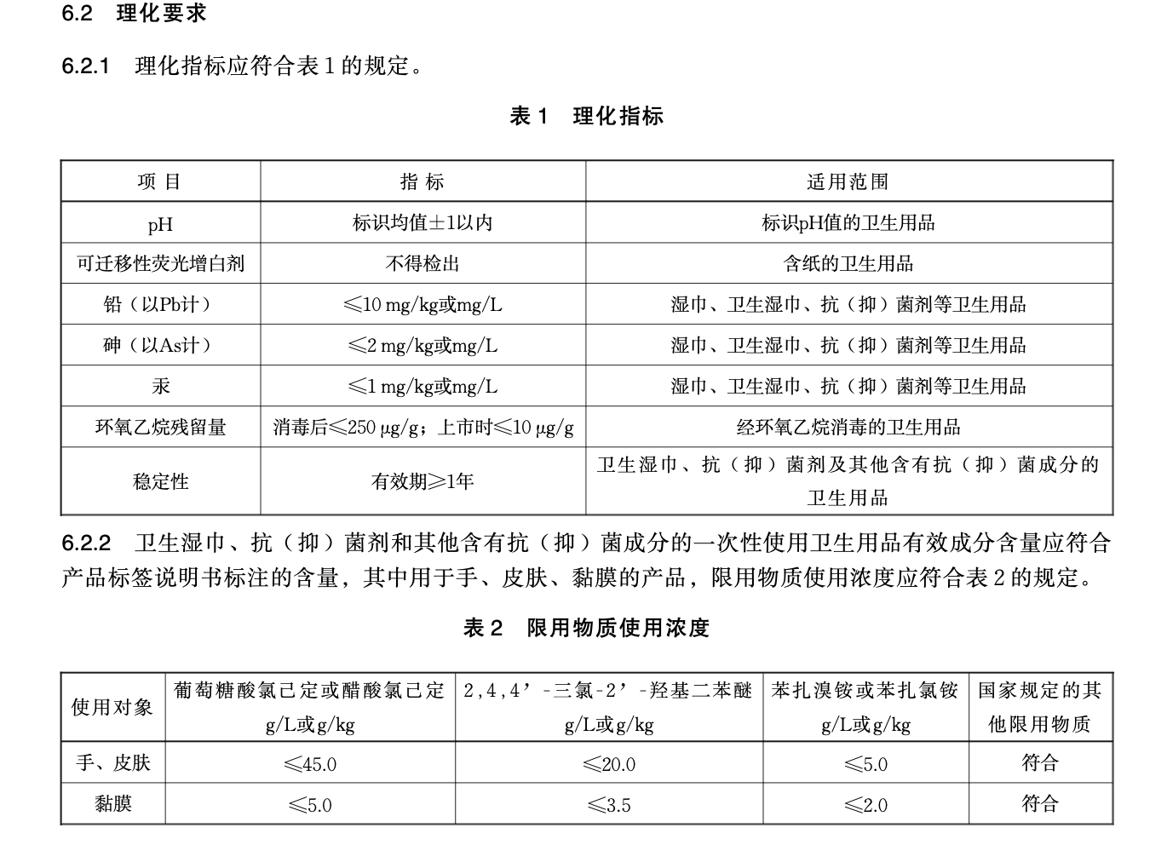
Control the Quality:
Safe & Qualified raw materials
Do NOT neglect product quality for profit
Follow hygiene standards
Strengthen quality inspection
Ingredients marked

Slide 6




Slide 7
下次再见

