Slide 1
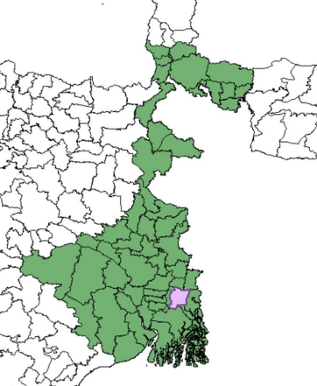
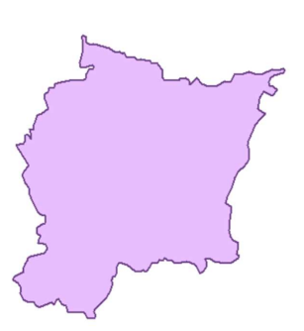
Study Area Analysis
Total area of Rajarhat subdivision is 88 km² including 64.39 km² rural and 24.07 km² urban
Spatial Resolution: (1.0, 1.0)
Height in kilometers = 180 * 1.0 = 180 kilometers
Width in kilometers = 228 * 1.0 = 228 kilometers
Area covered = 180 kilometers * 228 kilometers = 41,040 square kilometers

Slide 2
Block based
Height=180
Width=228
block size of 25x25 pixels
Number of blocks in height = 180/ 25 = 7
Number of blocks in width = 228 / 25 = 10
Total 7x8 = 80 blocks

Slide 3





Think In Different way
Show the weighted Difference

Slide 4

Block Based Methods Algorithm
Height
Reshape into 1D Array(size=height*width)
B1
B2
B3
.
.
.
Bn
Width
Calculate the intensity levels (√[ (x2 – x1 )² + (y2 – y1 )²]) of Each Block
Intensity
Intensity
otsu thresholding method to show only >threshold value only
Pixel Value
Pixel Value

Slide 5
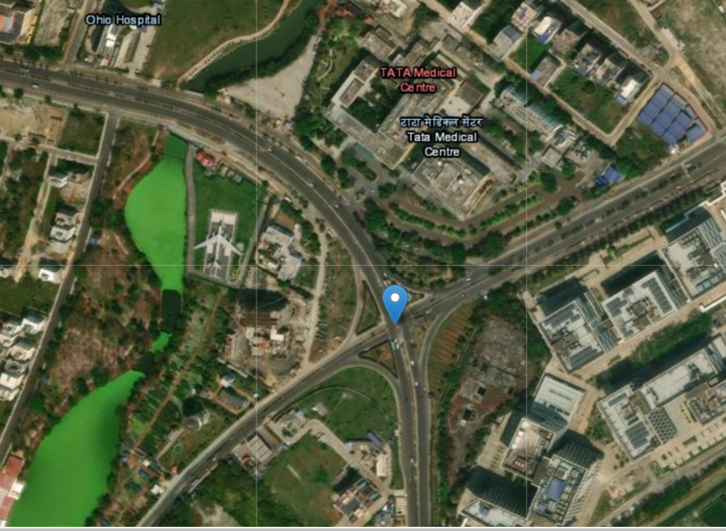
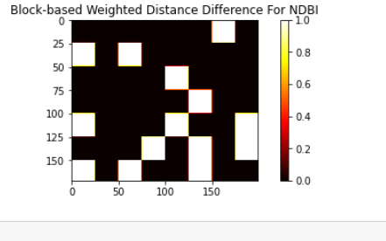
Validation and Ground Truths
Anahita
Magnolia

Slide 6
Thank You

