Slide 1

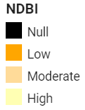
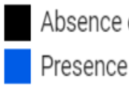
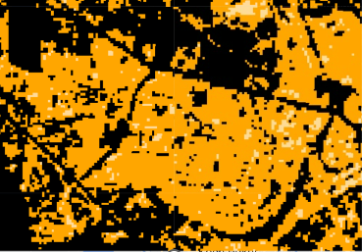
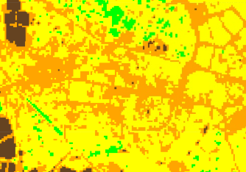
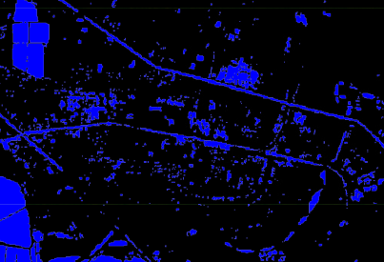
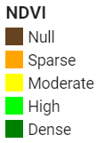
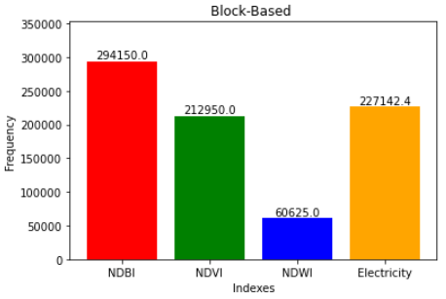
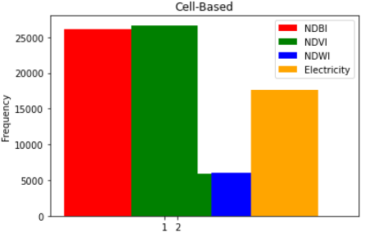
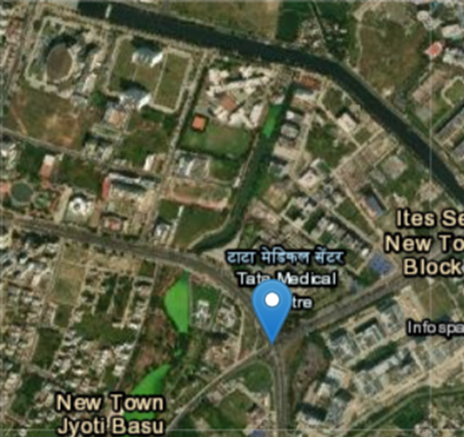
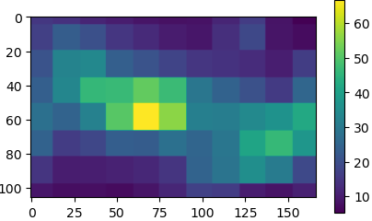
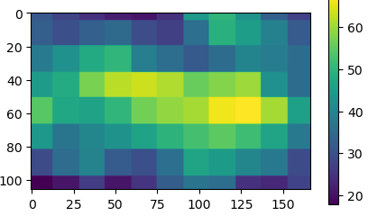
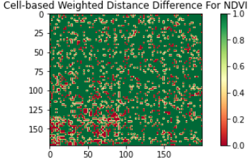
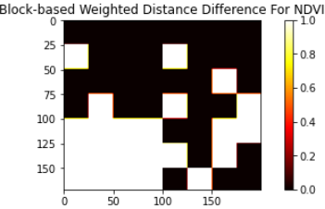
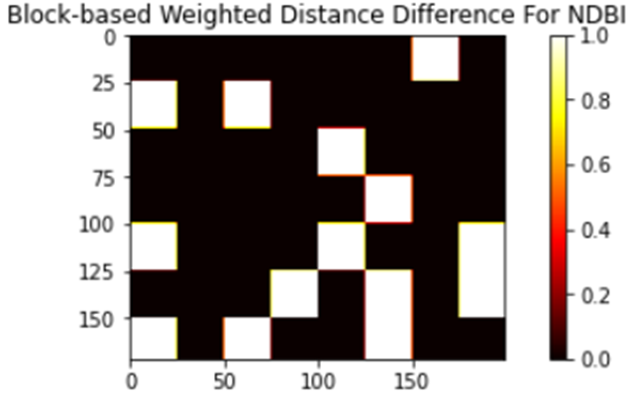
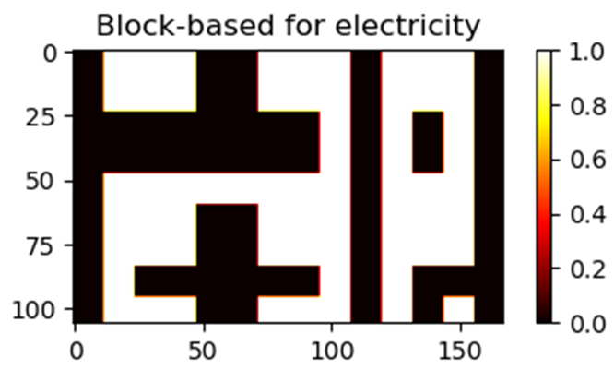
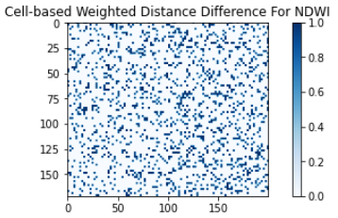
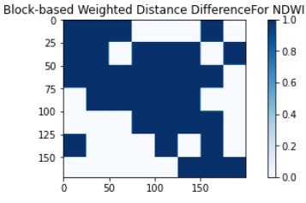
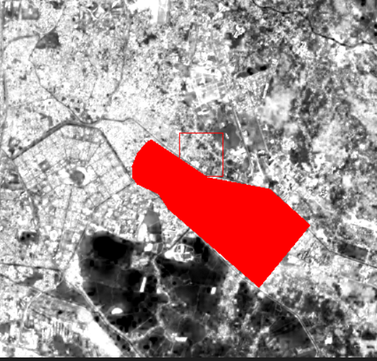
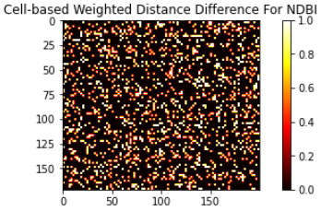

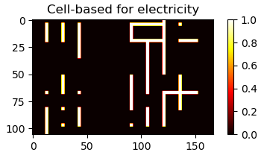

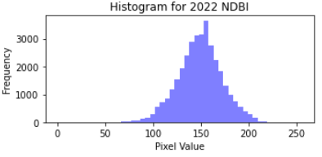
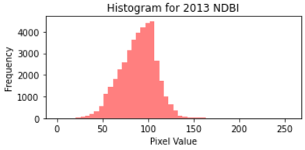
Spatio-Temporal Change Of Urbanization
ABHISEK ROY 10000219062
MONODIP BISWAS 10000220062
ABHISHEK BANIK 10000219064
SAMPRIT DAS 10000219078
Supervisor’s name- MS.DIPANWITA GHOSH
Department: INFORMATION TECHNOLOGY
Abstract
Methodology
Results
Conclusions
Urbanization, the process of increasing urban development and transformation, has significant implications for society and the environment. This study focuses on investigating the spatio-temporal changes of urbanization in the Newtown area of Kolkata using satellite data and indices.
The analysis utilizes indices such as NDVI, NDWI, NDBI, and the night light index to understand urbanization patterns. These indices provide insights into vegetation coverage, water bodies, built-up areas, and the presence of artificial lighting. By examining the changes in these indices over time, we aim to identify the patterns and dynamics of urban growth in Newtown.
The findings of this study contribute to urban planning efforts by providing valuable information about the expansion of built-up areas, changes in vegetation cover and water bodies, and the intensity of artificial lighting. These insights can aid in making informed decisions regarding sustainable urban development and resource management.
By employing satellite data and indices, this study enhances our understanding of the spatio-temporal changes associated with urbanization in the Newtown area of Kolkata. The results contribute to a comprehensive understanding of urban growth dynamics and can support evidence-based decision-making for sustainable urban planning.
Data Collection
Landsat-8 image:
Obtain satellite imagery for NDVI, NDWI, and NDBI from USGS Earth Explorer. And then Select Newtown area, Kolkata as the study area. Then Choose the satellite sensor (e.g., Landsat, Sentinel) and desired data collection dates. Finally Download relevant bands (NIR, red, green, SWIR) and preprocess the imagery.
Night Light Image:
Access night light imagery from Google Earth Engine.
Define Newtown area, Kolkata as the study region.
Select appropriate night light dataset (e.g., VIIRS Day/Night Band).Specify desired temporal range and resolution. Use Google Earth Engine API or code editor to access and download night light images.
Calculation of Indices:
Normalized Difference Vegetation Index (NDVI):
NDVI is calculated using the formula (NIR - Red) / (NIR + Red), where NIR represents the near-infrared band and Red represents the red band. This index helps identify vegetation coverage and changes over time.
b. Normalized Difference Water Index (NDWI): NDWI is computed using the formula (Green - NIR) / (Green + NIR). It highlights water bodies and their variations across different time periods.
c. Normalized Difference Built-Up Index (NDBI): NDBI is derived using the formula (SWIR - NIR) / (SWIR + NIR), where SWIR represents the shortwave infrared band. It focuses on built-up areas and the expansion of urban infrastructure.
NDVI NDWI NDBI
d. Electricity Index: The electricity index is generated based on available data on electricity consumption or infrastructure, which helps identify areas with active electricity usage and development.
Cell-Based Method:
a. In the cell-based method, each pixel in the satellite imagery is treated as an individual unit or cell.
b. The indices (NDVI, NDWI, NDBI, and electricity index) are calculated for each pixel/cell based on the corresponding spectral bands or available data.
c. The temporal changes in each index are analyzed to identify patterns of urbanization and their spatial distribution at the pixel level.
Block-Based Method:
a. In the block-based method, the satellite imagery is divided into larger blocks or regions of interest.
b. Indices (NDVI, NDWI, NDBI, and electricity index) are calculated for each block by aggregating the values of constituent pixels within the block..
Cell-Based Analysis:
The NDVI values indicated a decrease in vegetation coverage over time, suggesting increased urbanization and land transformation.
The NDWI values showed fluctuations in water bodies, with some areas experiencing a decrease in water presence due to urban expansion and infrastructure development.
The NDBI values exhibited a steady increase, indicating the growth of built-up areas and the expansion of urban infrastructure.
The electricity index revealed the expansion of electricity usage and infrastructure in certain regions, indicating urban development and increased human activity.
Block-Based Analysis:
Spatial patterns of urbanization were observed, with concentrated urban expansion and built-up areas in specific blocks within the Newtown area.
Some blocks showed a higher rate of urbanization compared to others, indicating varying levels of development and growth.
The distribution of vegetation, water bodies, built-up areas, and electricity usage varied across different blocks, reflecting the spatial heterogeneity of urbanization in Newtown.
The analysis of spatio-temporal changes in urbanization using satellite data and various indices (NDVI, NDWI, NDBI, and electricity index) in the Newtown area of Kolkata provides valuable insights into the patterns and dynamics of urban growth.
The analysis confirms the ongoing urbanization process in the Newtown area of Kolkata. The decrease in vegetation cover, fluctuations in water bodies, increase in built-up areas, and expansion of electricity usage and infrastructure all reflect the patterns of urban growth.
Overall, this study contributes to the understanding of urbanization dynamics in the Newtown area of Kolkata and provides a foundation for future research and policy interventions aimed at achieving sustainable urban development.
References
Guo HD, Zhang L, Zhu LW (2015) Earth observation big data for climate change research. Adv Clim Chang Res 6(2):108–117
M. Hussain, D. Chen, A. Cheng, H. Wei, and D. Stanley, “Change detection from remotely sensed images: From pixel-based to object-based
T. Fawcett, “An introduction to ROC analysis,” Pattern Recognit. Lett.,vol. 27, no. 8, pp. 861–874, Jun. 2006.
N. Otsu, “A threshold selection method from gray-level histograms,”

