Slide 1
Group – 2 (Khin NweTun, May Myint Myat, May Thinzar Htet, Phway Phway) Date – 04 sept 2021
Assignment - 1

Slide 2
Main Table 1NF
studentCode | Name | Town | Province | Course | DateRegistered
S100 | Dinesh | Colombo | Western | IT | 01-01-2017
S100 | Dinesh | Colombo | Western | Marketing | 20-05-2017
S101 | Jane | Galie | Southern | IT, Marketing | 21-05-2017
S102 | Jack | Kandy | Central | Marketing | 22-05-2017
S103 | Yeshan | Colombo | Western | Marketing | 03-06-2017
studentCode | Name | Town | Province | Course | DateRegistered
S100 | Dinesh | Colombo | Western | IT | 01-01-2017
S100 | Dinesh | Colombo | Western | Marketing | 20-05-2017
S101 | Jane | Galie | Southern | IT | 21-05-2017
S101 | Jane | Galie | Southern | Marketing | 21-05-2017
S102 | Jack | Kandy | Central | Marketing | 22-05-2017
S103 | Yeshan | Colombo | Western | Marketing | 03-06-2017

Slide 3
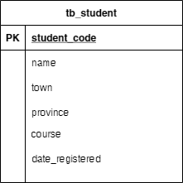
1NF ERD Diagram
Create Table tb_student(
Student_code Number,
Name varchar2(100),
Town varchar2(100),
province varchar2(100),
Course varchar2(200),
Date_registered date,
Constraint STUDENT_CODE_PK primary key (Student_code));

Slide 4
1NF 2NF
studentCode | Name | Town | Province | Course | DateRegistered
S100 | Dinesh | Colombo | Western | IT | 01-01-2017
S100 | Dinesh | Colombo | Western | Marketing | 20-05-2017
S101 | Jane | Galie | Southern | IT | 21-05-2017
S101 | Jane | Galie | Southern | Marketing | 21-05-2017
S102 | Jack | Kandy | Central | Marketing | 22-05-2017
S103 | Yeshan | Colombo | Western | Marketing | 03-06-2017
studentCode | Name | Town | Province
S100 | Dinesh | Colombo | Western
S101 | Jane | Galie | Southern
S102 | Jack | Kandy | Central
S103 | Yeshan | Colombo | Western
studentCode | Course | DateRegistered
S100 | IT | 01-01-2017
S100 | Marketing | 20-05-2017
S101 | IT | 21-05-2017
S101 | Marketing | 21-05-2017
S102 | Marketing | 22-05-2017
S103 | Marketing | 03-06-2017

Slide 5
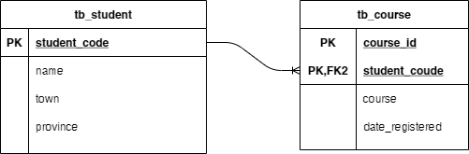
2NF ERD Diagram
Create Table tb_student(
Student_code Number,
Name varchar2(100),
Town varchar2(100),
province varchar2(100),
Constraint STUDENT_CODE_PK primary key (Student_code));
Create table tb_course(
Course_id Number,
Student_code Number,
Course varchar2(200),
Date_registered date,
Constraint COURSE_ID_PK primary key (Course_id)
constraint STUDENT_CODE_FK foreign key(Student_code) references tb_student(Student_code));

Slide 6
2NF 3NF
studentCode | Name | Town | Province
S100 | Dinesh | Colombo | Western
S101 | Jane | Galie | Southern
S102 | Jack | Kandy | Central
S103 | Yeshan | Colombo | Western
studentCode | Course | DateRegistered
S100 | IT | 01-01-2017
S100 | Marketing | 20-05-2017
S101 | IT | 21-05-2017
S101 | Marketing | 21-05-2017
S102 | Marketing | 22-05-2017
S103 | Marketing | 03-06-2017
studentCode | Name | Town
S100 | Dinesh | Colombo
S101 | Jane | Galie
S102 | Jack | Kandy
S103 | Yeshan | Colombo
Town | Province
Colombo | Western
Galie | Southern
Kandy | Central
Colombo | Western
studentCode | Course | DateRegistered
S100 | IT | 01-01-2017
S100 | Marketing | 20-05-2017
S101 | IT | 21-05-2017
S101 | Marketing | 21-05-2017
S102 | Marketing | 22-05-2017
S103 | Marketing | 03-06-2017

Slide 7
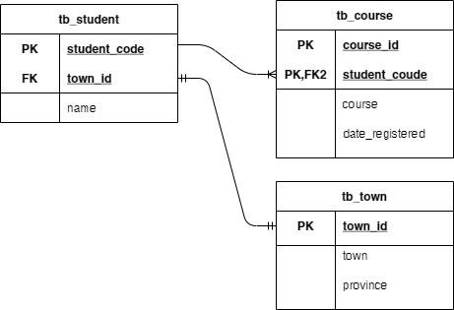
ERD Diagram of 3nf

Slide 8
SQL SCRIPTS of 3nf
Create Table tb_student(
Student_code Number,
Name varchar2(100),
Town varchar2(100),
province varchar2(100),
Constraint STUDENT_CODE_PK primary key (Student_code));
Create table tb_course(
Course_id Number,
Student_code Number,
Course varchar2(200),
Date_registered date,
Constraint COURSE_ID_PK primary key (Course_id)
constraint STUDENT_CODE_FK foreign key(Student_code) references tb_student(Student_code));
Create Table tb_town(
Town_id Number,
Town varchar2(100),
province varchar2(100),
Constraint TOWN_ID_PK primary key (town_id));

Slide 9
Thank You

