Slide 1
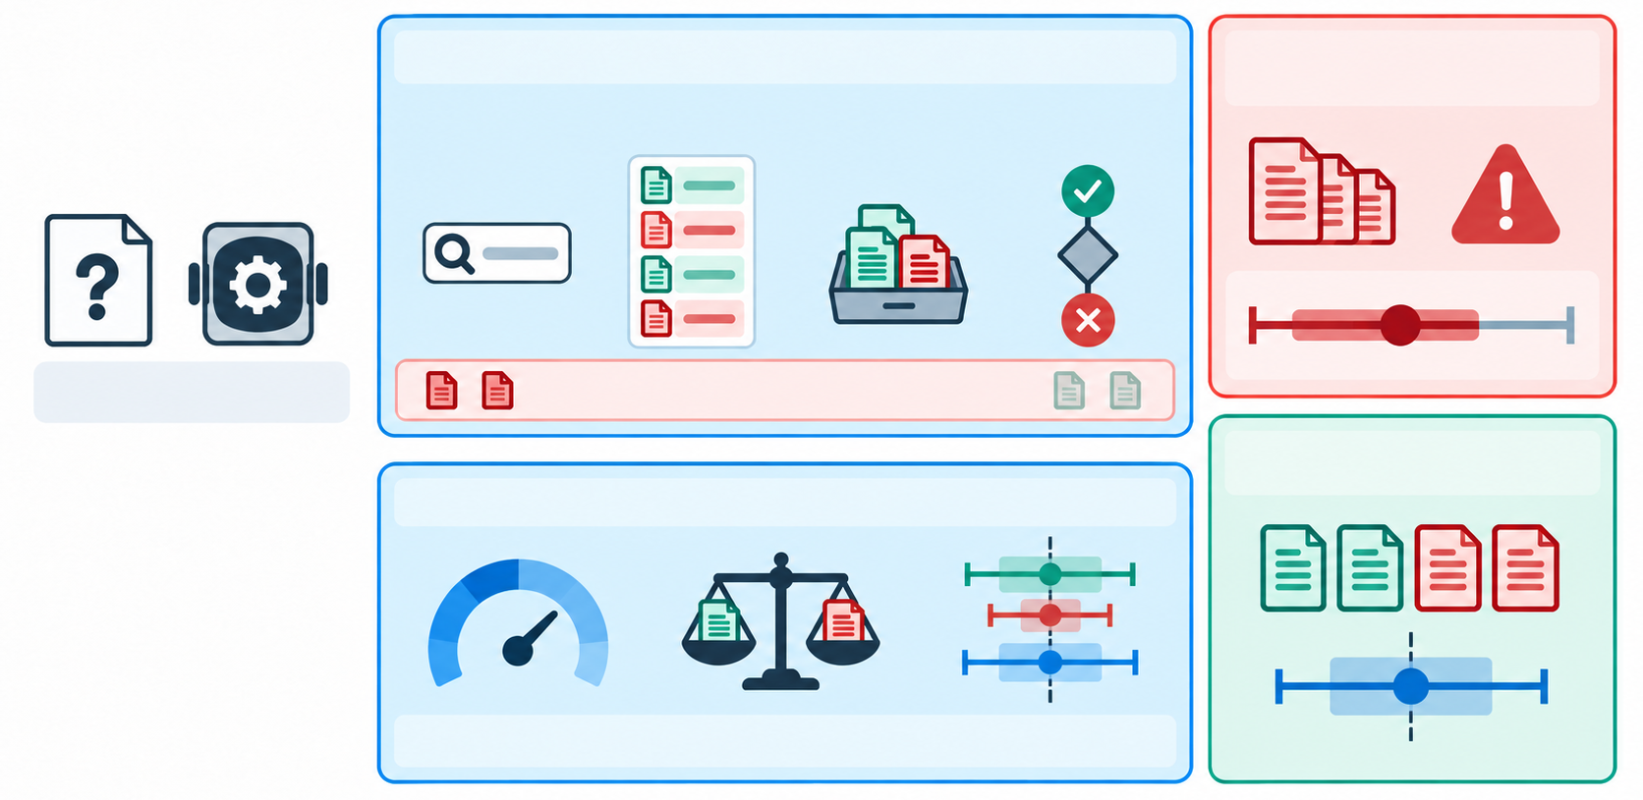
Evidence history updates the next query
Naive estimate
Selected evidence only
Query
Exposure
Inclusion
Stopping
Deep Research agent
Research question
Search policy shifts the evidence distribution
Logged search trajectory
CESS audit
CESS selection correction
Candidate-set estimate
Selection propensities
Evidence reweighting
Variance-aware shrinkage
Notes:
The base illustration was generated from the user-provided overview.pdf. All visible labels and connectors are native PowerPoint objects and remain editable. The raster base is movable but its internal icons are not vector-editable.

