Slide 1

Makings of a Superhost:
Data and Insight
Presented by Winrich Sy

Slide 2


Superhost
What is Airbnb?
Online marketplace for listers to host their property and for renters to find a place to stay.
Usually cheaper than hotels
Mainly used by travelers
Hosts millions of travel stays yearly
Evaluated at $31 Billion
What is a Superhost?
Experienced hosts that provide extraordinary experiences for their guests
Granted by Airbnb
Why become a Superhost?
Verification badge on profile
More visibility and trust will increase earnings
Extra 20% on referral bonus

Slide 3
About the Dataset
Airbnb Dataset on listings in Paris, France
Second most visited country by foreigners per year.
Downloaded from: http://insideairbnb.com/get-the-data.html
Listings.csv (241.3 MB):
65k of listings
106 features
Location
Host
Rating
etc.
Calendar.csv (1.02 GB):
23 million rows:
7 features
listing_id
date
Price
etc.

Slide 4
1. Exploratory Data Analysis

Slide 5
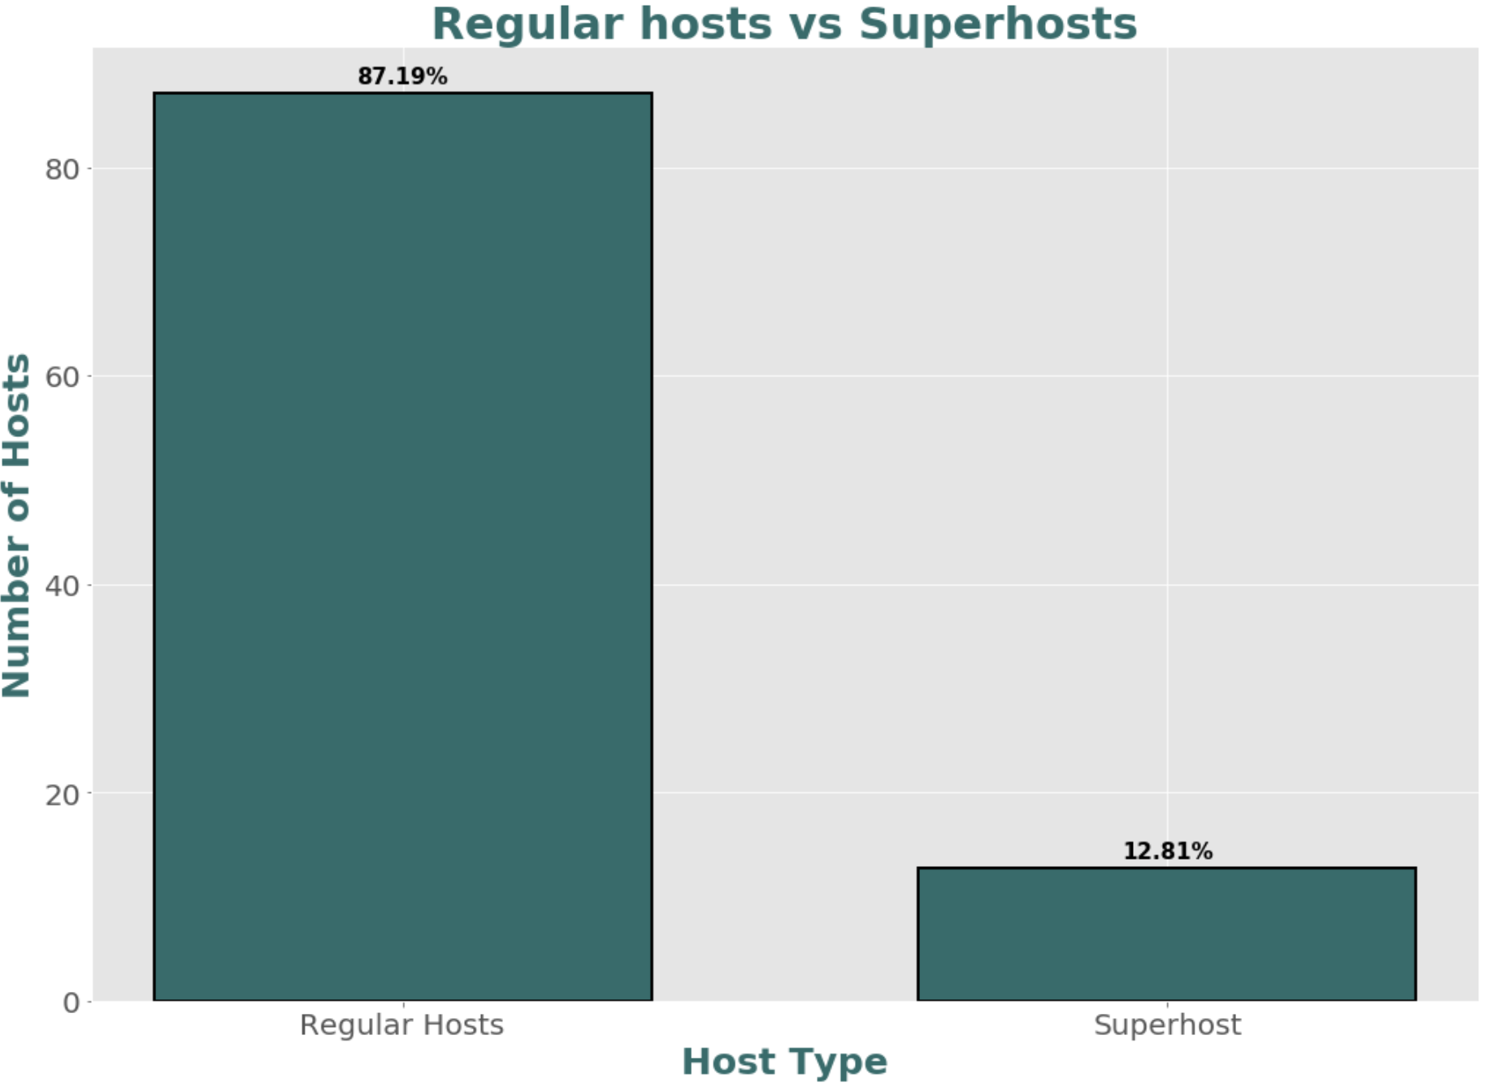

Slide 6
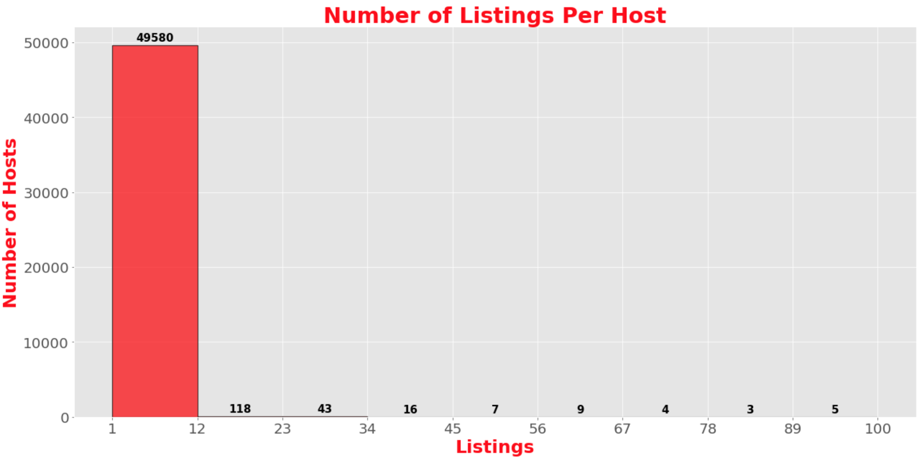
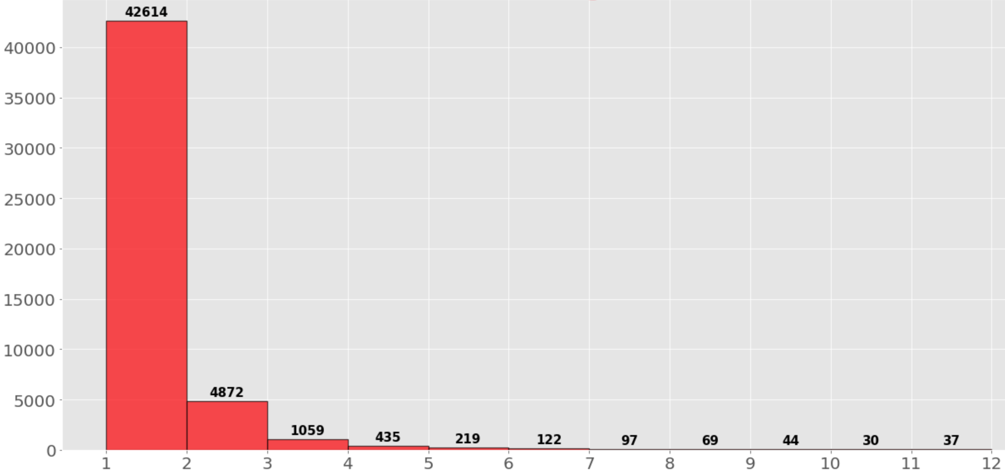

Slide 7
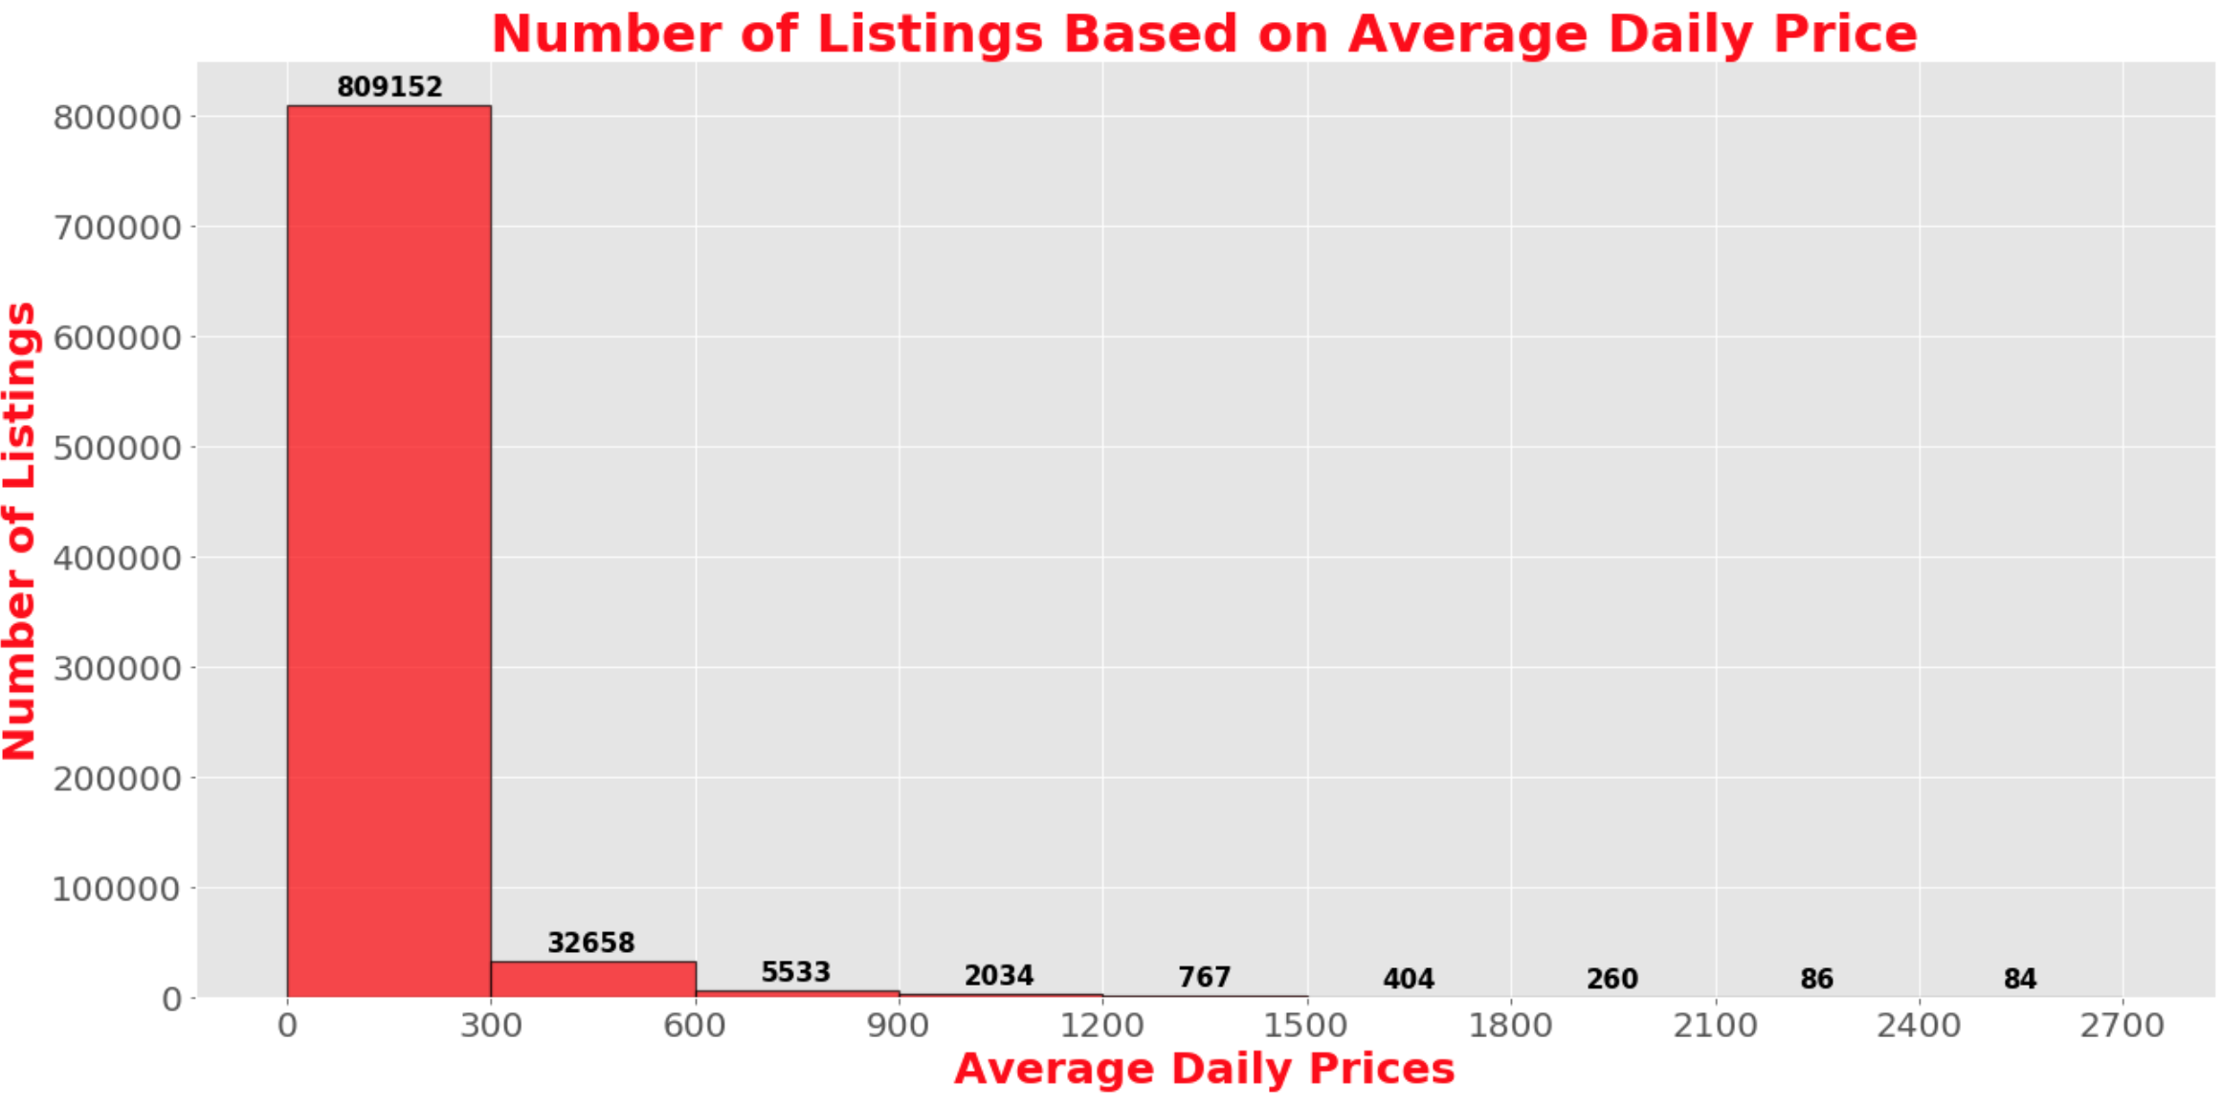
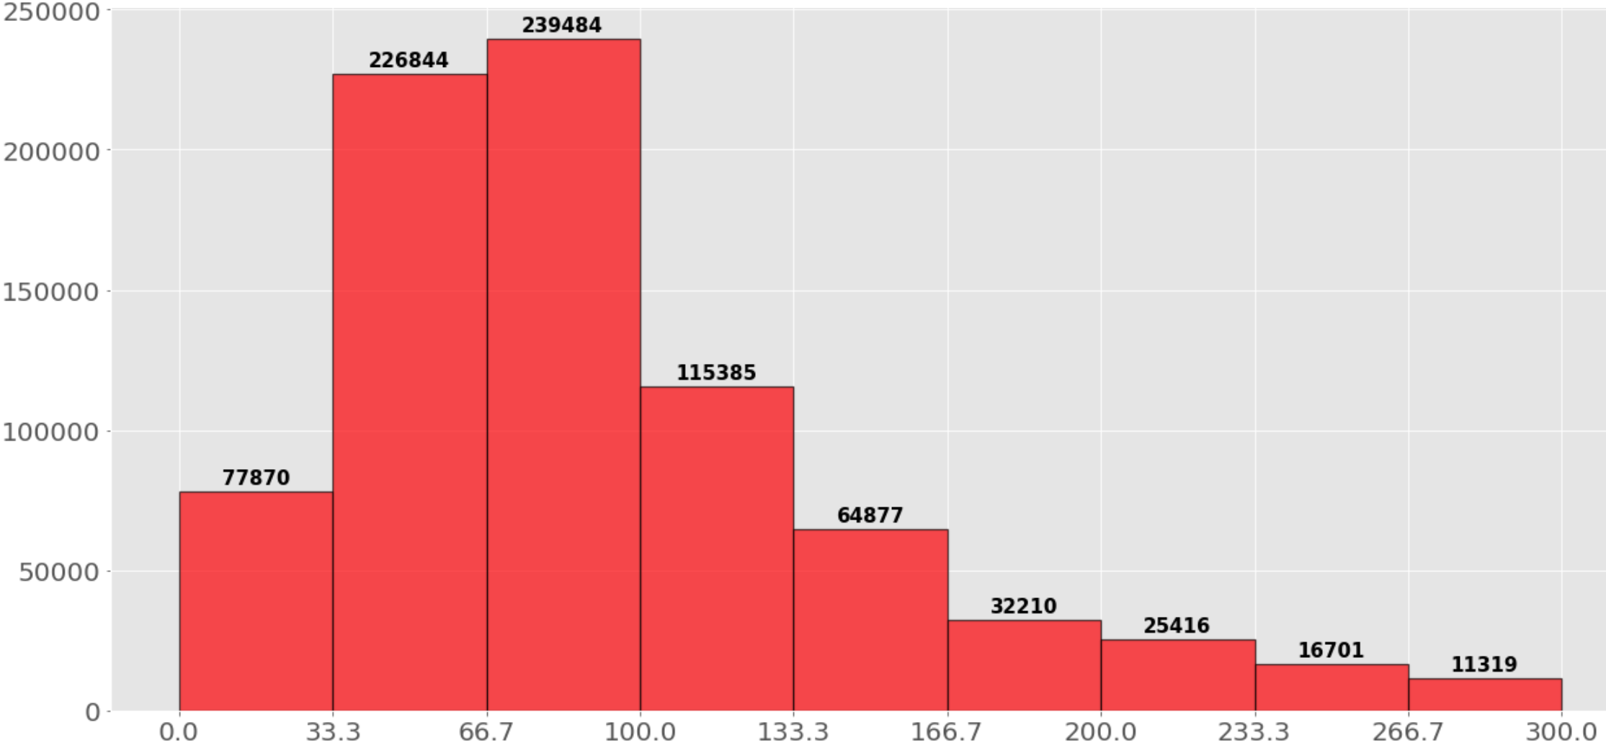

Slide 8
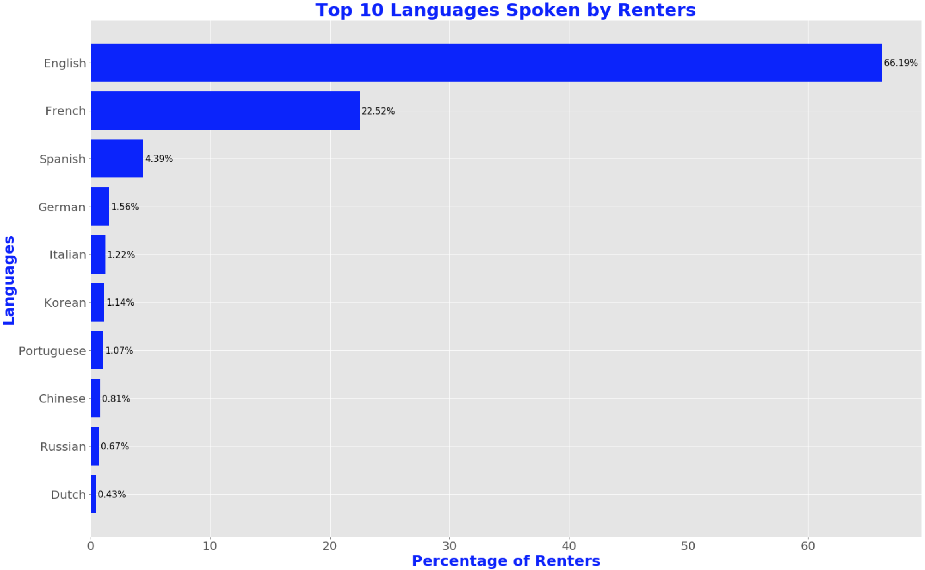

Slide 9
2. Modeling

Slide 10
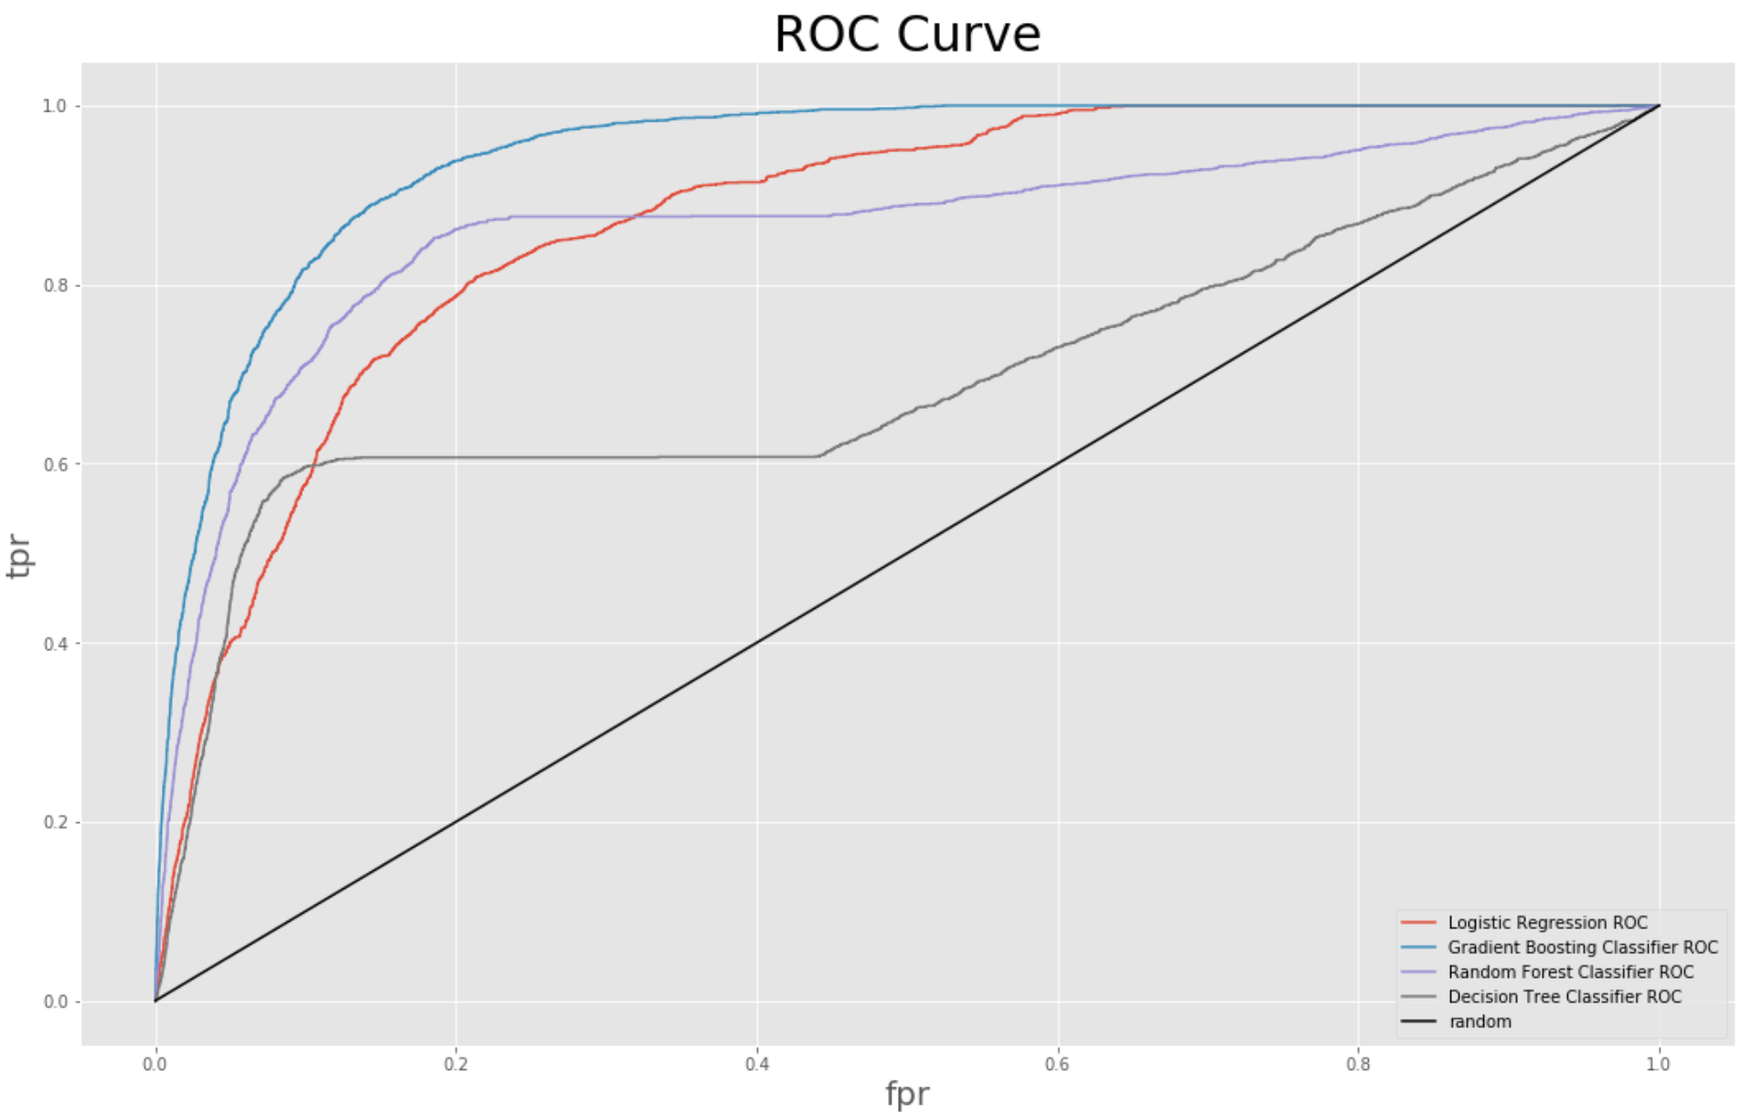
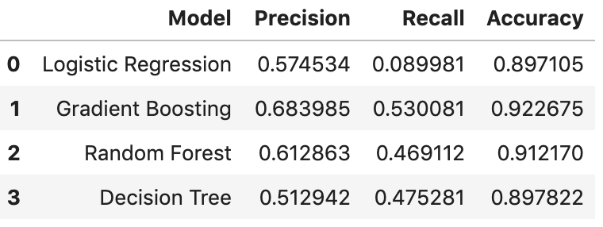
Without Host Vericiations

Slide 11
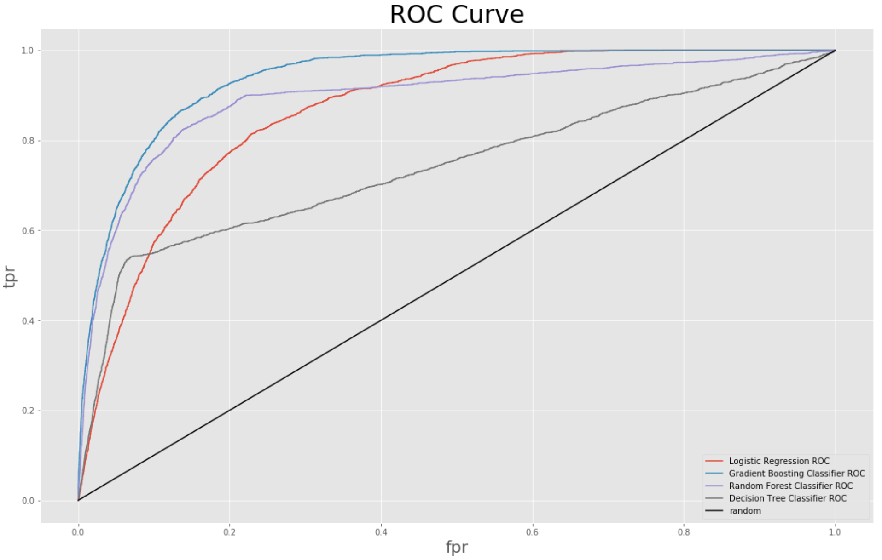
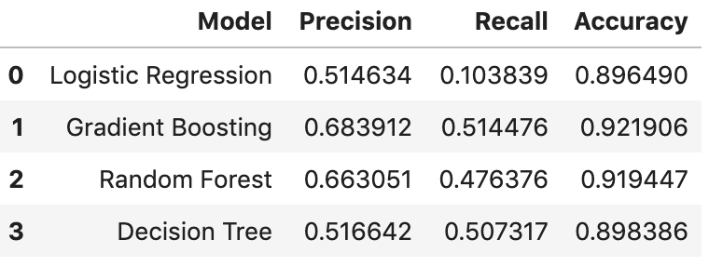
With Host Verications

Slide 12
Thanks!
Any questions?

