Slide 1
Classification
Prof.Nilkamal More

Slide 2
Classification and Prediction
What is classification? What is prediction?
Issues regarding classification and prediction
Classification by decision tree induction
Bayesian Classification
Classification by backpropagation
Classification based on concepts from association rule mining
Other Classification Methods
Prediction
Classification accuracy
Summary

Slide 3
Classification vs. Prediction
Classification:
  predicts categorical class labels
  classifies data (constructs a model) based on the training set and the values (class labels) in a classifying attribute and uses it in classifying new data
Prediction:
  models continuous-valued functions, i.e., predicts unknown or missing values
Typical Applications
  credit approval
  target marketing
  medical diagnosis
  treatment effectiveness analysis

Slide 4
Classification—A Two-Step Process
Model construction: describing a set of predetermined classes
  Each tuple/sample is assumed to belong to a predefined class, as determined by the class label attribute
  The set of tuples used for model construction: training set
  The model is represented as classification rules, decision trees, or mathematical formulae
Model usage: for classifying future or unknown objects
  Estimate accuracy of the model
    The known label of test sample is compared with the classified result from the model
    Accuracy rate is the percentage of test set samples that are correctly classified by the model
    Test set is independent of training set, otherwise over-fitting will occur

Slide 5
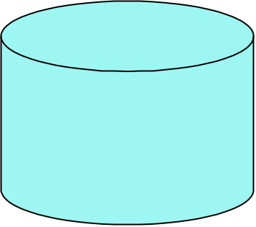

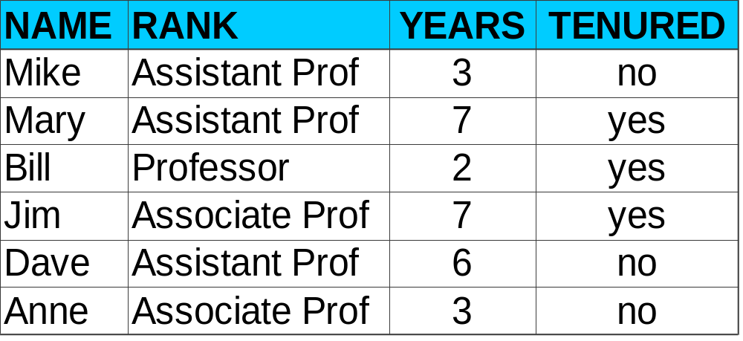
Classification Process (1): Model Construction
Classification
Algorithms
Training
Data
Classifier
(Model)
IF rank = ‘professor’
OR years > 6
THEN tenured = ‘yes’

Slide 6
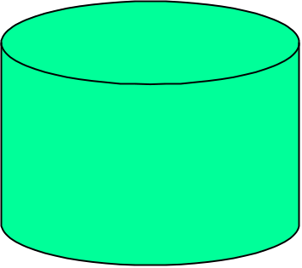



Classification Process (2): Use the Model in Prediction
Classifier
Testing
Data
Unseen Data
(Jeff, Professor, 4)
Tenured?

Slide 7
Supervised vs. Unsupervised Learning
Supervised learning (classification)
  Supervision: The training data (observations, measurements, etc.) are accompanied by labels indicating the class of the observations
  New data is classified based on the training set
Unsupervised learning (clustering)
  The class labels of training data is unknown
  Given a set of measurements, observations, etc. with the aim of establishing the existence of classes or clusters in the data.

Slide 8
Classification and Prediction
What is classification? What is prediction?
Issues regarding classification and prediction
Classification by decision tree induction
Bayesian Classification
Classification by backpropagation
Classification based on concepts from association rule mining
Other Classification Methods
Prediction
Classification accuracy
Summary

Slide 9
Issues (1): Data Preparation
Data cleaning
  Preprocess data in order to reduce noise and handle missing values
Relevance analysis (feature selection)
  Remove the irrelevant or redundant attributes
Data transformation
  Generalize and/or normalize data

Slide 10
Issues (2): Evaluating Classification Methods
Predictive accuracy
Speed and scalability
  time to construct the model
  time to use the model
Robustness
  handling noise and missing values
Scalability
  efficiency in disk-resident databases
Interpretability:
  understanding and insight provded by the model
Goodness of rules
  decision tree size
  compactness of classification rules

Slide 11
Classification and Prediction
What is classification? What is prediction?
Issues regarding classification and prediction
Classification by decision tree induction
Bayesian Classification
Classification by backpropagation
Classification based on concepts from association rule mining
Other Classification Methods
Prediction
Classification accuracy
Summary

Slide 12
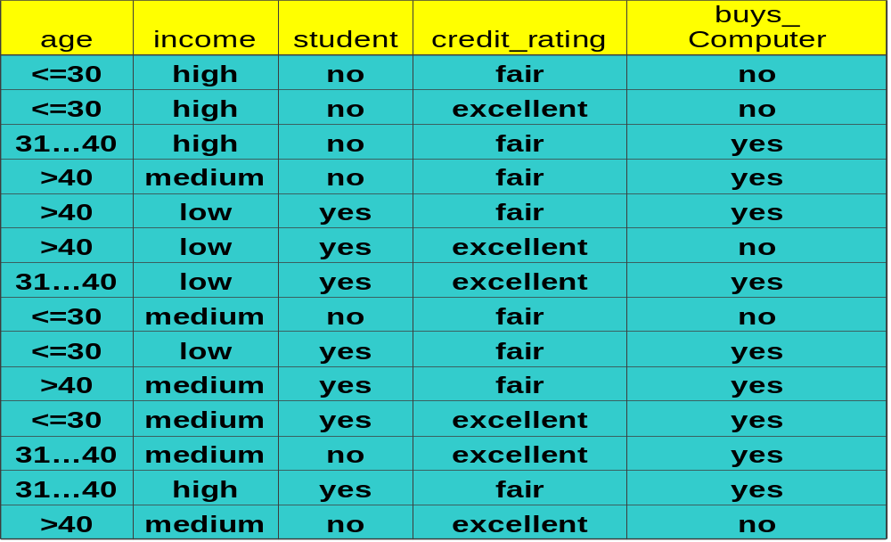
Training Dataset

Slide 13
Bayesian Classification: Why?
Probabilistic learning: Calculate explicit probabilities for hypothesis, among the most practical approaches to certain types of learning problems
Incremental: Each training example can incrementally increase/decrease the probability that a hypothesis is correct. Prior knowledge can be combined with observed data.
Probabilistic prediction: Predict multiple hypotheses, weighted by their probabilities
Standard: Even when Bayesian methods are computationally intractable, they can provide a standard of optimal decision making against which other methods can be measured

Slide 14
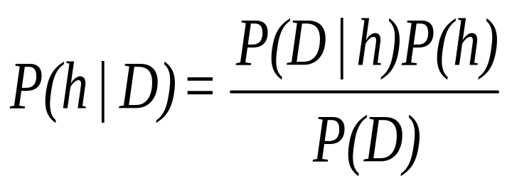
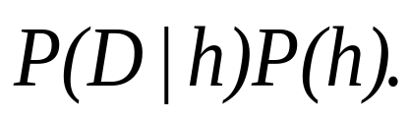
Bayesian Theorem
Given training data D, posteriori probability of a hypothesis h, P(h|D) follows the Bayes theorem
MAP (maximum posteriori) hypothesis
Practical difficulty: require initial knowledge of many probabilities, significant computational cost

Slide 15
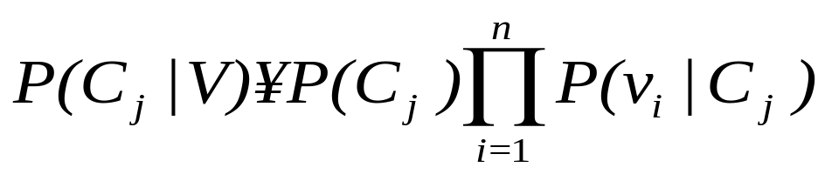
Naïve Bayes Classifier (I)
A simplified assumption: attributes are conditionally independent:
Greatly reduces the computation cost, only count the class distribution.

Slide 16
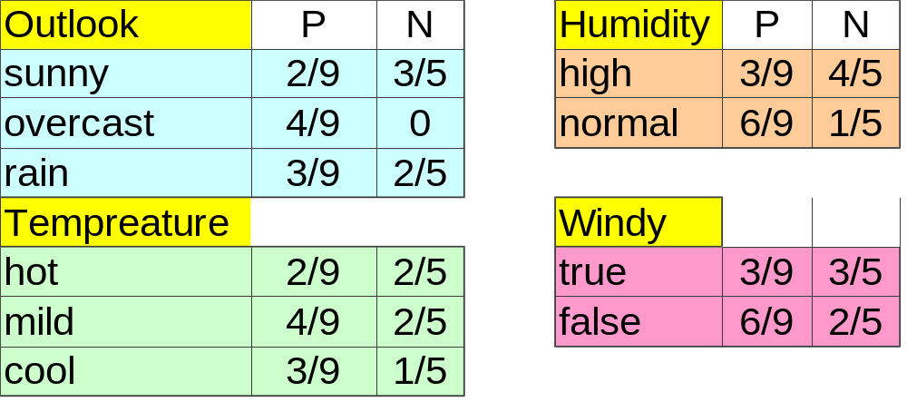
Naive Bayesian Classifier (II)
Given a training set, we can compute the probabilities

Slide 17
Bayesian classification
The classification problem may be formalized using a-posteriori probabilities:
P(C|X) = prob. that the sample tuple X=<x₁,…,x_{k}> is of class C.
E.g. P(class=N | outlook=sunny,windy=true,…)
Idea: assign to sample X the class label C such that P(C|X) is maximal

Slide 18
Estimating a-posteriori probabilities
Bayes theorem:
P(C|X) = P(X|C)·P(C) / P(X)
P(X) is constant for all classes
P(C) = relative freq of class C samples
C such that P(C|X) is maximum =
C such that P(X|C)·P(C) is maximum
Problem: computing P(X|C) is unfeasible!

Slide 19
Naïve Bayesian Classification
Naïve assumption: attribute independence
P(x₁,…,x_{k}|C) = P(x₁|C)·…·P(x_{k}|C)
If i-th attribute is categorical:
P(x_{i}|C) is estimated as the relative freq of samples having value x_{i} as i-th attribute in class C
If i-th attribute is continuous:
P(x_{i}|C) is estimated thru a Gaussian density function
Computationally easy in both cases

Slide 20
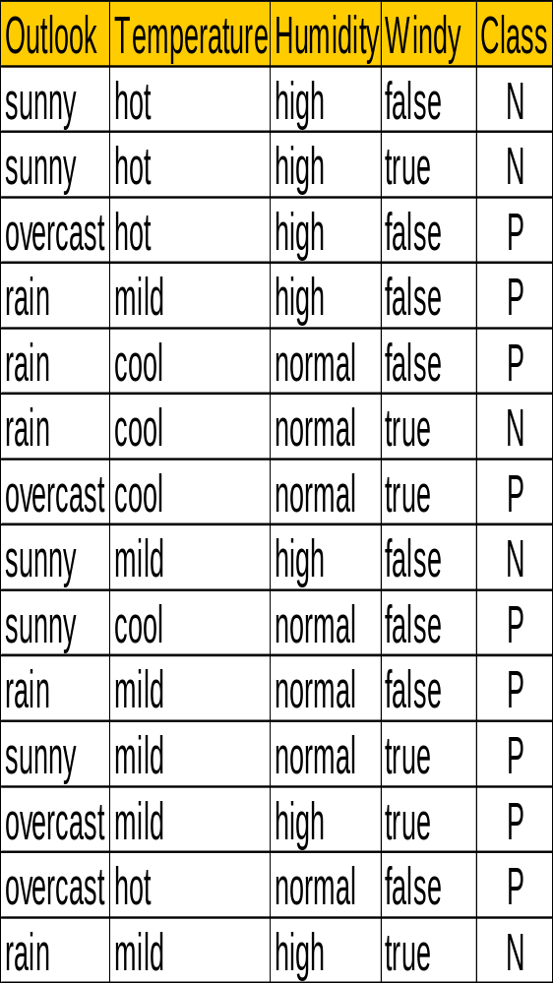
P(p) = 9/14
P(n) = 5/14
outlook
P(sunny|p) = 2/9 | P(sunny|n) = 3/5
P(overcast|p) = 4/9 | P(overcast|n) = 0
P(rain|p) = 3/9 | P(rain|n) = 2/5
temperature
P(hot|p) = 2/9 | P(hot|n) = 2/5
P(mild|p) = 4/9 | P(mild|n) = 2/5
P(cool|p) = 3/9 | P(cool|n) = 1/5
humidity
P(high|p) = 3/9 | P(high|n) = 4/5
P(normal|p) = 6/9 | P(normal|n) = 2/5
windy
P(true|p) = 3/9 | P(true|n) = 3/5
P(false|p) = 6/9 | P(false|n) = 2/5

Slide 21
Play-tennis example: classifying X
An unseen sample X = <rain, hot, high, false>
P(X|p)·P(p) =
P(rain|p)·P(hot|p)·P(high|p)·P(false|p)·P(p) = 3/9·2/9·3/9·6/9·9/14 = 0.010582
P(X|n)·P(n) =
P(rain|n)·P(hot|n)·P(high|n)·P(false|n)·P(n) = 2/5·2/5·4/5·2/5·5/14 = 0.018286
Sample X is classified in class n (don’t play)

Slide 22
The independence hypothesis…
… makes computation possible
… yields optimal classifiers when satisfied
… but is seldom satisfied in practice, as attributes (variables) are often correlated.
Attempts to overcome this limitation:
  Bayesian networks, that combine Bayesian reasoning with causal relationships between attributes
  Decision trees, that reason on one attribute at the time, considering most important attributes first

Slide 23
Example of Naïve Bayesian:
Unknown sample---- { Red, SUV, Domestic,?}
Example No. | Color | Type | Origin | Stolen?
1 | Red | Sports | Domestic | Yes
2 | Red | Sports | Domestic | No
3 | Red | Sports | Domestic | Yes
4 | Yellow | Sports | Domestic | No
5 | Yellow | Sports | Imported | Yes
6 | Yellow | SUV | Imported | No
7 | Yellow | SUV | Imported | Yes
8 | Yellow | SUV | Domestic | No
9 | Red | SUV | Imported | No
10 | Red | Sports | Imported | Yes

Slide 24
Color
P(Red|Yes)=3/5 | P(Red|No)=2/5
P(Yellow|Yes)=2/5 | P(Yellow|No)=3/5
Type
P(SUV|Yes)=1/5 | P(SUV|No)=3/5
P(Sports|Yes)=4/5 | P(Sports|No)=2/5
Origin
P(Domestic|Yes)=2/5 | P(Domestic|No)=3/5
P(Imported|Yes)=3/5 | P(Imported|No)=2/5
P(Yes) * P(Red | Yes) * P(SUV | Yes) * P(Domestic|Yes)
= 5/10 * 3/5 * 2/5 * 1/5 = 0.024
and for
v = No,
P(No) * P(Red | No) * P(SUV | No) * P (Domestic | No)
= 5/10 * 2/5 * 3/5 * 3/5 = 0.072
Since 0.072 > 0.024, our example gets classified as ’NO’

