Slide 1
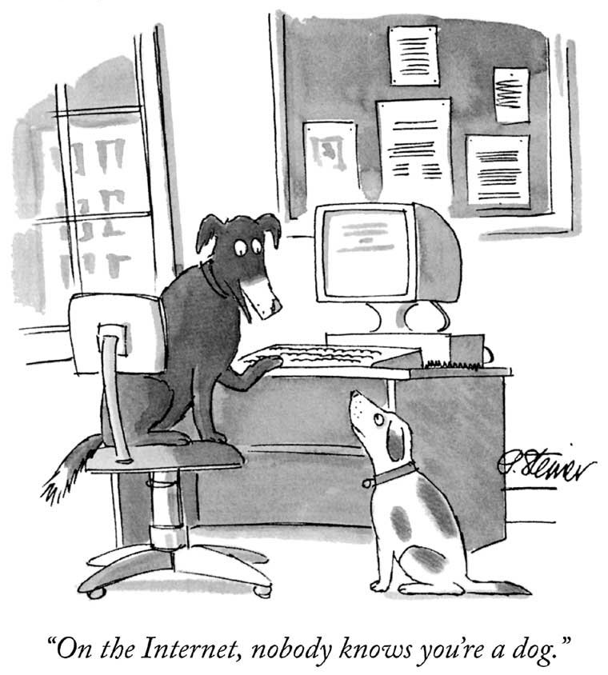

Slide 2
You Are Not Anonymous
Your IP address can be linked directly to you
ISPs store communications records
Usually for several years (Data Retention Laws)
Law enforcement can subpoena these records
Your browser is being tracked
Cookies, Flash cookies, E-Tags, HTML5 Storage
Browser fingerprinting
Your activities can be used to identify you
Unique websites and apps that you use
Types of links that you click

Slide 3

Wiretapping is Ubiquitous
Wireless traffic can be trivially intercepted
Airsnort, Firesheep, etc.
Wifi and Cellular traffic!
Encryption helps, if it’s strong
WEP and WPA are both vulnerable!
Tier 1 ASs and IXPs are compromised
NSA, GCHQ, “5 Eyes”
~1% of all Internet traffic
Focus on encrypted traffic

Slide 4
Who Uses Anonymity Systems?
“If you’re not doing anything wrong, you shouldn’t have anything to hide.”
Implies that anonymous communication is for criminals
The truth: who uses Tor?
Journalists
Law enforcement
Human rights activists
Normal people
Fact: Tor was/is developed by the Navy
Business executives
Military/intelligence personnel
Abuse victims

Slide 5
Why Do We Want Anonymity?
To protect privacy
Avoid tracking by advertising companies
Viewing sensitive content
Information on medical conditions
Advice on bankruptcy
Protection from prosecution
Not every country guarantees free speech
Downloading copyrighted material
To prevent chilling-effects
It’s easier to voice unpopular or controversial opinions if you are anonymous

Slide 6
Anonymity Layer
Application
Function:
Hide the source, destination, and content of Internet flows from eavesdroppers
Key challenge:
Defining and quantifying anonymity
Building systems that are resilient to deanonymization
Maintaining performance
Anonymity
Presentation
Session
Transport
Network
Data Link
Physical

Slide 7
What is Anonymity ?
Anonymity describes situations where the acting person's identity is unknown. Some writers have argued that namelessness, though technically correct, does not capture what is more centrally at stake in contexts of anonymity.
The important idea here is that a person be non-identifiable, unreachable, or untrackable.

Slide 8
Why is Anonymity necessary ?
This is the final step of any sort of penetration testing as a process – all the rest is paperwork. In a nutshell, its goal is to erase the digital signs left out by the pen tester during the earlier stages of the test. These digital signs, in essence, prove the pen tester’s presence in the targeted computer system.

Slide 9
How to achieve Anonymity ?
There are three basic ways of ensuring anonymity on the internet. They are :
1. Use of ProxyChains
Proxychains is a program that allows you to use SSH, TELNET, VNC, FTP and any other Internet application from behind HTTP(HTTPS) and SOCKS(4/5) proxy servers. This "proxifier" provides proxy server support to any app.
2. Use of VPN
A virtual private network (VPN) extends a private network across a public network and enables users to send and receive data across shared or public networks as if their computing devices were directly connected to the private network.
3. Use of TOR Networking
Tor directs Internet traffic through a free, worldwide, volunteer overlay network consisting of more than seven thousand relays to conceal a user's location and usage from anyone conducting network surveillance or traffic analysis.

Slide 10
ProxyChains
Support SOCKS5, SOCKS4, and HTTP CONNECT proxy servers.
Proxychains can be mixed up with a different proxy types in a list
Proxychains also supports any kinds of chaining option methods, like: random, which takes a random proxy in the list stored in a configuration file, or chaining proxies in the exact order list, different proxies are separated by a new line in a file. There is also a dynamic option, that lets Proxychains go through the live only proxies, it will exclude the dead or unreachable proxies, the dynamic option often called smart option.
Proxychains can be used with servers, like squid, sendmail, etc.
Proxychains is capable to do DNS resolving through proxy.
Proxychains can handle any TCP client application, ie., nmap, telnet.
Notes:
https://linuxhint.com/proxychains-tutorial/

Slide 11
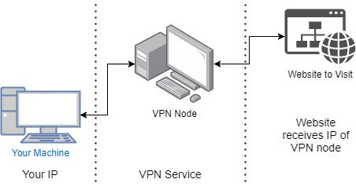
VPN
A VPN is created by establishing a virtual point-to-point connection through the use of dedicated circuits or with tunneling protocols over existing networks.
A VPN available from the public Internet can provide some of the benefits of a wide area network (WAN).
From a user perspective, the resources available within the private network can be accessed remotely.

Slide 12
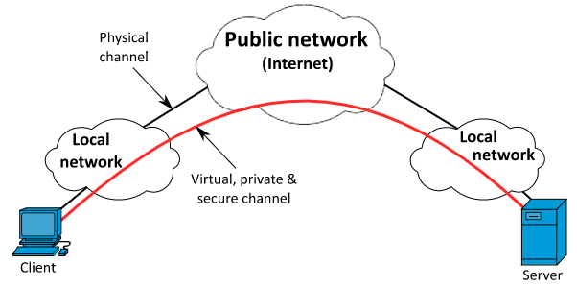
In simple terms, a virtual channel is created for the client's request trading.
The server will think that the VPN node sent the request.
This will allow a basic level of security for your requests.
This will be single anonymity layer which will keep your real identity hidden.

Slide 13
 | VPN | Proxy
1. | VPN ensures encryption, authentication and integrity protection. | Proxy does not ensure or provide any security.
2. | Protocols used in VPN are PTTP (Point to point tunneling protocol), L2TP (Layer 2 tunneling protocol) etc. | Protocols used in Proxy are FTP (File transfer protocol), SMTP (Simple mail transfer protocol) HTTP (Hyper Text Transfer Protocol) etc.
3. | VPN works on firewall. | Proxy works on browsers.
4. | VPN stands for Virtual Private Network. It simulate a private network over public network. | It does not simulate a private network over public network.

Slide 14
5 | VPN creates tunnel between end users. | But proxy does not create tunnel between end users.
6 | VPN offers high amount of security. | Proxy does not offer any type of security.

Slide 15
Outline
Definitions and Examples
Crowds
Chaum Mix / Mix Networks
Tor

Slide 16














Quantifying Anonymity
How can we calculate how anonymous we are?
Anonymity Sets
Suspects (Anonymity Set)
Who sent this message?
Larger anonymity set = stronger anonymity

Slide 17


Slide 18
Other Definitions
Unlinkability
From the adversaries perspective, the inability the link two or more items of interest
E.g. packets, events, people, actions, etc.
Three parts:
Sender anonymity (who sent this?)
Receiver anonymity (who is the destination?)
Relationship anonymity (are sender A and receiver B linked?)
Unobservability
From the adversaries perspective, items of interest are indistinguishable from all other items

Slide 19


Crypto (SSL)
Data Traffic
Content is unobservable
Due to encryption
Source and destination are trivially linkable
No anonymity!

Slide 20








Anonymizing Proxies
HTTPS Proxy
No anonymity!
Source is known
Destination anonymity
Destination is known
Source anonymity

Slide 21

Anonymizing VPNs
VPN Gateway
No anonymity!
Source is known
Destination anonymity
Destination is known
Source anonymity

Slide 22
Using Content to Deanonymize
HTTPS Proxy
Reading Gmail
Looking up directions to home
Updating your Facebook profile
Etc…
No anonymity!
Fact: the NSA leverages common cookies from ad networks, social networks, etc. to track users

Slide 23
Statistical Inference Attacks
VPN Gateway
Statistical analysis of traffic patterns can compromise anonymity, i.e. the timing and/or volume of packets

Slide 24
Data To Protect
Personally Identifiable Information (PII)
Name, address, phone number, etc.
OS and browser information
Cookies, etc.
Language information
IP address
Amount of data sent and received
Traffic timing

Slide 25
Outline
Definitions and Examples
Crowds
Chaum Mix / Mix Networks
Tor

Slide 26
Crypto Algorithms
Symmetric algorithms
Conventional algorithms
Encryption and decryption keys are the same
Examples: DES, 3DES, AES, Blowfish
Asymmetric algorithms
Commonly known as Public Key algorithms
Encryption key and decryption key are different
Examples: Diffie-Hellman, RSA, Elliptic curve

Slide 27
Symmetric Key Crypto
Let’s say we have a plaintext message M
… a symmetric encryption algorithm E
… and a key K
M → E(K, M) = C → E(K, C) = M
Advantages:
Fast and easy to use
Disadvantages
How to securely communicate the key?
Cyphertext C
Symmetric encryption is reversible

Slide 28
Public Key Crypto
Let’s say we have plaintext message M
… a public key algorithm F
… and two keys K_{P} (public) and K_{S} (private)
M → F(K_{P}, M) = C → F(K_{S}, C) = M
M → F(K_{S}, M) = C → F(K_{P}, C) = M
Encrypt with the public key…
Decrypt with the private key

Slide 29


Public Key Crypto in Action
K_{P}
<K_{P}, K_{S}>
K_{P}
Safe to distribute the public key K_{P}
Can only decrypt with the private key K_{S}
Computationally infeasible to derive K_{S} from K_{P}

Slide 30

Tor: The 2nd Generation Onion Router
Basic design: a mix network with improvements
Perfect forward secrecy
Introduces guards to improve source anonymity
Takes bandwidth into account when selecting relays
Mixes in Tor are called relays
Introduces hidden services
Servers that are only accessible via the Tor overlay

Slide 31

Deployment and Statistics
Largest, most well deployed anonymity preserving service on the Internet
Publicly available since 2002
Continues to be developed and improved
Currently, ~5000 Tor relays around the world
All relays are run by volunteers
It is suspected that some are controlled by intelligence agencies
500K – 900K daily users
Numbers are likely larger now, thanks to Snowden

Slide 32

Celebrities Use Tor

Slide 33
How Do You Use Tor?
Download, install, and execute the Tor client
The client acts as a SOCKS proxy
The client builds and maintains circuits of relays
Configure your browser to use the Tor client as a proxy
Any app that supports SOCKS proxies will work with Tor
All traffic from the browser will now be routed through the Tor overlay

Slide 34





Tor Example
Encrypted Tunnels
Relay
[K_{P} , K_{P} , K_{P}]
<K_{P}, K_{S}>
<K_{P}, K_{S}>
<K_{P}, K_{S}>
<K_{P}, K_{S}>
<K_{P}, K_{S}>
<K_{P}, K_{S}>
<K_{P}, K_{S}>
<K_{P}, K_{S}>
E(K_{P} , E(K_{P} , E(K_{P} , M))) = C
Non-encrypted data
Relays form an anonymous circuit
All traffic is protected with layers of encryption

Slide 35

Attacks Against Tor Circuits
Source: known
Dest: known
Source: known
Dest: unknown
Source: unknown
Dest: unknown
Source: unknown
Dest: known
Entry/
Guard
Middle
Exit
Tor users can choose any number of relays
Default configuration is 3
Why would higher or lower number be better or worse?

Slide 36
Predecessor Attack
Assumptions:
N total relays
M of which are controlled by an attacker
Attacker goal: control the first and last relay
M/N chance for first relay
(M-1)/(N-1) chance for the last relay
Roughly (M/N)² chance overall, for a single circuit
However, client periodically builds new circuits
Over time, the chances for the attacker to be in the correct positions improves!
This is the predecessor attack
Attacker controls the first and last relay
Probability of being in the right positions increases over time

Slide 37
Circuit Lifetime
One possible mitigation against the predecessor attack is to increase the circuit lifetime
E.g. suppose your circuit was persistent for 30 days
Attacker has 1 chance of being selected as guard and exit
Problems?
If you happen to choose the attacker as guard and exit, you are screwed
A single attacker in the circuit (as guard or exit) can still perform statistical inference attacks
Tor relays are not 100% stable, long lived circuits will die
Bottom line: long lived circuits are not a solution
Tor’s default circuit lifetime is 10 minutes

Slide 38
Selecting Relays
How do clients locate the Tor relays?
Tor Consensus File
Hosted by trusted directory servers
Lists all known relays
IP address, uptime, measured bandwidth, etc.
Not all relays are created equal
Entry/guard and exit relays are specially labelled
Why?
Tor does not select relays randomly
Chance of selection is proportional to bandwidth
Why? Is this a good idea?

Slide 39
Guard Relays
Guard relays help prevent attackers from becoming the first relay
Tor selects 3 guard relays and uses them for 3 months
After 3 months, 3 new guards are selected
Only certain relays may become guards:
Have long and consistent uptimes…
Have high bandwidth…
Are manually vetted by the Tor community
Problem: what happens if you choose an evil guard?
M/N chance of full compromise (i.e. source and destination)

Slide 40
Exit Relays
Relays must self-elect to be exit nodes
Why?
Legal problems.
If someone does something malicious or illegal using Tor and the police trace the traffic, the trace leads to the exit node
Running a Tor exit is not for the faint of heart

Slide 41
Hidden Services
Tor is very good at hiding the source of traffic
But the destination is often an exposed website
What if we want to run an anonymous service?
i.e. a website, where nobody knows the IP address?
Tor supports Hidden Services
Allows you to run a server and have people connect
… without disclosing the IP or DNS name
Many hidden services
Tor Mail, Tor Char
DuckDuckGo
Wikileaks
The Pirate Bay
Silk Road (2.0? 3.0?)

Slide 42

Hidden Service Example
Introduction Points
https://go2ndkjdf8whfanf4o.onion
Hidden
Service
Rendezvous Point
Onion URL is a hash, allows any Tor user to find the introduction points

Slide 43
Perfect Forward Secrecy
In traditional mix networks, all traffic is encrypted using public/private keypairs
Problem: what happens if a private key is stolen?
All future traffic can be observed and decrypted
If past traffic has been logged, it can also be decrypted
Tor implements Perfect Forward Secrecy (PFC)
The client negotiates a new public key pair with each relay
Original keypairs are only used for signatures
i.e. to verify the authenticity of messages
An attacker who compromises a private key can still eavesdrop on future traffic
… but past traffic is encrypted with ephemeral keypairs that are not stored

Slide 44
Tor Bridges
Anyone can look up the IP addresses of Tor relays
Public information in the consensus file
Many countries block traffic to these IPs
Essentially a denial-of-service against Tor
Solution: Tor Bridges
Essentially, Tor proxies that are not publicly known
Used to connect clients in censored areas to the rest of the Tor network
Tor maintains bridges in many countries

Slide 45
Obfuscating Tor Traffic
Bridges alone may be insufficient to get around all types of censorship
DPI can be used to locate and drop Tor frames
Iran blocked all encrypted packets for some time
Tor adopts a pluggable transport design
Tor traffic is forwarded to an obfuscation program
Obfuscator transforms the Tor traffic to look like some other protocol
BitTorrent, HTTP, streaming audio, etc.
Deobfuscator on the receiver side extracts the Tor data from the encoding

Slide 46
Sources
Crowds: http://avirubin.com/crowds.pdf
Chaum mix: http://www.ovmj.org/GNUnet/papers/p84-chaum.pdf
Tor: https://svn.torproject.org/svn/projects/design-paper/tor-design.pdf
Predecessors attack: http://prisms.cs.umass.edu/brian/pubs/wright-tissec.pdf

