Slide 1

Simulation Examples
~ By Hand
~ Using Excel
Chapter 2

Slide 2
Why do examples by hand or spreadsheet??
Insight to system
Hands-on
Helps with programming
Complex systems not amenable to spreadsheet simulation

Slide 3
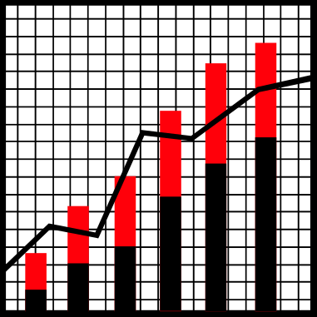
Process
Determine Characteristics of system
Construct simulation table
Generate & compute values

Slide 4

Key Components
Random Numbers
  Number: between 0 & 1
  Variable: some quantity; perhaps from a known distribution
Descriptive Statistics
  Values used for describing a systems and making predictions about its behavior
Note: www.bcnn.net has files

Slide 5
Random Variable
A quantity determined by some random experiment
Examples
  Number of heads obtained when flipping a coin 10 times
  Number of customers arriving in an hour
  Maximum length of a queue during the day
  Shortest service time for a customer for the day

Slide 6
Randomness
True Random vs. Pseudo-Random
Random number sequence
  Uniformly distributed
  Each number statistically independent of previous numbers
Where?
  Random Number Generators (functions)
  Random Number Tables
  1 2 5 3 8 2 5 0 8 3 7 5 2 5 8 6 2 5 9

Slide 7
Excel – Random numbers
=RAND( )
  Generates real values: 0 <= val < 1
=RANDBETWEEN (low, high)
  Generates integers: low <= val <= high
To use in Excel
  IF (RAND ( ) < 0.5, 0, 1)
  IF (A2 <= 0.33, 0, (IF A2 <= 0.66, 1, 2)
Problem with Excel….

Slide 8
Other sources of random numbers
Authors provide Visual Basic functions in the sample spreadsheets on web site.
  We will not use these.
  Discussed in 2.1.2 and 2.1.3
Random Number Tables in text
  Table A1 (p. 592) – uniform
  Table A2 (p. 593) – normal
Limitations: Excel & VB functions – don’t use in professional work

Slide 9
Random Number Generator (RNG) Features
RNG is a mathematical function
  Different strategies
Period: Number of values generated before sequence repeats
Seed: Initialization value for a RNG

Slide 10

Example: Coin Tossing
Monte Carlo Simulation
Fair coin → Head/Tail equally likely
  IF (RAND ( ) < 0.5, “H”, “T”)

Slide 11
Example: Random Service Times
Integer value 1 to 10, inclusive
  =RANDBETWEEN (1, 10)
Integer value with given probability
  3 @ 30%; 6 @ 45%, 10 @ 25%
  Develop cumulative probability
    0 - .3 → 3
    .3 - .75 → 6
    .75 – 1 → 10
  IF (A2 <= 0.3, 3, (IF A2 <= 0.75, 6, 10)
  Why not? IF (RAND() <= 0.3, 3, (IF RAND <= 0.75, 6, 10))

Slide 12
Arrival Times
Arrival Time vs. Inter-Arrival Time
Arrival time – Clock time of arrival
Inter-Arrival Time: time between successive arrivals
Example: Initialize: Clock = 0
Inter-Arrival Time | Arrival Time (Clock)
3 | 3
7 | 10
2 | 12

Slide 13
Queuing(Waiting Line) Systems
Calling population
  Infinite vs. Finite population
Nature of arrivals
  Arrival Rate vs. Effective Arrival Rate
Service mechanism
  Single vs. Multiple vs. Sequential
Service time
Queue discipline

Slide 14
Arrivals & Services
Generally defined by a distribution (random)
Arrivals
  Time between arrivals – inter-arrival time
Service
  Service times
      Arrival rate must be less than the service rate. What if it is not? Unstable, explosive

Slide 15

Queue Basics
System State
  Number & status of entities (units)
Event
  Circumstance that causes a change in system state
Clock
  Relative time

Slide 16
Single Server & Queue
Arrive Queue Server Depart
What are the state variables?
What are the events?
Refer to flow diagrams – Pg. 42 +

Slide 17
Future Events List (FEL)
Can Generate Events
  up-front
    Before simulation begins
    OK for small/short simulations
  on-the-fly
    As needed
    Used for professional/complex simulations
Generate Inter-arrival times & Service times

Slide 18
Brief Example
Cust # | IAT | A-time *Clock | S-begin *Clock | S-time | S-end *Clock
1 | 0 | 0 | 0 | 2 | 2
2 | 2 | 2 | 2 | 1 | 3
3 | 4 | 6 | 6 | 3 | 9
4 | 3 | 7 | 9 | 2 | 11
5 | 2 | 9 | 11 | 1 | 12
6 | 6 | 15 | 15 | 4 | 19

Slide 19

Other simulation items
What else can we keep track of during the simulation?
  Wait time in queue
  Time in system
  Server idle time
Calculate these for previous example.

Slide 20
Other simulation items
What can we calculate at the end of simulation?
  Average inter-arrival time
  Average service time
  Server utilization (% busy)
  *Average queue length
Calculate for previous example.

Slide 21
Common Stats to Calculate
Customer
  Time in queue, Time in system, Probability of waiting in queue, Inter-arrival time
  Averages, max, min
Server
  Utilization, Service times (max, min, average)
Queue
  Length (current, average, max, min)

Slide 22
System State vs. Performance Measure
* Current vs. After Simulation
Current queue length
Server status (busy, idle)
Customer wait time
Average, max, min queue length
Average, min, max service time; utilization
Average wait time, max, min

Slide 23
Simulation Statistics
Numerous standard statistics of interest
Some results calculated from parameters
  Used to verify the simulation
Most calculated by program

Slide 24
Statistics – Performance Measures
Average Wait time for a customer
= total time customers wait in queue
total number of customers
Average wait time of those who wait
= total time of customers who wait in queue
number of customers who wait

Slide 25
More Statistics
Proportion of server busy time
= number of time units server busy
total time units of simulation
Average service Time
= total service time
number of customers serviced

Slide 26
More Statistics
Average time customer spends in system
= total time customers spend in system
total number of customers
Probability a customer has to wait in queue
= number of customers who wait
total number of customers

Slide 27
Traffic Intensity
A measure of the ability of the server to keep up with the number of the arrivals
TI= (service mean)/(inter-arrival mean)
If TI > 1 then system is unstable & queue grows without bound

Slide 28
Server Utilization
% of time the server is busy serving customers
If there is 1 server
  SU = TI = (service mean)/(inter-arrival mean)
If there are N servers
  SU = 1/N * (service mean)/(inter-arrival mean)

Slide 29
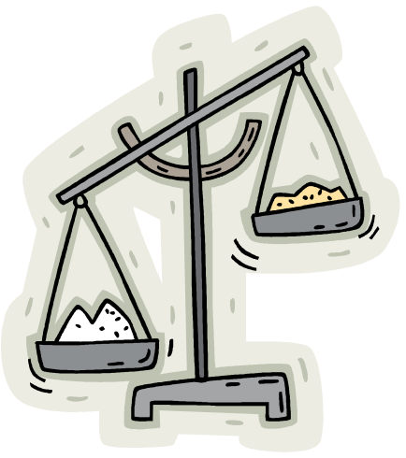
Weighted Averages
Necessary when unequal probability of values.
Example: Service times: 20% take 5 minutes, 38% take 8 minutes, 42% take 11 minutes.
What is the average service time?
  Is it (5 + 8 + 11) / 3 = 8 ???

Slide 30
Correct Answer
20% take 5 minutes, 38% take 8 minutes, 42% take 11 minutes.
AST = .2 * 5 + .38 * 8 + .42 * 11
= 1 + 3.04 + 4.62
= 8.66

Slide 31
Spreadsheet Homework
DUE:
Page 78+ (Show all work & document)
# 2: Calculate expected number of customers per day & number of bagels needed: Based in these values, what is expected cost, income, & profit. Don’t simulate.
# 4: Calculate expected # of calls 9 am – 5 pm. & avg. service time. What is utilization of taxi? What is utilization if 2 taxis? Complete an Excel Simulation for 9 to 5 day with 1 taxi. (Print off values & formulas version. Document well.)
#51: Calculate best case, worst case, and average case scenario for the student. What are the maximum & minimum loan amounts that he will need? Don’t simulate.

