Slide 1
Day Care Project
Group Members:
Huai Huang
Xiaoge Zhang
PinHo Wang
Mengfan Shi
Qianru Yi
Wentao Pu

Slide 2
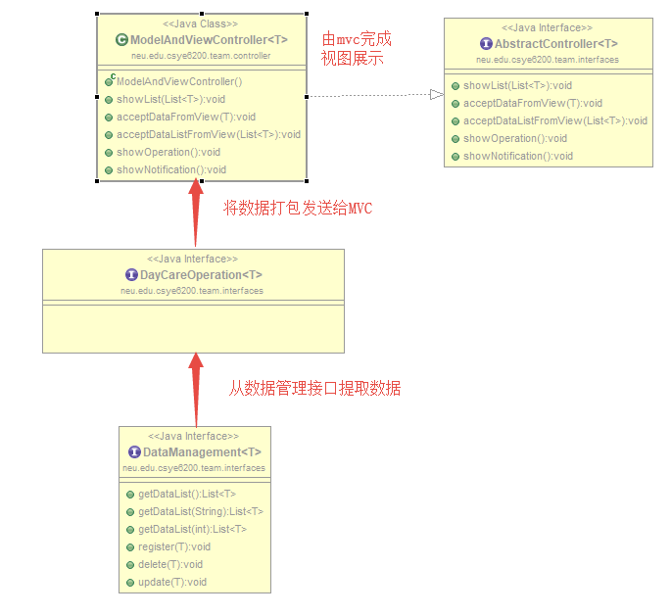

Slide 3
