Slide 1
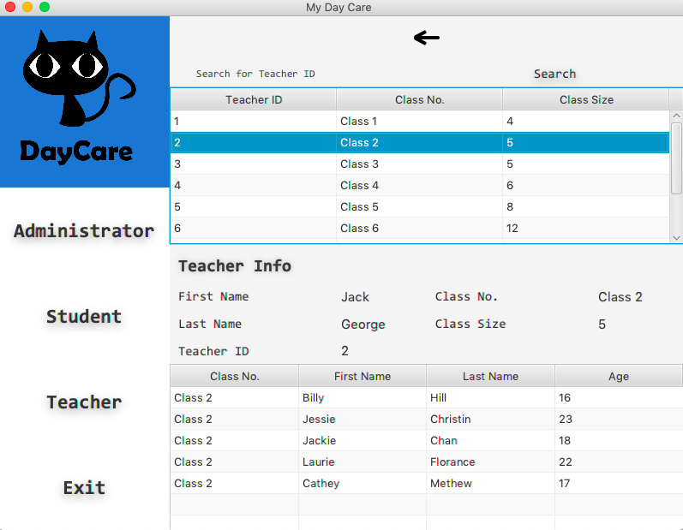
View Teacher Table

Slide 2
studentList
teacherList
classroomList
Main
ViewTeacherController
DataStore

Slide 3


Slide 4
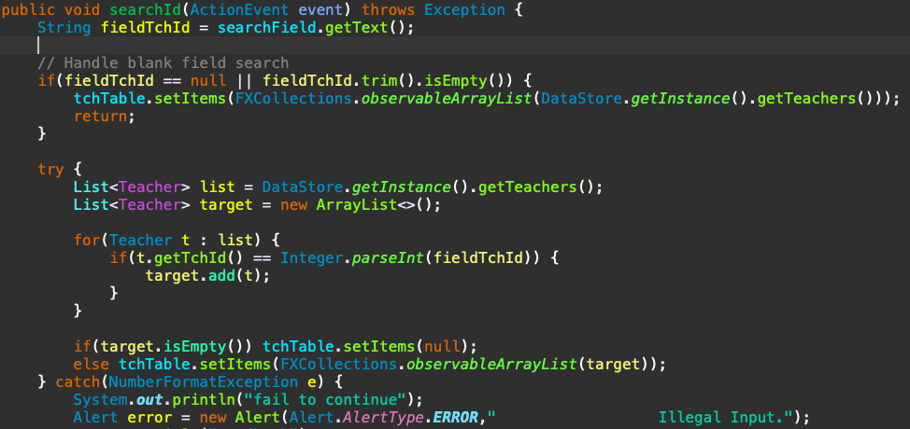

Slide 5


Slide 6


