Slide 1
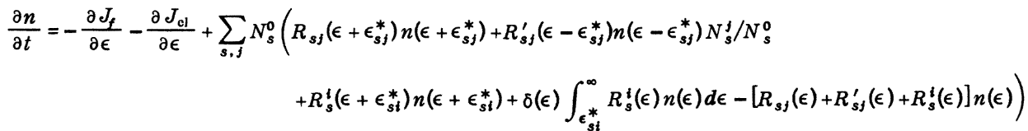
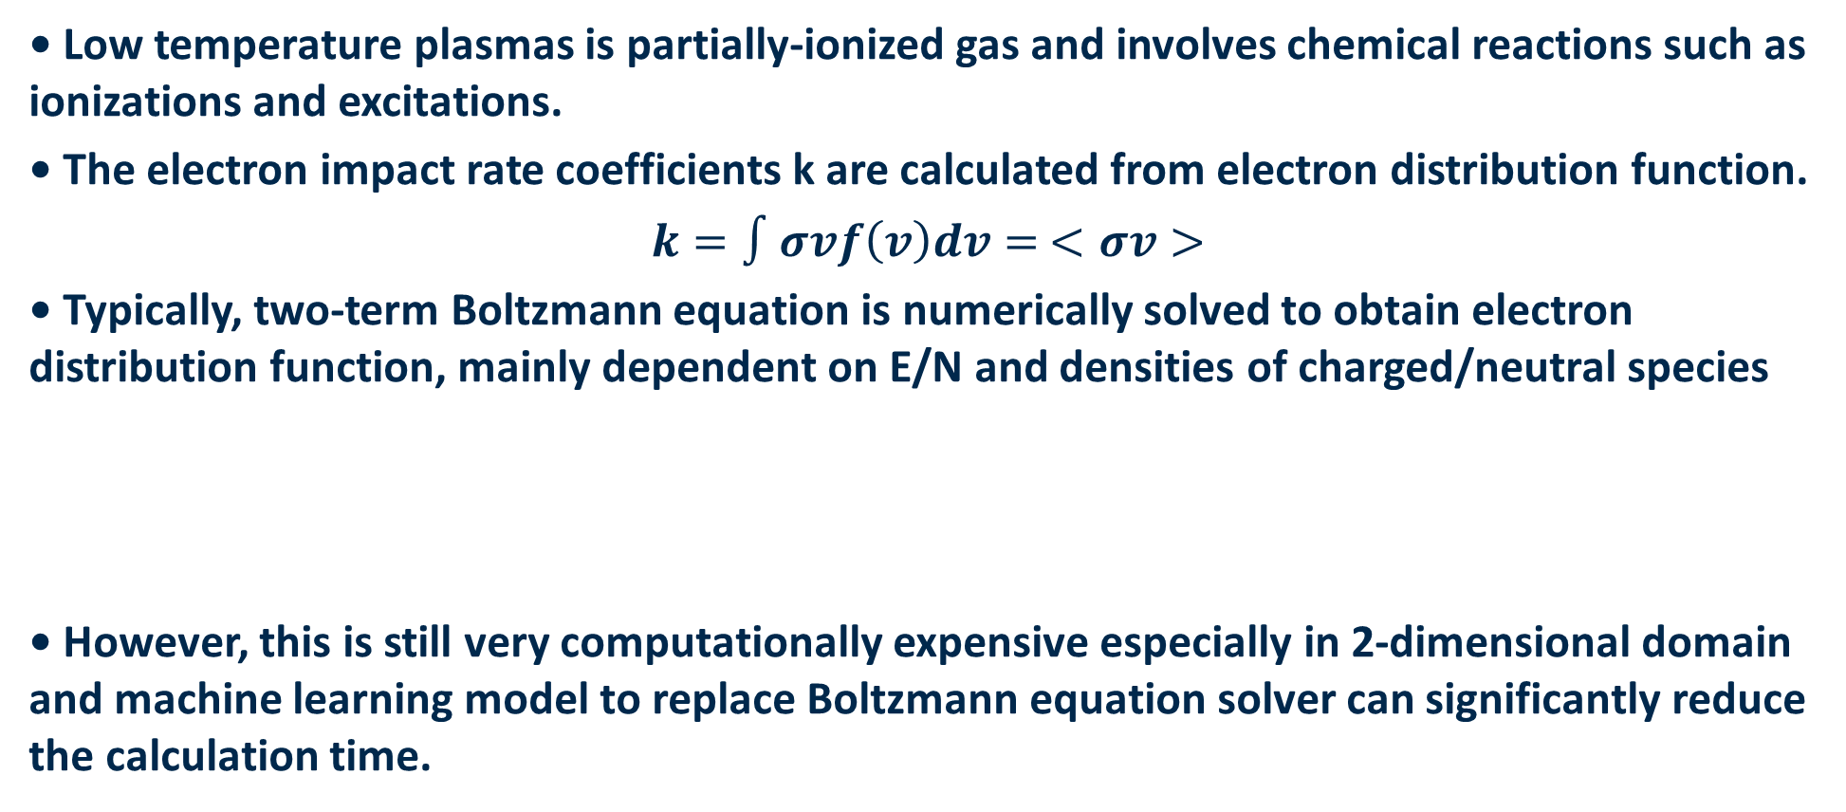
Introduction
• Low temperature plasmas is partially-ionized gas and involves chemical reactions such as ionizations and excitations.
• The electron impact rate coefficients k are calculated from electron distribution function.
$$k=∫σvf\left(v\right)dv= <σv>$$
• Typically, two-term Boltzmann equation is numerically solved to obtain electron distribution function, mainly dependent on E/N and densities of charged/neutral species
• However, this is still very computationally expensive especially in 2-dimensional domain and machine learning model to replace Boltzmann equation solver can significantly reduce the calculation time.

Slide 2
Data
• 0-dimensional model GlobalKin developed by Prof. Kushner’s group was used to obtain the data set of rate coefficients & E/N and densities of charged/neutral species.
• The electron impact rate coefficients includes 204 chemical reactions such as ionization, excitation, and super-elastic reactions.
• Ar/H2O = 98/2, 1 kHz pulse with width of 100 ns, energy deposition per pulse from 0.1 to 10 J/cm³.
• Electron impact rate coefficients in the range of E/N from 10⁻³ to 10³ Td are recorded for total 10 pulses with recording frequency of 10 ns for 200 ns.
Input: E/N and densities of charged/neutral species
Output: Electron impact rate coefficients

