Slide 1
Applied Machine Learning for Plasma Kinetics Simulation
Bingqing Wang & Jisu Jeon
Department of Nuclear Engineering and Radiological Sciences,
University of Michigan, Ann Arbor, Michigan 48109-2104, USA
“NERS 590: Applied Machine Learning for Nuclear Engineers” - Class Project

Slide 2
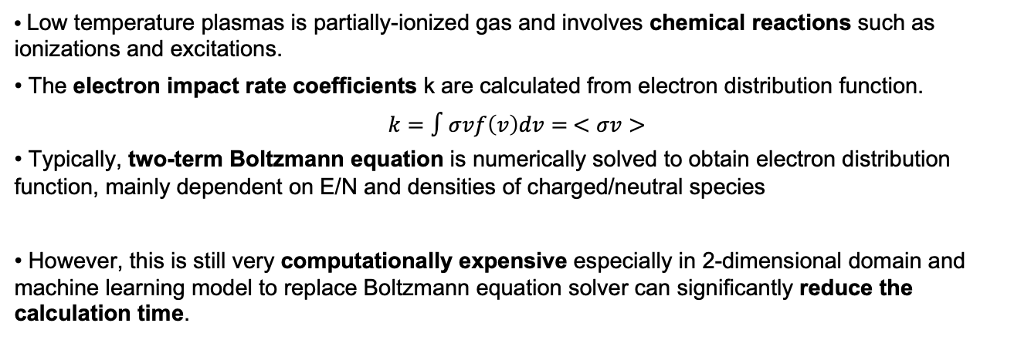
Introduction
• Low temperature plasmas is partially-ionized gas and involves chemical reactions such as ionizations and excitations.
• The electron impact rate coefficients k are calculated from electron distribution function.
$$k=∫σvf\left(v\right)dv= <σv>$$
• Typically, two-term Boltzmann equation is numerically solved to obtain electron distribution function, mainly dependent on E/N and densities of charged/neutral species
• However, this is still very computationally expensive especially in 2-dimensional domain and machine learning model to replace Boltzmann equation solver can significantly reduce the calculation time.

Slide 3
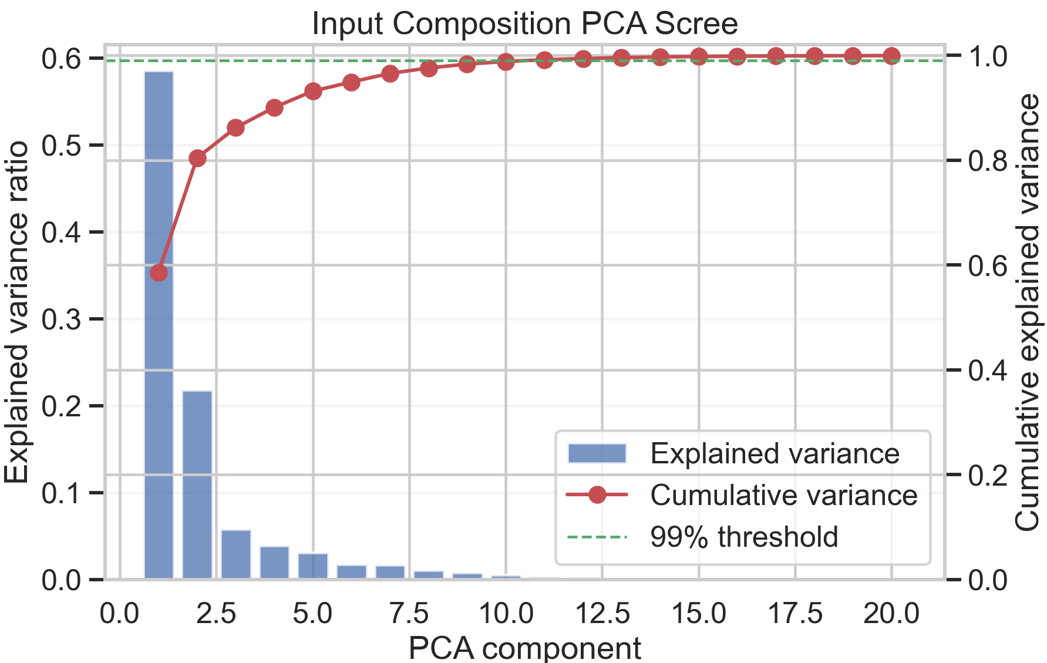
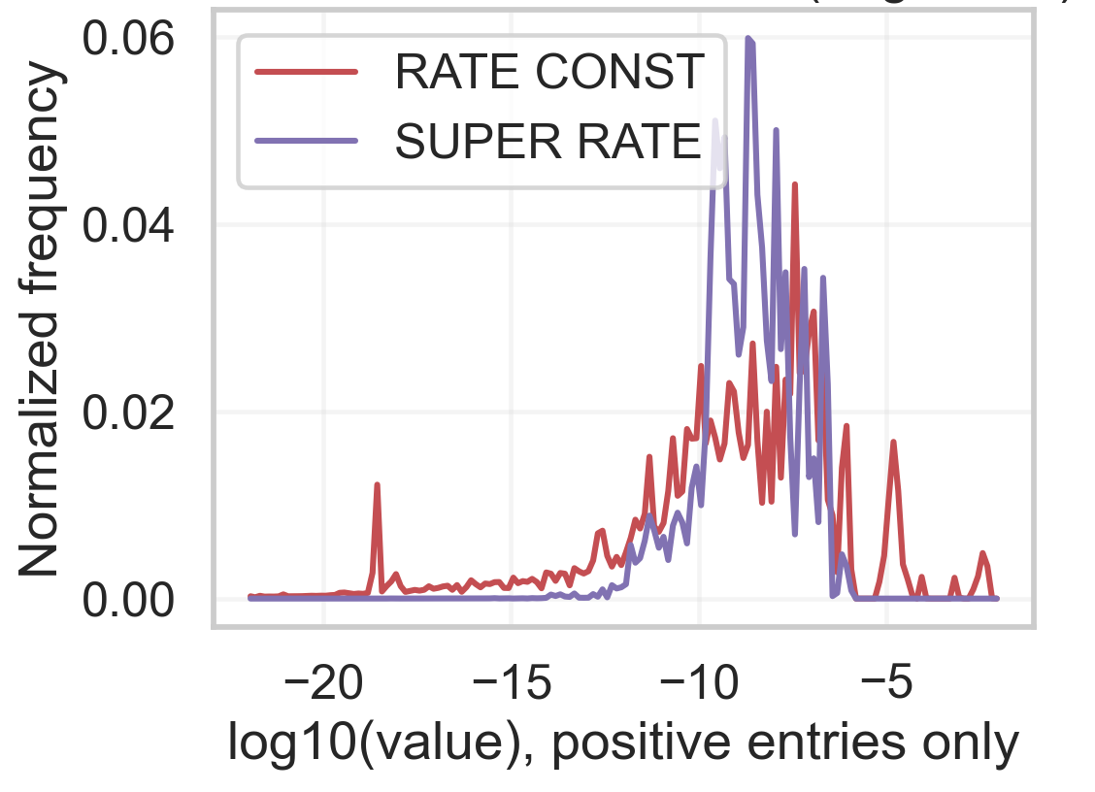


Input/Output Space and Label Types
For one plasma case:
Output labels Y
Input features X: 39D
37 gas mole-fraction features
Electron-impact rate coefficients: 204
input_01 | … |input_37
Super-elastic Rate Coefficients : 204
Delete “positive” and right graph
Power, 0.1 to 10 across 13 levels
(use $log_{10}(Power$))
E/N, 1e-20 to 1e-14 [Vcm2]
(use $log_{10}(E/N)$)
#3
Notes:
Each data point is one plasma operating case. Our input space has 49 mole-fraction variables, plus two operating-condition scalars: reduced electric field E/N and discharge power. All are continuous, and we model E/N and power in log scale because their ranges are multiplicative. In the joint setup this gives a 51-dimensional input vector. For outputs, we predict reaction kinetics: 204 RATE CONST values and 204 SUPER RATE values. Both are nonnegative and highly skewed; RATE CONST has many tiny values and some zeros, while SUPER RATE is even sparser, with many channels always zero. To make regression stable, we apply a per-reaction epsilon and train in log space, then invert back to physical units for reporting and downstream use.

Slide 4
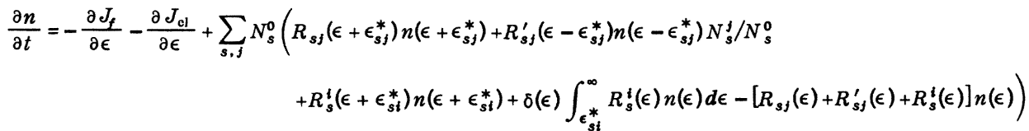
Data Generation
0-dimensional model GlobalKin developed by Prof. Kushner’s group was used to obtain the data set of rate coefficients & E/N and densities of charged/neutral species.
Ar/H2O = 98/2, 1 kHz pulse with width of 100 ns, energy deposition per pulse from 0.1 to 10 J/cm³.
E/N from 10⁻³ to 10³ Td are recorded for total 10 pulses with recording frequency of 10 ns for 200 ns.
Data size: 83,317 plasma cases

Slide 5
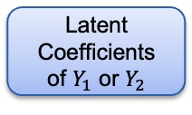




ML Models & Hyperparameter Tuning
Separate-task models
Joint models
Ridge(Baseline)
$$Y_{1}$$
PCA
X
$Y_{1}$or $Y_{2}$
X
FNN
ExtraTrees
$$Y_{2}$$
FNN
Ridge(Baseline)
PCA
Decode
X
Latent Coefficients of $Y_{1}$ or $Y_{2}$
$Y_{1}$ or $Y_{2}$
ExtraTrees
FNN
#4

Slide 6
Hyperparameter Tuning
Validation Sets: 5 shuffled CV on train/val pool (seeds 7, 21, 42, 84, 126)
Two test settings: random-case split and power-holdout (10mJ)
Selection metrics:
Separate-task: validation log-RMSE
Joint-task: validation joint log-RMSE
Curated Tuning
Baseline- Ridge: alpha = 10
Extratrees: n_estimators=200, max_depth=12, min_samples_leaf=1
FFN: width=256, layers=3, dropout=0, weight_decay=1e-5, lr=1e-3, batch=256, early stopping
Latent-output: PCA k=8
#4
Notes:
We simplify the method comparison along three axes. First, task strategy: separate-task models train RATE CONST and SUPER RATE independently, while joint-task models predict both together. Second, model family: we compare Ridge as a linear baseline, ExtraTrees as a nonlinear tree model, and FFN as a neural baseline. Third, for separate-task models, we compare direct-output versus latent-output, where latent-output uses PCA to compress the 204-dimensional target, predicts latent coefficients, then reconstructs the full output vector. To keep the presentation focused, we only report best-performing feature configurations: for RATE CONST we use composition-PCA with log E/N and log power; for SUPER RATE and joint FFN we use all inputs with log E/N and log power. For tuning, we use 5-fold shuffled cross-validation on train/validation data, and select by validation log-RMSE, or joint log-RMSE for multitask. Hyperparameters are curated and fixed to stable settings: Ridge alpha 10, ExtraTrees with 200 trees and depth 12, and FFN with 3 layers of width 256 plus early stopping. This gives us a fair, controlled comparison between separate vs joint learning and direct vs latent output modeling

Slide 7
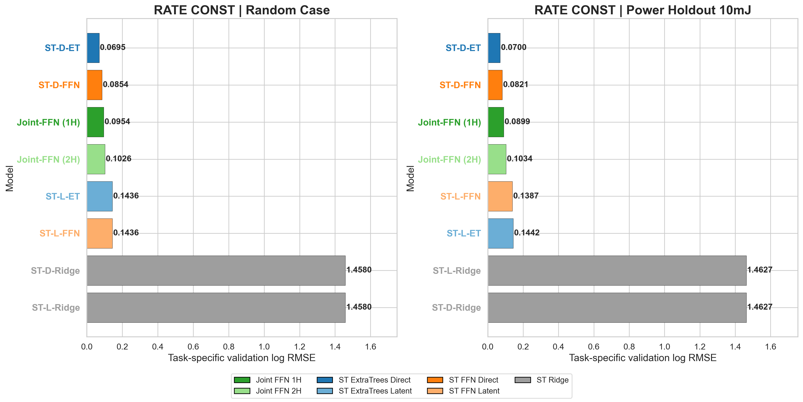
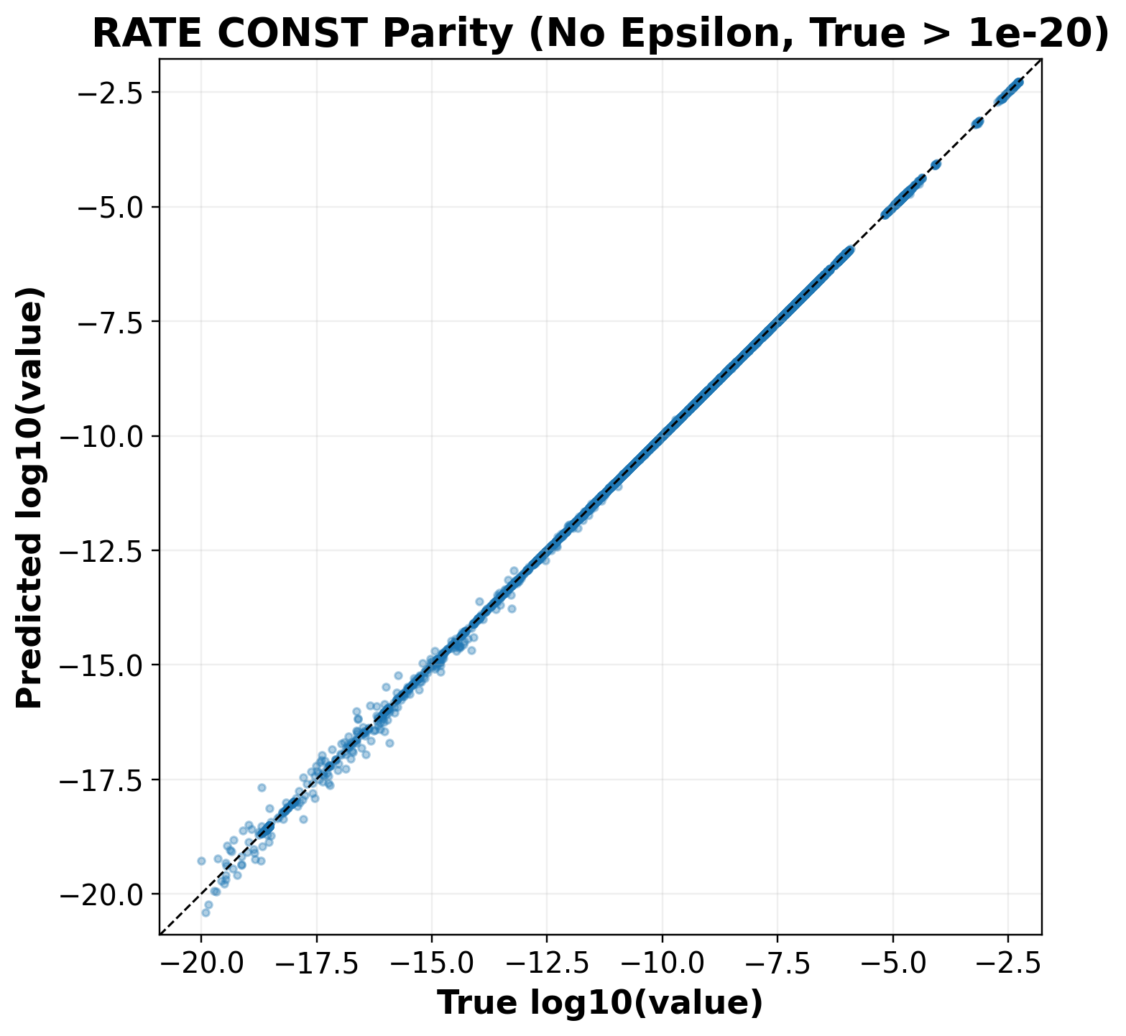
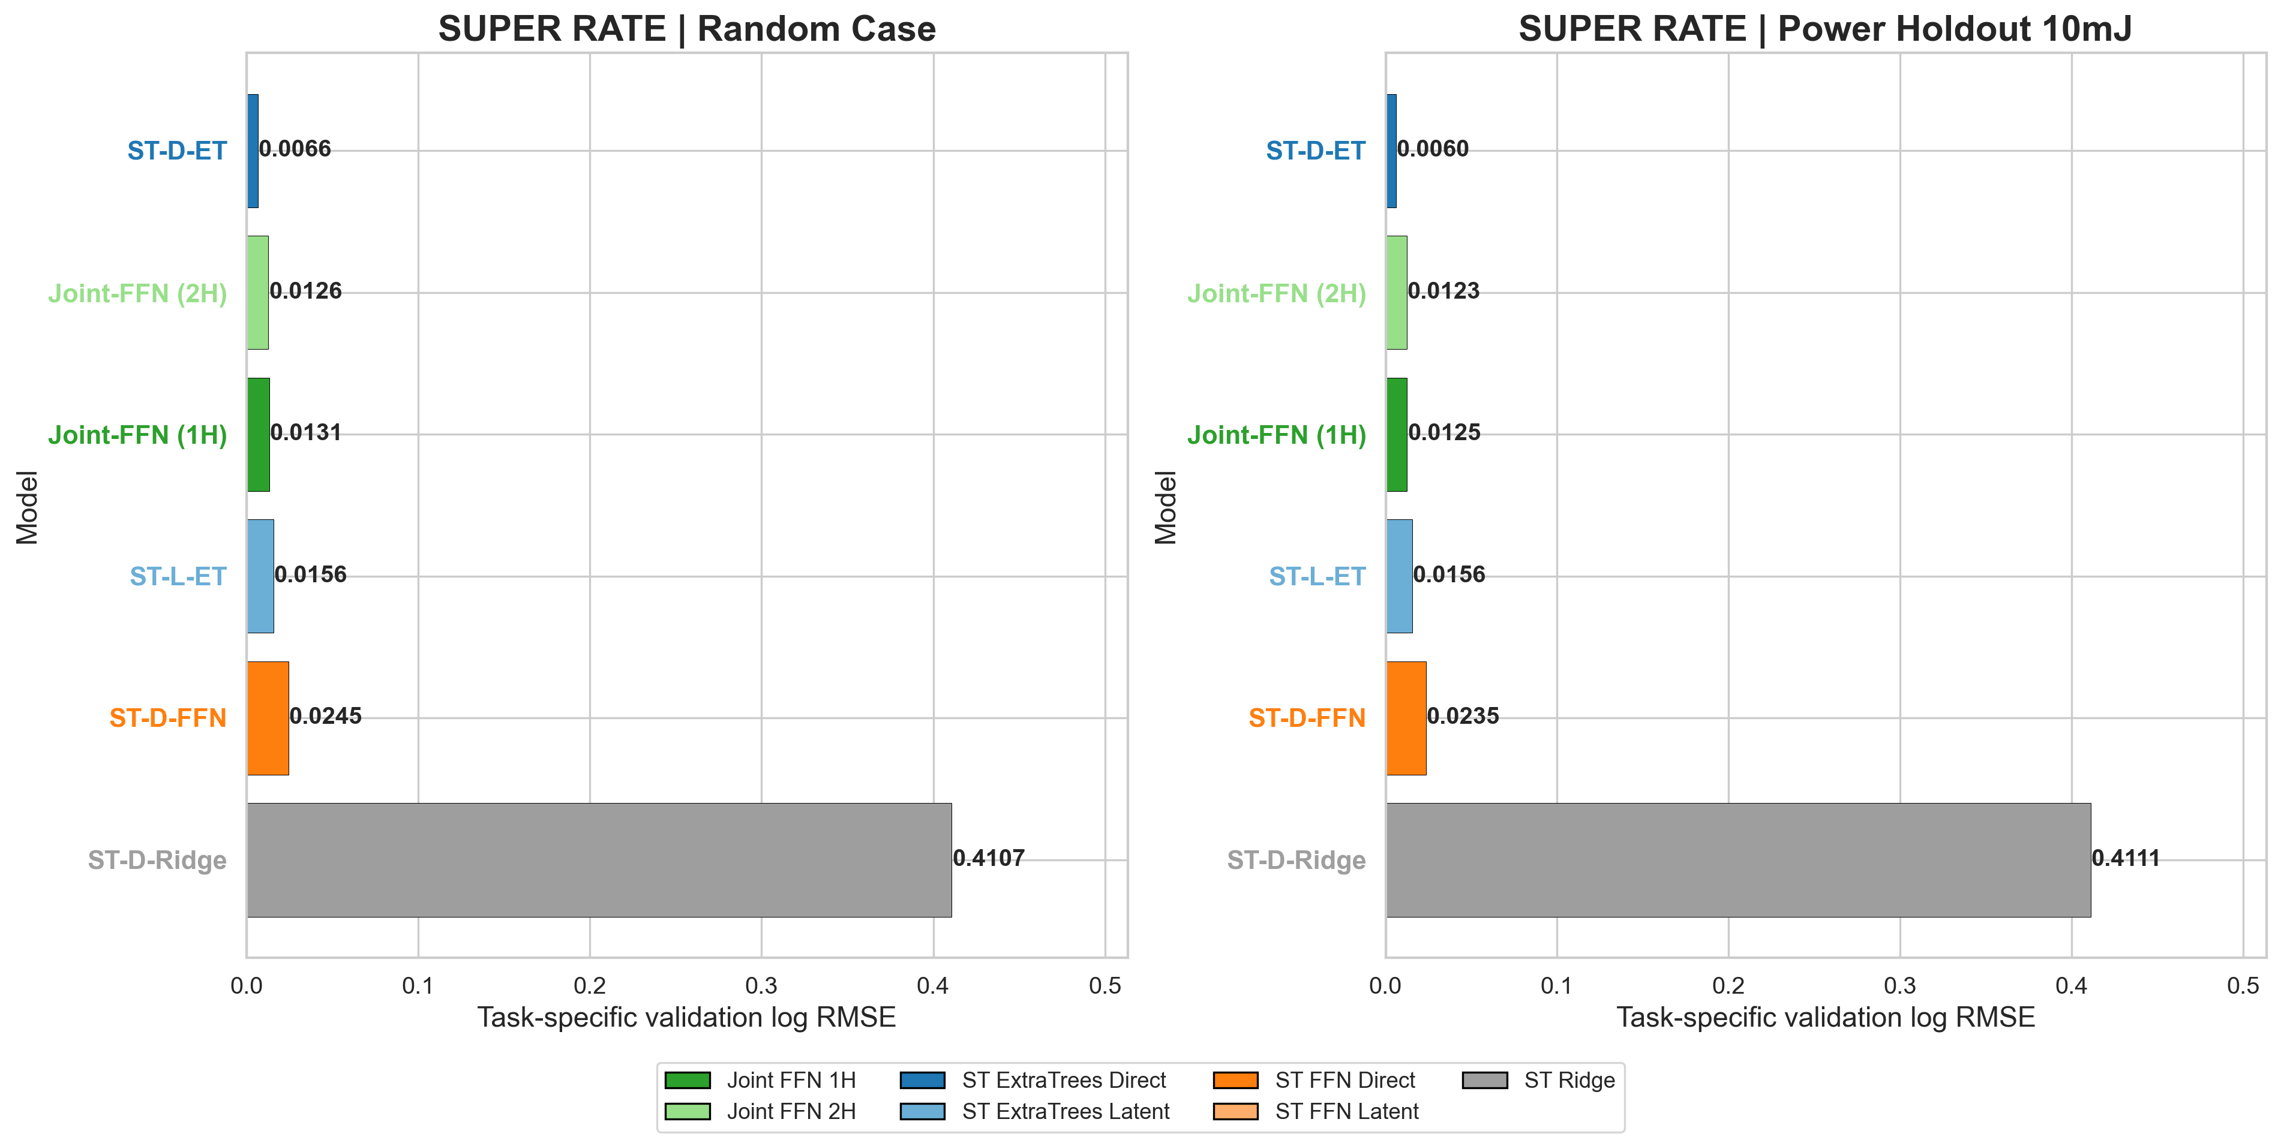
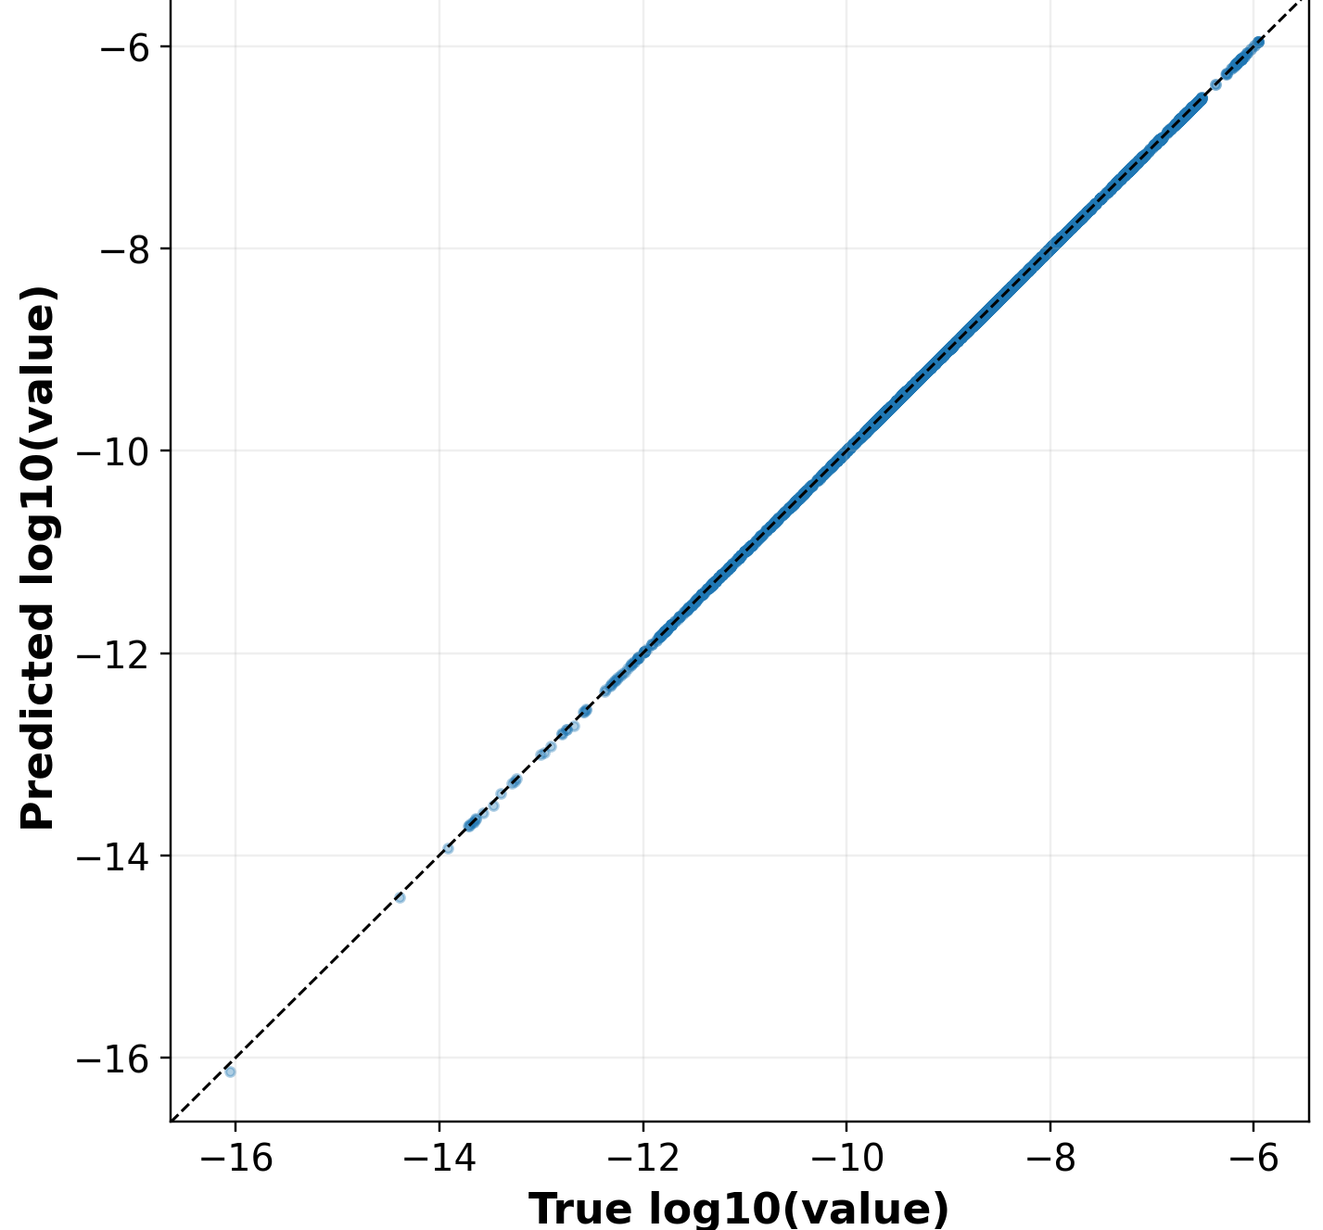
Results
Rate constant
The mapping is highly nonlinear and tabular Tree ensembles capture threshold-like interactions naturally.
The targets are heavy-tailed with many near-zero values. ExtraTrees is robust to this heterogeneity and less sensitive than FFN optimization to imbalance across channels.
Super elastic Rate constant
Notes:
Across both targets and both splits, Separate-task ExtraTrees is consistently best.”
“For RATE CONST, log-RMSE is 0.0685 (random) and 0.0487 (10mJ holdout), clearly below joint FFN.”
“For SUPER RATE, the gap is larger: 0.00382 and 0.00362 for separate-task vs higher joint errors.”
“So joint learning is feasible, but currently shows negative transfer compared with separate-task.”
Dataset size is moderate for deep nets but strong for tree ensembles; ExtraTrees often wins in this “scientific tabular” regime.
Randomized splits in ExtraTrees reduce variance and improve generalization stability, which you can see in consistent performance across random-case and power-holdout settings.
Multi-output regression with trees works well when outputs share structure but not a smooth shared latent manifold, which appears true here.

Slide 8
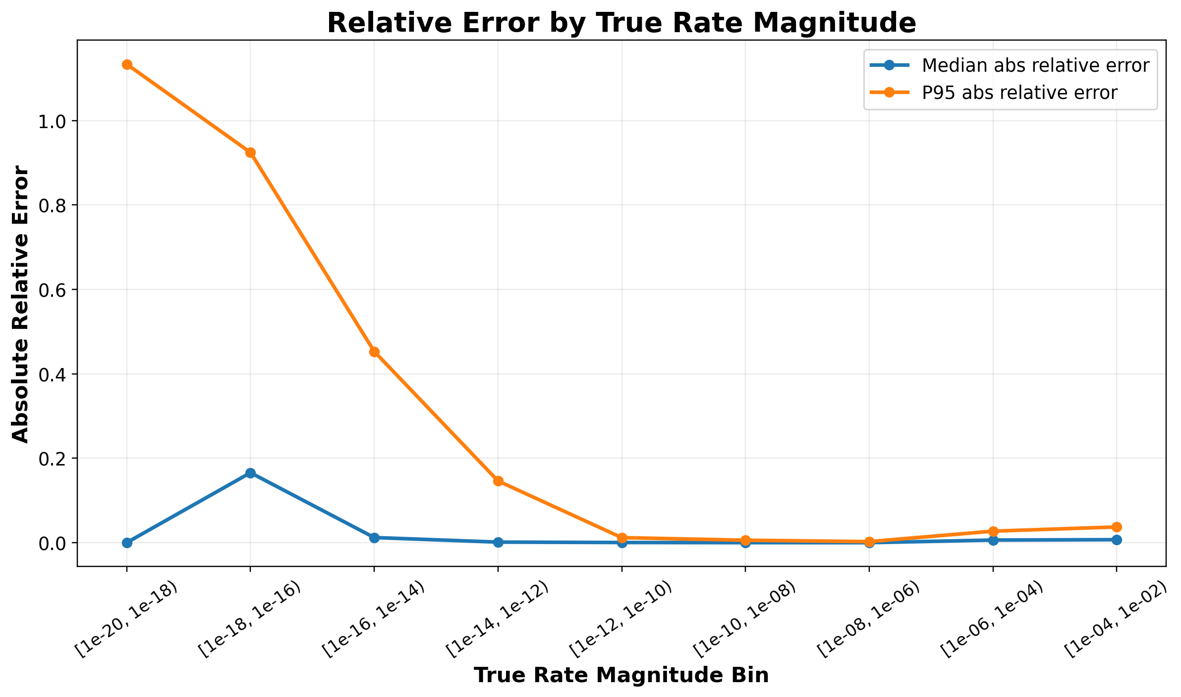
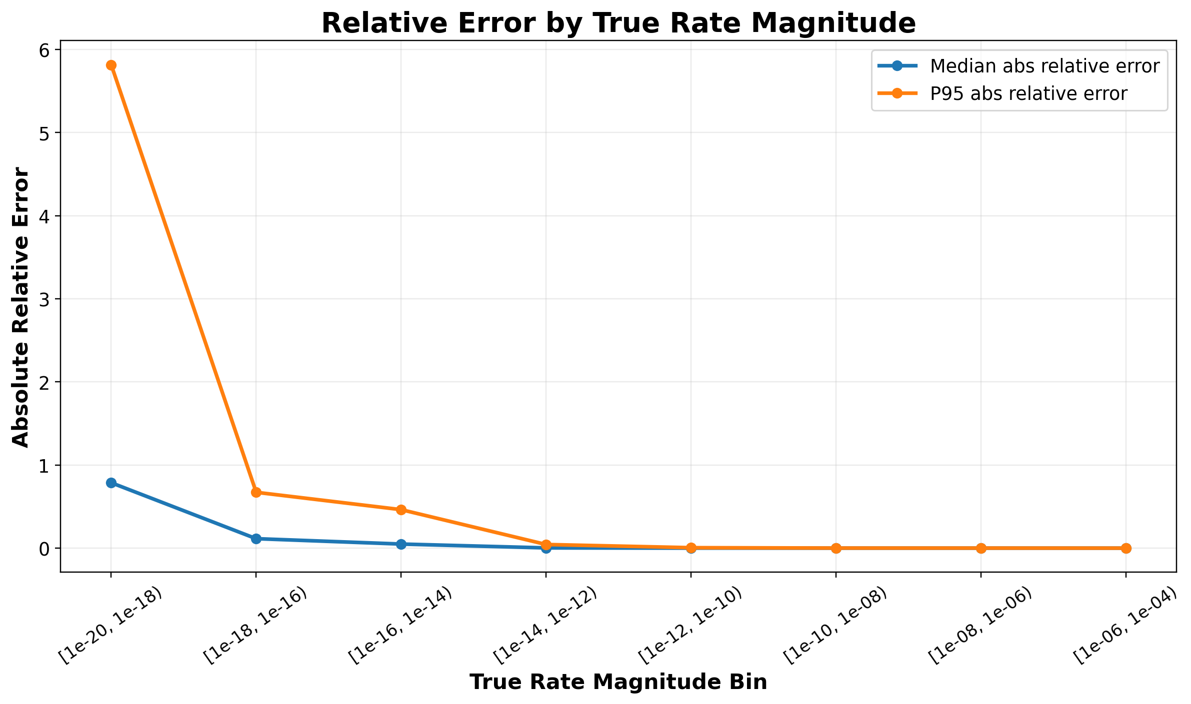
Results
Worst Case Analysis
Rate constant
Super-elastic Rate constant
Worst Case | Power | E/N
Rate Constant | 1 | 6e-17
Super-Elastic Rate | 0.1 | 1e-18
Error is strongly magnitude-dependent: very small true values have larger relative error.
However, these values are physically weak and typically have limited impact on the overall plasma kinetics.
The more relevant regime is the moderate-to-high magnitude range (roughly >=1e-12), where the model shows substantially lower and more stable error.

Slide 9
Summary
We built and evaluated separate-task and joint models for predicting Electron-impact rate coefficients and Super-elastic Rate Coefficients.
Separate-task ExtraTrees provides the most reliable overall accuracy, while joint FFN remains a useful multitask baseline but is less stable on task-specific test metrics.
Relative error is naturally inflated in ultra-low-magnitude targets (especially around 1e-20 to 1e-18) because tiny denominators amplify ratio-based error. These channels are generally less influential for practical plasma behavior. In the physically important range (roughly >=1e-12), errors are much smaller and more stable, which better reflects usable model quality.
We will extend this model to 1D/2D to replace the computationally expensive Boltzmann solver in the future.
#8

Slide 10
Thank You!

