Slide 1

NeuGraph:
Parallel Deep Neural Network Computation on Large Graphs
Lingxiao Ma †, Zhi Yang †, Youshan Miao ‡, Jilong Xue ‡, Ming Wu ‡, Lidong Zhou ‡, Yafei Dai †
† Peking University
‡ Microsoft Research
国光硕1905
何雨迪

Slide 2

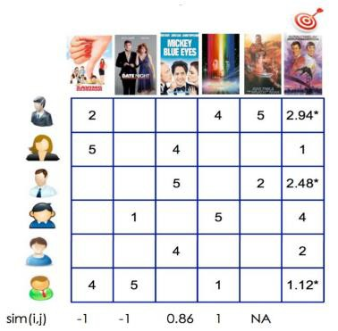
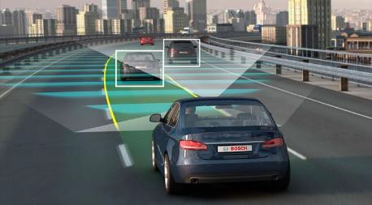

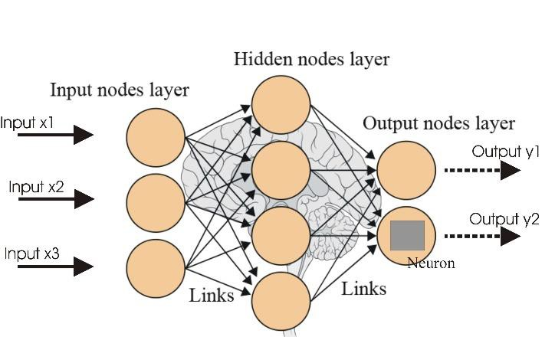
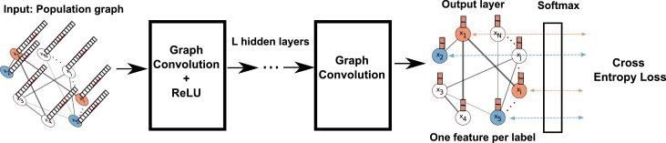
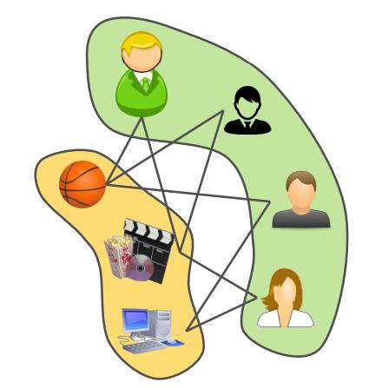
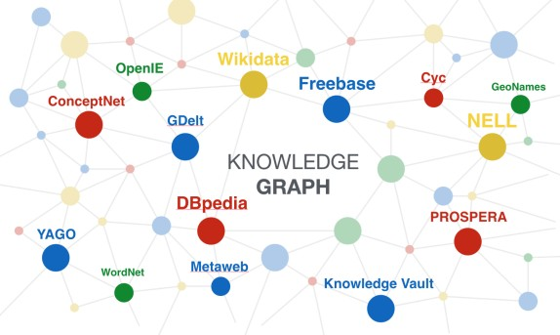
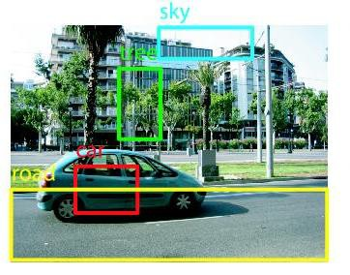

Personal Assistant
* Figures from Internet
Self-Driving
Recommendation
Question Answering
Input Feature Vector
Input: Graph Data
Neural Networks
Graph Neural Networks
Image Object Detection
Speech Recognition
User-Item Graph
Knowledge Graph

Slide 3
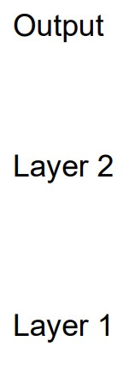
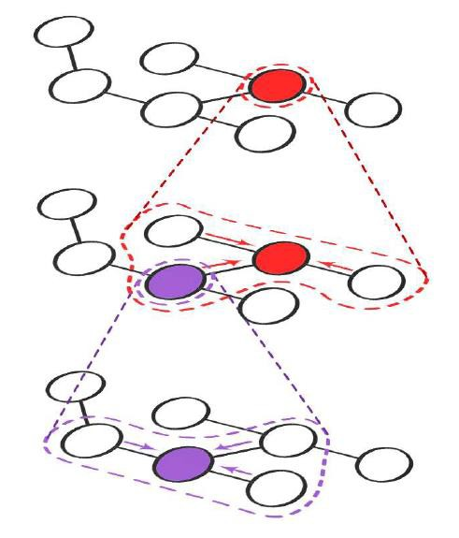
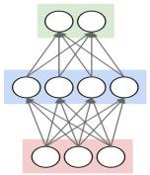

Graph Neural Networks (GNN)
Information propagation via Graph
Information transformation via Neural Networks
EdgeNN Transformation
反向传播
前馈计算
VertexNN Transformation
Feed-forward computation of 2-layer GNN

Slide 4
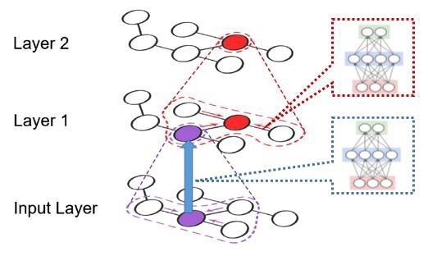
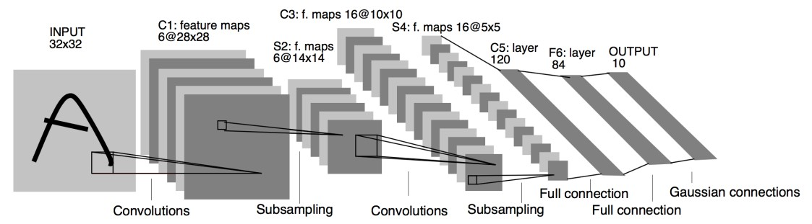
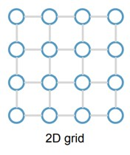
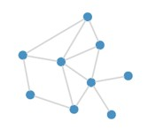
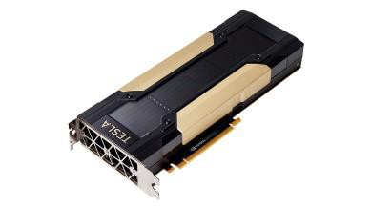
Challenges in Processing GNNs on GPU
* Figures from Internet
small and regular
large, sparse, and irregular
Graphs
Scalability Problem
Efficiency Problem

Slide 5
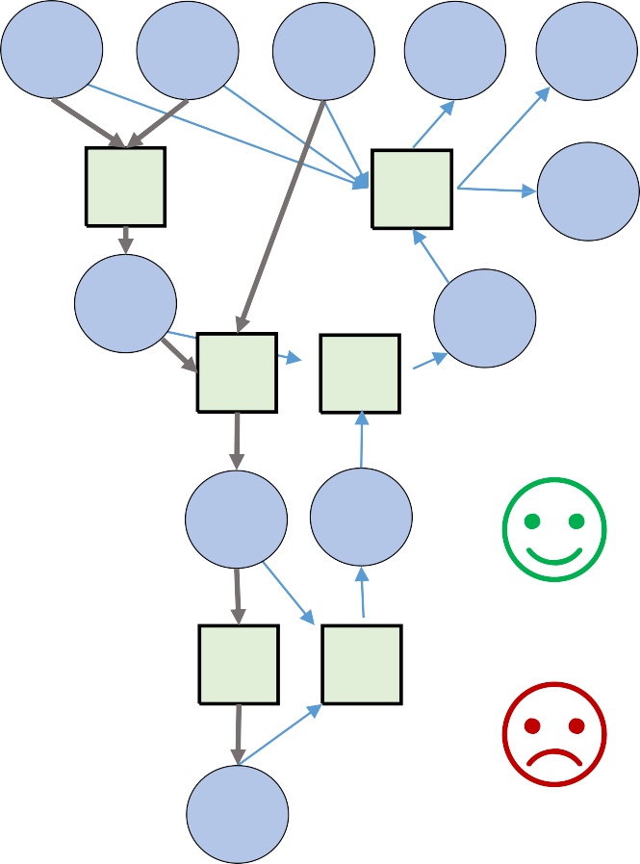



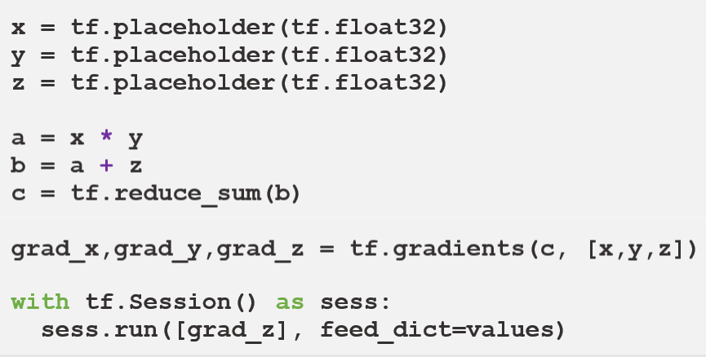
Existing Systems are Insufficient
Deep Learning Systems
x y
z
𝛻x
𝛻y
*
a
*𝐠
𝛻z
Dataflow Graph
as
𝛻a
+
+𝐠
Intermediate Representation
𝛻b
easy to express NNs
efficient for grid structures
b
Σ Σ𝐠
hard to express graph ops hard to handle large graphs
c

Slide 6

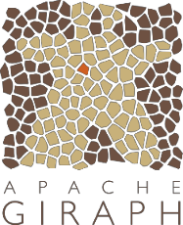







Existing Systems are Insufficient
Graph Computing Systems
Vertex Programming
e.g.: GAS
Gather(D_{u},
return
Sum(a, b):
return a + b
^{D}(u,v)^{, D}v^{):}
D_{v}.rank / #outNbrs(v)
easy to program graph apps graph-aware optimizations scale to trillion edges
hard to express NNs (e.g., no backprop.)
insufficient NN execution (e.g., vertex-by-vertex)
Apply(D_{u}, acc):
^{r}new
= 0.15 + 0.85 * acc
D_{u}.delta =
^{(r}new
- D_{u}.rank) / #outNbrs(u)
D_{u}.rank
Scatter(D_{u},
^{= r}new
^{D}(u,v),
D_{v}):
if(|D_{u}.delta|>ε) Activate(v) return delta

Slide 7
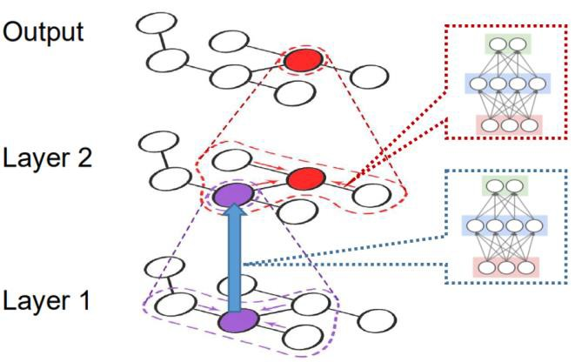

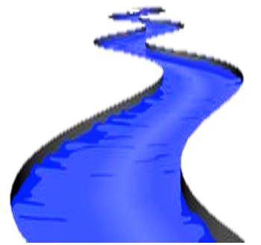
We propose: NeuGraph
- Bridge graph and dataflow models to support efficient and scalable GNN processing
NeuGraph
easy to program graph apps graph-aware optimizations scale to trillion edges
easy to express NNs
efficient for grid structures
Deep Learning Systems
Graph Systems

Slide 8
NeuGraph
Bridge graph and dataflow models to support efficient and scalable GNN processing
Key techniques
SAGA-NN model for graph-based neural networks
-> programming GNN apps
Chunk-based dataflow graph translation & streaming processing out of GPU core
-> processing graphs larger than GPU memory
Highly-optimized graph propagation operators
Chain-based parallel streaming
-> efficient multi-GPU parallel execution
Performance
Outperform state-of-the-art frameworks (e.g., TensorFlow and DGL) on small graphs
Scale to large real-world graphs with GPUs

Slide 9
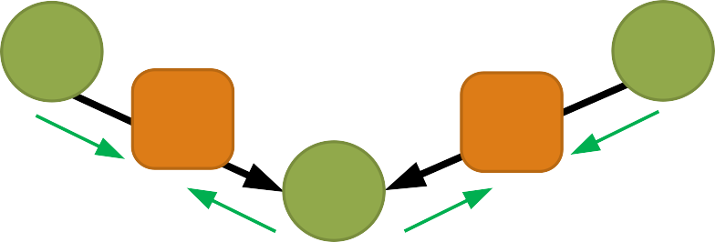






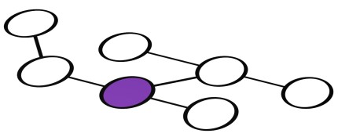


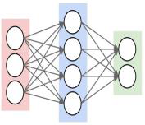
SAGA-NN Abstraction
v
0
v
2
Scatter-ApplyEdge-Gather-ApplyVertex with Neural Networks
edge
edge
Scatter
v1
vertex feature edge feature edge output accumulated vertex output
Neural Network
V₀
V
1
V₂

Slide 10
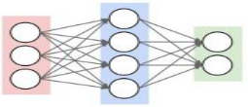


SAGA-NN Abstraction
v
0
v
2
Scatter-ApplyEdge-Gather-ApplyVertex with Neural Networks
edge
edge
Scatter
v1
ApplyEdge
vertex feature edge feature edge output accumulated vertex output
Neural Network
V₀
V
1
V₂
EdgeNN
Transformation
10

Slide 11


SAGA-NN Abstraction
v
0
v
2
Scatter-ApplyEdge-Gather-ApplyVertex with Neural Networks
edge
edge
Scatter
v1
ApplyEdge
Gather
accum.
vertex feature edge feature edge output accumulated vertex output
Neural Network
V₀
V
1
V₂
EdgeNN
Transformation

Slide 12
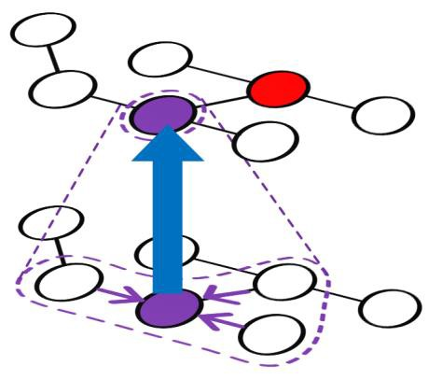
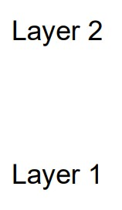
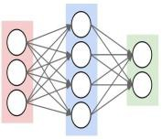

SAGA-NN Abstraction
v
0
v
2
Scatter-ApplyEdge-Gather-ApplyVertex with Neural Networks
edge
edge
Scatter
v1
ApplyEdge
Gather
VertexNN
Transformation
accum.
vertex feature edge feature edge output accumulated vertex output
Neural Network
V₀
V
1
V₂
ApplyVertex
EdgeNN
Transformation

Slide 13
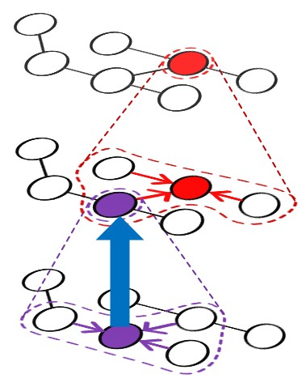
SAGA-NN Abstraction
v
0
v
2
Scatter-ApplyEdge-Gather-ApplyVertex with Neural Networks
edge
edge
Scatter
v1
ApplyEdge
Gather
VertexNN
Transformation
accum.
vertex feature edge feature edge output accumulated vertex output
Neural Network
V₀
V
1
V₂
ApplyVertex
EdgeNN
Transformation

Slide 14
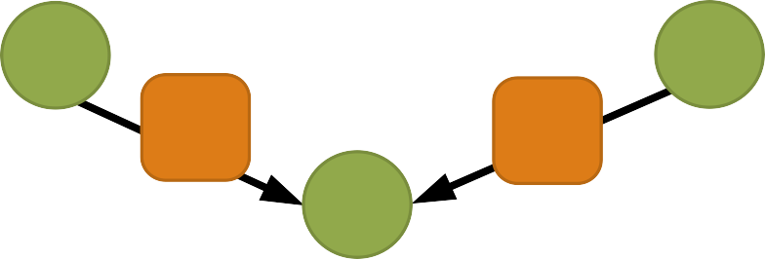
SAGA-NN Abstraction
v
0
v
2
edge
edge
Scatter
v1
Graph Operations
transparent to users
ApplyEdge
Neural Network Operations
define NN computation
with dataflow
Gather
accum.
vertex feature edge feature edge output accumulated vertex output
Neural Network
ApplyVertex

Slide 15


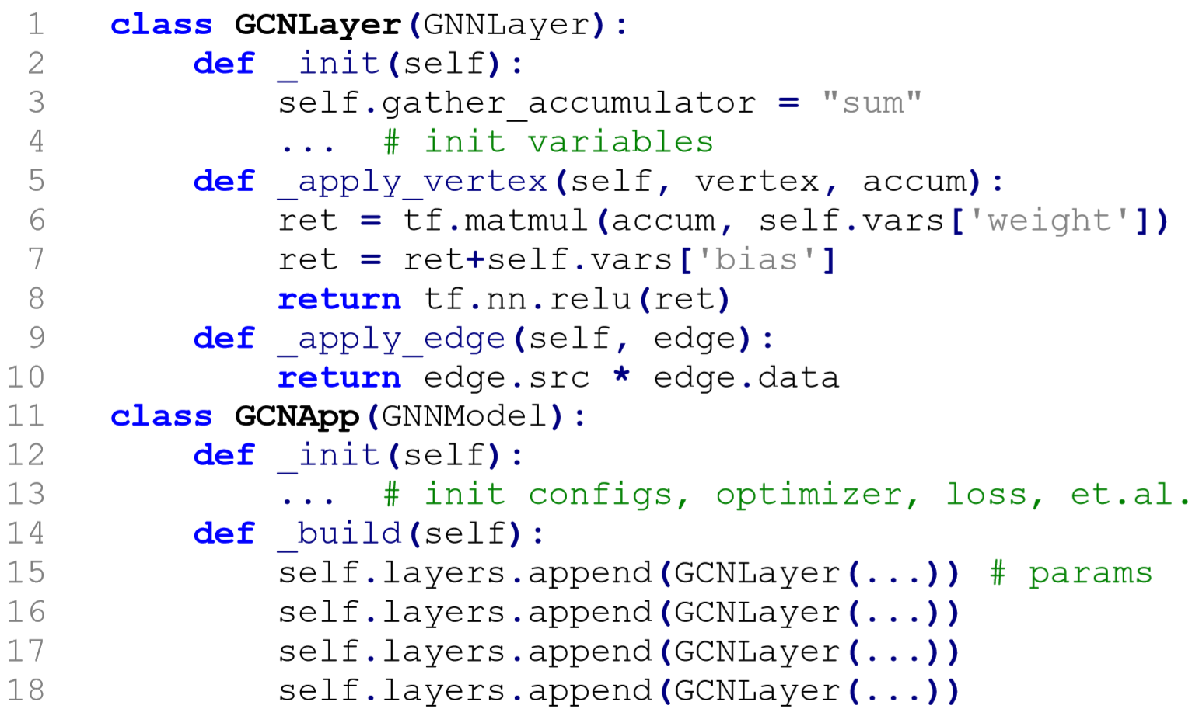
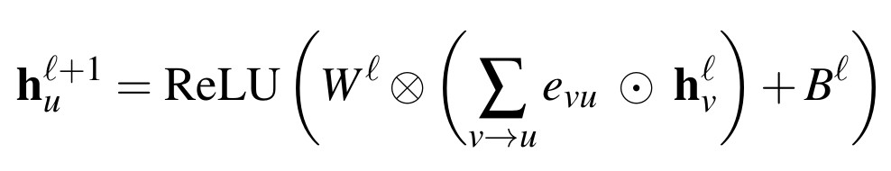
Example: Graph Convolutional Network (GCN)
是第l层顶点v的特征向量
是边v->u的特征值，可以理解为权值
Gather
Scatter
ApplyEdge
ApplyVertex

Slide 16
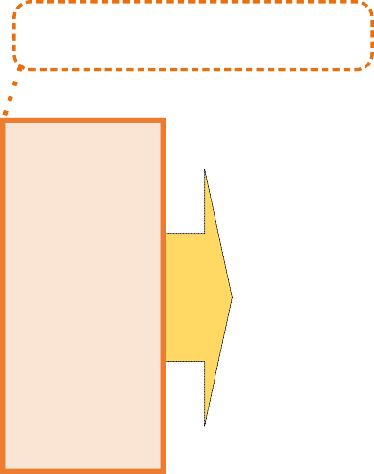
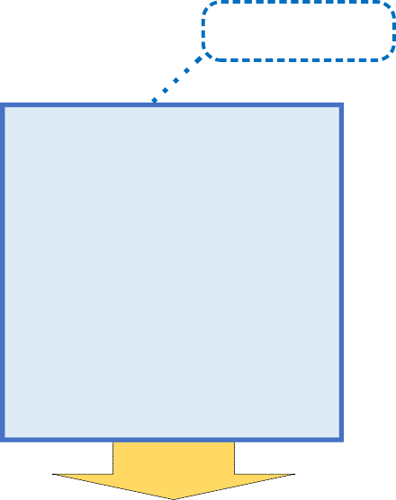


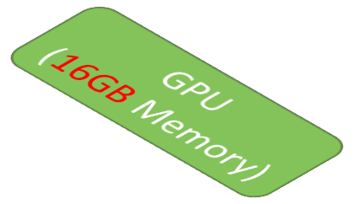
Scaling beyond GPU memory limit
Input Vertex Feature
Edges
0
1
0 1 2 1
1 3 3 0
1 2
3
2
Graph
Output Vertex Feature

Slide 17








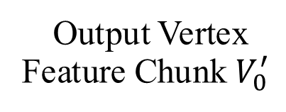
Scaling beyond GPU memory limit
- 2D graph partitioning
E_{0,1}
E0,1
Edge Chunk E_{0,0}
3 0
0 1
0
1
Input Vertex Feature Chunk V₀
Chunk V₁
E0,0
E1,1
1 3
2 1
1 2
E1,0
Chunk E_{1,0}
E_{1,1}
3
2
Graph
Output Vertex Feature Chunk $V_{0}^{′}$
3 0
P=2

Slide 18
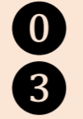



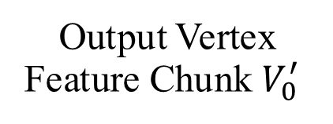
Scaling beyond GPU memory limit
Accumulate in
GPU memory
- 2D graph partitioning
E0,1
Edge Chunk E_{0,0}
3 0
0 1
0
1
Input Vertex Feature Chunk V₀
Chunk V₁
E0,0
E1,1
1 3
2 1
1 2
E1,0
Chunk E_{1,0}
3
2
Graph
Output Vertex Feature Chunk $V_{0}^{′}$
3 0
column-by-column chunk scheduling

Slide 19
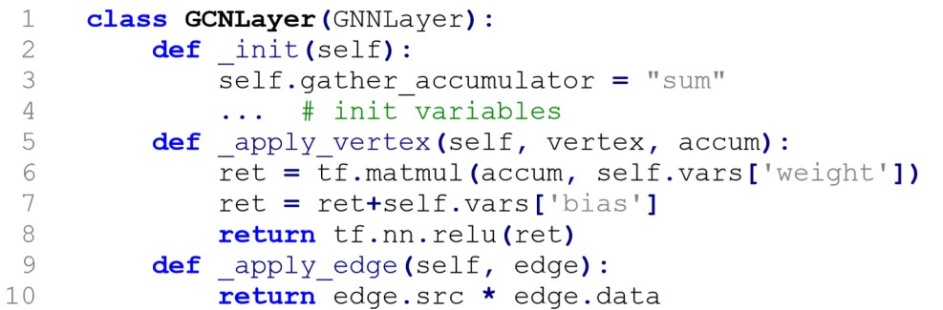
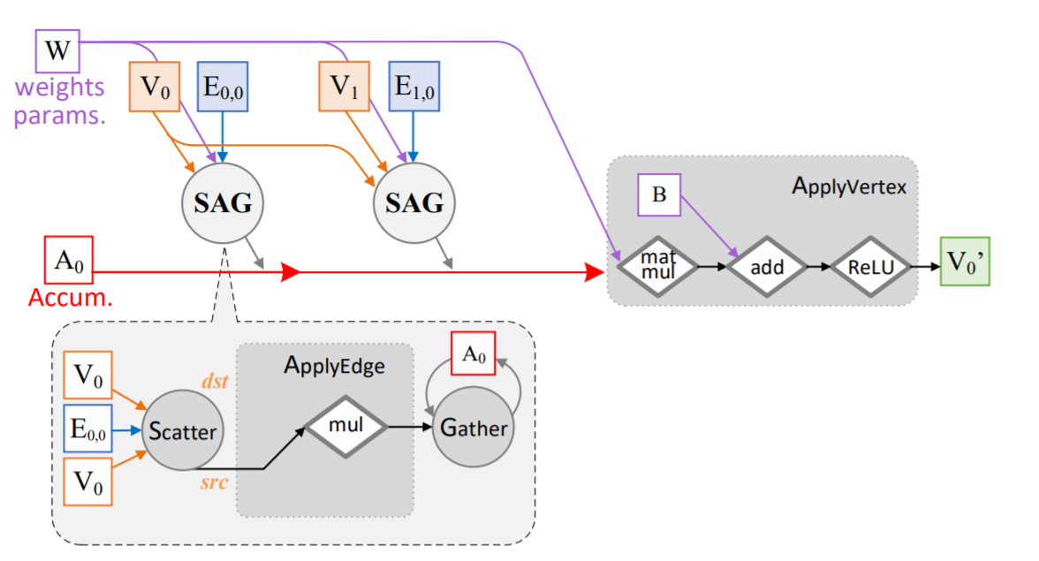
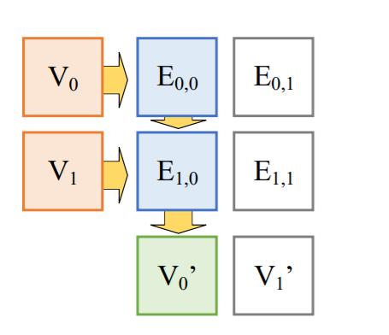
Chunk-based Dataflow Translation: GCN
19

Slide 20
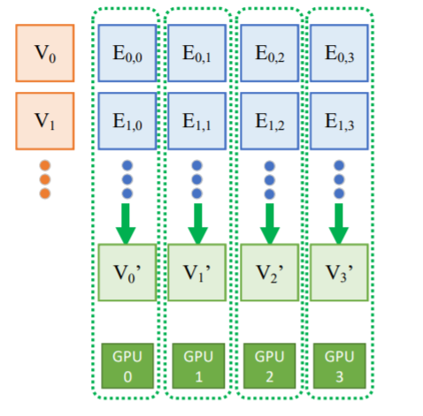




Scaling to multi-GPU
Naïve solution:
Approach: each GPU takes a “column” of edge chunks
Problem: redundant data transfer through shared upper links
V₀
V₁
bandwidth
bottleneck
CPU / DRAM
PCIe Host Bridge
x16
x16
PCIe Switch
x16 x16
PCIe Switch
x16 x16
GPU GPU
0 1
GPU
2
GPU
3
V₀
V₀

Slide 21


Scaling to multi-GPU
Observation: link to neighbor GPU is empty
Approach: directly load from neighbor GPU
V₀
V₁
CPU / DRAM
GPU-to-GPU
PCIe Host Bridge
x16
x16
PCIe Switch
x16 x16
PCIe Switch
x16 x16
GPU GPU
0 1
GPU
2
GPU
3
V₀
V₀

Slide 22
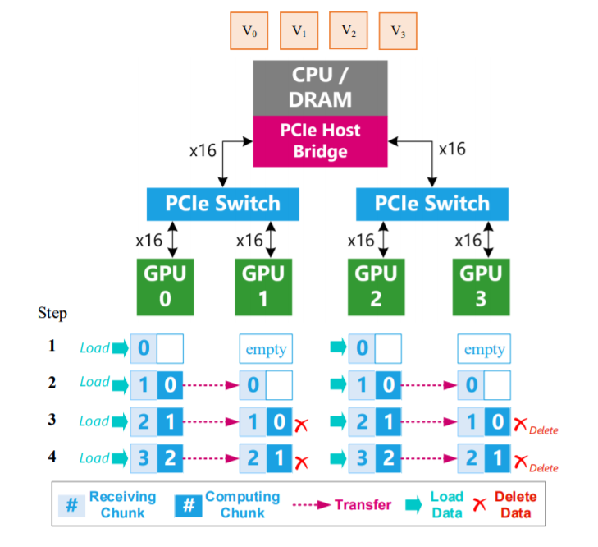
Chain-based Parallel Streaming
- Each GPU can consume all the chunks in chain for a PCIe switch
V₀
V₀
E0,0
E0,1
E0,1
E0,2
E0,3
E0,3
E0,0
E0,2
V₁
V₁
E1,0
E1,1
E1,1
E1,2
E1,3
E1,3
E1,0
E1,2
V₀
V
V
V₀
V
V
V
V
0
GPU
0
GPU
1
GPU
2
GPU
3

Slide 23



High performance graph propagation kernels
Traditional multithread parallelization
PageRank, SSSP, CC, etc: one-dimension scalar value on vertices
A thread takes a vertex/edge
V0
edge
V1
diff ops. on diff vertices
inefficient in GPU(SIMD)
Thread 0
Thread 1

Slide 24












High performance graph propagation kernels
Observation
High-dimension feature
More-regular operations along feature-dimension
Solution: exploit feature-dimension parallelization in GNNs
V0
edge
V1
same ops. efficient in GPU(SIMD)
Thread 0
Thread 1
Thread 2
Thread 3

Slide 25
Experiment Setup
Typical GNN Applications
Communication neural network (CommNet)
// no computation in ApplyEdge
Graph convolutional networks (GCN)
// element-wise Mul in ApplyEdge
Gated graph neural networks (GG-NN)
// GRU in ApplyVertex
Testbed
dataset | vertex | edge | feature | label | degree | type
blog | 10.3K | 668.0K | 128 | 39 | 65 | social
pubmed | 19.7K | 108.4K | 500 | 3 | 5 | cite
reddit_small | 58.2K | 1.4M | 300 | 41 | 25 | social
reddit_full | 2.4M | 705.9M | 300 | 50 | 292 | social
enwiki | 3.6M | 276.1M | 300 | 12 | 77 | knowledge
amazon | 8.6M | 231.6M | 96 | 22 | 27 | review
- 2x E5-2690-v4 (14-core with HT)
512GB Quad-Channel RAM
8x NVIDIA Tesla P100 GPU
Ubuntu 16.04
CUDA 9.0 + cuDNN 7
- Comparison
TF: TensorFlow v1.7 (CPU/GPU)
DGL: Deep Graph Library v0.1.3 with PyTorch v1.0 backend
TF-SAGA: SAGA-NN with TensorFlow v1.7 backend
NG: NeuGraph on top of TensorFlow v1.7

Slide 26
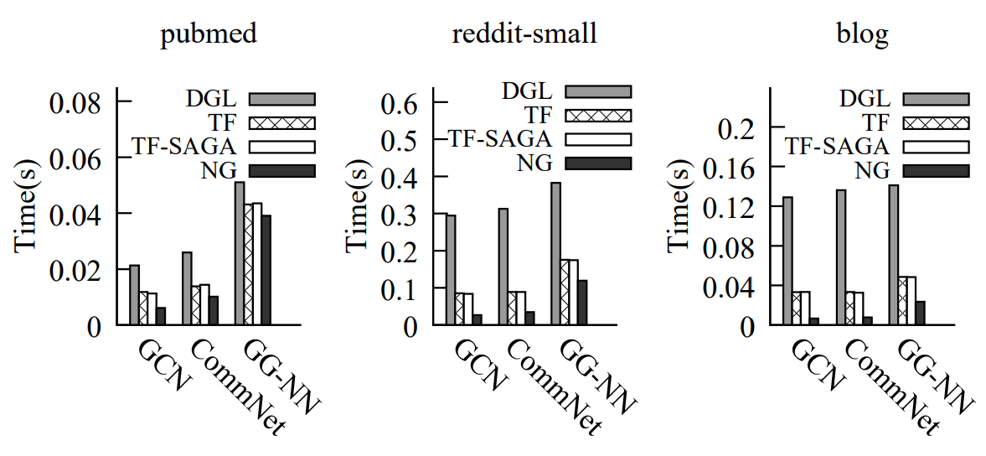
Performance on a Single GPU
Compare with TF, DGL on small graphs
up to 5x speedup vs TF
up to 19x speedup vs DGL
higher density
Avg. epoch time; #layer=2, hidden_size=512

Slide 27

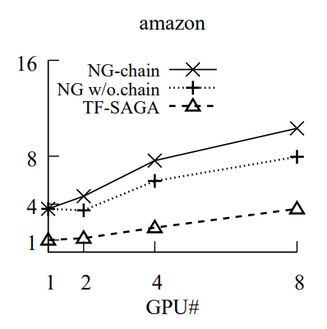
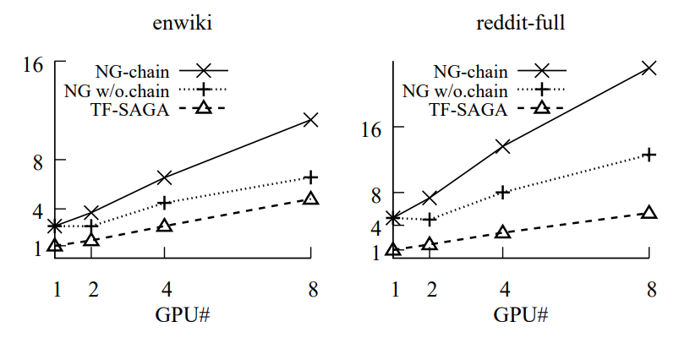
Scaling-out on Multiple GPUs
- GCN on three large graphs on different number of GPUs
higher density
Avg. speedup over TF-SAGA-1GPU; #layer=2, hidden_size=16 (amazon), 32 (enwiki), 64 (reddit-full)

Slide 28
Conclusion
NeuGraph: advocate unifying deep learning and graph computing for
graph neural networks
Define a new, flexible SAGA-NN model to express GNNs
Fuse graph-related optimizations into deep learning frameworks
Demonstrate NeuGraph achieves efficient and scalable GNN processing

Slide 29
NeuGraph
Thanks for your listening.

