Slide 1

VIETTEL SEMICONDUCTOR TECHNOLOGY DIVISION
Design System and Develop application Department
SoC virtual platform
Integration manual
huannd25@viettel.com.vn

Slide 2
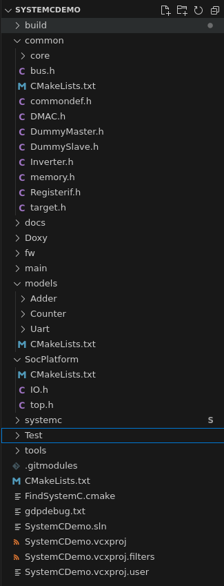
Folder structure
Common model
RTL modules after converting to systemC model using vs2c tool are contained in models folder
Top module file, using to connect port and bus interface
Test folder is used to contain test cases

Slide 3
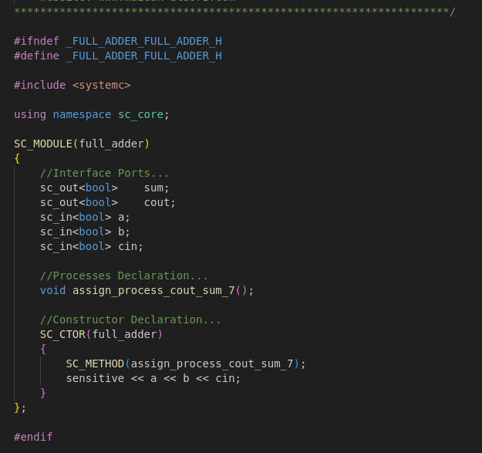
V2SC convertor tool
By using v2sc tool, you can convert verilog module to systemC syntax directly, the example for full-adder is depicted in below
Interface of systemC model after convertation process by v2sc
Please following this link for more information about v2sc tool
https://www.mazdak-alborz.com/v2sc

Slide 4
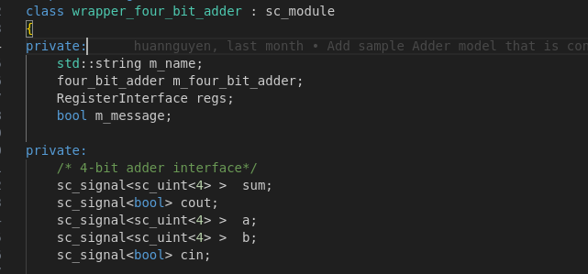
Design Wrapper
In this slide, a wrapper model template is provided to define register and bind port in/out.
Instancing top model of adder
Instancing RegisterInterface
Defining sc_signal that correspond with model’s interface

Slide 5
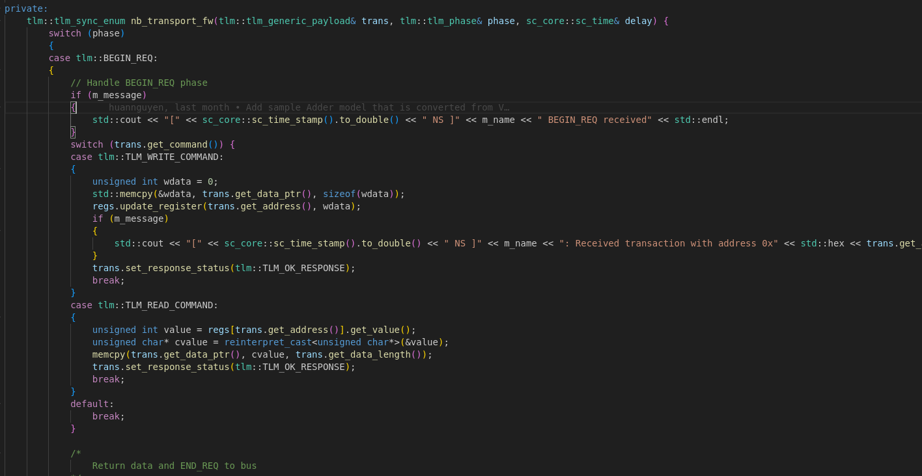
Design Wrapper
In the next step, defining nb_transport_fw function to update or return register value when the target socket is accessed by bus model

Slide 6
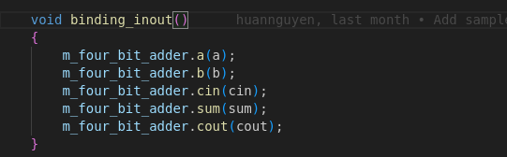
Design Wrapper
The binding_inout function is used to bind model’s interface with internal sc_signal of wrapper
Sc_signal<...>
Model’s interface

Slide 7
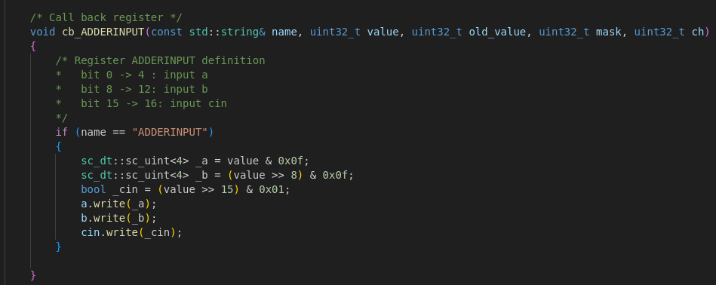
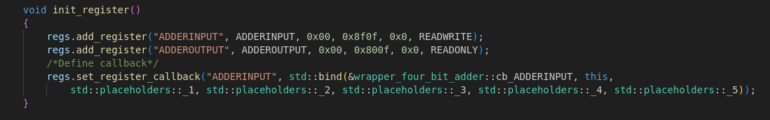
Design Wrapper
Define register interface corresponding with model’s register interface,
the callback register function will be called when the register changes its value.
Creating new registers with specific name, initial value, R/W permission, and mask

Slide 8
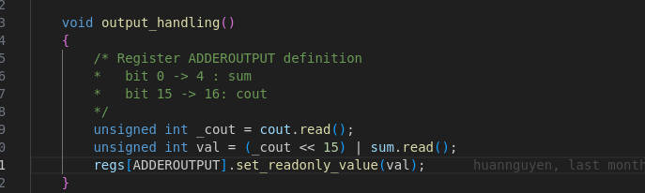
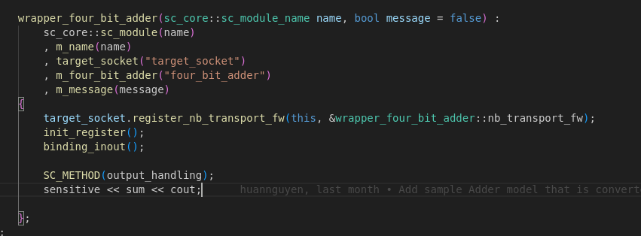
Design Wrapper
Defining the output_handling function to map model’s output ports to specific registers.
Update register’s value when the output port of model is changed
Add output ports to sensitive list

Slide 9
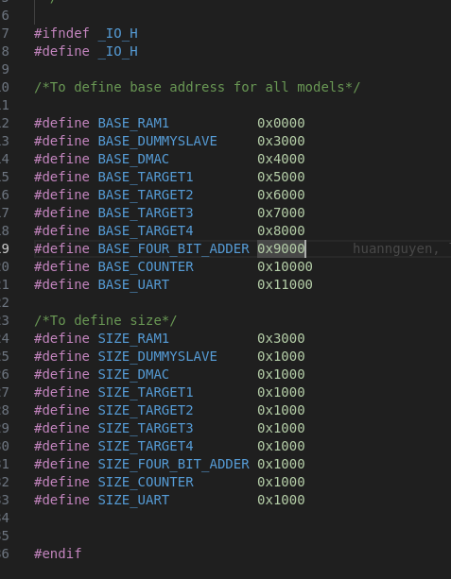
Intergrating to SoC Platform
First of all, you need define base address and address range of your model

Slide 10
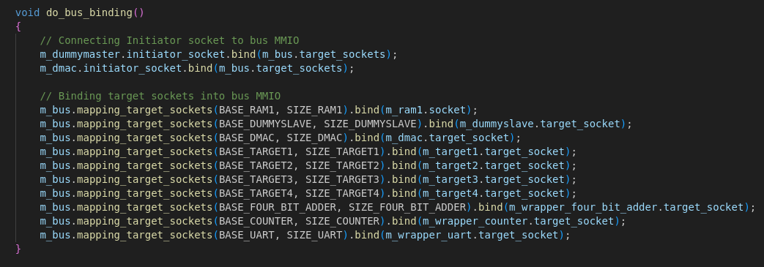
Intergrating to SoC Platform
In top model, mapping model’s target socket and initiator socket into bus MMIO with specific address range

Slide 11
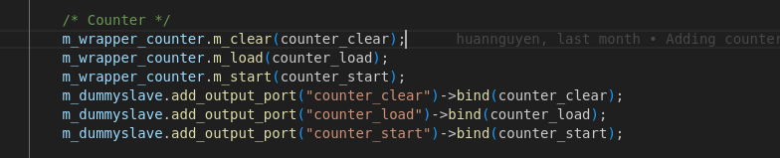
Intergrating to SoC Platform
Connecting in/out interface of wrapper model with another models

Slide 12
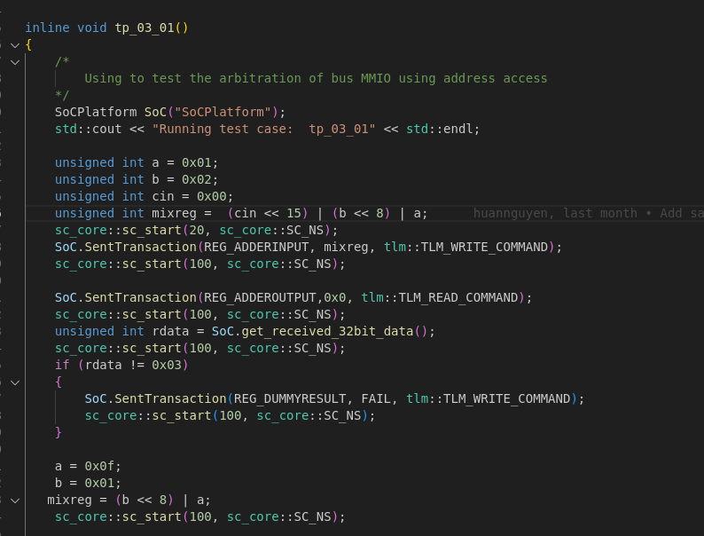
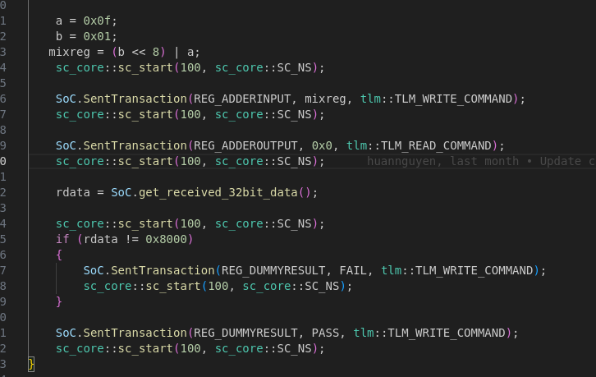
Example for test case
In the test case, the user interacts with SoC Platform by using dummy_master to request read/write transaction for setting register and dummy_salve to control input ports directly. Specially, the simulation time can be controlled by sc_core::sc_start().

Slide 13
VIETTEL SEMICONDUCTOR TECHNOLOGY DIVISION
Design System and Develop application Department
Thank you
huannd25@viettel.com.vn

