Slide 1
C/C++ Language Test
Dec 2020

Slide 2
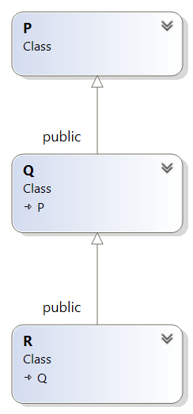
1. The Output of the program ?
class P {
public:
void print()
{
cout << " Inside P::";
}
};
class Q : public P {
public:
void print()
{
cout << " Inside Q";
}
};
class R : public Q {
};
int main()
{
R r;
r.print();
return 0;
}
_________________________________________________________________________________________________
Inside Q

Slide 3
2. Write program to access and change the value of byte 3 : BB -> EE in the variable below using pointer
unsigned int var = 0xAABBCCDD; (The system uses little endian )
_________________________________________________________________________________________________
unsigned char *ptr = (unsigned char*)(&var);
//Print before changing values
cout << hex << var << endl;
*(ptr + 2) = 0xEE;
//Print after changing values
cout << hex << var << endl;

Slide 4
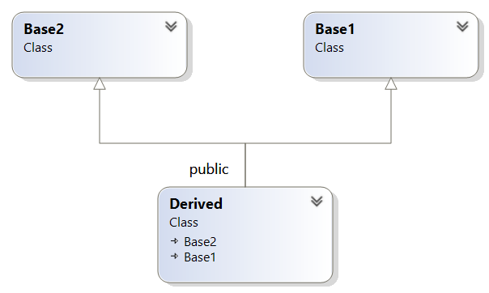
3. The output of the program ?
class Base1 {
public:
Base1() {
cout << "Base1's constructor called" << endl;
}
};
class Base2 {
public:
Base2() {
cout << "Base2's constructor called" << endl;
}
};
class Derived : public Base2, public Base1 {
public:
Derived() {
cout << "Derived's constructor called" << endl;
}
};
int main() {
Derived d;
return 0;
}
_________________________________________________________________________________________________
Base2's constructor called
Base1's constructor called
Derived's constructor called

Slide 5
4. Write a function to swap two inputs (any value type : int, float, char..) using reference, template
_________________________________________________________________________________________________
template <typename T>
void Swap(T &n1, T &n2)
{
T temp;
temp = n1;
n1 = n2;
n2 = temp;
}

Slide 6
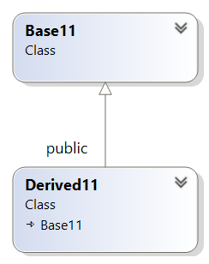
5. The output of the program ?
class Base11
{
public:
Base11()
{
fun(); //note: fun() is virtual
}
virtual void fun()
{
cout << "\nBase Function";
}
};
class Derived11 : public Base11
{
public:
Derived11() {}
virtual void fun()
{
cout << "\nDerived Function" << endl;
}
};
int main()
{
Base11* pBase = new Derived11();
delete pBase;
return 0;
}
_________________________________________________________________________________________________
Base Function

Slide 7
6. Consider a compiler where int takes 4 bytes(platform 32 bits)The output of the program ?
int arri[] = { 1, 2 ,3 };
int *ptri = arri;
char arrc[] = { 1, 2 ,3 };
char *ptrc = arrc;
struct example
{
int a;
bool b;
char c;
};
example test;
printf("sizeof arri[] = %d ", sizeof(arri));
printf("sizeof ptri = %d ", sizeof(ptri));
printf("sizeof arrc[] = %d ", sizeof(arrc));
printf("sizeof ptrc = %d ", sizeof(ptrc));
printf("sizeof test = %d ", sizeof(test));
_________________________________________________________________________________________________
sizeof arri[] = 12
sizeof ptri = 4
sizeof arrc[] = 3
sizeof ptrc = 4
sizeof test = 6

Slide 8
7. The output of the program ?
class Point {
private:
int x;
int y;
public:
Point(int i, int j); // Constructor
};
Point::Point(int i = 0, int j = 0) {
x = i;
y = j;
cout << "\nConstructor called" << endl;
}
int main()
{
Point t1, *t2;
return 0;
}
_________________________________________________________________________________________________
Constructor called

Slide 9
8. The out of the program ?
class Test8 {
int value;
public:
Test8(int v);
};
Test8::Test8(int v) {
value = v;
cout << "\nThe constructor of class test8 is called" << endl;
}
int main()
{
Test8 t[100];
return 0;
}
_________________________________________________________________________________________________
Complier error !!!

Slide 10
9. The output of the program ?
int &fun() {
static int a =10;
return a;
}
int main()
{
int &y = fun();
y = y + 100;
cout << fun();
return 0;
}
_________________________________________________________________________________________________
110

Slide 11
10. The output of the program ?
class Point7 {
private:
int x;
int y;
public:
Point7(int i = 0, int j = 0); // Normal Constructor
Point7(const Point7 &t); // Copy Constructor
};
Point7::Point7(int i, int j) {
x = i;
y = j;
cout << "Normal Constructor called\n";
}
Point7::Point7(const Point7 &t) {
y = t.y;
cout << "Copy Constructor called\n";
}
int main()
{
Point7 *t17, *t27;
t17 = new Point7(10, 15);
t27 = new Point7(*t17);
Point7 t3 = *t17;
Point7 t4;
t4 = t3;
return 0;
}
_________________________________________________________________________________________________
Normal Constructor called
Copy Constructor called
Copy Constructor called
Normal Constructor called

Slide 12
11. The output of the program ?
void fun23(int *ptr)
{
*ptr = 30;
}
int main()
{
int y = 20;
fun23(&y);
printf("%d", y);
return 0;
}
_________________________________________________________________________________________________
30

Slide 13
12. The output of the program ?
class Test10
{
public:
int a;
public:
Test10();
};
Test10::Test10() {
cout << "Constructor Called 10\n";
}
int main()
{
cout << "Start \n";
Test10 t1();
cout << "End \n";
return 0;
}
_________________________________________________________________________________________________
Start
End

Slide 14
13. Write a function add two values input and store the results through pointers
_________________________________________________________________________________________________
void add(int a, int b, int *ptr) {
if (ptr != NULL) {
*ptr = a + b;
}
else {
cout << "ptr is NULL" << endl;
}
}

Slide 15
14. The output of the program ?
class base14 {
public:
virtual void print(){
cout << "print base class" << endl;
}
void show()
{
cout << "show base class" << endl;
}
};
class derived14 : public base14 {
public:
void print()
{
cout << "print derived class" << endl;
}
void show(){
cout << "show derived class" << endl;
}
};
int main()
{
base14* bptr;
derived14 d;
bptr = &d;
bptr->print();
bptr->show();
return 0; }
_________________________________________________________________________________________________
print derived class
show base class

Slide 16
15.The output of the program ?
int main()
{
int ab = 1;
int *ptr_ab = &ab;
cout << ab << endl;
*ptr_ab =5;
cout << ab << endl;
return 0;
}
_________________________________________________________________________________________________
1
5

Slide 17
16. The output of the program ?
class base_15{
public:
virtual void func() {
cout << "\nbase_15" << endl;
}
};
class derive_15 : public base_15 {
public :
void func() {
cout << "\derive_15" << endl;
}
};
void printout(base_15 *x) {
x->func();
}
int main()
{
derive_15 d;
printout(&d);
return 0;
}
_________________________________________________________________________________________________
derive_15

Slide 18
17. Write program to access and print private members of classes using friend function feature
_________________________________________________________________________________________________
class person{
private:
char* name;
int age;
friend void getattribute(person);
public:
person() :name(“Nguyen Van A"), age(25){}
};
void getattribute(person p) {
cout << "name : " << p.name << endl;
cout << "age : " << p.age << endl;
}
int main()
{
person P;
getattribute(P);
return 0;
}

Slide 19
18. Write program to add two integer numbers as well as three integer numbers in the function having the same name
_________________________________________________________________________________________________
class Democlass {
public:
int add(int i, int j) {
return i + j;
}
int add(int i, int j, int k) {
return i + j + k;
}
};

Slide 20
19. The output of the program ?
void fun(int *p)
{
int q = 10;
p = &q;
}
int main()
{
int r = 20;
int *p = &r;
fun(p);
printf("%d", *p);
}
_________________________________________________________________________________________________
20

Slide 21
20. The output of the program ? Write the reason ?
int main()
{
for(unsigned char i = 1; i < 300; i++)
{
if (i == 299) {
printf("i = %d\n", i);
}
}
printf(“End\n", i);
return 0;
}
_________________________________________________________________________________________________
Nothing is printed. The value of i can not be reached to 299 because Its type is unsigned char(maximum value : 255) that leads to “End” can not be printed(Infinite loop)

Slide 22
21. write a program according to the following requirements
Q1 Car and human
Using C++ concepts (class, method, attribute, encapsulation, polymorphism, inheritance) to describe real world.
1.1 General Motor has two car product lines, normal and performance. Both of them have properties
Normal:
serial number (ex: 0123456789)
engine power (ex: 500hp)
engine speed (ex: 100.5 km/h)
Performance:
serial number (ex: 0123456789)
engine power (ex: 500hp)
engine speed (ex: 100.5 km/h)
turbo charger (boost engine speed to 10%)
Navigating system (longitude, latitude)
Note: serial number and engine power are fixed when manufacturing //DECLARE CONSTANT, TO NOT CHANGE
1.2 Car can be used by person with certain extents //declare 3 class
Engineer: Class engineer{} is Derived Class, inheritance from Class person{}
drive a car
program navigating system (longitude, latitude)
read serial number, engine power, engine speed
User:
drive a car
positioning the car (longitude, latitude)
read engine power, engine speed
Note: engine speed can be read in form (100.5 km/h or 100 km/h)
Hint: Describe car, person as a class; using “static” to create a serial number

Slide 23
Thank you!

