Slide 1
FILL PRM GUIDANCE
JB5001
Date: aug/24/2021
CORESW – RH850 Modeling GROUP
Renesas Electronics Corporation

Slide 2
Background
For align with DR analysis, PRM should be recorded correctly.

Slide 3
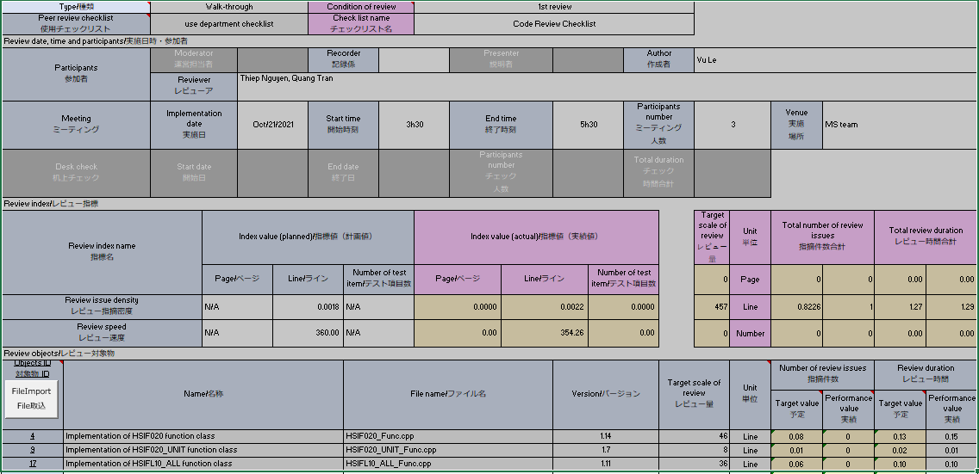
Walkthrough PR
RVC-JB5001-002e: reviewer is “Person who confirms the content of the work product and points out issues and questions”.
RHM: person who take part in review; but do NOT point out issue and question can be listed as reviewer because they spent effort.
Count the number of person attending meeting (includes author).
Review time in walkthrough is MEETING TIME spent for each object.
(*)
(*) All members spent 0.15h for this object

Slide 4
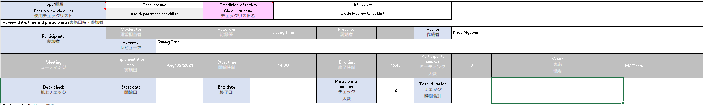
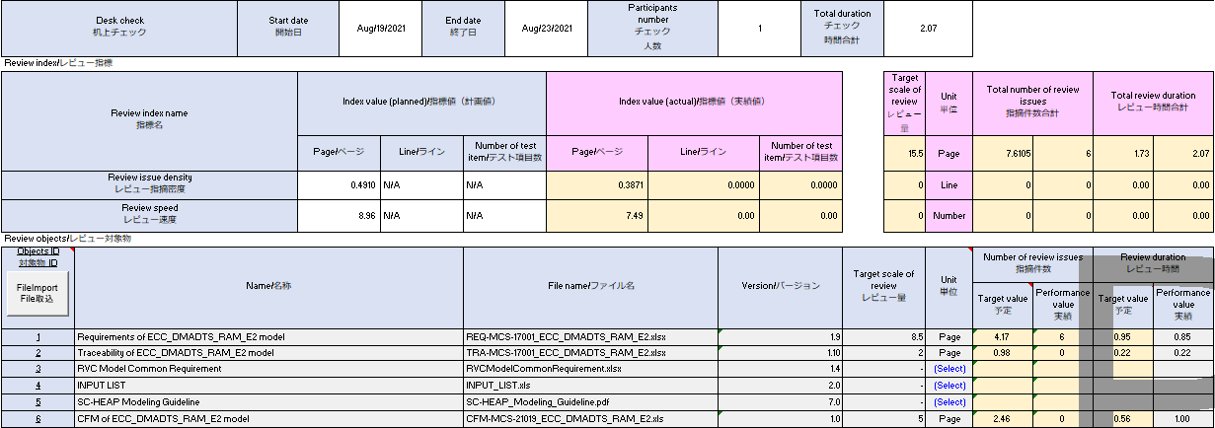
Pass-around PR
RVC-JB5001-002e: reviewer is “Person who confirms the content of the work product and points out issues and questions”.
RHM: person who take part in review; but do NOT point out issue and question can be listed as reviewer because they spent effort.
2
Count author as participant to have correct PR effort.
Review time in pass-around is AVERAGE TIME b/w reviewer(s) and author(s).
Reviewer (1h) + author (0.7) -> average = 1.7/2* = 0.85
Reviewer (0.22h) + author (0.22) -> average = 0.44/2* = 0.22
Reviewer (0.5h) + author (1.5) -> average = 2/2* = 1
Notes: (*) 2 is the participants number above

Slide 5
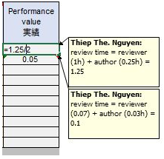
Pass-around PR – How to fill review effort
Leave notes as: http://172.29.143.164:8080/issues/148823#note-2
Or we write directly the formula: = (1 + 0.25)/2 (the first values are reviewers; the last one is author – because the author effort is usually lesser).

Slide 6
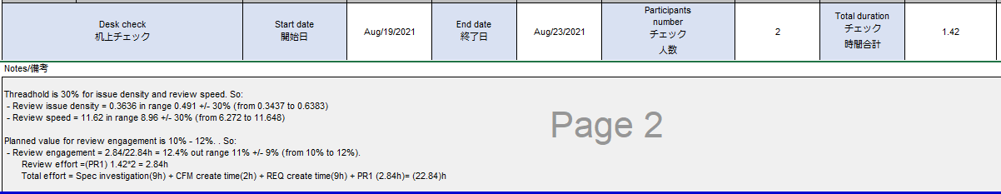
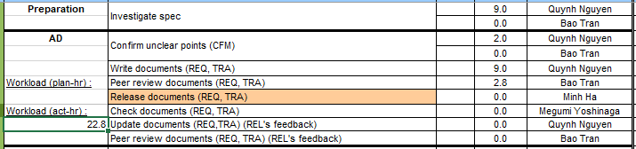
PR effort & review engagement
Total effort includes review effort.
PR effort = Total duration x Participants number
= 1.42 x 2
Review engagement = Review effort / total effort
Total effort should match with SCD.

Slide 7
references
RCT-JB5001en_s8_Measurement_And_Analysis_Item_Table.xlsx

Slide 8
Renesas.com

