Slide 1
V-model Fundamental
Nov 2020

Slide 2
Outline
Overview
Acronyms
RH850’s models development flow
RCAR’s models development flow

Slide 3
OVERVIEW

Slide 4
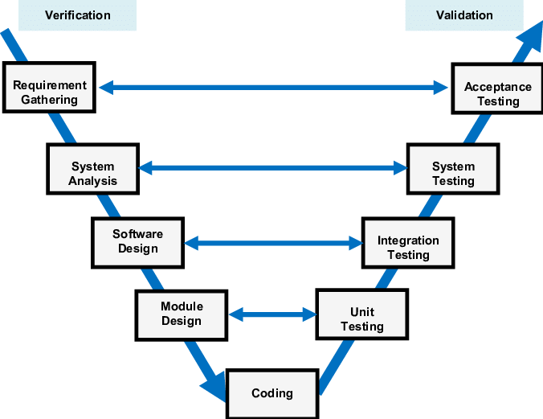
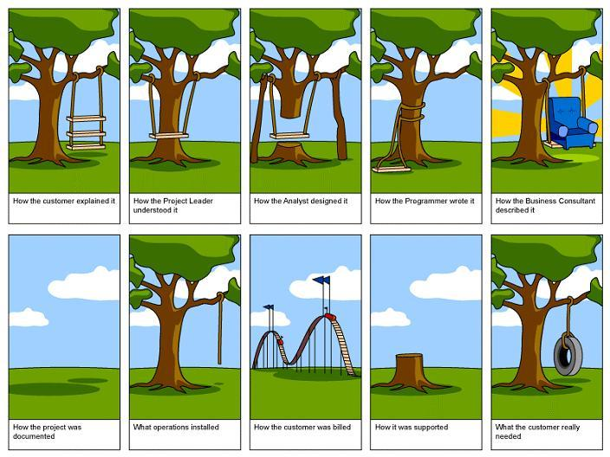
Introduction
V-model is a Software development Life Cycle (SDLC) that emphasizes the concept of “Verification and Validation” that determines the relationship between each phase of the software development and ensures that each phase of software development is associated with testing.

Slide 5
Structure
The V model is divided into two branches: left and right. The left branch analyzes and determines the requirements of the software to be developed. The right branch, on the other hand, includes the testing activities. The left and right branches of this model work NOT concurrently.
Testing occurs in every phase of software development and does not occur only after the coding is completed.
V-model is a sequential process in which the next phase begins only after the completion of the present phase in each branch.
Designer
Functional Debug
Design documentation
Implementation
Unit test
Get specification
Confirm specification
Acceptance test
Release
Verifier
Integrated test
test environment documentation
Create test environment
Create
test case
System test
Timeline

Slide 6
Requirement Gathering ← →Acceptance Testing
In the process of gathering requirements for the system to meet its client’s expectation, a testing phase involved in the finished product in a real user environment will be planned.
Acceptance Testing may conclude the overall client experience of the entire system as a complete product.

Slide 7
System Analysis ← → System Testing
System Design plan out how the system components will be and how they will interact with each other to run the entire system (only proceeded after finish requirement gathering).
System Testing is the phase after all the modules are combined and the complete system is made (only proceeded after finish integration test)

Slide 8
Software Design ← →Integration Testing
A technical phase of software design where the concept and plan will be implemented into smaller modules to accomplish each functionality and requirement of the project itself (Only proceeded after finish Unit test).
Integration Test of each component and their architectural design will be planned at the same time. It tests the interface between modules of the software application (Only proceeded after finish Unit test).

Slide 9
Module Design ← →Unit Testing
Lower-level designed the basic component in each module works properly in order to eliminate any fault in fundamental functionality that higher level component will be based on.
Unit Testing will be designed ensure that the system can handle each one appropriately on the code level.

Slide 10
Coding
An actual implementation of a code. Coding will be done based on the design of the afore mentioned components and modules.

Slide 11
Pros & Cons
Advantages
Less bugs: Do testing in every layer
Provide an explanation of problems involved in detail.
Emphasizes the importance of testing and makes sure that testing is planned.
Disadvantages
A bit complicated when comparing with other methods.

Slide 12
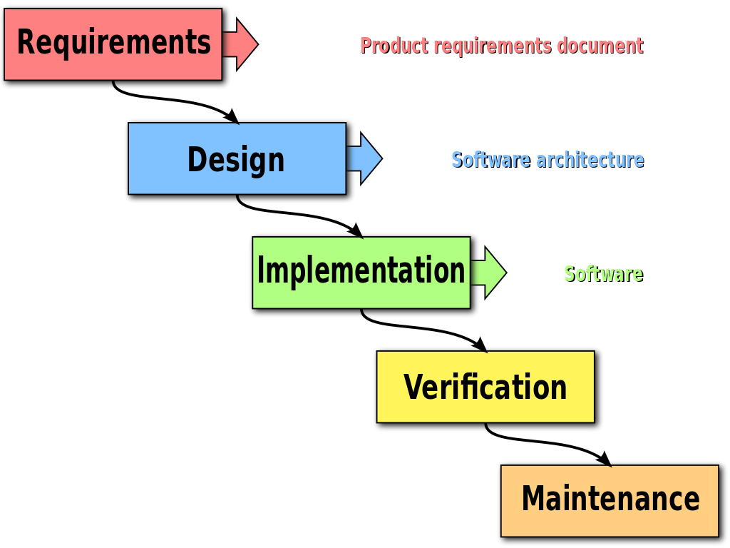
Comparison with waterfall models
V-Model tests at the first stage: while Waterfall tests after the development stage.
V-Model costs higher: Since the process is more complex than waterfall. development cost is expensive.

Slide 13
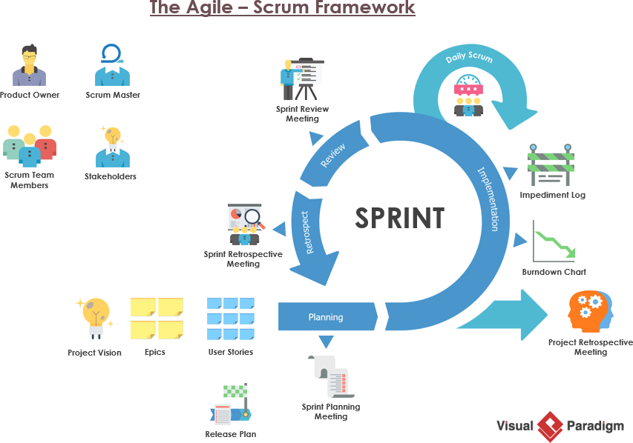
Comparison with Agile
V-model
Development and testing are not concurrent.
It consists of five verification and five validation phases.
Development team and testing team don’t interact much with end users.
Developers and testers are independent.
Agile
Development and testing are concurrent.
It consists of different sprints.
Testing is easy as compared to V-model.
Communication is easy between end users, development team and testing team.
Developers and testers are dependent on each other.

Slide 14
Acronyms

Slide 15
SCD: Schedule
CFM: Confirmation
AD: Architect Design
UD: Unit Design
PR: Peer-Review
CD: Coding
UT: Unit Test
REQ: Requirement
INT: Internal Specification
VRF: Verification Specification
VRF-01: Checklist
INR: Test Report
USR: User Manual
TRA: Traceability

Slide 16
RH850’s model development flow

Slide 17
RH850’s model development flow
Designer
Verifier
Estimate SCD
Reviewer
Review SCD
Investigation spec
Feedback CFM
DEV
Check AD
RVC
CFM
REQ
Release AD
PR REQ
PR DEV
REL
AD
PR TRA
Update DEV, TRA
TRA
Check UD
PR DEV, TRA
Release UD
INT
PR, Walk-Through source code
UD
PR INT
Update DEV, TRA
Static check
PR DEV, TRA
Update INT
Release CD
Check CD
Implement source code
PR source code after UT
CD
Functional Debug Windows
Memory check
Get coverage
Update after RVC acceptance test
Prepare env
Create TMs
Functional Debug Linux
PR USR
Check data and all documents
VRF
VRF-01
USR
Update TRA, DEV
UT
PR VRF
PR VRF-01
Acceptance test
PR TRA, DEV
Final release
PR INR
INR
Prepare data
PR data

Slide 18
RCAR’s model development flow

Slide 19
RCAR’s model development flow
Designer
Verifier
Estimate SCD
Review SCD
Reviewer
Investigation spec
Feedback CFM
TRA
Check AD
RVC
CFM
REQ
Release AD
PR REQ
PR TRA
REL
AD
Check UD
Release UD
Update TRA
PR TRA
INT
PR, Walk-Through source code
UD
PR INT
Static check
Update TRA
Update INT
Release CD
Check CD
PR TRA
PR source code after UT
CD
Implement source code
Functional Debug Windows
Prepare env
Create TMs
Functional Debug Linux
Check data and all documents
VRF
VRF-01
UT
PR VRF
PR VRF-01
Update TRA
Final release
PR INR
PR TRA
INR
Prepare data
PR data

Slide 20
Thank you!

