Slide 1
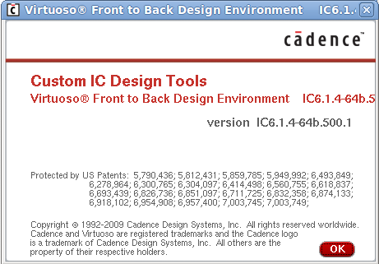
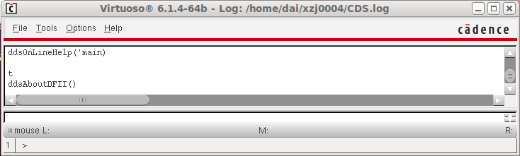
Start Cadence Tool
Command Interpreter Window (CIW)

Slide 2
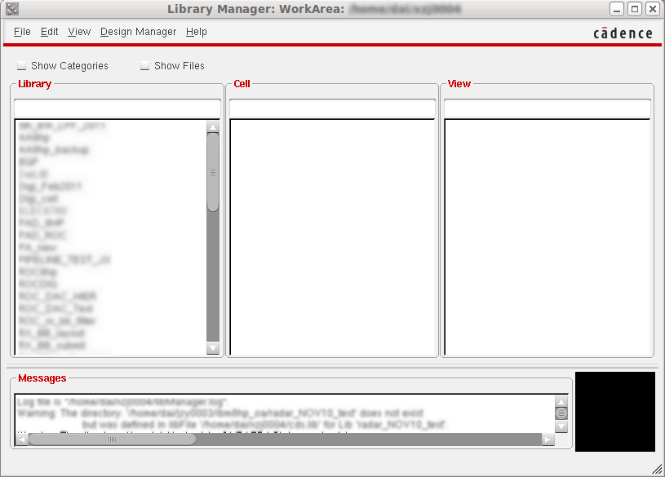
Library Manager
CIW: Tools ->
Library Manager.

Slide 3
Library Manager -- View
schematic - contains the logical design of the device.
symbol - contains the symbol representation of the schematic.
layout - contains the silicon -level representations of the transistors and wiring.
CdsSpice, HspiceS, Spectre, spectreS –contain spice information for the element.
abstract - contains an abstract representation of the layout for use by Cadence place and route software.
extracted - contains layout connectivity for use by verification programs.
behavioral – contains the VHDL description of the cell

Slide 4
Creating a New Cellview
In the CIW or library manager, select FILE – New – Cellview.
Create a new cellview from the Library Manager or CIW.
Specify the library Name, Cell Name, View Name, and Tool to use. The path to the cds.lib file will appear in the form and is not editable.
Modify the Tool field to create a layout, verilog, symbol, schematic, vhdl, or ahdl view.

Slide 5
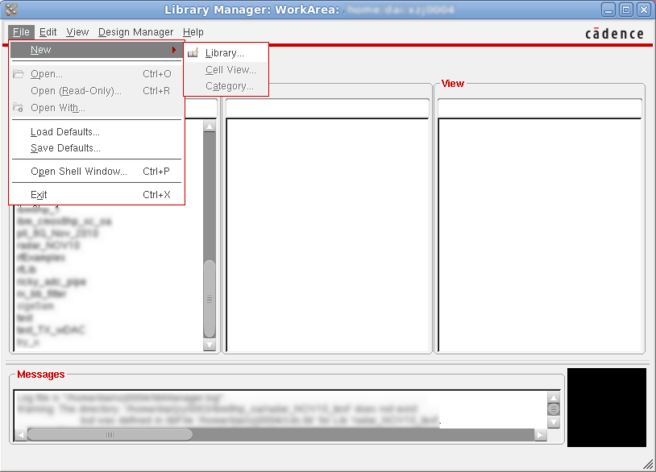
Create your own Library
From Lib manager menu, select File>New>Library.
Type library name, e.g. my_test. Then click Next to see “Technology file for new library” window,click OK.
Chap 6, Cadence, 5190/6190, FDAI, 2010

Slide 6
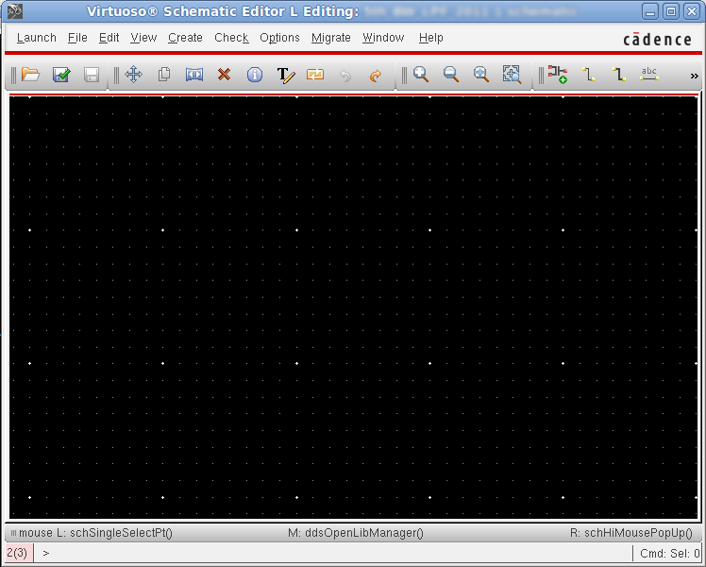
Create your own Library
Click my_test lib and select File>New>cell view. Name your own cell and make sure view name is “schematic” and tool is “Composer-schematic”. Then click OK, you will see schematic interface.

Slide 7
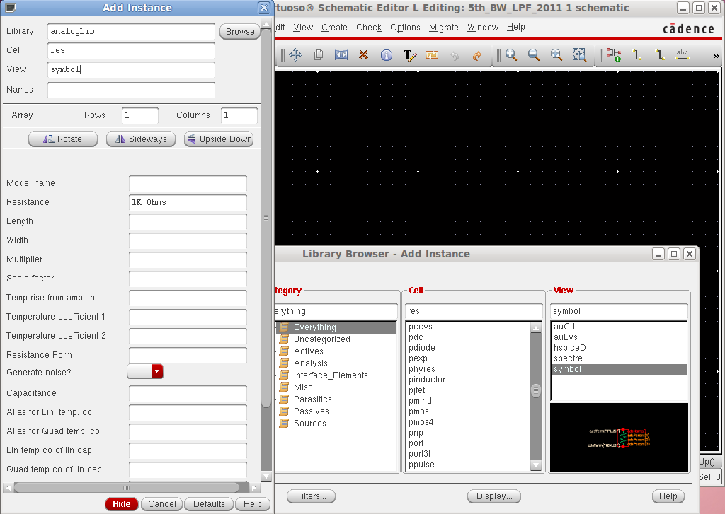
Add instance to your schematic
Select Add – Instance or the bindkey “I” to display the ADD Instance form.

Slide 8
Adding Component Instances
Design components are generally instances of a symbol cellview and might be design primitives. Here are some properties associated with design component instances:
The Instance Name is assigned automatically, unless explicitly specified.
Find analog design primitives in the analogLib library. This library is included wherever the Analog Artist software is installed in the path ../tools/dfII/etc/cdslib/artist. Include this path in your library search path to use analogLib components.
The system prompts for component parameters when instantiating the components. Attach multiplier suffixes, such as k for 1000, to numerical quantities.
Use the rotate, upsidedown, and sideways buttons to change the orientation of your components as they are placed in the schematic.
Parameter | Example Value
Library Name | analogLib
Cell Name | res
View Name | symbol
Instance Name | R2
Chap 6, Cadence, 5190/6190, FDAI, 2010

Slide 9
Adding Source and Ground
Sources, taps, and grounds are instance of cells.
Sample source cells are in the analog library.
Choose from independent, dependent, and place-wise linear (PWL) sources.
Choose tap and ground cells, which use to establish global nets.
An instance of the cell gnd is required in the design for DC convergence.
vcc
vcca
vcca
vcca
vdc
+
_
+
_
gnd
gnda
gnda
gnda
gnda
gnd
Chap 6, Cadence, 5190/6190, FDAI, 2010

Slide 10
Adding Source and Ground
Adding Sources and Ground
Ground
Always include the symbol gnd found in the analogLib library, Analog simulators require that all nodes in the circuit must have a DC path ground. This would be represented as node 0 in the Cadence SPICE circuit simulator, for example. Use other ground symbols, such as gnda, for a ground that is connected to the reference ground through an analog circuit.
Voltage sources
Include all of your DC and transient voltage and current sources in the schematic, There are many types of voltage sources in analogLib. For example, some of the independent voltage sources are vdc, vsin, vpulse, vexp, vpwl and vpwlf. Each source has a current equivalent that begins with the letter i. There are also equivalent dependent sources.
All sources generate input waveforms except for pwlf sources, which simulate a circuit using a text file of data tables. It is not necessary to include sources in the schematic, although this is often convenient. Attaching a stimulus file to the final netlist is discussed In the analog simulation section of this course.
Voltage taps
Use taps symbol to transfer voltages and currents throughout the design without using wires. Voltage tap symbols, such as vcc,vdd,vcca, and vccd are in the analogLib library.
Chap 6, Cadence, 5190/6190, FDAI, 2010

Slide 11
Adding Pins
Pins have a user-defined Name and a Direction (input, output or input/output).
Pins are of three types:
  Schematic pins provide ports to a schematic.
  Symbol pins provide ports to a symbol representing a schematic, and are connection points to the symbol in a hierarchal design.
  Offsheet pins are used in large designs without hierarchy.
Pin names and directions must match in all cellviews of a cell.
Offsheet Pin
Schematic Pin
IN
OUT
Symbol Pin
IN
OUT
Chap 6, Cadence, 5190/6190, FDAI, 2010

Slide 12
Pins
For analog designers, pins have two primary functions:
Pins represent connection points between different cellviews such as schematic, symbol, and layout representation. Using named pins identifies eqivalent inputs, outputs, and I/O ports throughout the design environment.
Pins provide connection points for objects which are hierarchically instantiated.
Pin Properties
Pins have a pin name, pin type, and pin direction. These should be consistent throughout your design.
Multiple Sheet Design with Offset Pins
The composer: Design Entry Help manual includes a section on multiple sheet design methodology and information on the offsheet pin type.
Pins (ipin, opin, iopin, sympin) now come from “basic” library.
Chap 6, Cadence, 5190/6190, FDAI, 2010

Slide 13
Adding Wires and Wire Labels
Automatic routing is the default mode.
Wire Label
sig1
Route Entered
The System Routes
When not labeling a wire, the system names the net formed by the wires.
If the router cannot find a path between two points,
Adotted “fight linw” is placed to establish connectivity only.
Click on intermediate points to guide the router to yield a solid line of connectivity.
Use the Cmd Options icon or F3 key to modify the wiring options.
Chap 6, Cadence, 5190/6190, FDAI, 2010

Slide 14
Wires
Draw wires between the instance pins and schematic pins to connect them. Use wide wires to indicate multiple signals on a wire, the system does not force or check this. Draw wires at any angle, but most designers frequently restrain wires to orthogonal lines
Using Route Methodology
The route draw mode chooses two points in your design and then it automatically routes a wire around components. If a routed net remains dotted, it is because there are no clear routing channel. This can happen if the instances sre too close or overlap the selection boxes. To solve this, move the components further apart to give a routing channel.
Routing method options exits to wire together two points immediately (the default) or indicate many points to route together later in a single step. More information on route methods in included in the design entry reference documentation.
Wire Labels
Labeling wires gives the corresponding net a meaningful name in the simulation results data. Otherwise nets are system named. There is some control over the automatically generated names, but these may not be meaningful as custom names
Click the Cmd Options icon in the schematic window or press the F3 key to change the default wiring setup.
Chap 6, Cadence, 5190/6190, FDAI, 2010

Slide 15
Interconnecting Components
Wire to Wire
VCCI
Design Global Net
Wire to Pin
Pin to Pin
IN
OUT
OUT
By Name (Local)
IN
IN
OUT
Avoid this when possible
Schematic Pins and glabal symbol pins name wires by adoption.
Note: Inherited connections, not shown, will be discussed in the Inherited Connection chapter
Chap 6, Cadence, 5190/6190, FDAI, 2010

Slide 16
Interconnecting Components
Physical Connectivity
All physical connections are made by wire to pin, wire to wire, or pin to pin connections.
Connectivity by Name
If two wires have been labeled with the same name, they become part of the same net when connectivity is established.
System Assigned Names
If a net is unnamed, the system generates a name such as net100 or net7. optionally change the base name from net to something else. If a wire is connected to a schematic pin, then the pin is used to name the net by adoption when connectivity is established,
Global Nets
Any net or pin name that ends in an exclamation point will be part of a global net when connectivity is established. Global nets are automatically connected through the hierarchy without the use of wires. For example, voltage taps have symbol pin names that end in an exclamation point. If a wire is connected to a pin that has global name, the pin name is used to name the net by adoption. This is how voltage and ground signals are propagated throughout a design.
Chap 6, Cadence, 5190/6190, FDAI, 2010

Slide 17
Schematic Checking
During schematic checking, all of the following are performed by default:
Update Connectivity
This process associates wires and pins with logical connections called nets.
Schematic Rules Check
- Logical checks
- Physical checks
- Name checks
Cross – View Checker
This option checks for pin name and direction consistency between cellviews.
Select check – Rules setup from a schematic window to edit the rules. Disable any or all of these schematic checking features, if not needed.
Chap 6, Cadence, 5190/6190, FDAI, 2010

Slide 18
Schematic Checking
Schematic checking is a critical step in the design process.
Either check a single cellview or descend through the hierarchy to check all cellviews in your design.
Checking a schematic accomplishes the following:
Update Connectivity – When connectivity is established, wires and pins in the design entry window become associated with logical connections called nets. It is necessary to correct connectivity problems prior to going on to the next design phase.
Schematic Rules Check – This process checks the schematic with a set of rules. Access them with the Check – Rules Setup command from the schematic window.
The checks include:
-- Logical checks, such as Floating Input Pins and Shorted Output Pins.
-- Physical checks, such as Unconnected Wires and Overlapping Instances.
-- Name checks, such as Instances Name Syntax.
Cross-View Checker – This option checks the pin consistency between different views of the cell. Pin name directions must match between cellviews.
Chap 6, Cadence, 5190/6190, FDAI, 2010

Slide 19
Schematic Entry Flow
Open Design
Add Component Instances
Add Pins
Add and Name Wires
Check
Save
Symbol Editor
Chap 6, Cadence, 5190/6190, FDAI, 2010

