Slide 1


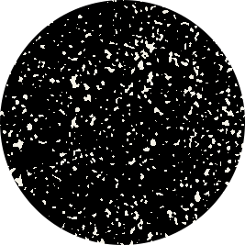
Improved Waveform Classification for Integrated Radar-Communication 6G Systems via Convolutional Neural Networks
Thien Huynh-The, Senior Member, IEEE, Nguyen Cong Luong, Hoc Phan,
Daniel Benevides da Costa, Senior Member, IEEE, and Quoc-Viet Pham, Senior Member, IEEE
Presentation: Huan Nguyen-Duy
Student ID: 2390703
Supervisor: Dr.Tan Do-Duy

Slide 2
Preview
IEEE EPLORE | Journals & Magazine
IEEE Transactions on Vehicular Technology | Improved Waveform Classification for Integrated Radar-Communication 6 G Systems Via Convolutional Neural Networks
Cite | T. Huynh-The, N. C. Luong, H. Phan, D. B. da Costa and Q. -V. Pham, "Improved Waveform Classification for Integrated Radar-Communication 6 G Systems Via Convolutional Neural Networks," in IEEE Transactions on Vehicular Technology, doi: 10.1109/TVT.2024.3384918.
Date of Publication | 04 April 2024
Authors | Thien Huynh-The Department of Computer and Communications Engineering, Ho Chi Minh City University of Technology and Education, Ho Chi Minh City, Vietnam Nguyen Cong Luong Faculty of Computer Science, Phenikaa University, Vietnam Hoc Phan Department of Computer and Communications Engineering, Ho Chi Minh City University of Technology and Education, Ho Chi Minh City, Vietnam Daniel Benevides da Costa Department of Electrical Engineering, King Fahd University of Petroleum & Minerals, Dhahran, Saudi Arabia Quoc-Viet Pham School of Computer Science and Statistics, Trinity College Dublin, Ireland

Slide 3
ABSTRACT
To overcome the spectrum congestion problem in next-generation wireless networks, an integrated radar-communication system with spectrum sharing becomes a promising solution, wherein radar and communication signals can be discriminated by means of modulated waveforms. This letter presents an efficient radar-communication waveform classification method by taking advantage of the combination of smooth pseudo Wigner-Ville distribution-based time-frequency analysis and deep learning to achieve a good trade-off between complexity and accuracy. To this end, a high-performance convolutional network, namely the radar-communication waveform recognition network (RadComNet), is designed with multiple cutting-edge techniques and advanced structures, including depthwise convolution for complexity reduction and residual connection and multi-level attention mechanisms for learning efficiency enhancement. Relying on the simulation results acquired on a synthetic signal dataset of 12 radar and communication waveform types with the presence of channel impairments, our proposed method shows superiority over other classification approaches and deep models in terms of accuracy and complexity.

Slide 4
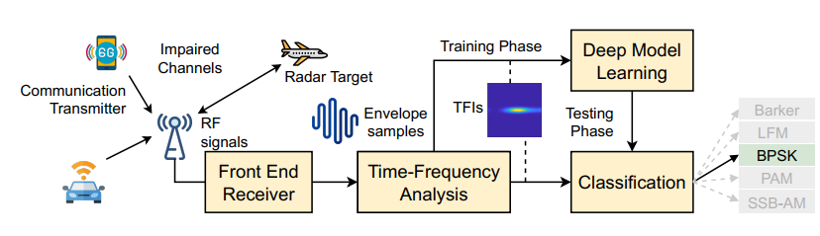
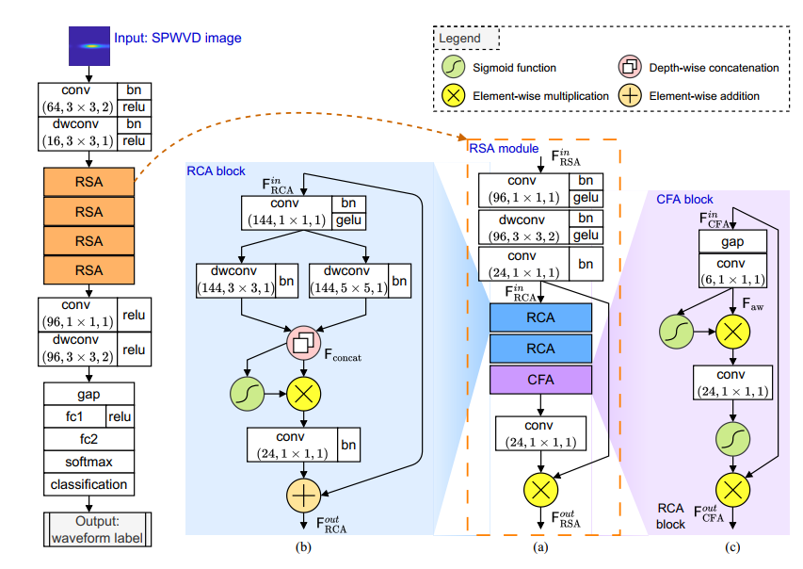
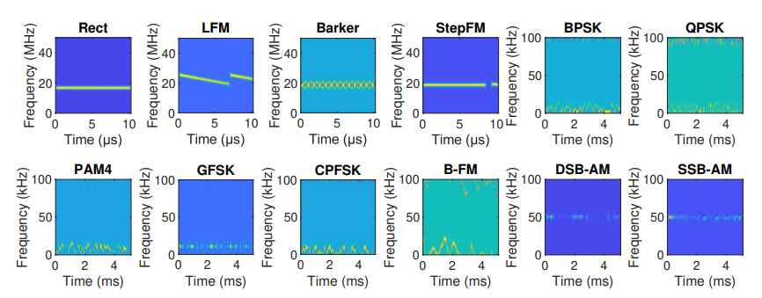
OUTLINE
MOTIVATION
CONTRIBUTION
INTRODUCTION
SOLUTION
EVALUTION
CONCLUSION

Slide 5
MOTIVATION
Reality and Demand in next generation wireless network
  Demand of wide bandwidths for high performance in the next-generation wireless network.
  Demand of accurately identified and classified types of spectrum base on waveform in limited resource.
  Recognition radar waveform in autonomous vehicles that requires highly accurate detection in limited resource.
Solution for recognition and classification waveform
  Deep learning is exploited for radar recognition and communication modulation classification.
  Proposing solution to reduce the size of deep learning network to reach highly accuracy and performance that have ability to deploy in limited resource devices.

Slide 6
CONTRIBUTION
The smooth pseudo WVD (SPWVD) recognition
  De-composing a signal into high-resolution time-frequency representation.
Waveform-based radar and communication signal classification
  Design a deep learning network that utilizes cutting edge deep learning architecture.
  Applying modern connection structure (depth-wise convolution, residual connection, and attention mechanism)
Performance evaluation by Mat-Lab simulation tool
  Generating a synthetic signal data set that comprise 12 radar and communication types.
  Proposing deep model that reduces complexity and increase accuracy.

Slide 7

INTRODUCTION
Signal Model
The receiver can receive pulsed radar signal and modulated communication signal in difference transmission source
The complex received signal is illustrated by:
X(k) : the transmitted radio signal
H(k) : the transmission channel coefficient
N(k) : the complex additive white Gaussian noise (AWGN)
Y(k) : the radar communication received signal

Slide 8


INTRODUCTION
Time Frequency analysis (TFA)
The receiver can receive pulsed radar signal and modulated communication signal in difference transmission source
The energy spectrum in frequency is given by:
S(t) denote for continuous signal
The total energy spectrum in frequency is given by:
WVDn denote for energy of noise

Slide 9

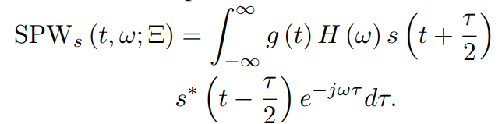
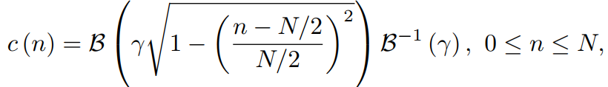
INTRODUCTION
The Smooth Pseudo Winger-Ville Distribution (SPWVD)
The smoothing function is given by:
-g(t) : filter in time domain
-H(w) : filter in frequency domain
The SPWVD function is given by:
The Kaiser window function is given by:
-B : length of N + 1
-y: shape factor

Slide 10
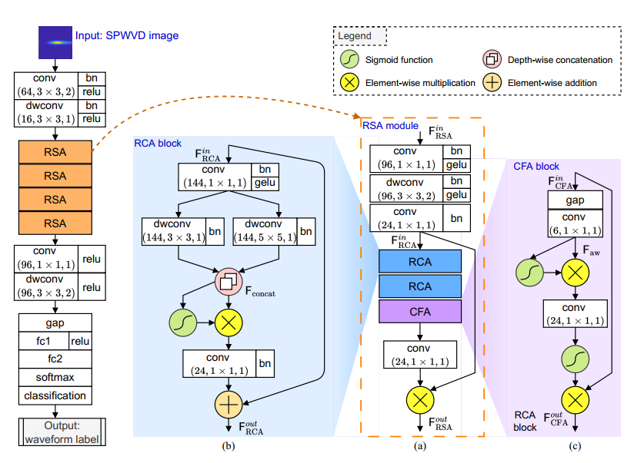
SOLUTION
RadComNet-Robust And Cost-efficient ConvNet Waveform Classification

Slide 11

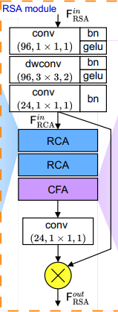
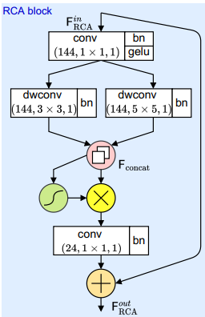
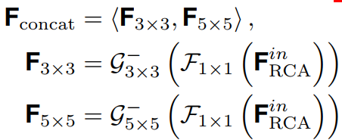
SOLUTION
RadComNet-Robust And Cost-efficient ConvNet Waveform Classification
The input function of RCA block
RCAs extract intrinsic features at multiple scales of SPWVD-based time-frequency representations
The Output function of RSA block
The Output function of RCA block

Slide 12

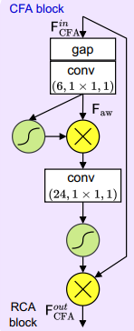
SOLUTION
RadComNet-Robust And Cost-efficient ConvNet Waveform Classification
Attention mechainsm
The Output of CFA block
CFA refines these features by selectively amplifying the more relevant ones
combination of RCA and CFA improves classification accuracy

Slide 13
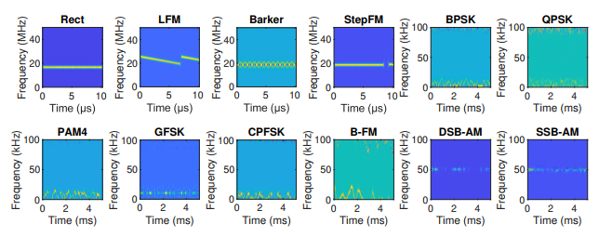
EVALUTION
Data Set Training
SPWVD spectrum image of radar communication that were generated by MatLab tool box

Slide 14
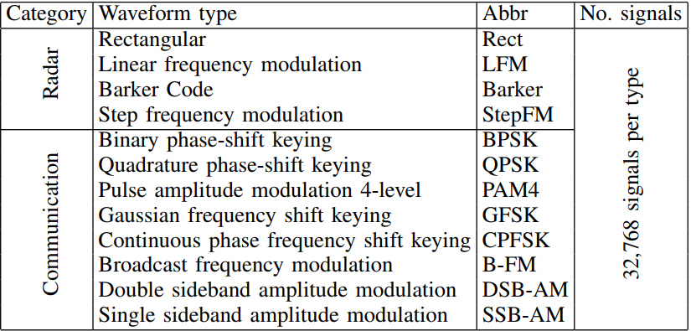
EVALUTION
Data Set Training
Data Set Information of 12 waveform types

Slide 15
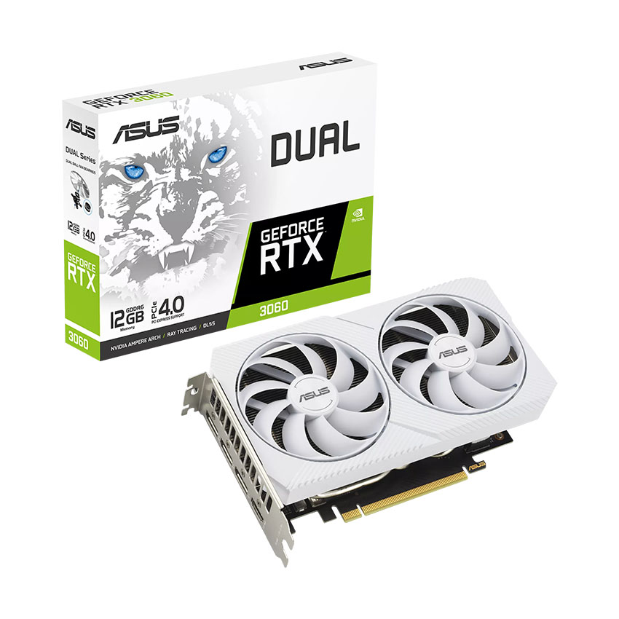
EVALUTION
Data Set Training
The radar communication spectrums are generated with specific parameter:
Path delays : [0, 9, 7] x 10^-6
Average path gain: [0, -2, -10] dB
Signal to noise: [-5:5:30] dB
The Maximum Doppler shift Fd = 70 Hz
Data image size : 224 x 224
The number of data in each class: 393,216
The ratio of training set: 70%
The ratio of validation set: 15%
The ratio of test set: 15%
Hardware for training deep learning network
CPU: 3.8 GHz
RAM: 64 GB
GPU: Nvidia GTX 3060Ti

Slide 16
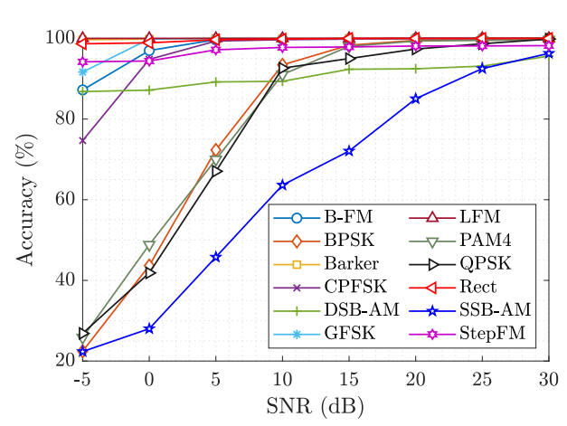
EVALUTION
RadComNet classification performance
The classification accuracy for each radar waveform signal class increase when the Signal to Noise (SNR) is high.
All waveform reached than 90% at SNR = 25dB
Rect, Barker, LFM, StepAM, BFM, GFSK, and CPFSK are outstanding with over 95% at 5dB.

Slide 17
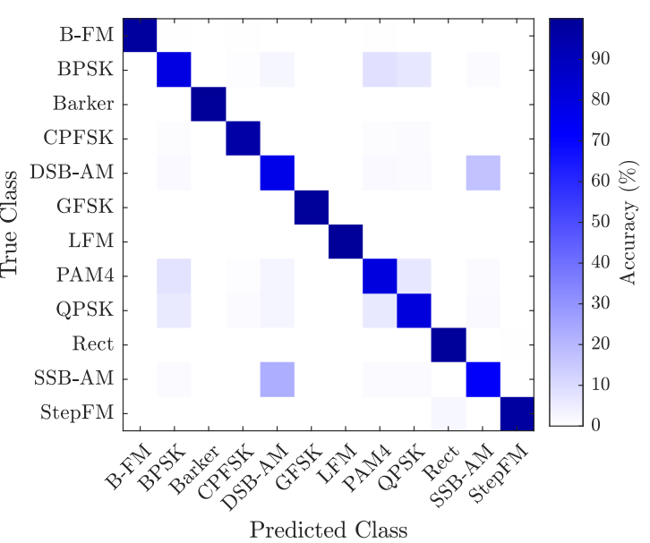
EVALUTION
RadComNet Confusion matrix
RadComNet reached impressive result at all classification classes

Slide 18
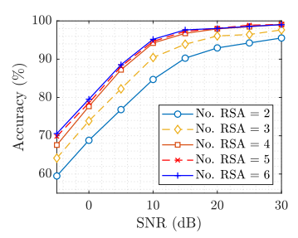
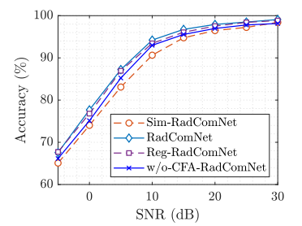
EVALUTION
RadComNet Performance in different deep network design
Classification performance with different the number of RSA blocks
Classification performance with different network designs

Slide 19
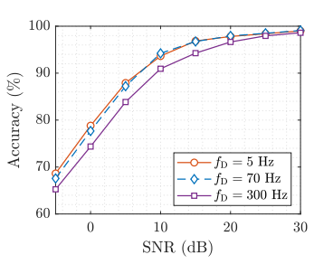
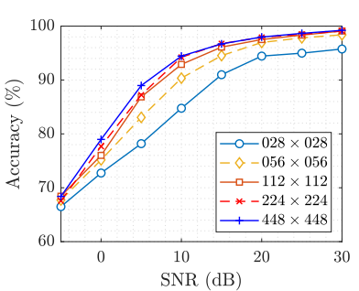
EVALUTION
RadComNet Performance in different Parameters
Classification performance in different doppler shifts Fd
Classification performance in difference image sizes

Slide 20
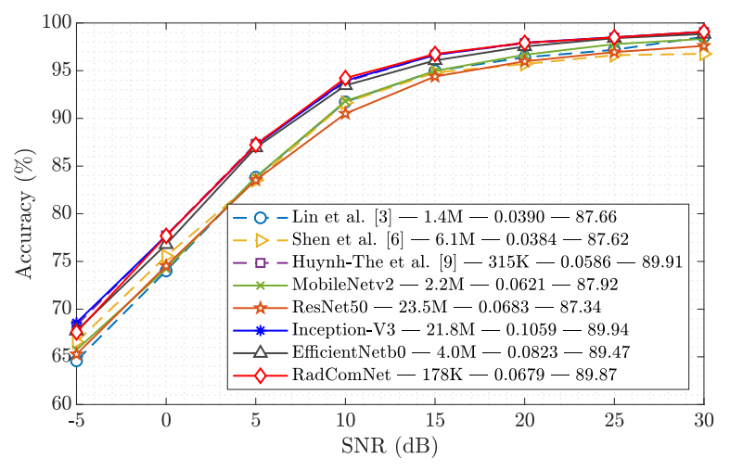
EVALUTION
RadComNet Performance in different Parameters
Performance comparison between RadComNet with other existing
methods and various backbone networks

Slide 21
EVALUTION
RadComNet Performance in different Parameters
Performance comparison between RadComNet with other existing
methods and various backbone networks

Slide 22
EVALUTION
RadComNet Performance in different Parameters
Performance comparison between RadComNet with other existing
methods and various backbone networks

Slide 23

CONCLUSION
Introduction of RadComNet: Efficient radar-communication waveform classification method.
Aim: Alleviation of spectrum congestion through deep ConvNet with SPWVD representation.
Features: Cutting-edge architecture, multiple techniques, and advanced topologies.
Goal: Reduction of complexity without compromising accuracy.
Performance: Robust classification on a dataset of 12 radar and communication waveforms.
Comparison: RadComNet achieves comparable accuracy to other deep models but with significantly lower complexity and faster processing, suitable for resource-constrained devices.

Slide 24
REFERENCE
[1] P. Gong, K. Xu, Y. Wu, J. Zhang, and H. C. So, “Optimization
of LPI-FDA-MIMO radar and MIMO communication for spectrum coexistence,” IEEE Wirel. Commun. Lett., 2023, Early Access.
[2] A. Venon, Y. Dupuis, P. Vasseur, and P. Merriaux, “Millimeter wave
FMCW RADARs for perception, recognition and localization in automotive applications: A survey,” IEEE Trans. Intell. Veh., vol. 7, no. 3, pp. 533–555, Sep. 2022.
[3] S. Zheng, S. Chen, P. Qi, H. Zhou, and X. Yang, “Spectrum sensing
based on deep learning classification for cognitive radios,” China Commun., vol. 17, no. 2, pp. 138–148, Feb. 2020.
[4] A. Lin, Z. Ma, Z. Huang, Y. Xia, and W. Yu, “Unknown radar waveform
recognition based on transferred deep learning,” IEEE Access, vol. 8, pp.
184 793–184 807, 2020.
[5] G. Kong, M. Jung, and V. Koivunen, “Waveform recognition in multipath
fading using autoencoder and CNN with fourier synchrosqueezing transform,” in Proc. IEEE RADAR, 2020, pp. 612–617.
[6] H. Huang, Y. Li, J. Liu, D. Shen, G. Chen, E. Blasch, and K. Pham,
“LPI waveform recognition using adaptive feature construction and convolutional neural networks,” IEEE Aerosp. Electron. Syst. Mag., vol. 38, no. 4, pp. 14–26, Apr. 2023.
[7] L. Shen, D. Quan, X. Wang, X. Jin, and N. Jin, “Radar waveform
recognition based on time-frequency images under deteriorating channel conditions,” in Proc. IEEE ICCC, China, Dec. 2022, pp. 188–192.
[8] I. Guven, C. Yagmur, B. Karadas, and M. Parlak, “Classifying LPI radar
waveforms with time-frequency transformations using multi-stage CNN system,” in Proc. 23rd IRS, Gdansk, Poland, Sep. 2022, pp. 501–506.

Slide 25
REFERENCE
[9] G. Kong, M. Jung, and V. Koivunen, “Waveform classification in radarcommunications coexistence scenarios,” in Proc. IEEE GLOBECOM, Taipei, Taiwan, Dec. 2020, pp. 1–6.
[10] T. Huynh-The, Q.-V. Pham, T.-V. Nguyen, D. B. da Costa, and D.-
S. Kim, “RaComNet: High-performance deep network for waveform
recognition in coexistence radar-communication systems,” in Proc. IEEE
ICC, Seoul, South Korea, May 2022, pp. 1–6.
[11] D. Soydaner, “Attention mechanism in neural networks: where it comes
and where it goes,” Neural Computing and Applications, vol. 34, no. 16, pp. 13 371–13 385, 2022.
[12] M. Sandler, A. Howard, M. Zhu, A. Zhmoginov, and L.-C. Chen,
“MobileNetV2: Inverted residuals and linear bottlenecks,” in Proc. IEEE CVPR, USA, Jun. 2018, pp. 4510–4520.
[13] K. He, X. Zhang, S. Ren, and J. Sun, “Deep residual learning for image
recognition,” in Proc. IEEE CVPR, USA, Jun. 2016, pp. 770–778.
[14] C. Szegedy, V. Vanhoucke, S. Ioffe, J. Shlens, and Z. Wojna, “Rethinking
the inception architecture for computer vision,” in Proc. IEEE CVPR, USA, Jun. 2016, pp. 2818–2826.
[15] M. Tan and Q. Le, “Efficientnet: Rethinking model scaling for convolutional neural networks,” in Proc. ICML. PMLR, 2019, pp. 6105–6114.

